Slide 1
I CAN PLAY
By Oksana solodka

Slide 2
I CAN SWIM

Slide 3
I CAN JUMP

Slide 4
I CAN RUN

Slide 5
I CAN HOP

Slide 6
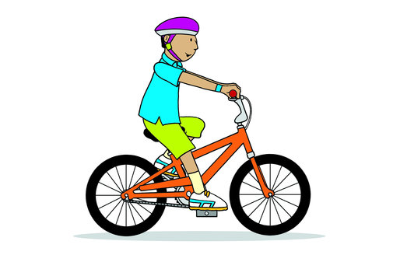
I CAN RIDE A BIKE

Slide 7
I CAN CLIMB A TREE

Slide 8
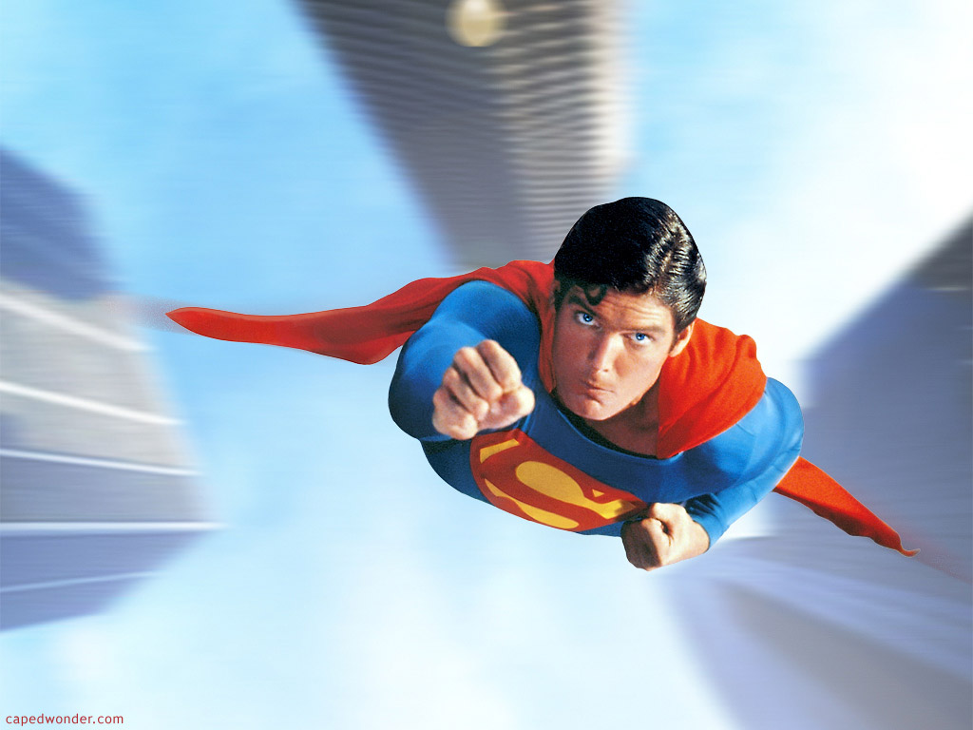
I CAN FLY

Slide 9
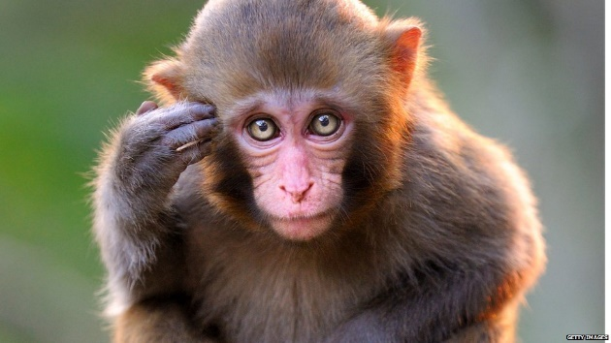
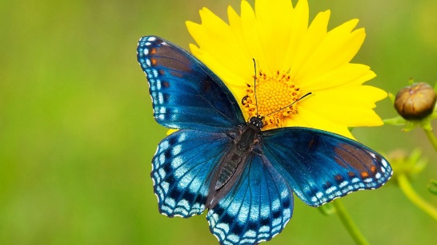
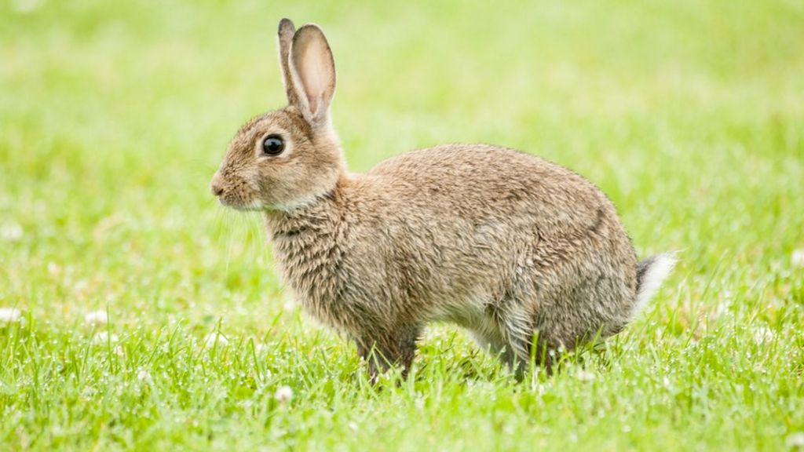
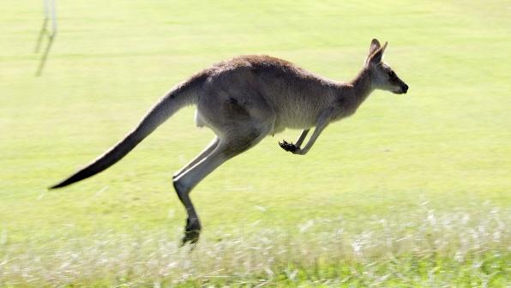
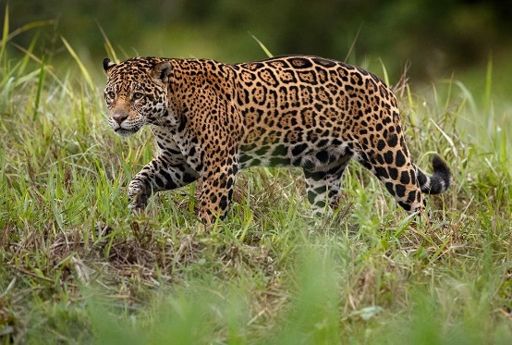
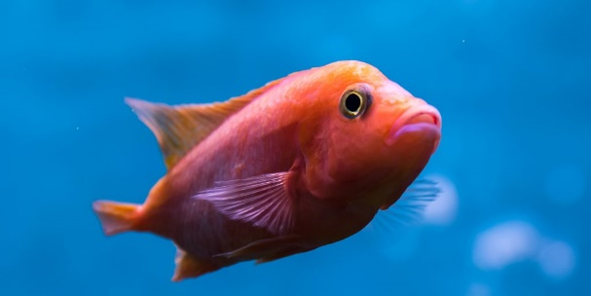
https://www.youtube.com/watch?v=d8SbAkn3uvs
Climb
Fly
Hop
Jump
Run
Swim

Slide 10
https://www.youtube.com/watch?v=BbS7KfgZ30s
C-A-N can P-A-M Pam
C-A-T cat S-A-M Sam
A-N-T ant A-N-N Ann

Slide 11
A-N-D and D-A-N Dan
H-A-S has J-A-M jam

