Slide 1
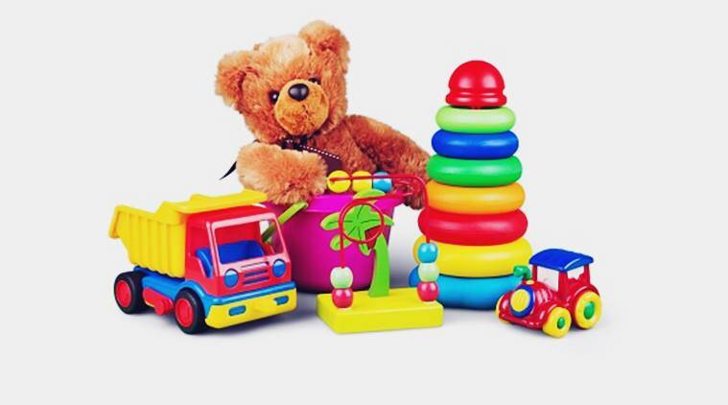
My Toys
By Oksana solodka

Slide 2
IT’S A BALL

Slide 3
IT’S A DOLL

Slide 4
IT’S A TRAIN

Slide 5
IT’S A PLANE

Slide 6
IT’S A BELL

Slide 7
https://www.youtube.com/watch?v=7Ln7o5t7E0o
Watch the video and name the toys you’ve learned/ the toys you have at home/ the toys you like to play
Books – p. 58, ex. 3 – name the toy and the colour of it

Slide 8
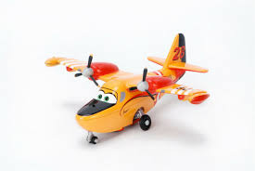
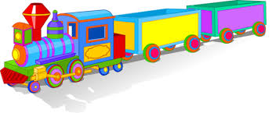
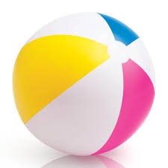
What is this? What colour is this?

