Slide 1
Definite Article THE
By Oksana Solodka

Slide 2
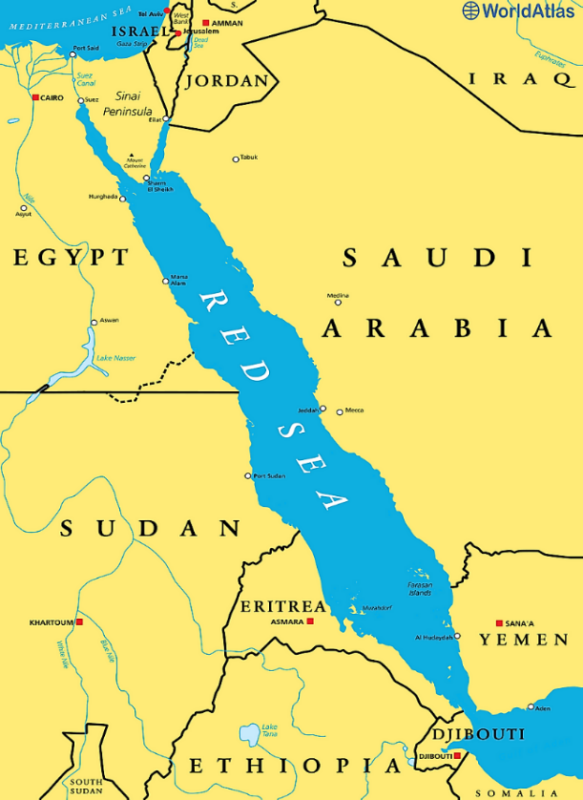
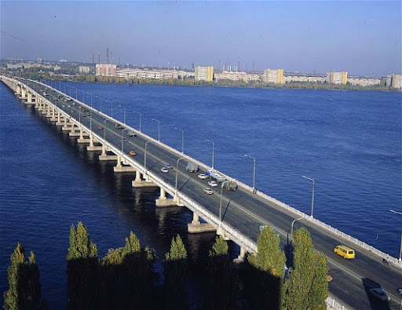
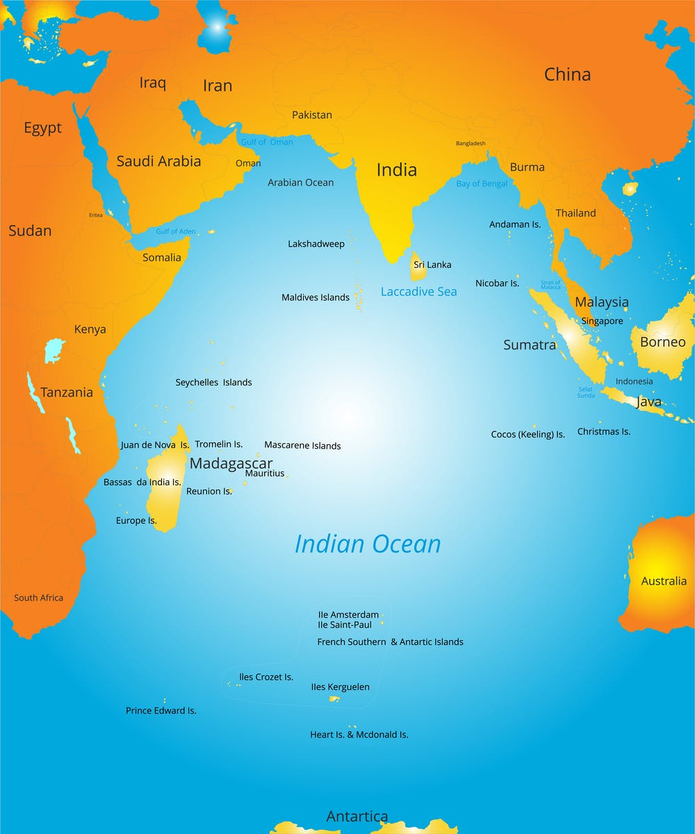
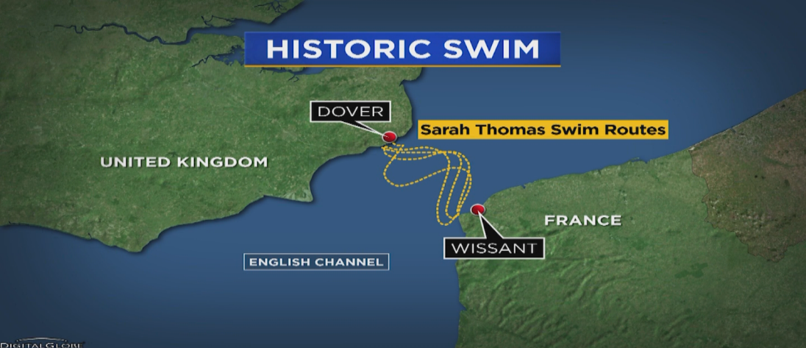
THE
RIVERS, SEAS, OCEANS, CANALS, STREAMS

Slide 3
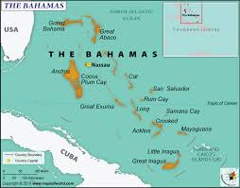
THE
MOUNTAINS, ISLANDS

Slide 4
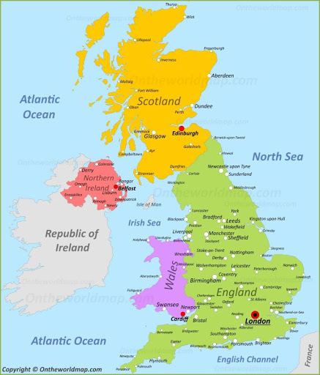
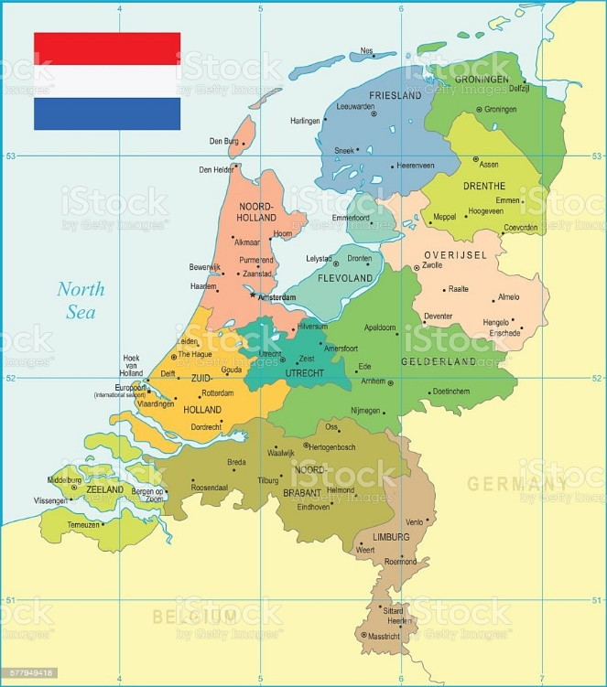
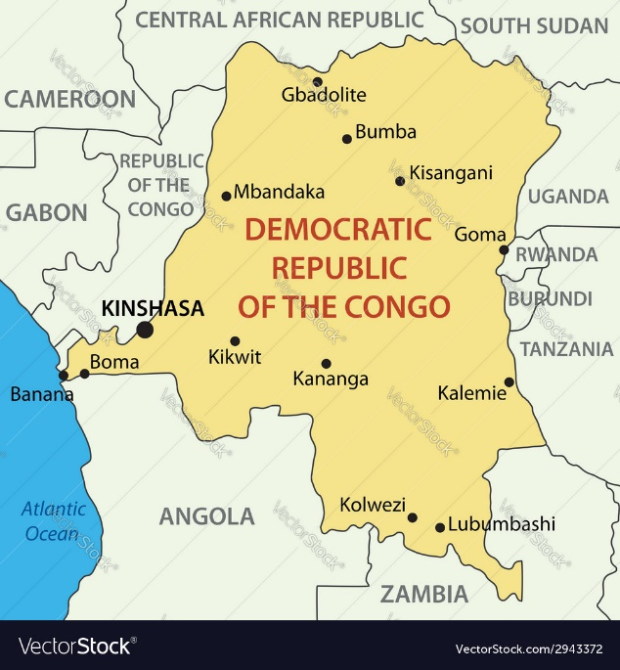
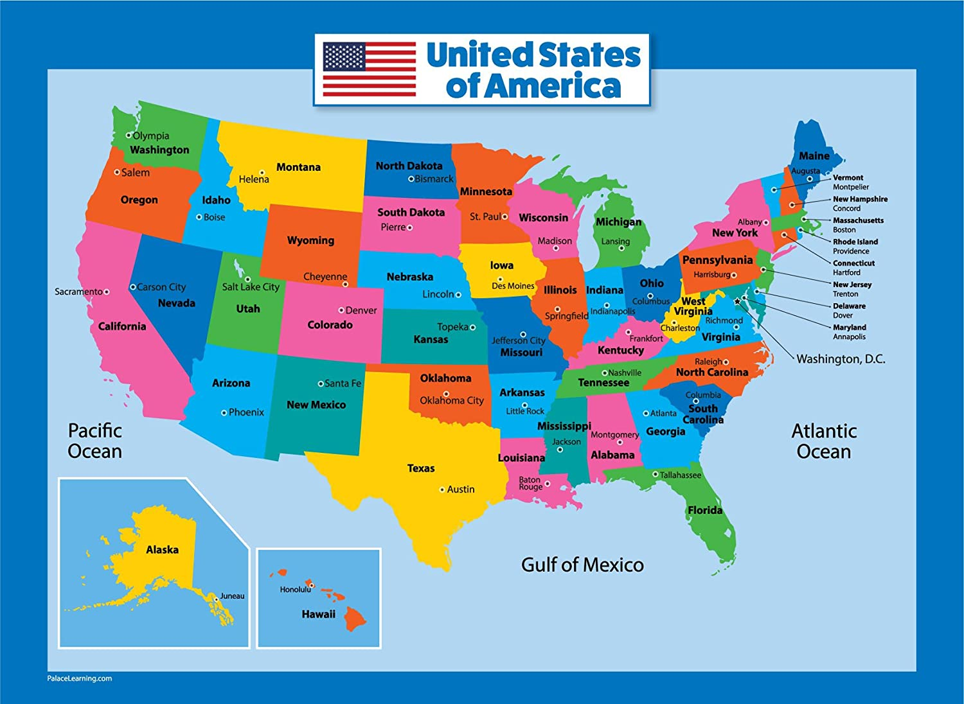
THE
WITH SOME COUNTRIES: the USA, the UK, the Netherlands, the Republic of Congo

Slide 5
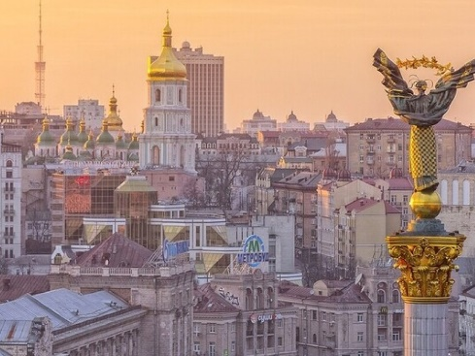
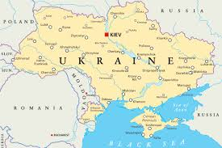
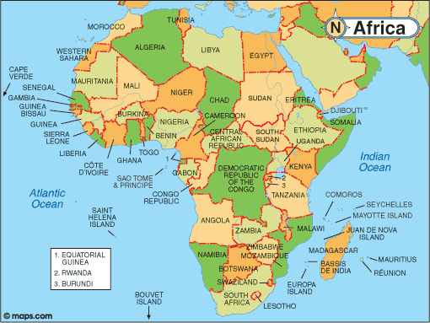
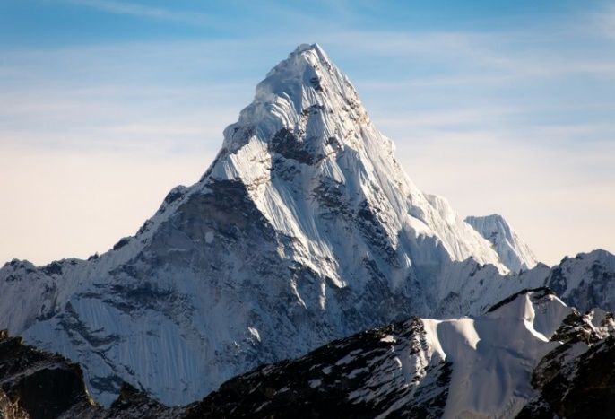
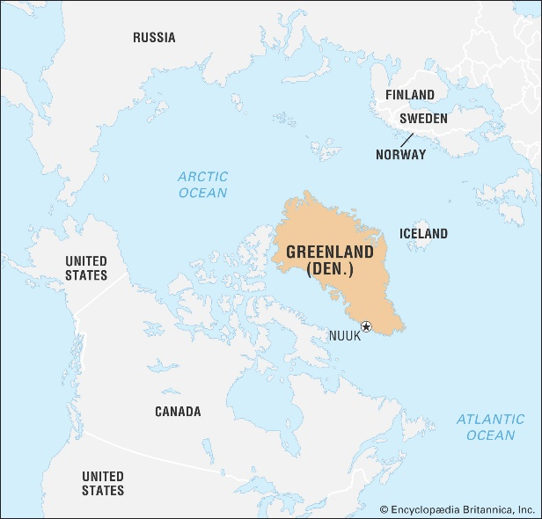
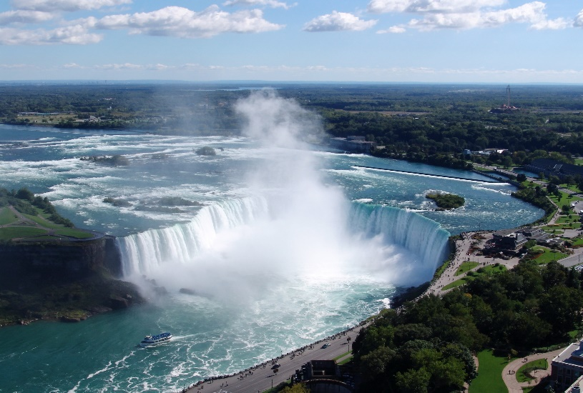
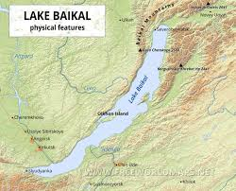
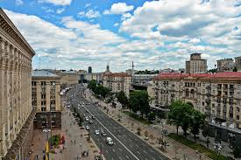
NO ARTICLE
CITIES, TOWNS, VILLAGES
COUNTRIES, CONTINENTS
ISLANDS (ONE)
MOUNTAINS (ONE)
STREETS
LAKES, FALLS

Slide 6
THE/NO THE
https://www.liveworksheets.com/cm184594bp
https://classroom.google.com/c/NTQyNjM3NTY0MDZa
Hometask : ex. 4,5, p.202

