Slide 1

ABC- party

Slide 2
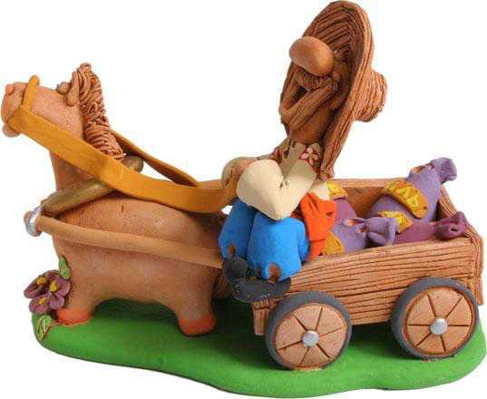

Slide 3
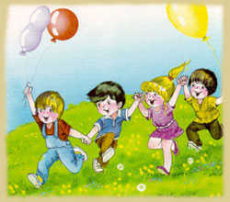
Hello!!!

Slide 4
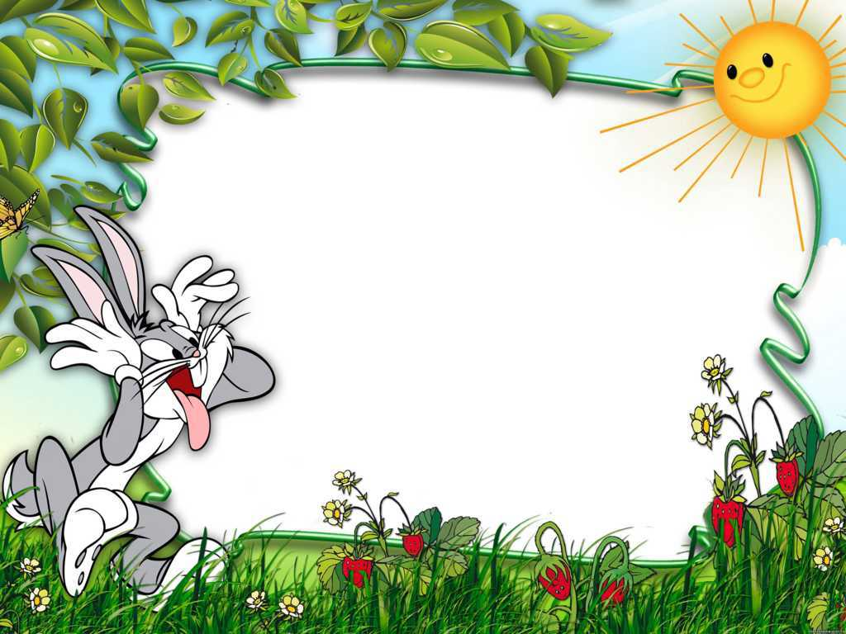
«Can you hear me?»

Slide 5

«The ABC quiz»

Slide 6
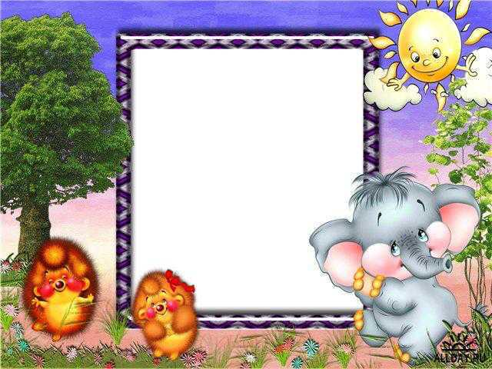
Match pictures

Slide 7
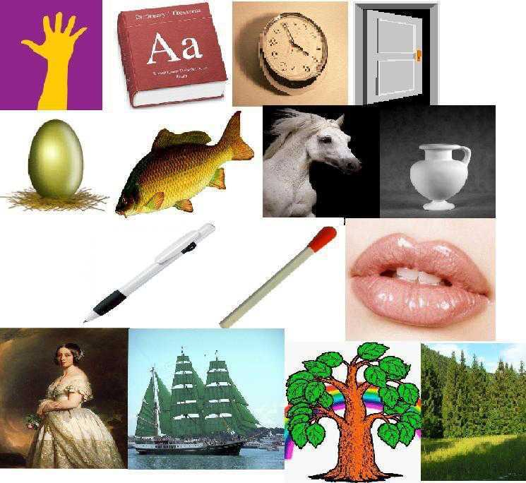

Slide 8
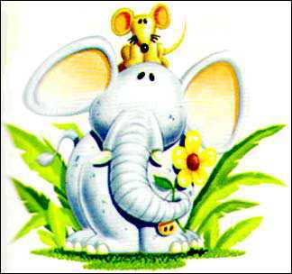
Big and little letters

Slide 9
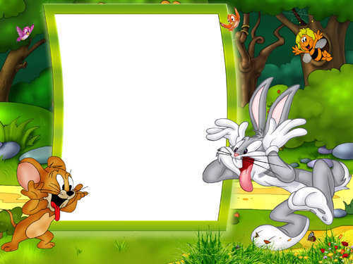
“Spell the word”

Slide 10
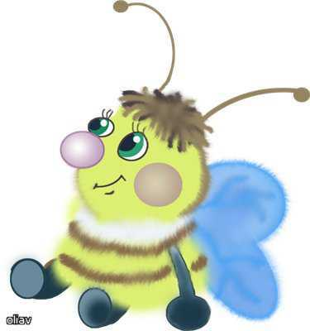
Find the missing letters
t - - e p - - k
q - - e n l - - t - e
- o – r - l - - r
b - - - h s - - e - t

Slide 11
«Anagram»
obok albk
lkcoc rsat
odog anem
sehor rgene
espeh rsetet

Slide 12

Where’s the letter?
e
[I] [I:] [a:] [ e]
street cat
sit farm
ship hand
sheep fat
green park
little star
lips lamp

Slide 13
Leaders’ competition
A fat cat sat on a mat and ate a fat rat

Slide 14

Get me

Slide 15
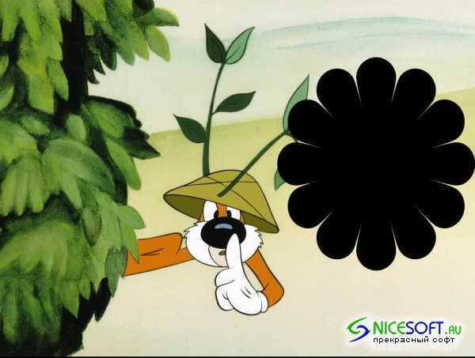
Secret message

Slide 16
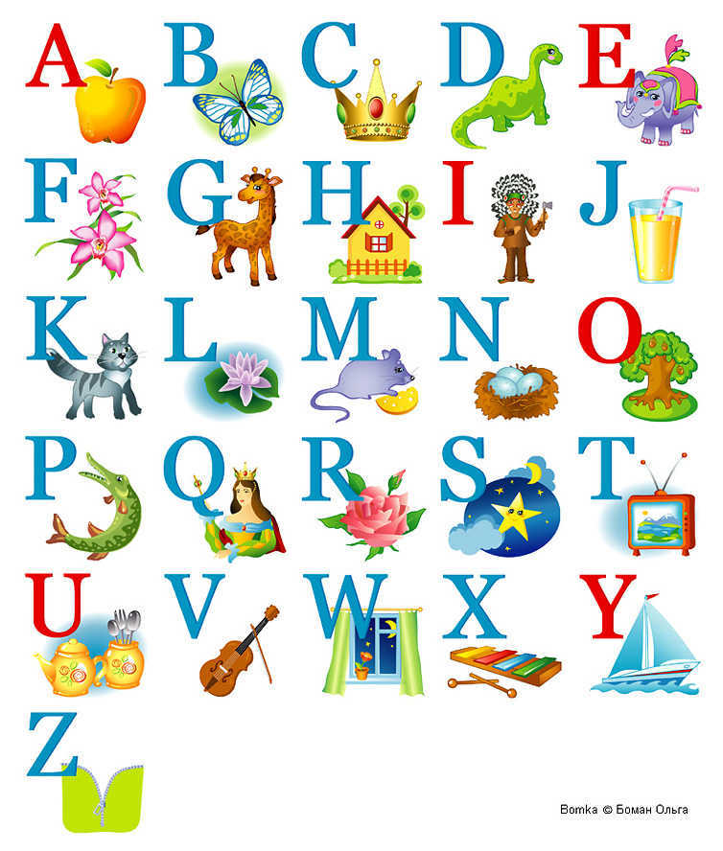

Slide 17

Letters parade

Slide 18
ALPHABET

Slide 19


Slide 20

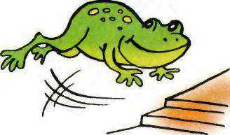

Slide 21


Slide 22

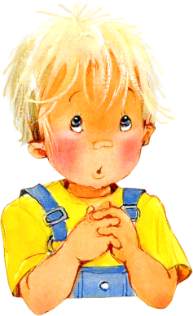


Slide 23
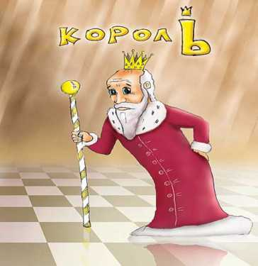
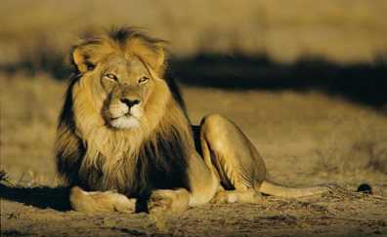

Slide 24
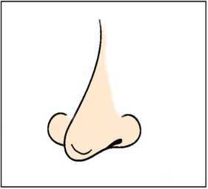

Slide 25
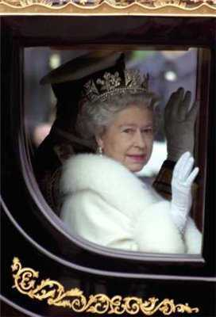

Slide 26
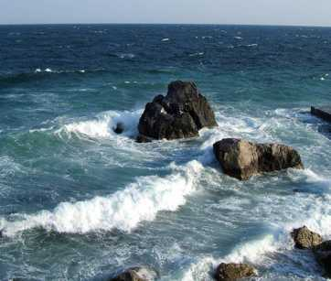
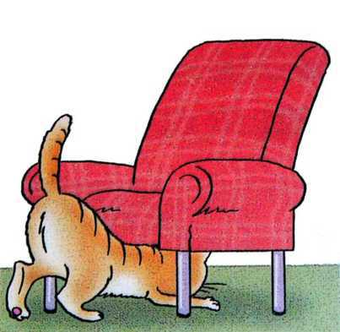

Slide 27
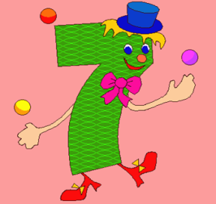
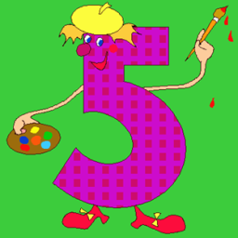
12
11

Slide 28
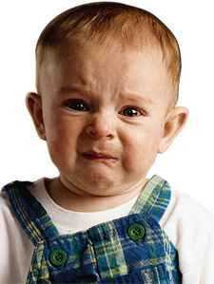
WHY?
WILLY

Slide 29



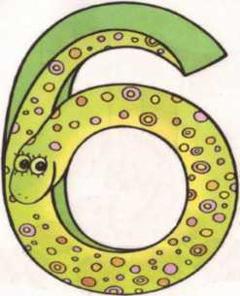
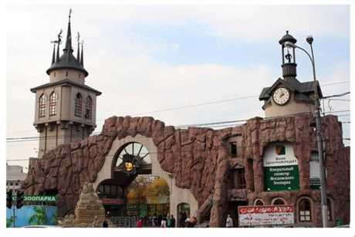

Slide 31

Good-bye!!!

