Slide 1
Leonard Norman Cohen
a Canadian singer-songwriter, musician, poet, and novelist

Slide 2
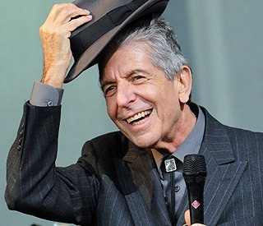
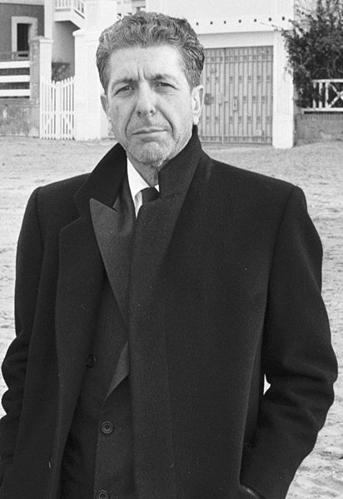
He was born on 21September 1934
in Westmount, an English-speaking area of Montreal, Quebec, into a middle-class Jewish family.

Slide 3
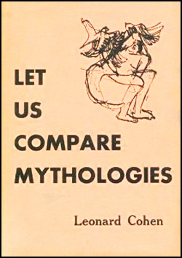
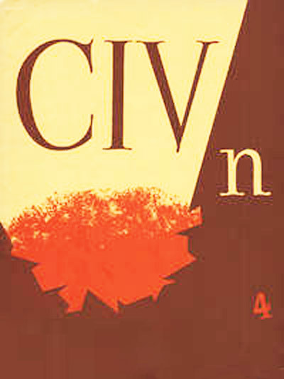
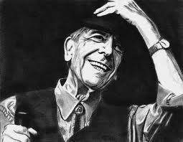
Cohen published his first poems in March 1954 in the magazine CIV/n

Slide 4
In 1967 Cohen moved to the United States to pursue a career as a folk music singer-songwriter.
Cohen's first album was Songs of Leonard Cohen (1967). Cohen followed up that first album with Songs from a Room (1969) (featuring the often-recorded "Bird on the Wire") and Songs of Love and Hate (1970).
1972 he toured in Europe.
Australia, Israel and Europe
in 1980.

Slide 5
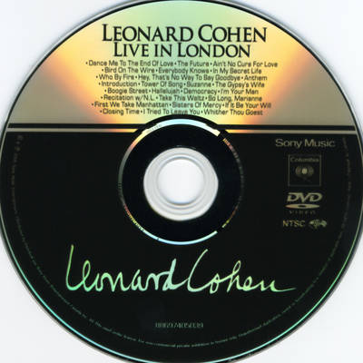
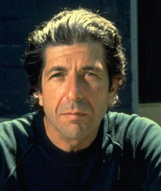
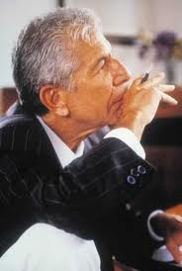
Live in London
On 21 March 2009, Cohen released Live in London, recorded on 17 July 2008 at London's O2 Arena. The album contains 25 songs and is over two-and-a-half hours long. It was the first official DVD in Cohen's recording career.

Slide 6
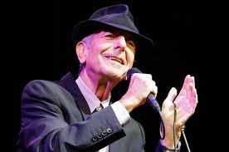
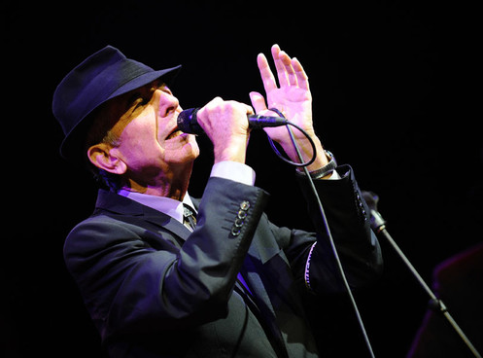
2008-2010 World Tour
Began 11 May in Fredericton, New Brunswick. in Summer of 2008 Canada and Europe, Dublin. In September, October and November 2008, Cohen gave a marathon tour of Europe, including stops in Austria, Ireland, Poland, Romania, Italy, Germany, and Scandinavia. In London, he played two more shows at the O2 Arena and two additional shows at the Royal Albert Hall. New Zealand and Australia from 20 January to 10 February 2009. And others country.

Slide 7
Studio Albums
Songs of Leonard Cohen | 27 December 1967
Songs from a Room | April 1969
Songs of Love and Hate | March 1971
New Skin for the Old Ceremony | August 1974
Death of a Ladies' Man | November 1977
Recent Songs | September 1979
Various Positions | December 1984
I'm Your Man | February 1988
The Future | 24 November 1992
Ten New Songs | 9 October 2001
Dear Heather | 26 October 2004
Old Ideas | 31 January 2012

Slide 8
Tribute albums
Title Release date
Famous Blue Raincoat 1987
I'm Your Fan1991Tower of Song 1995
Famous Blue Cheese 2005
Leonard Cohen: I'm Your Man 2006
Cohen - The Scandinavian Report 2009

Slide 9
Publications
Poetry
Let Us Compare Mythologies. Montreal: Contact Press [McGill Poetry Series], 1956.^{[110]} reissued 2007
The Spice-Box of Earth. Toronto: McClelland & Stewart, 1961.^{[110]}
Flowers for Hitler. Toronto: McClelland & Stewart, 1964.^{[110]}
Parasites of Heaven. Toronto: McClelland & Stewart, 1966.^{[110]}
Selected Poems 1956–1968. Toronto: McClelland & Stewart, 1968.^{[110]}
The Energy of Slaves. Toronto: McClelland and Stewart, 1972. ISBN 0-7710-2204-2 ISBN 0771022034 New York: Viking, 1973.^{[110]}
Death of a Lady's Man. Toronto: McClelland & Stewart, 1978. ISBN 0-7710-2177-1 London, New York: Viking, Penguin, 1979.^{[110]} - reissued 2010
Book of Mercy. Toronto: McClelland & Stewart, 1984.^{[110]} - reissued 2010

Slide 10
Stranger Music: Selected Poems and Songs. London, New York, Toronto: Cape, Pantheon, McClelland & Stewart, 1993.^{[110]} ISBN 0-7710-2230-1
Book of Longing. London, New York, Toronto: Penguin, Ecco, McClelland & Stewart, 2006.^{[110]} (poetry, prose, drawings) ISBN 978-0-7710-2234-0
The Lyrics of Leonard Cohen. London: Omnibus Press, 2009.^{[110]} ISBN 0-7119-7141-2
Poems and Songs. New York: Random House (Everyman's Library Pocket Poets), 2011.
Fifteen Poems. New York: Everyman's Library/Random House, 2012. (eBook)
Novels
The Favorite Game. London, New York, Toronto: Secker & Warburg, Viking P, McClelland & Stewart, 1963.^{[110]} Reissued as The Favourite Game. Toronto: McClelland & Stewart [New Canadian Library], 1994. ISBN 978-0-7710-9954-0
Beautiful Losers. New York, Toronto: Viking Press, McClelland & Stewart, 1966. Toronto: McClelland & Stewart [New Canadian Library], 1991. ISBN 978-0-7710-9875-8 McClelland & Stewart [Emblem], 2003.^{[110]} ISBN 978-0-7710-2200-5

Slide 11
