Slide 1
Літературна Вітальня!
Literature around the world!
Literatur in der Welt!

Slide 2
«Poetry is the opening and clothing of a door, leaving those who look through to guess about what it seen during a moment.»

Slide 3
«Bücher sind Schokolade für die Seele …
Bücher haben aber auch einen Nachteil: Selbst das dickste Buch hat eine letzte Seite, und man braucht wieder ein neues.»
Richard Atwater

Slide 4
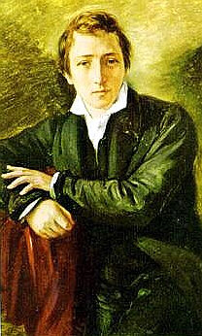
„Letzter Dichter der Romantik“ so haben die Leute Heinrich Heine genannt.

Slide 5
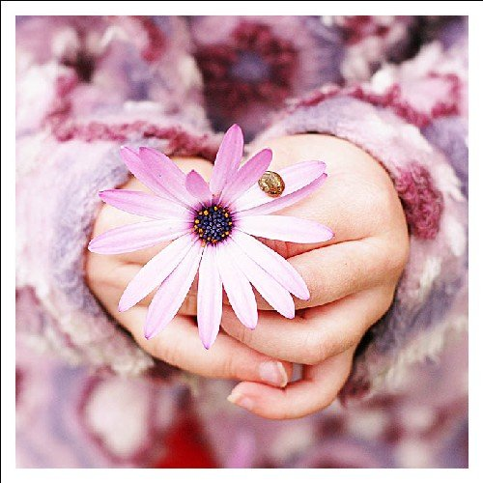
«Es ist mit der Liebe auch wie mit anderen Pflanzen: Wer Liebe ernten will, muss Liebe Pflanzen.»
Jeremias Gotthelf
Heinrich Heine «Du bist wie eine Blume»

Slide 7
«For poetry, he’s past his prime,
He takes an hour to find a rhyme;
His fire is out, his wit decayed,
His fancy sunk, his muse a jade.
I’d have him throw away his pen,
But there’s no talking to some men»
Jonathan Swift
Lord Edward Taylor.

Slide 8
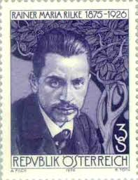
«Ein sicheres Zeichen von einem guten Buche ist, wenn es einem immer besser gefällt, je älter man wird.»
Georg Christoph Lichtenberg
Reiner Maria Rilke.

Slide 9
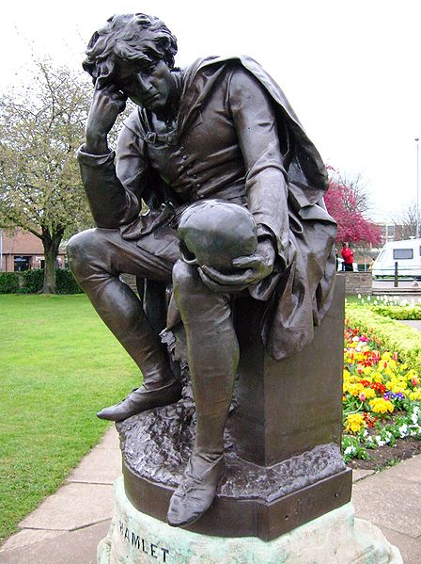
«To be, or not to be: that is the question»
W. Shakespeare.

Slide 10
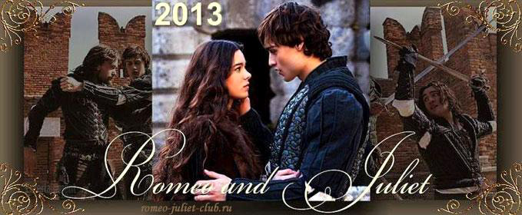
«All the world's a stage,
And all the men and women merely players;
They have their exits and their entrances,
And one man in his time plays many parts…»
«Romeo and Juliet»

Slide 14
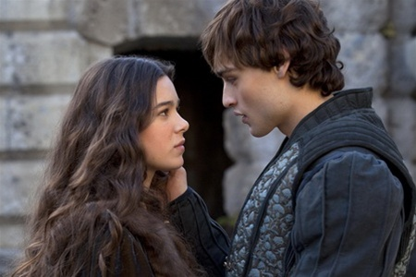

Slide 15
„Was auch als Wahrheit der Fabel
In tausend Büchern dir erscheint,
Das alles ist ein Turm zu Babel,
Wenn es die Liebe nicht vereint.“
Johann Wolfgang von Goethe
Johannes Becher.

Slide 16
«The crown of literature is poetry. It is its end and aim. It is the sublimest activity of the human mind. It is the achievement of beauty and delicacy. The writer of prose can only step aside when the poet passes.»
W. Somerset Maugham
Lilian Rayland
«Some of us»

Slide 17
Rose Ausländer.

Slide 18
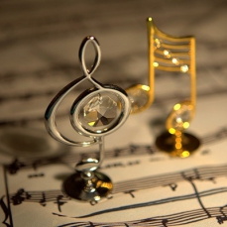
«Every day we should hear at least one little song, read one good poem, see one exquisite picture, and, if it possible, speak a few sensible words»
Johann Wolfgang von Goethe
“Price Tag”

Slide 19
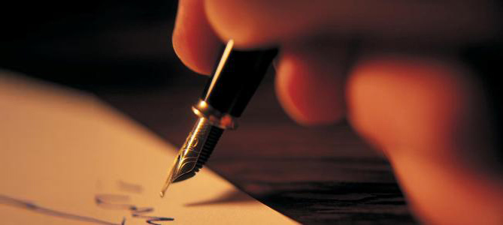
«All good poetry is the spontaneous overflow of powerful feelings: it takes its origin from emotion recollected in tranquility»
William Wordsworth.

Slide 20
„Die Prinzessin auf der Erbse“ H.Ch.Anderson

Slide 21
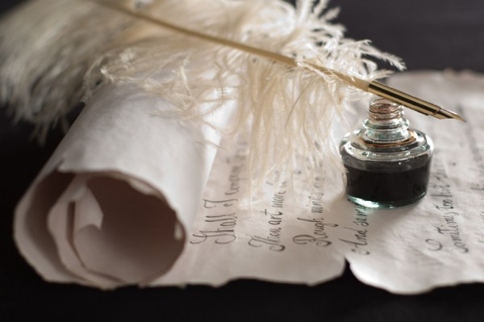
«Poetry is the language in which man explores his own amazement . . . says heaven and earth in one word speaks of himself and his predicament as though for the first time.»
Christopher Fry
Leonard Norman Cohen

Slide 22
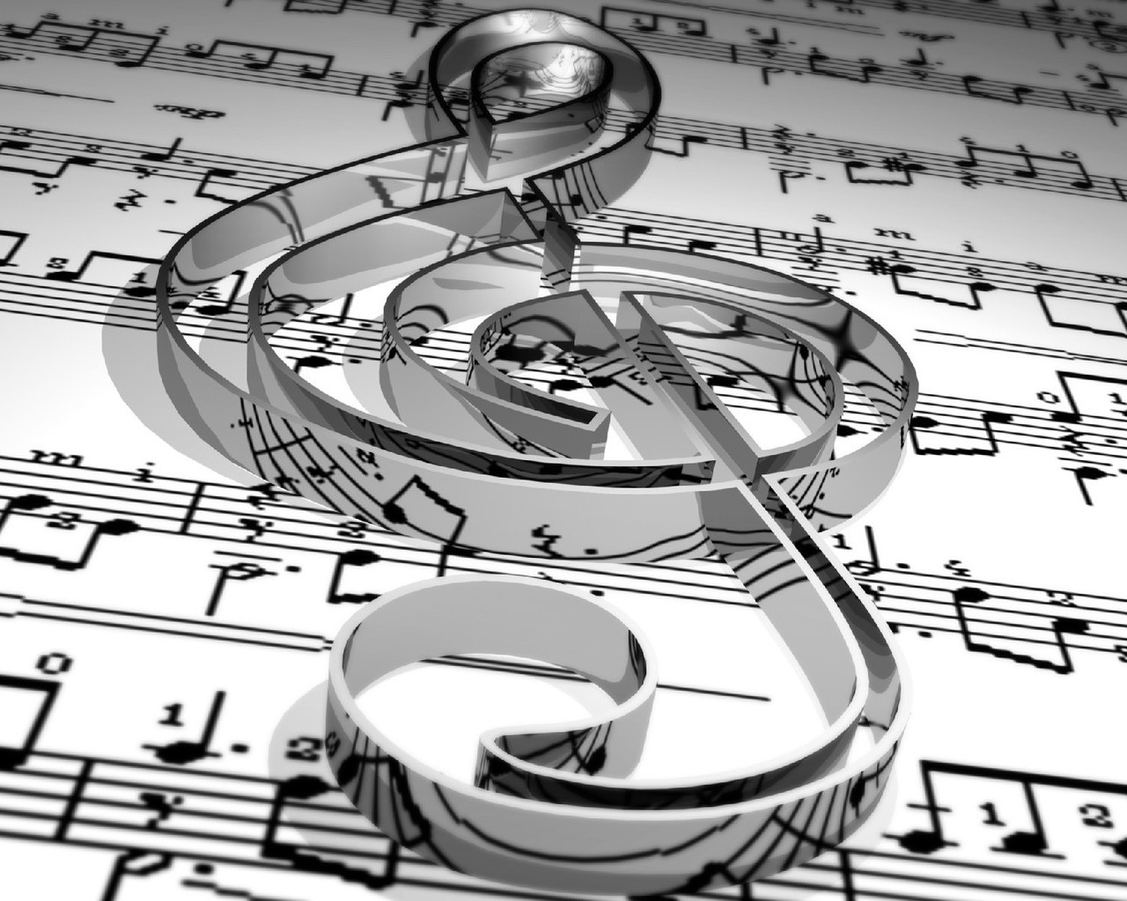
„Die Musik drückt das aus, was nicht gesagt werden kann und worüber zu schweigen unmöglich ist“
Victor Hugo

Slide 23
Yesterday
Yesterday all my troubles seemed so far away. Now it looks as though they're here to stay, Oh, I believe in yesterday.
Suddenly, I'm not half the man I used to be. There's a shadow hanging over me, Oh, yesterday, came suddenly.
Why she had to go, I don't know, she wouldn't say. I said something wrong, now I long for yesterday.
Yesterday love was such an easy game to play, Now I need a place to hide away, Oh, I believe in yesterday.
Why she had to go, I don't know, she wouldn't say. I said something wrong, now I long for yesterday.
Yesterday love was such an easy game to play, Now I need a place to hide away, Oh, I believe in yesterday.

Slide 24
Ein Haus ohne Bücher ist arm, auch wenn schöne Teppiche seinen Boden und kostbare Tapeten und Bilder die Wände bedecken.
Hermann Hesse

Slide 25
Thank you for your attention!

Slide 26
Danke
für
die Aufmerksamkeit!

