Slide 1
Teaching listening skills at school
Done by Oksana Haleshchuk
Teacher of Berezhany gymnasium after B.Lepkiy

Slide 2
Types of texts
Natural sound
A conversation
A phone call
An announcement
A lecture
News
Music
A movie
A TV program
A talk show

Slide 3
Matching
Gap filling
Task types
True
\false
Multiple
choice

Slide 4
Listening skills and strategies:
For main idea (gist)
For specific information
For details
For predicting
For inferring meaning
For opinion
For inferring relations
For recognizing context

Slide 5
Main difficulties
Pupils try to understand every word
Pupils don’t know the topical vocabulary
Different accents
Pupils don’t recognize the words they know
Lack of listening strategies
Making predictions
Guessing words
Recognizing main points
Difficult listening material

Slide 6
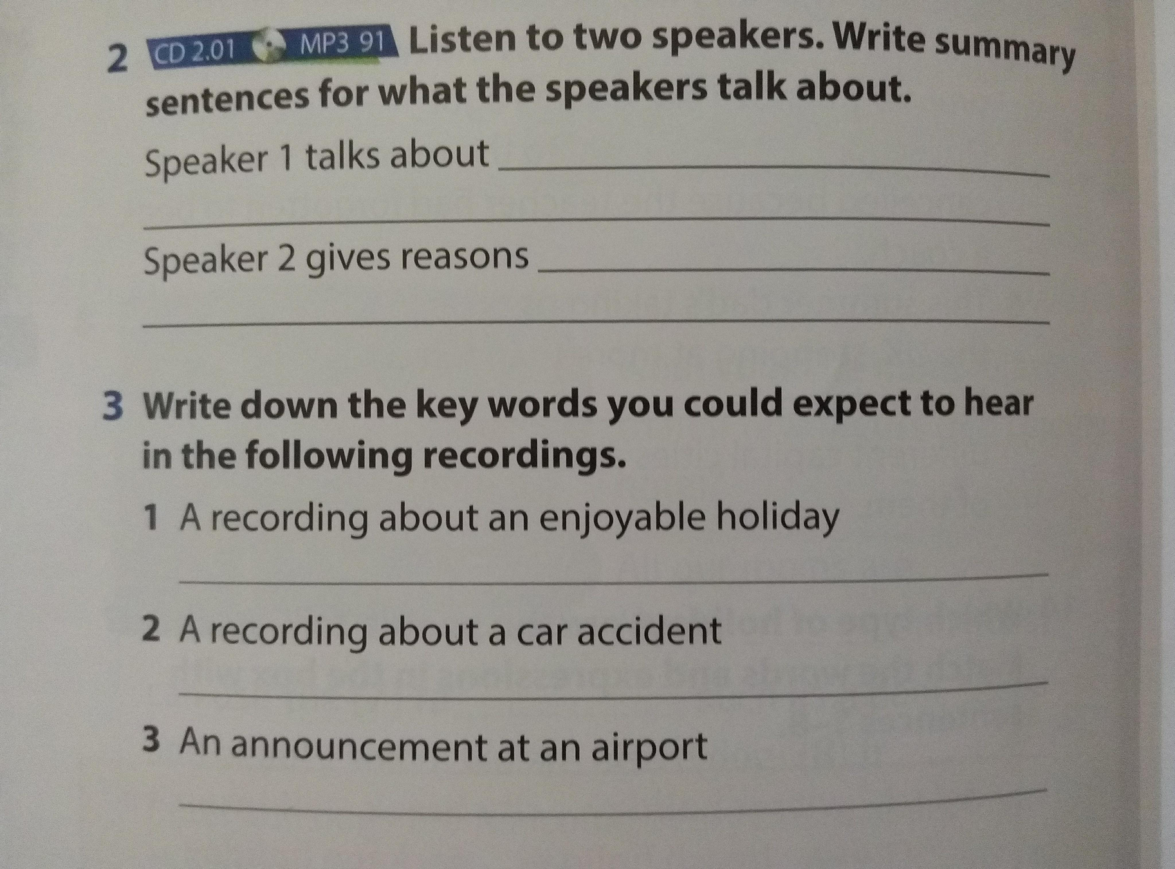
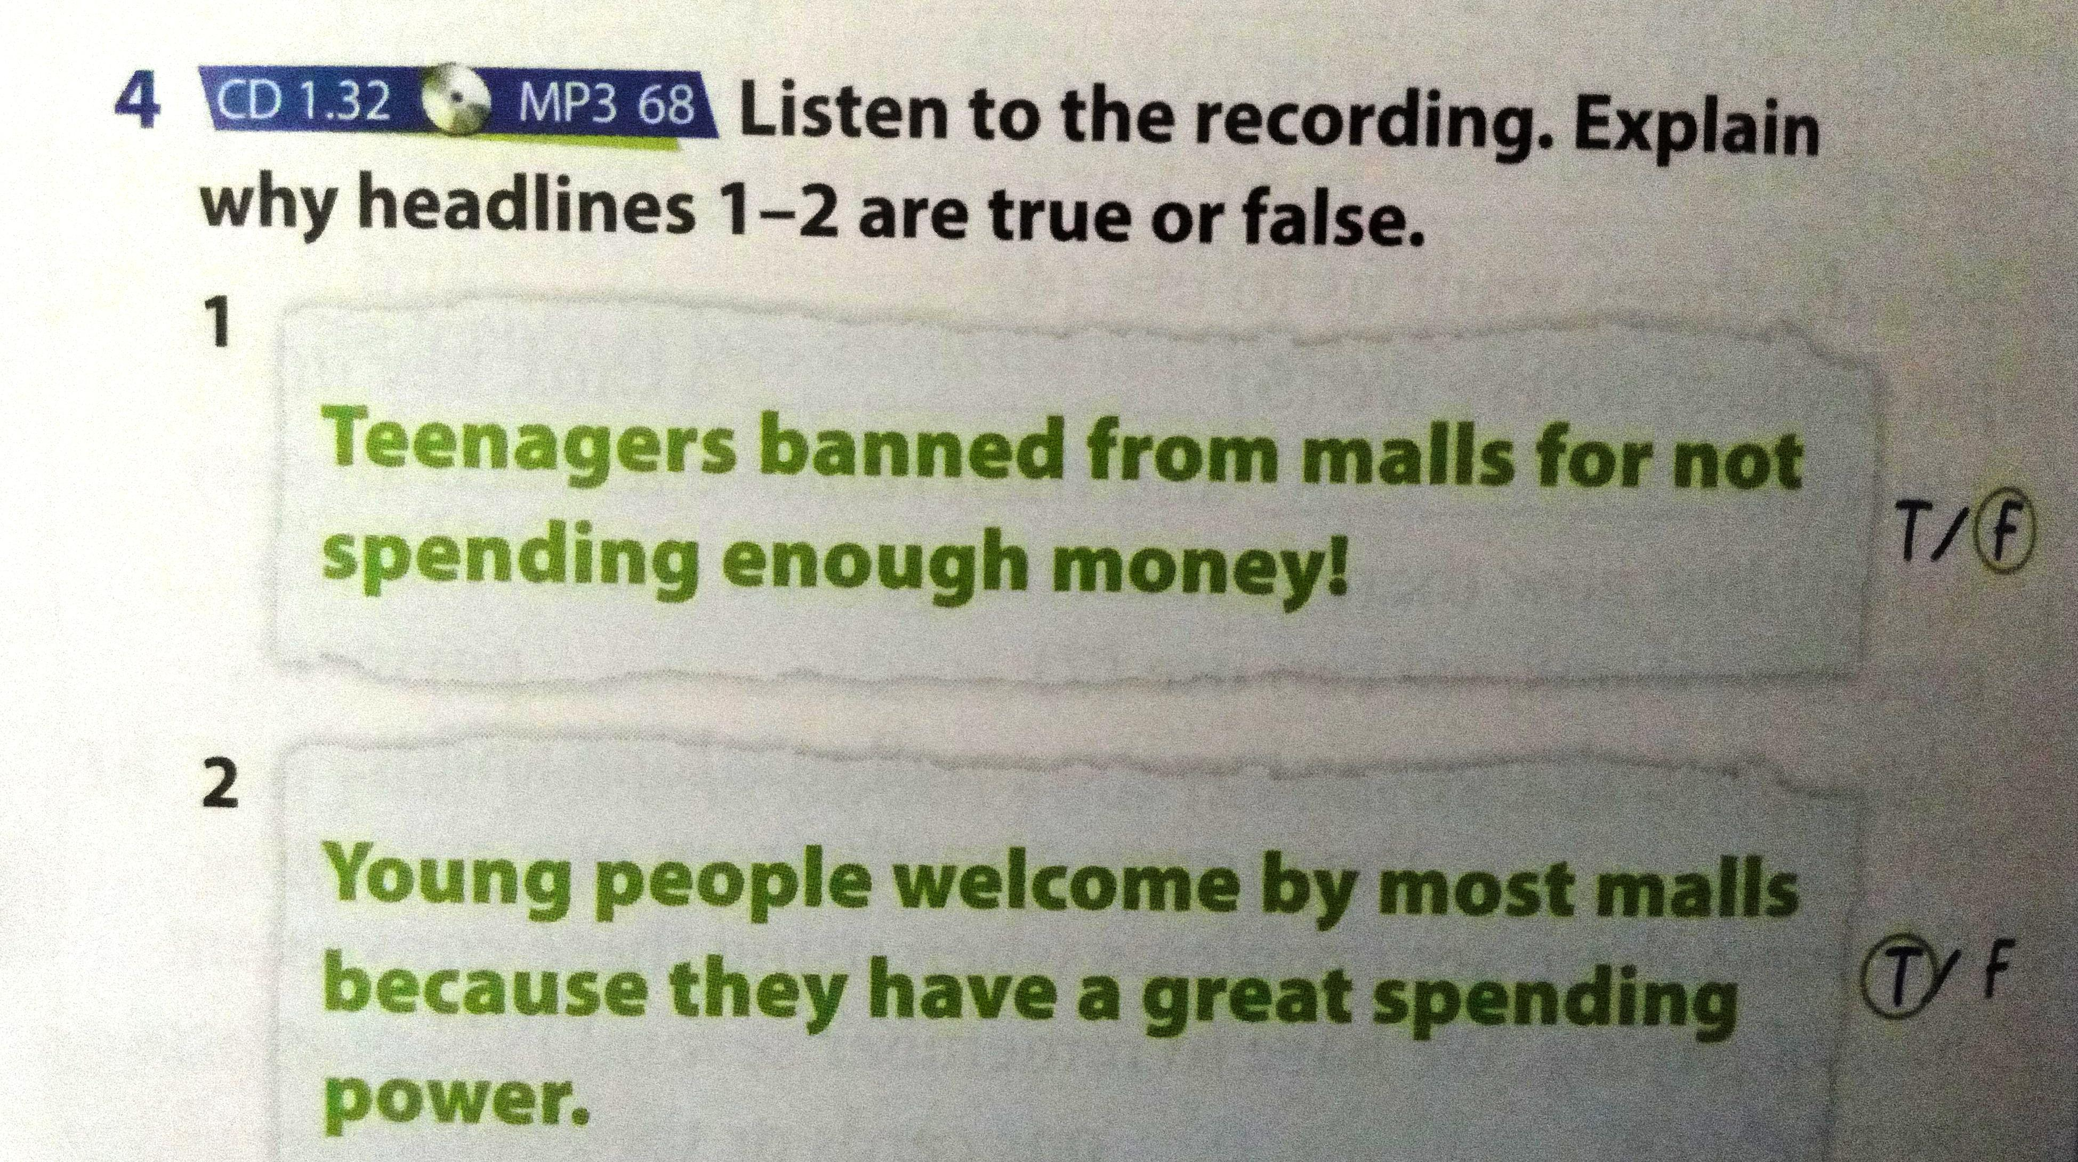
Active listening

Slide 7
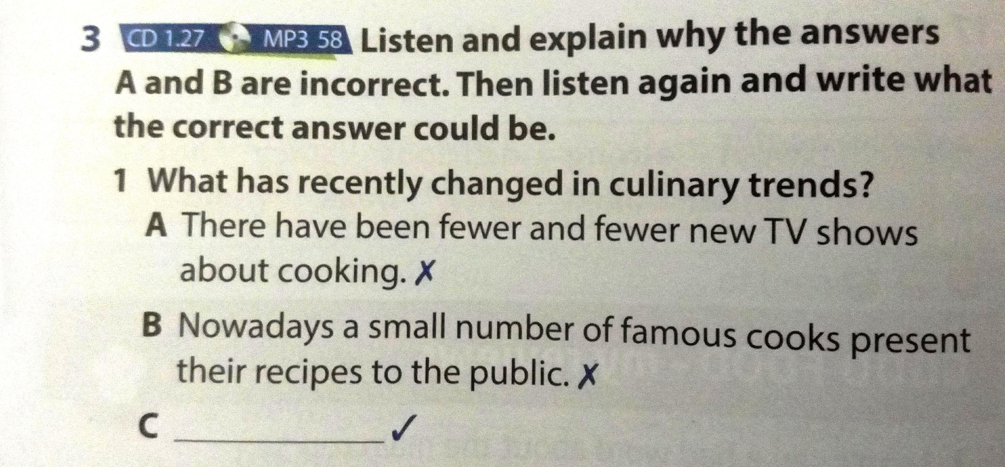
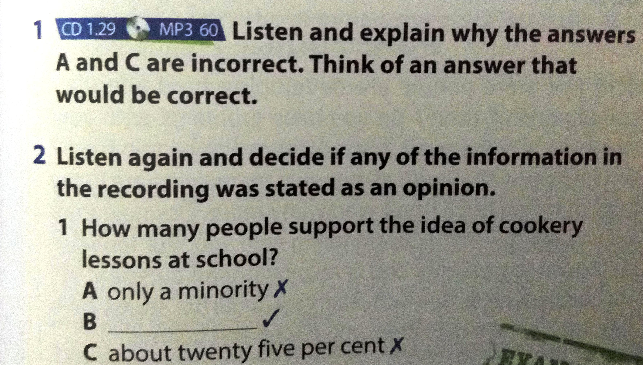

Slide 8
Pre-listening skills and activities
While-listening skills and
activities
Post-listening skills and activities

Slide 9
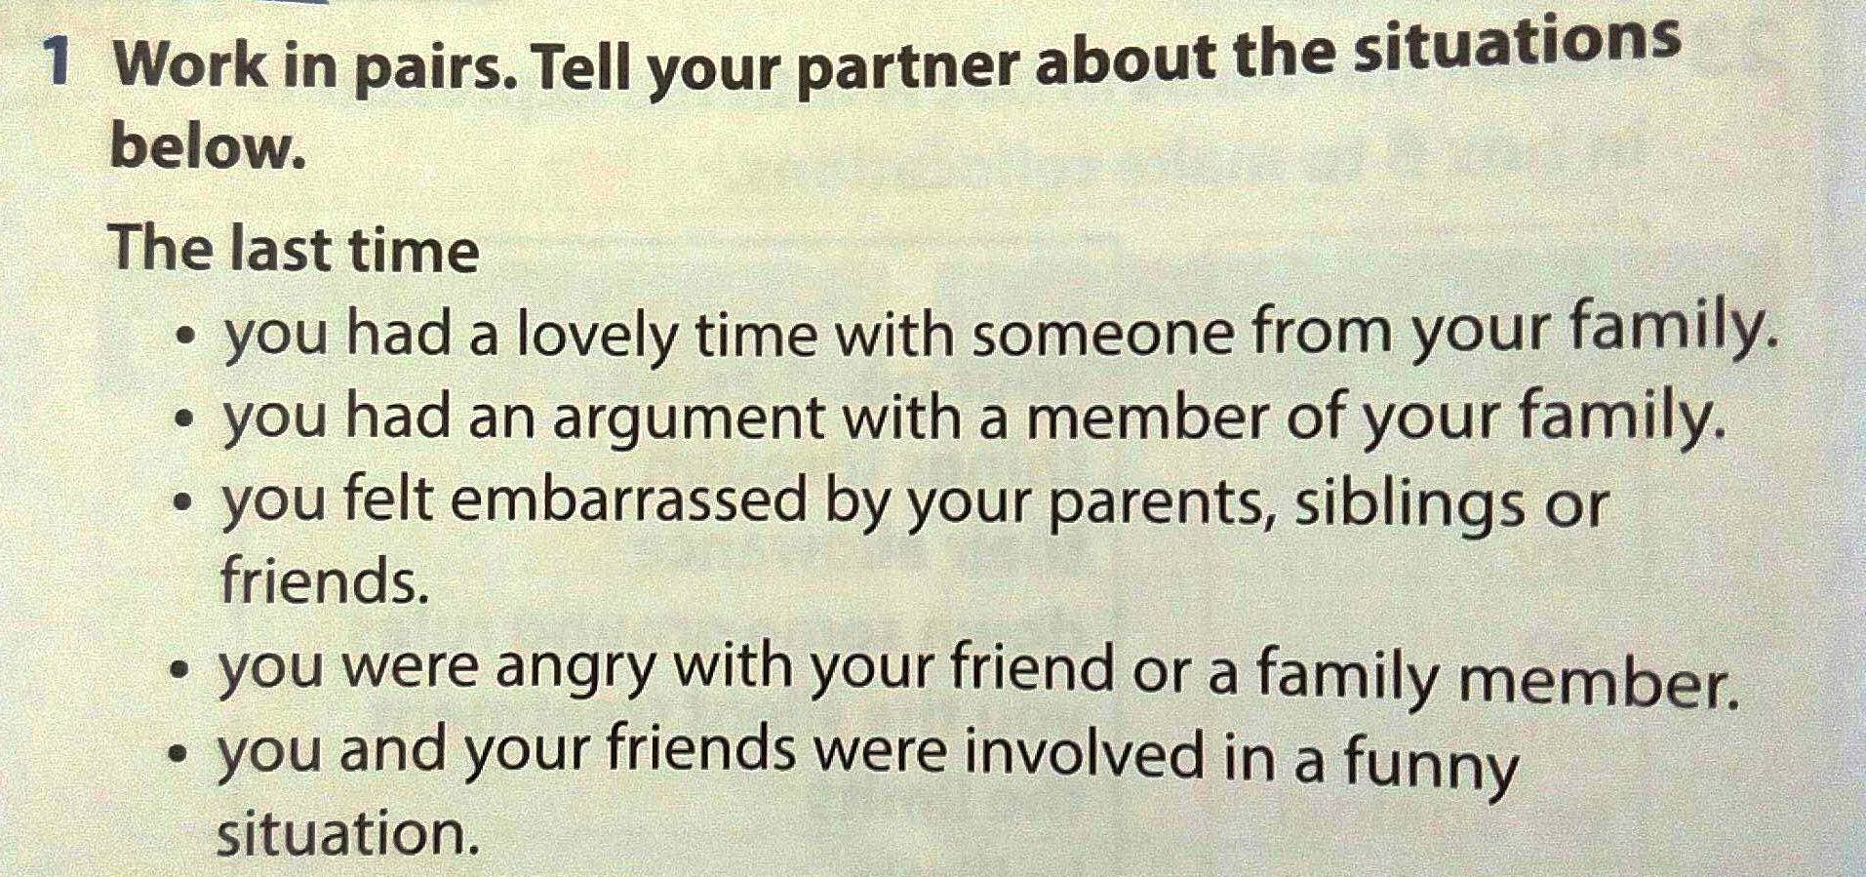
Lesson plan
Step 1 Warm up

Slide 10
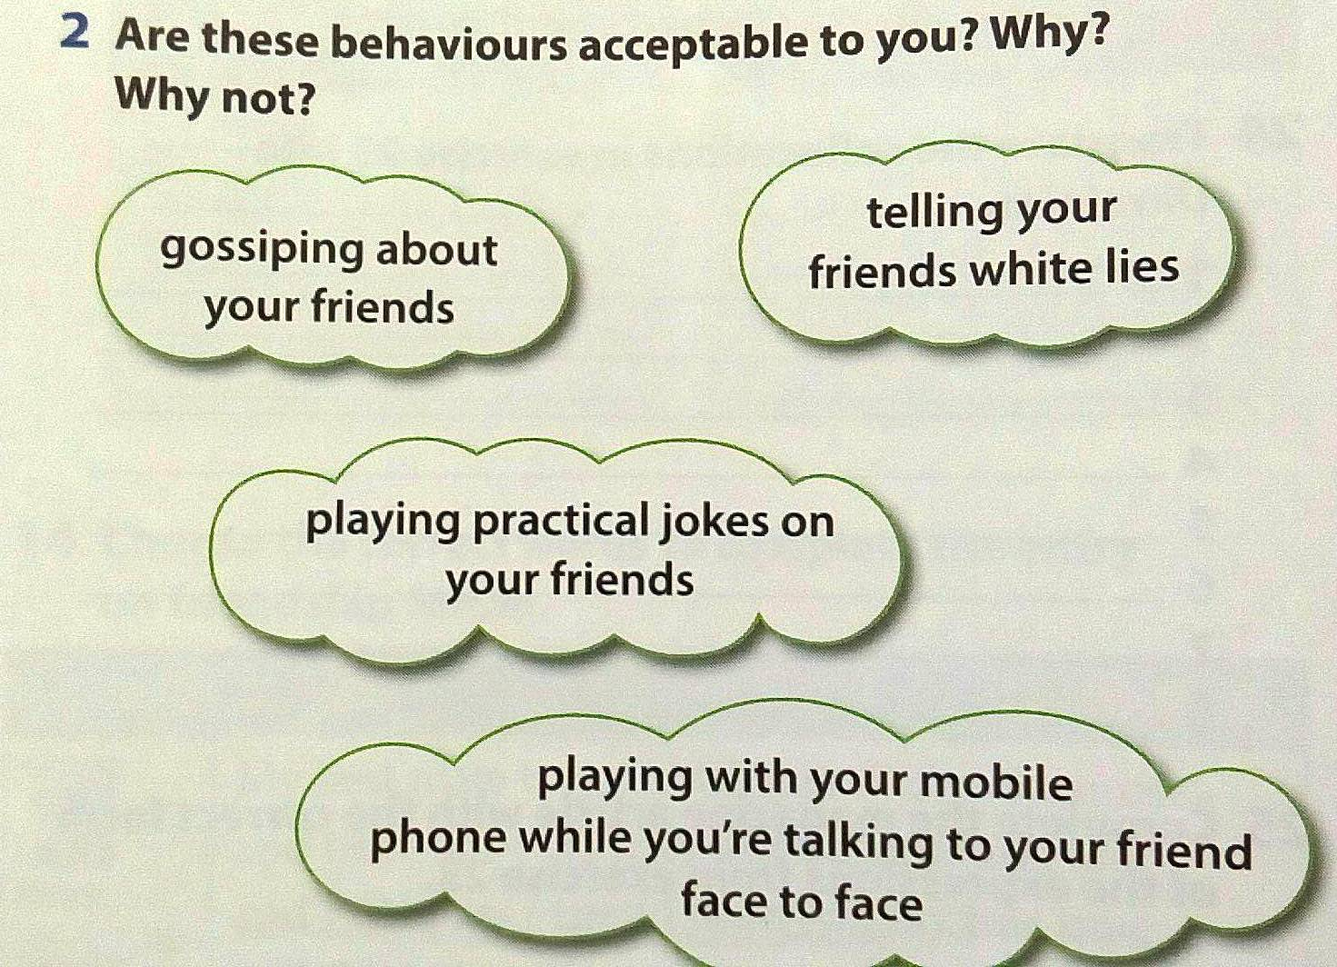
Step 2 Motivating+activating vocabulary

Slide 11
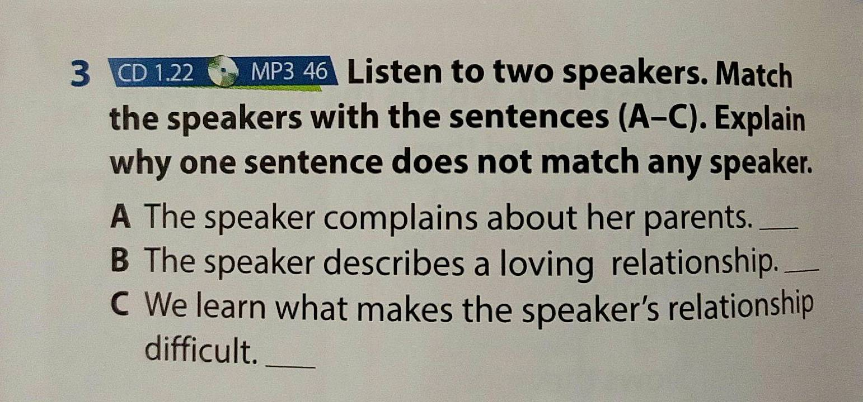
Step3 Focus on sub-skills / listening strategies

Slide 12
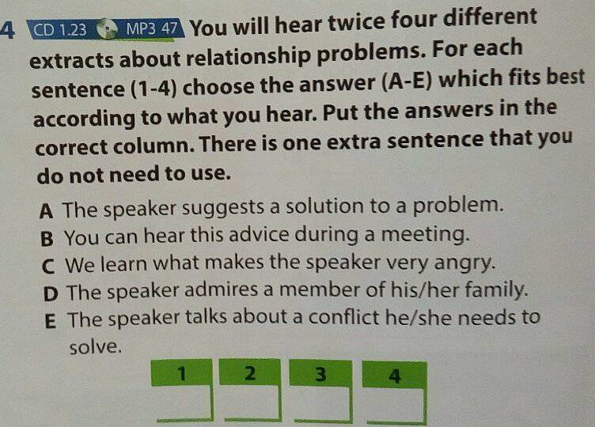
Step 4 Listening comprehension activity

Slide 13
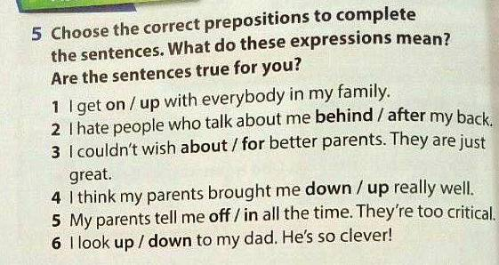
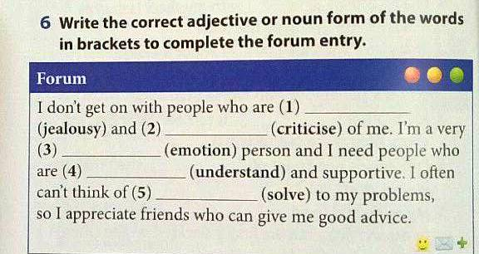
Step 5 Developing other language skills

Slide 14
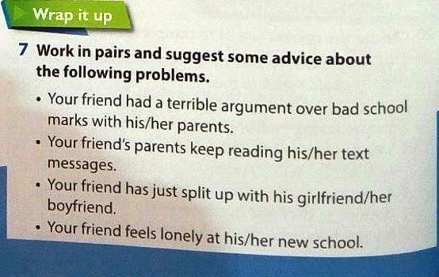
Final step + home assignment

Slide 15
Top tips
Make sure pupils know what they are listening
Underline key words, think of synonyms
Predict the contents
Give questions to check the pupils’
comprehension
Never choose the answer because there is such
a word in the listening fragment

Slide 16
Thank you
for attention

