Slide 1
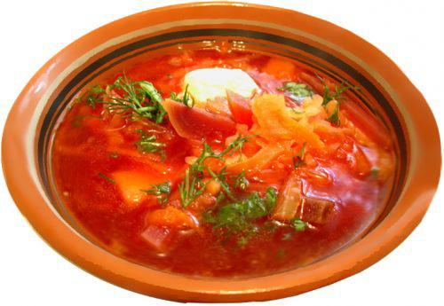
Дидактичний матеріал за темою“Фестивалі рідної землі ” для опрацювання учнями 1-го гімназійного класу
Мета:розвивати навички зорового сприймання (reading for specific information)
Завдання: read the text about a famous food festival in Ukraine and answer the questions.
BORSCH FESTIVAL
The Borsch Festival takes place every year in different areas of Ukraine. People celebrate their national dish-borsch. It is a huge event with contests and fun activities. During the festival people collect different recipes of borsch and there is a competition of cooking borsch using these different recipes. There is also a free tasting of borsch. You can see famous people,talented stars,lovers of Ukrainian culture and borsch from Ukraine and from abroad at the festival.
1.Where does the Borsch Festival take place?
2.What do people celebrate?
3.What activities are there?
4.Whom can you see at the festival?
5.Do you think it is an interesting event?

Slide 2
