Slide 1
Communicative approach in teaching Foreign language
Lidia Dsioba
School of Velyky Dederkaly
Shumsk District

Slide 2
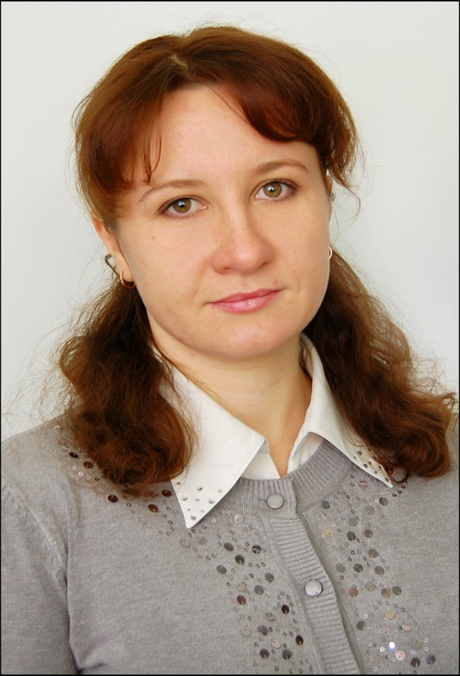
Work of experience: 6 years
Category: II
MY MOTTO:
There is no royal road to learning

Slide 3
The GREATEST PROBLEM IN COMMUNICATION IS THE ILLUSION THAT IT HAS BEEN ACCOMPLISHED.
Daniel W. Davenport
Communication leads to community, that is, to understanding, intimacy and mutual valuing
Rollo May

Slide 4
The main goals of the communicative approach:
students should become communicatively competent, be able to use the language appropriately for a given social context, and manage the process of negotiating meaning with interlocutors.

Slide 5
The roles of the communicative approach:
- the teacher facilitates students’ learning by managing classroom activities and setting up communicative situations;
- students are communicators, actively engaged in negotiating meaning

Slide 6
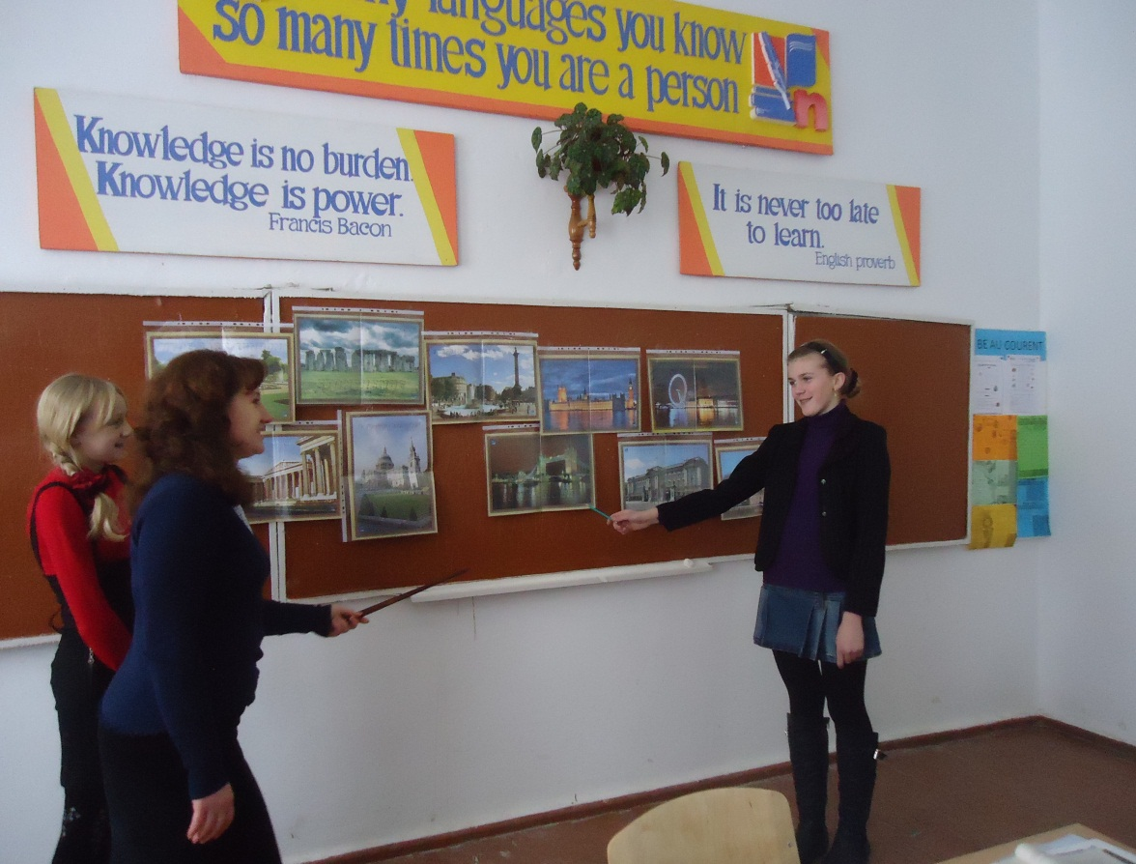
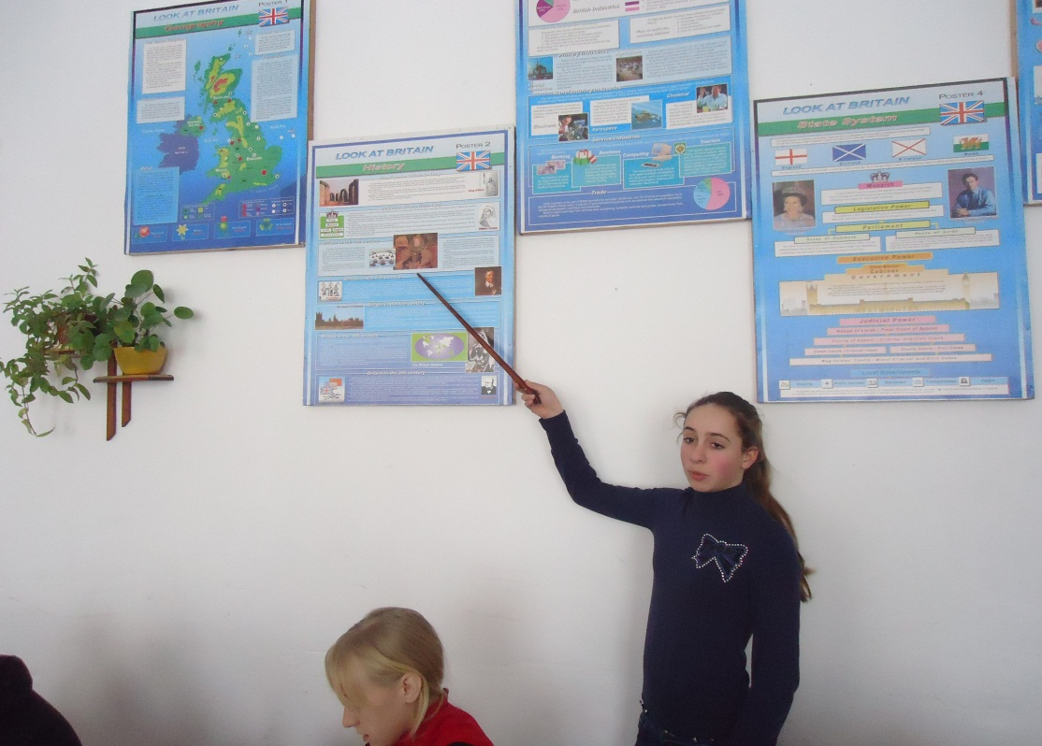
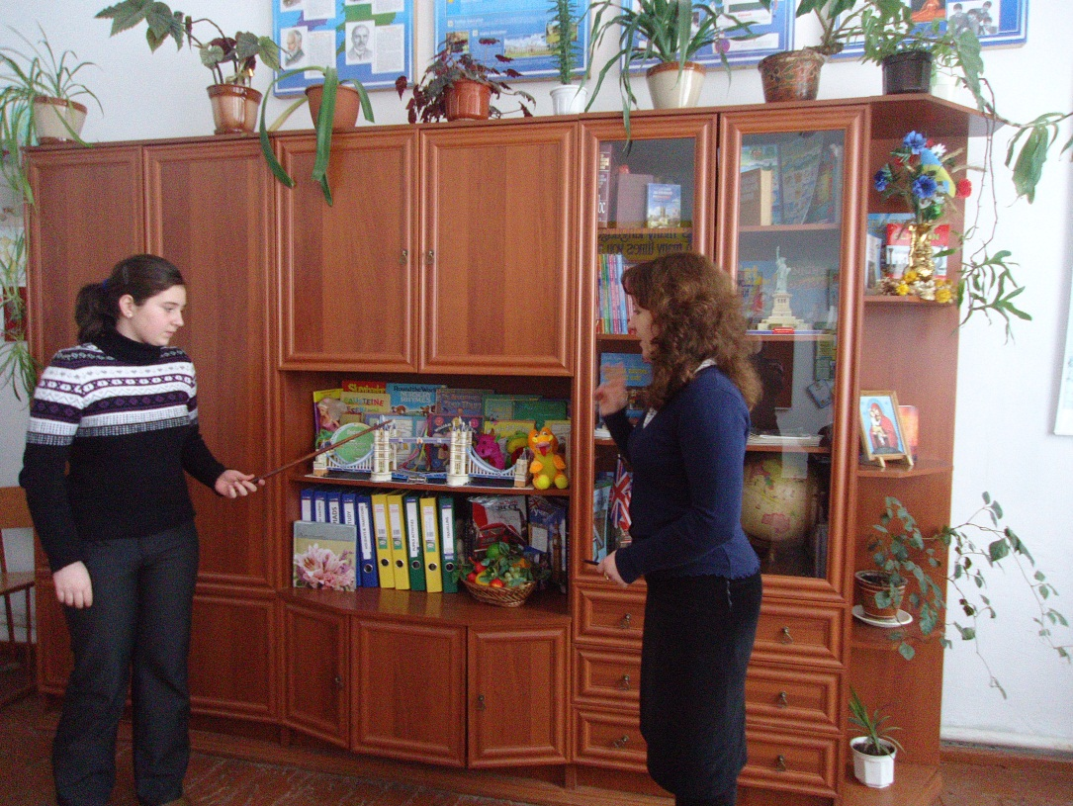
According to the Communicative Approach:
- the most important part of learning foreign language is to develop the skill to comfortably and creatively express ideas and understand what others are saying;
- the usefulness of the language is reinforced;
- speaking is emphasized as the main activity;
- less importance is given to perfect mastery of grammar;
- different teaching techniques are used: games, problem-solving, tasks, role-plays;

Slide 7
Seven features of communicative approach:
Informational gap
✵ Choice
✵ Feedback
✵ Realia/Authentic Materials
✵ Student Motivation
✵ Fluency over Accuracy
✵ Little or no Teacher Intervation

Slide 8
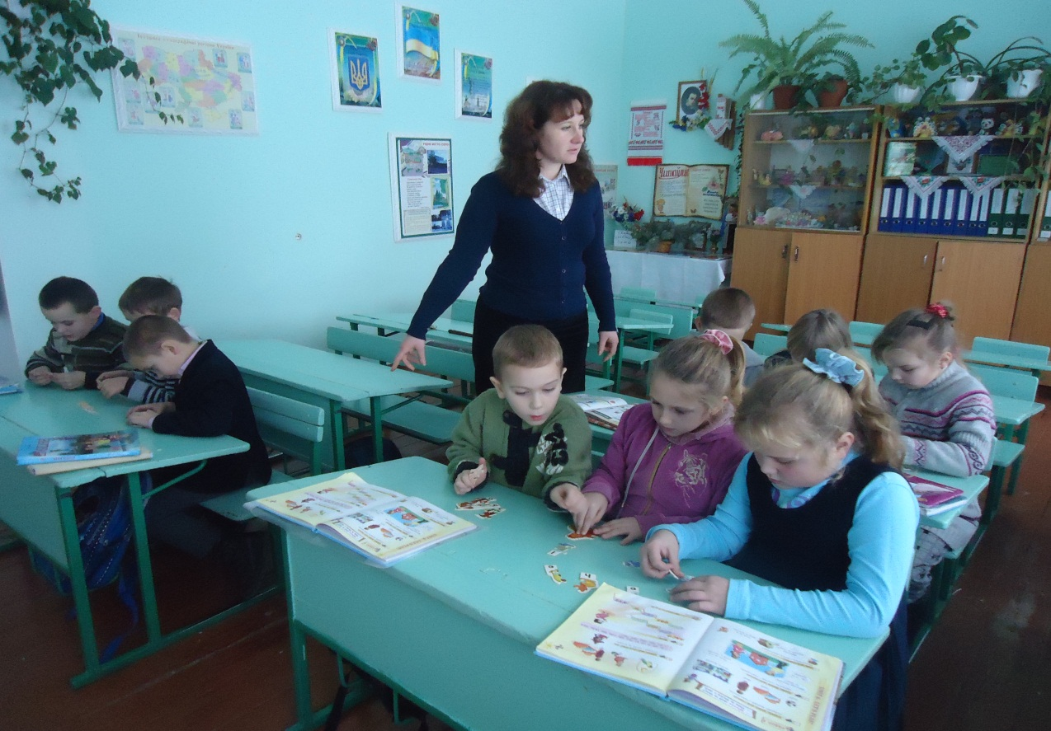
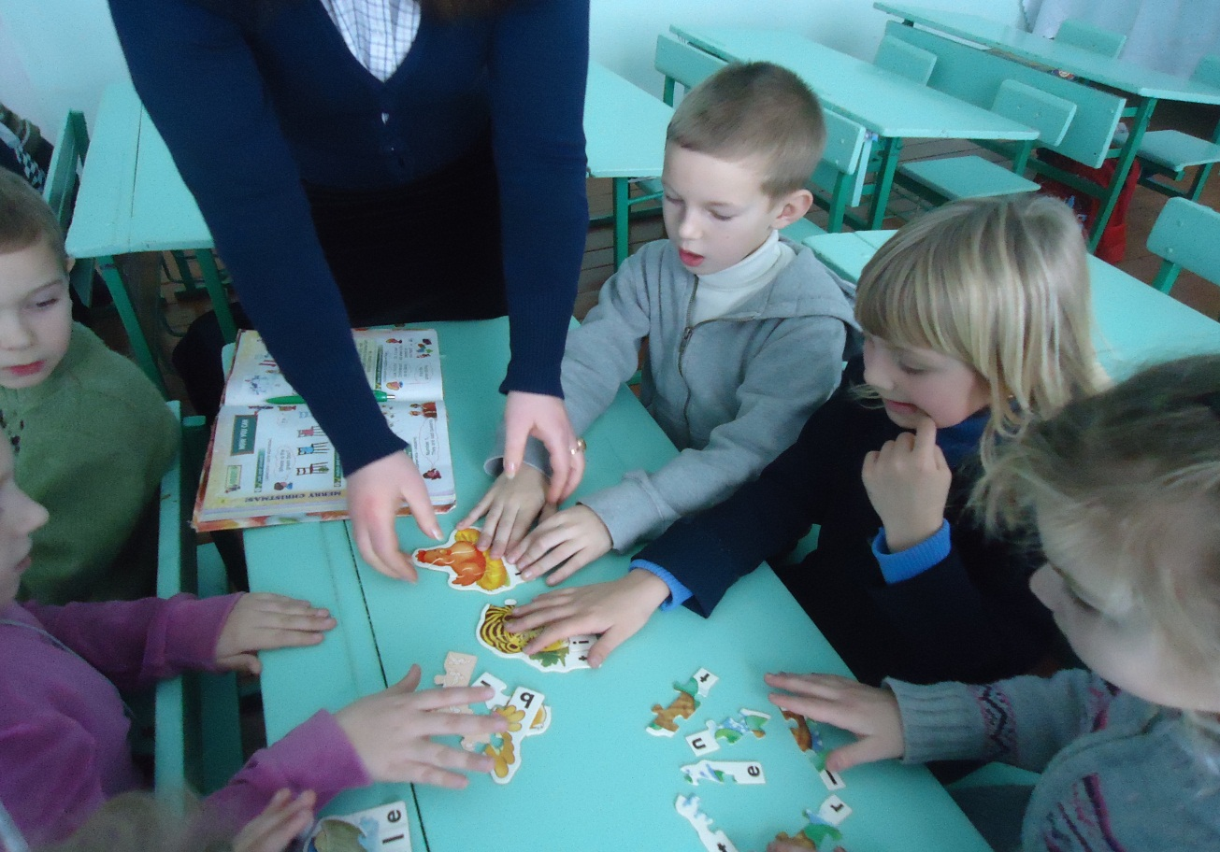
1.Task-Oriented
2. Needs-Based
3. Learning-Centered
4. Contextualized
Communicative lessons are:
5. Authentic
6. Situated in Discourse
7. Recursive
8. Sequenced with Attention to Learning and Acquisition

Slide 9
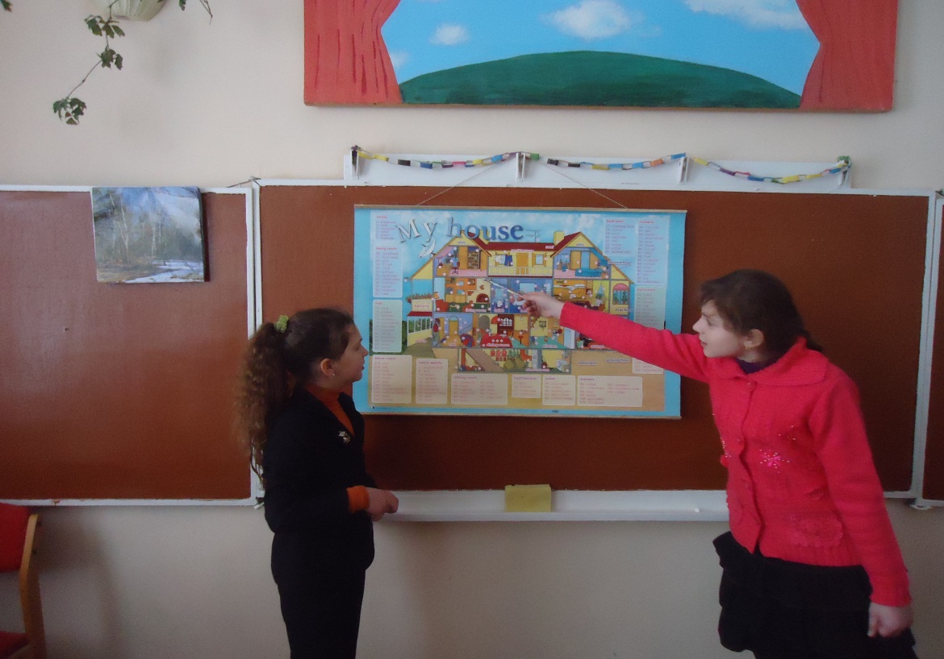
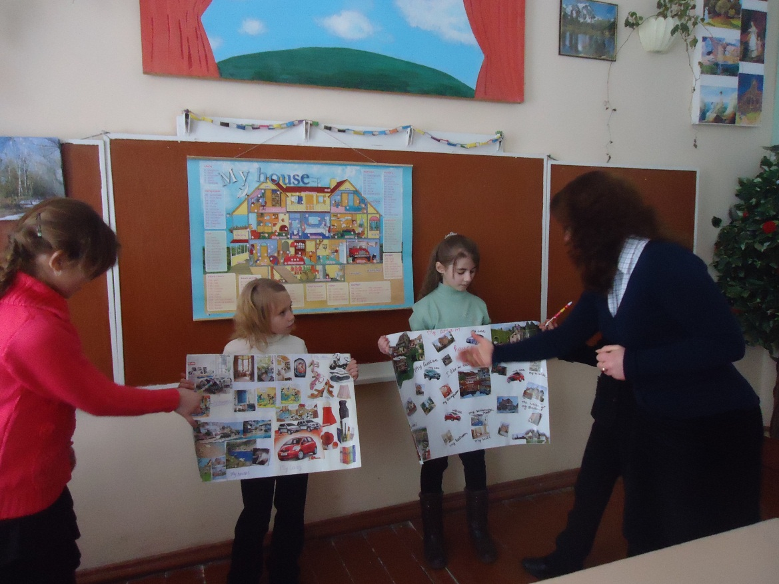
Aspects of Language the Approach Emphasizes
Pupils start with simple forms of work and move to more complex ones.
Students work at a discourse level. Consistent focus is placed on negotiated meaning.

Slide 10
Communicative Techniques
Authentic
Materials
Role-plays
Brain teasers
Scramble
sentences
Buzz groups
Q & A
Charades
Peer
teaching
Fishbowls
Ice-breakers
Panel
discussion
Language
games

Slide 11
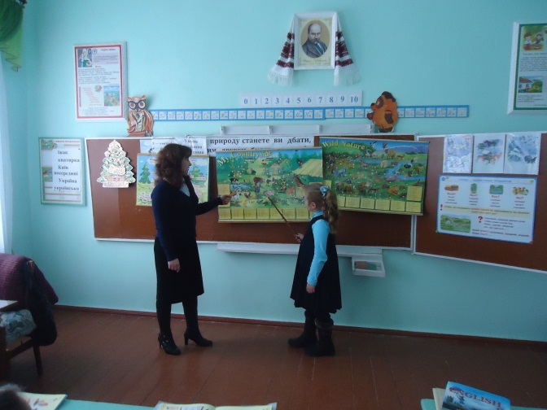
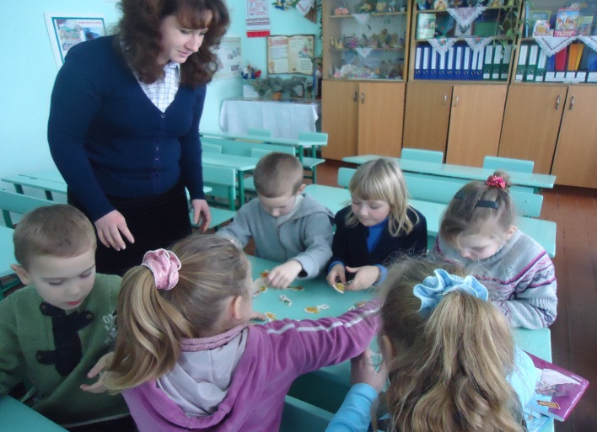
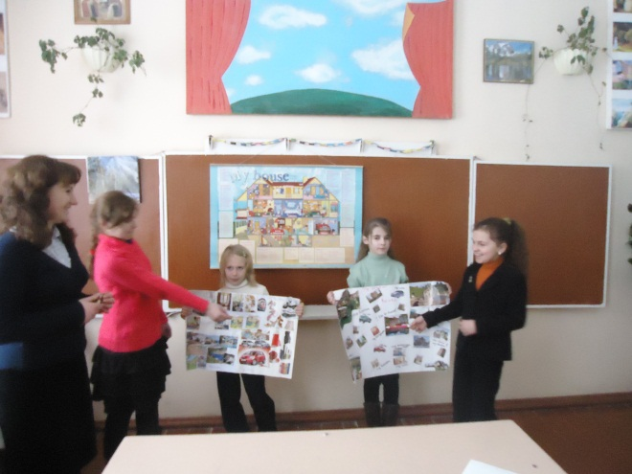
The role of the teacher
Prompter: students sometimes get lost, cannot think of what to say next or
in some other way lose the fluency we expect of them. Teacher can leave them
to struggle out of such situation on their own, and indeed sometimes this may be
the best option. However, we may be able to help them and the activity to
progress by offering discrete suggestions. If this can be done supportively,
without disruption the discussion or forcing students out of role, it will stop
the sense of frustration that some students feel when they come to a dead
end of language or ideas.
Participant: teachers should be good animators when asking students to
produce language. Sometimes this can be achieved by setting up an activity clearly
and with enthusiasm. Teachers may participate in discussions or role-plays themselves.
So they can prompt covertly, introduce new information to help the activity along, ensure
continuing students engagement and generally maintain a creative atmosphere.
Feedback provider: the vexed questions of when and how to give feedback
in speaking activities is answered by considering carefully the effect of possible
different approaches. When students are in the middle of a speaking task,
over-correction may inhibit them and take the communicativeness out of the activity.
On the other hand, helpful and gentle correction may get students out of difficult
misunderstanding and hesitations. Everything depends on our tact and the
appropriacy of the feedback we give in particular situations.

Slide 12
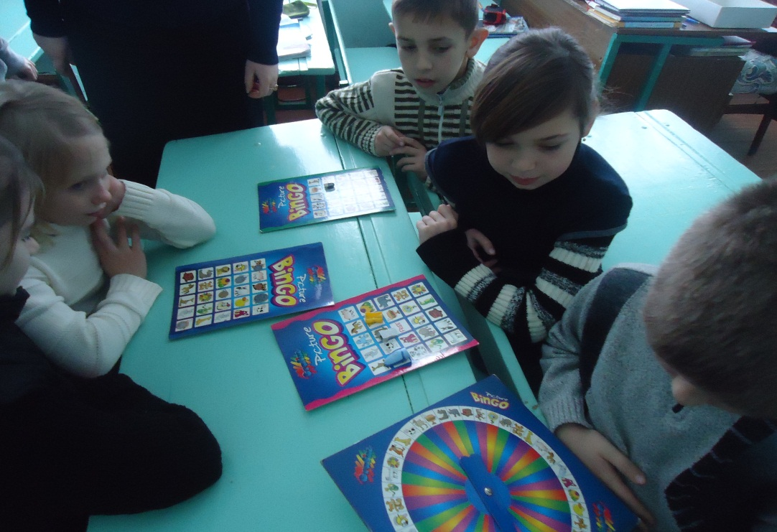
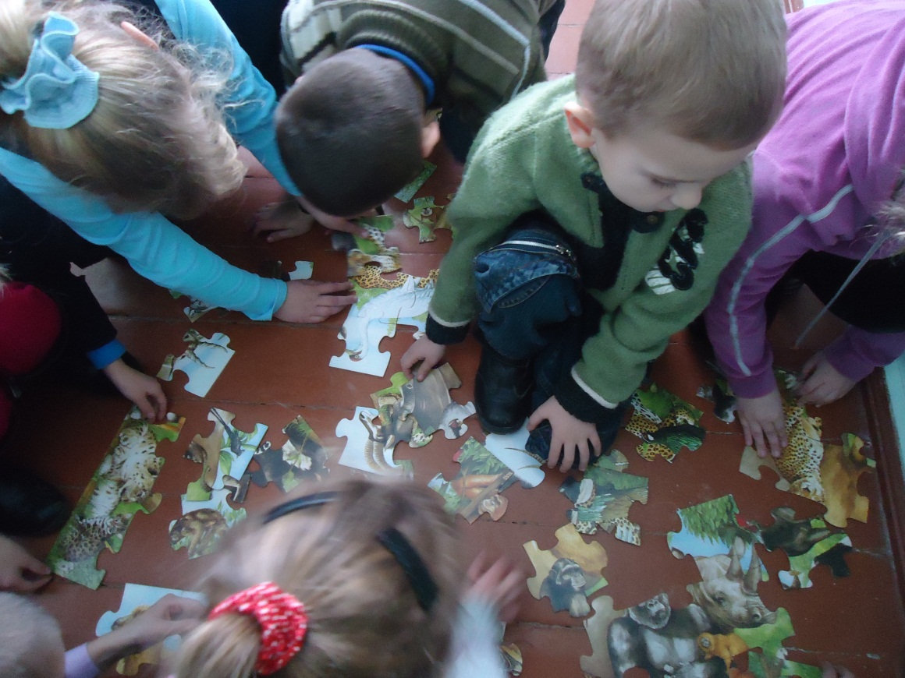
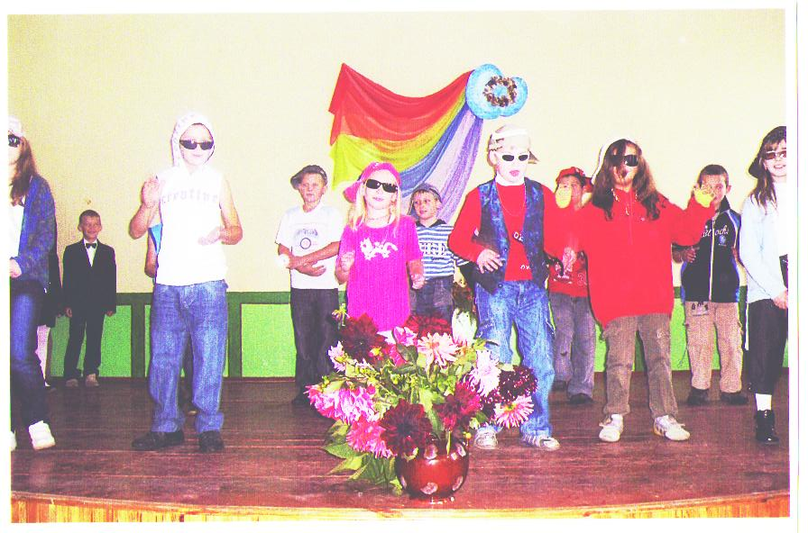
Communicative extra-school activities

Slide 13
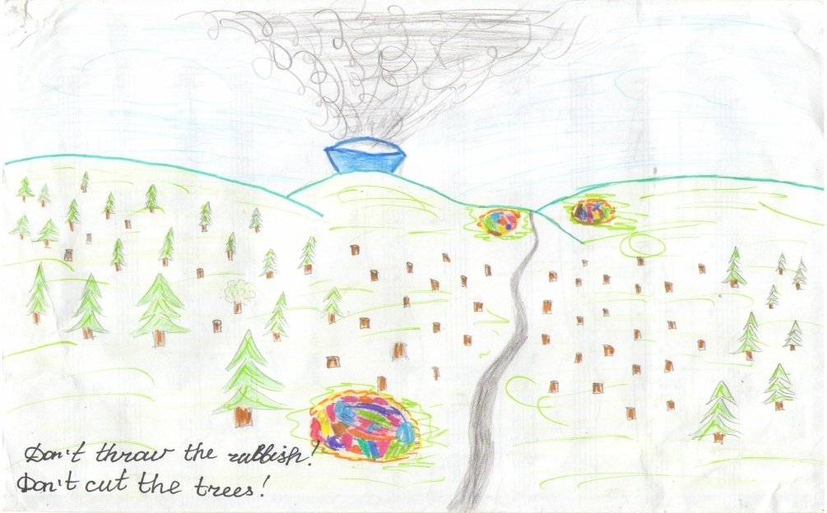
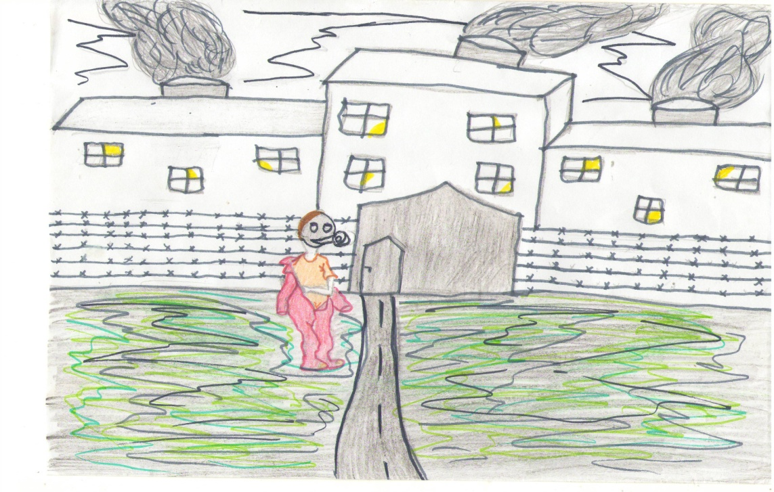
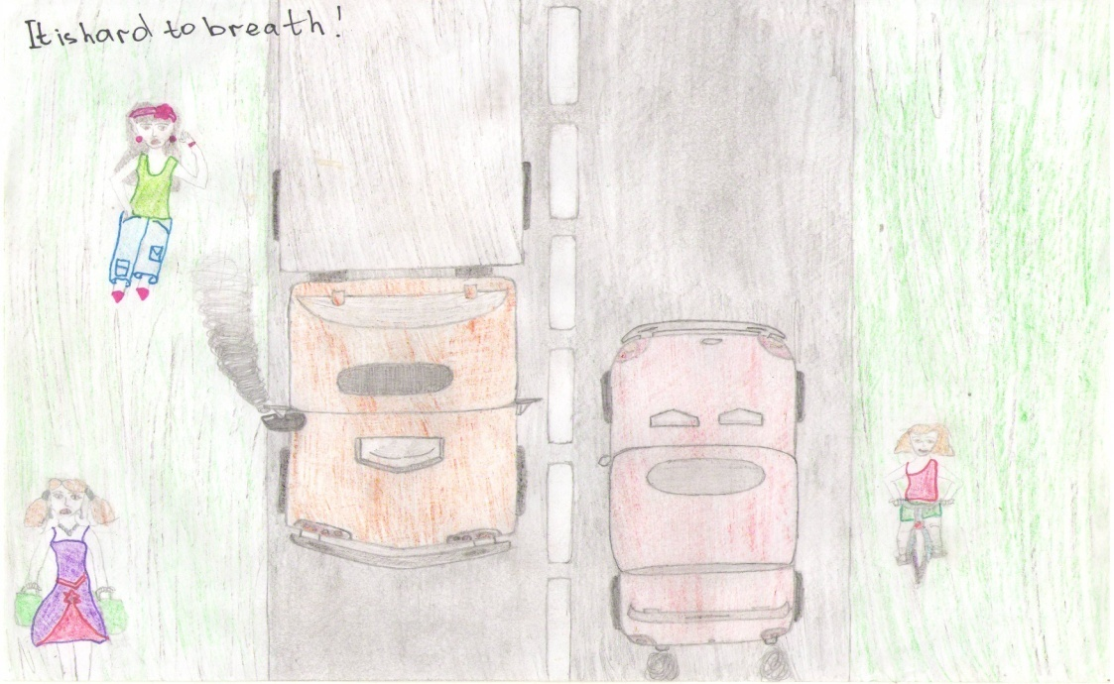
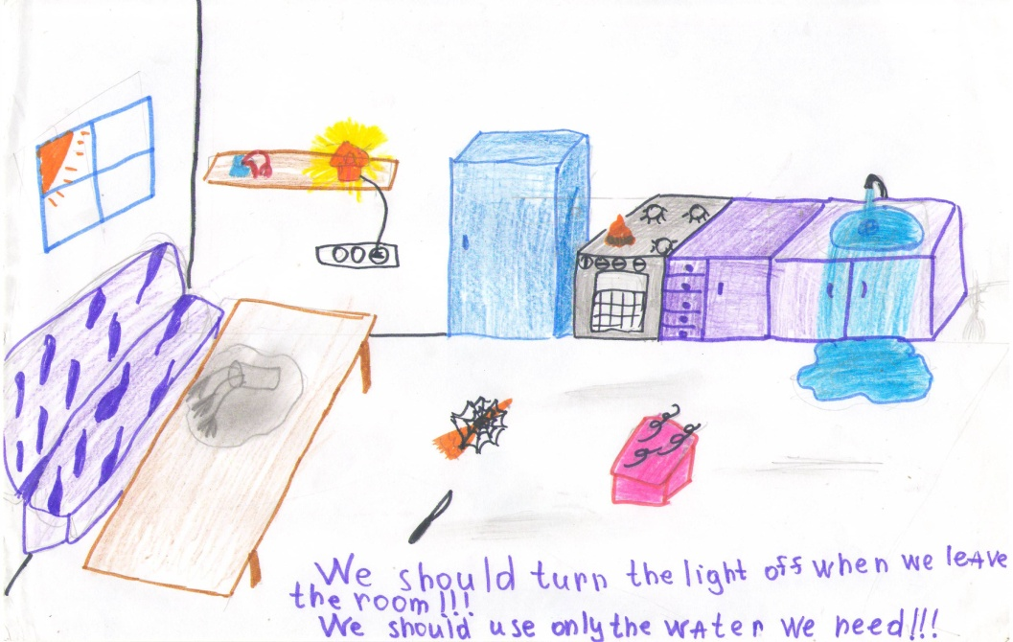
Civilization is being poisoned by its own waste products
(DIGEST. “Pollution of the environment. Reasons & consequences ”

Slide 14

Level of knowledge

Slide 15


Who dares to teach must never cease to learn

