Slide 2
The Walt Disney Company is the largest in the world. Founded on October 16, 1923, by Walt and Roy Disney as the Disney Brothers Cartoon Studio.

Slide 3
Walt Disney
Disney was born on December 5, 1901,
in Chicago.

Slide 4
Welcome to the world of Walt Disney

Slide 5
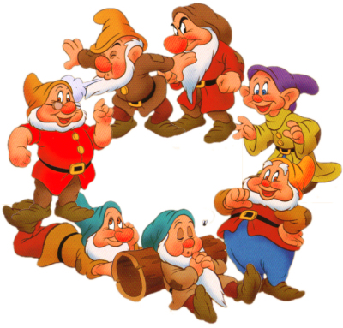
SNOW WHITE & THE 7 DWARFS

Slide 7
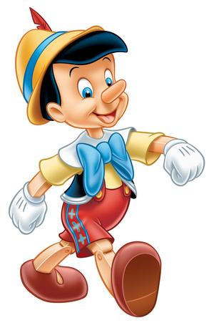
PINOCCHIO

Slide 17
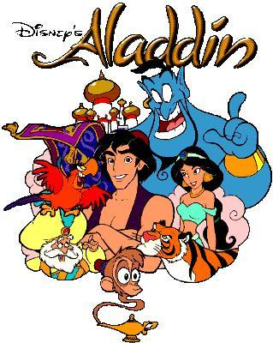

Slide 21
MICKEY
MOUSE

Slide 22
