Slide 1
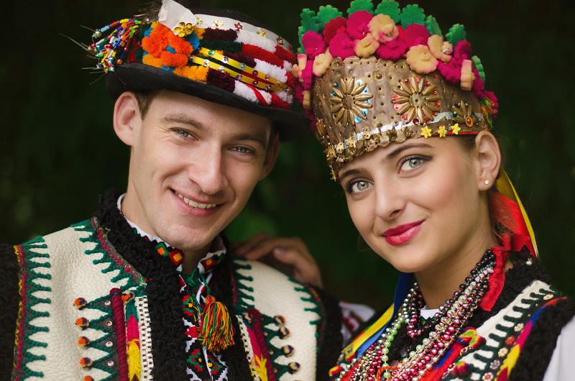
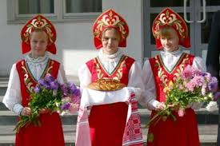
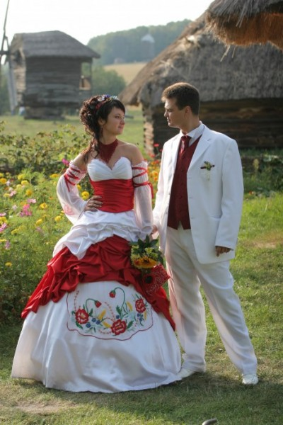
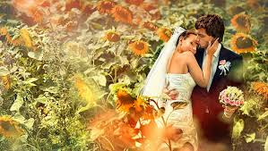
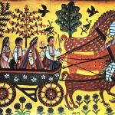
Ukrainian Wedding Traditions
Prepared by
Julia Haydanka Grade 9

Slide 2
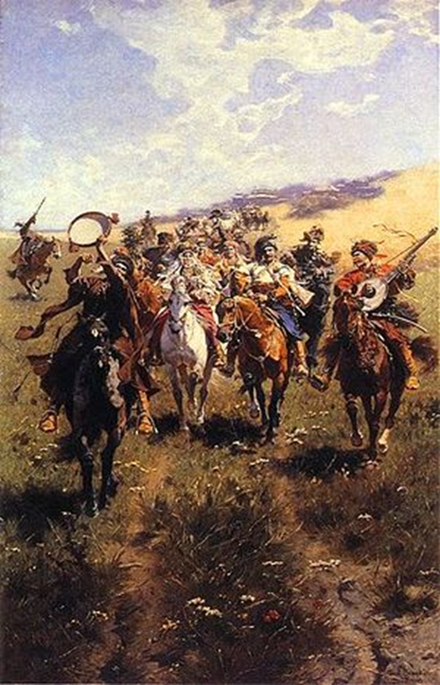
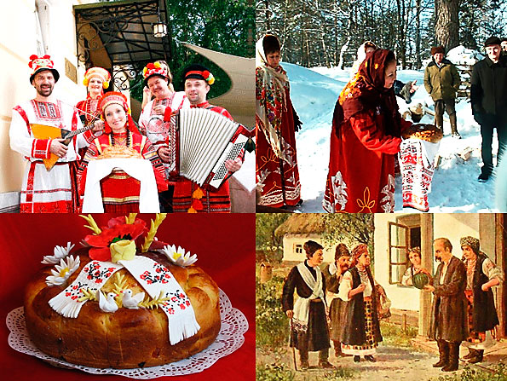
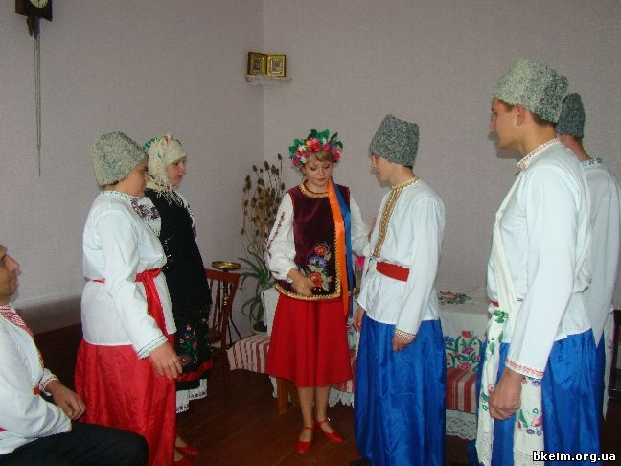
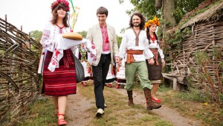
Engagement
Ukrainian wedding traditions procedure starts from the formal engagement, when a bride-groom together with two elder men (“starosty”) visits his future bride’s place and asks her parents her hand.

Slide 3
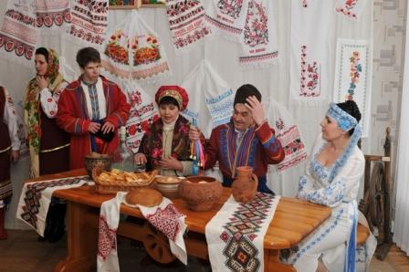
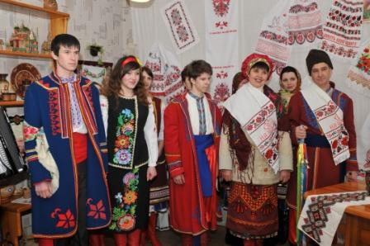
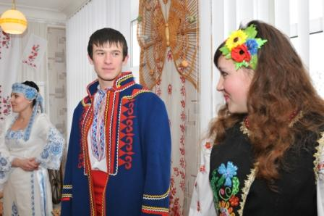
If the girlparents agreed, they gave blessings; the girl brought the towels to her future husband and the elders. If the girl refused to marry the young man, she brought out a pumpkin.

Slide 4
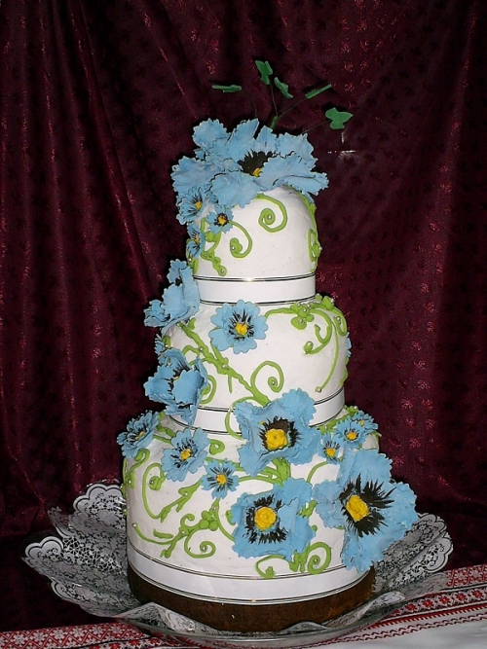
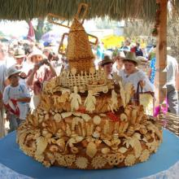
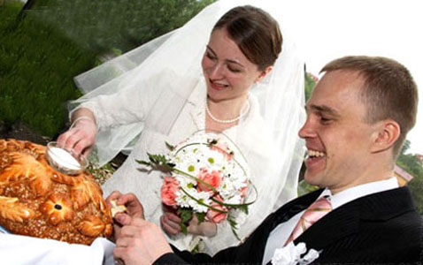
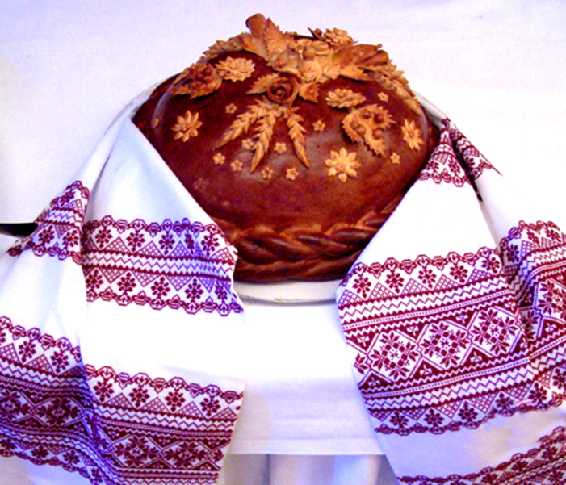
Korovoay
A couple of days before the wedding itself, bride’s and groom’s families bake special wedding bread (‘korovoay’). A young couple visit their relatives and friends and invite them to their wedding ceremony.

Slide 5
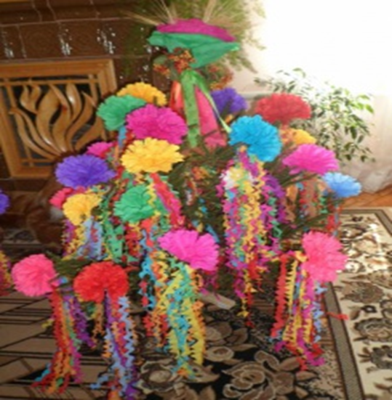
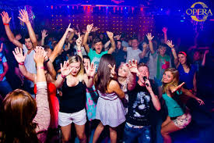
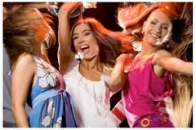
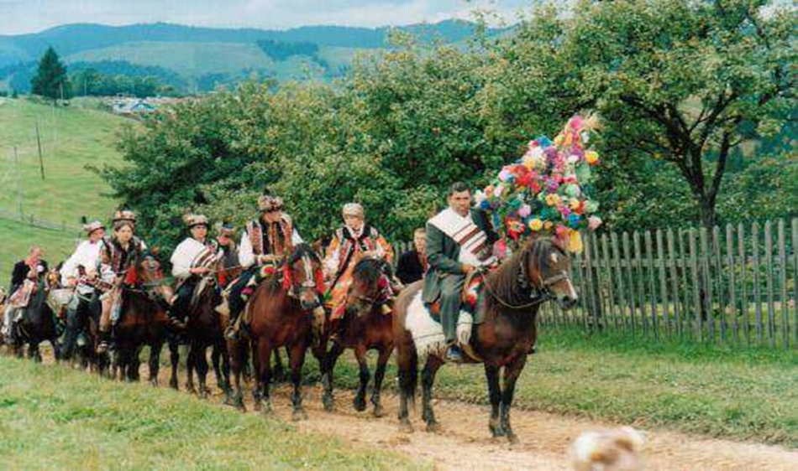
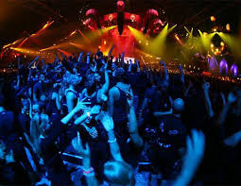
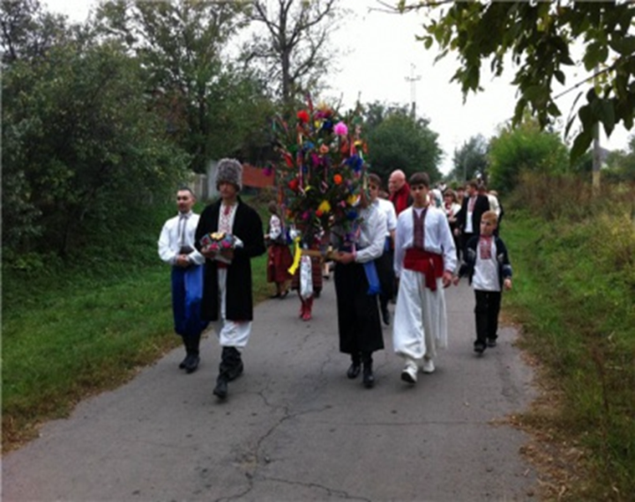
Tradition and modernity
Traditionally, girls weave periwinkle or making a ritual tree and sing sad folk song, but today such party is usually completed with visiting a night club.

Slide 6
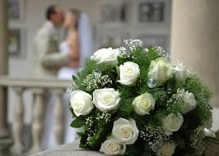
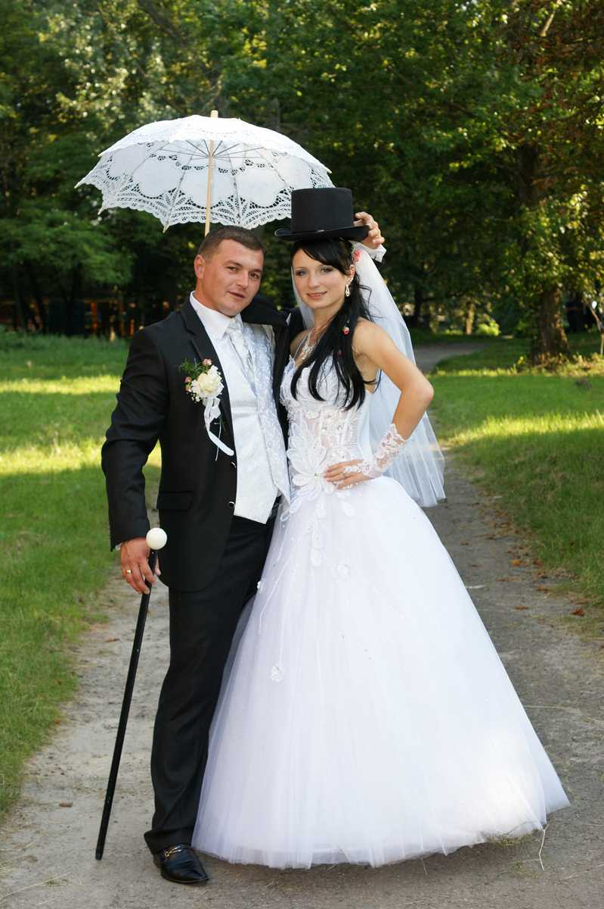
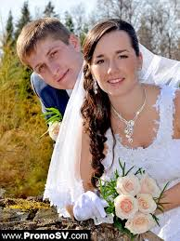
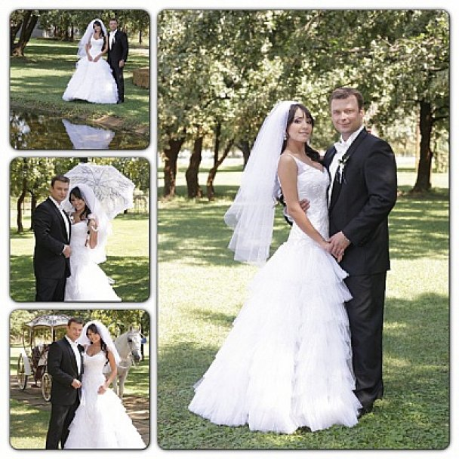
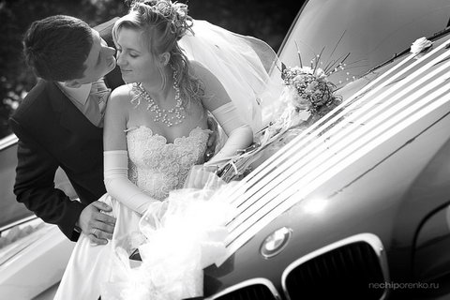
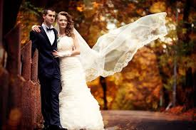

Slide 7
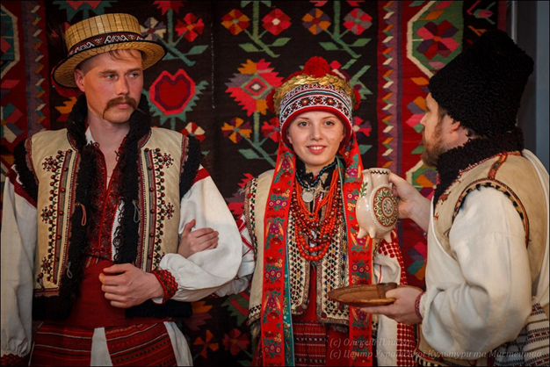
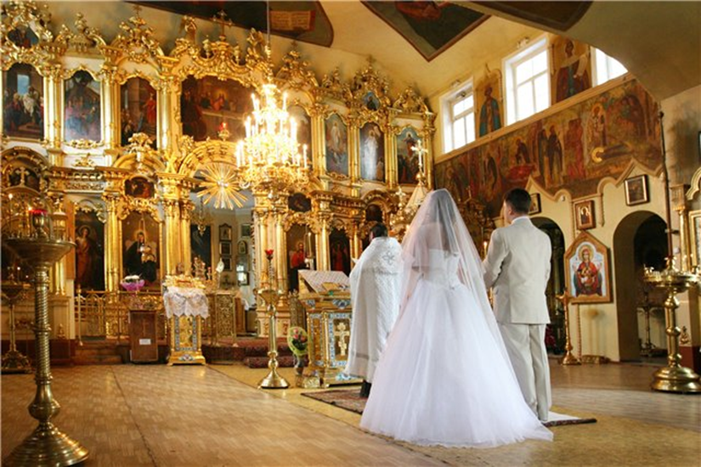
The wedding ceremony
In the Ukrainian tradition, the bride and groom entered the church together arm-in-arm as willing and equal partners. The priest met the young couple in the church and the ceremony began. The bride and groom affirmed to the priest that they were both entering into this union of their own free will.

Slide 8
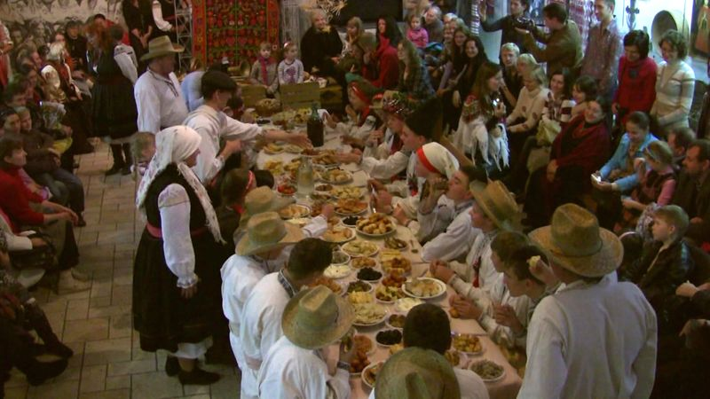
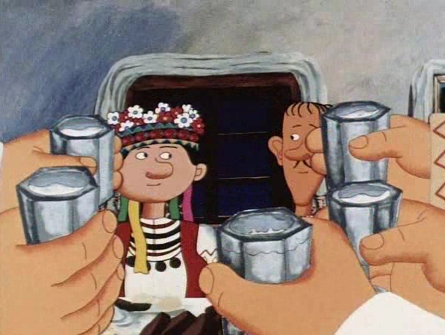
Following the main ceremony the couple is separated. A meal is presented at each respective home. The groom's mother will then send him with the wedding train to the bride's house. A type of game is played where the groom is refused entry and has to pay for entrance. After giving money and horilka, he is allowed to sit at the family table.

Slide 9
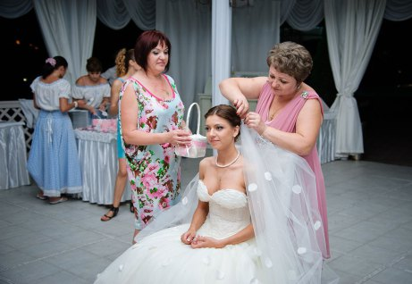
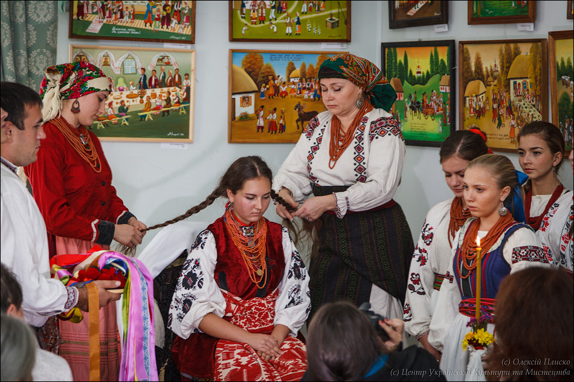
The end of the wedding ceremony
Ukrainian wedding officially ends with the tradition of covering a bride with the kerchief, which means that from now on she is a wife.

Slide 10
Thank you for your attention

