Slide 1
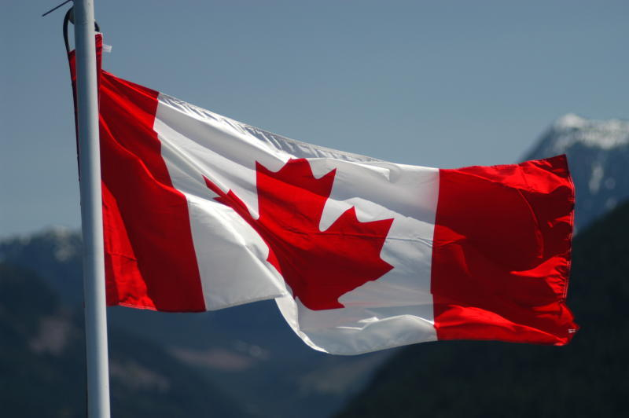
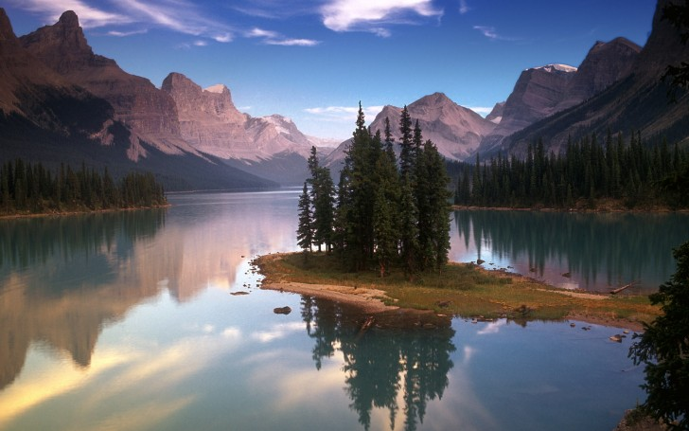
Canada
« A mari usque ad mare »
« From Sea to Sea »

Slide 2
National Flag and Coat of Arms

Slide 3
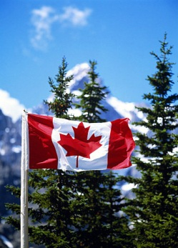
National Anthem
O Canada! Our home and native land, True patriot love in all thy sons command. With glowing hearts we see thee rise, The True North strong and free. From far and wide, O Canada, We stand on guard for thee. God keep our land glorious and free, O Canada, we stand on guard for thee. O Canada, we stand on guard for thee.

Slide 4
Canada is an independent federative state. It is one of the most developed countries.
Canada consists of ten provinces and two territories.
It is situated on the North American continent. In size Canada is the second in the world after Russia. Its area is almost 10 million km2. About 32,268,000 million people live in Canada. Canada's people are varied. About 57 % of all Canadians have some English ancestry and about 32 % have some French ancestry. The capital of Canada is Ottawa, which is situated on the bank of the Ottawa River. It is famous for its beautiful parks. It is also known as the city of bridges.

Slide 5
Canada is an independent country. Canada got full independence in 1931. The country is a member of the Commonwealth. Queen Elizabeth II is the head of the Commonwealth and the Queen of Canada but only formally. Canada is a founding member of the United Nations. It has been active in a number of major UN agencies.

Slide 6
Toronto and Montreal are the largest cities of Canada
Toronto
Montreal

Slide 7
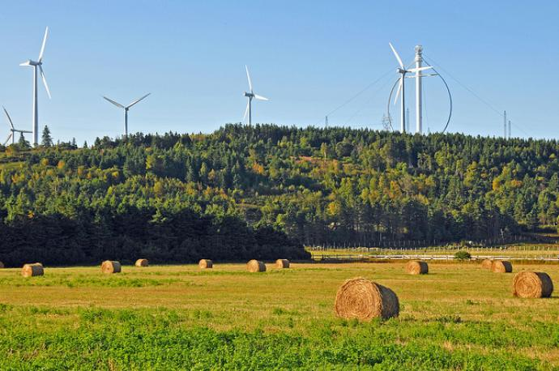
Canada is very rich in forest, minerals and fur-bearing animals. It holds the first place in the world in the amount of forests. It is rich in the following natural resources: non-ferrous metals, uranium, oil, natural gas, coal. Canadian industries produce cars, airliners, locomotives, sea vessels, snow-removal machines, and agricultural equipment. The most developed industries are timber, mining, chemical, meat and milk and food industries. Canada grows wheat, barley, flax, potatoes, vegetables and fruit. Fishing is also one of the prosperous industries.

Slide 8
The Canadian National Men's Ice Hockey Team is the ice hockey team representing Canada internationally. The team is overseen by Hockey Canada, a member of the International Ice Hockey Federation. From 1920 until 1963, Canada's international representation was by senior amateur club teams. Canada's national men's team was founded in 1963 by Father David Bauer as a part of the Canadian Amateur Hockey Association, playing out of the University of British Columbia. The nickname "Team Canada" was christened for the 1972 Summit Series and has been frequently used to refer to the Canadian national team ever since.

Slide 9
Official languages of Canada are English and French. Nearly 60 percent of the population speak English and 27 percent speak French. The rest speaks other languages, such as Eskimo, Indian, German, Ukrainian and Italian.

Slide 10
Interesting Facts
Country name comes from the word «kanata», that the language of the tribes of the Iroquois means "village".
In Canada, were designed and invented telephone, zipper for garment, chocolate, matches and glove for baseball.
In the Canadian city of Ontario is the smallest prison in the world. Its area - only 24.3 square meters.
Ice Hotel in Quebec, known as Hotel de Glace, using 500 tons of ice and more than 1000 tons of snow. Every summer, it melts and winter again restored.
In 1991, in Canada, on a concrete pedestal, was a monument to the ax. Weight monument was 7 tons.
In Canada, during exams, students have the right to speak with teachers to "You".

