Slide 1
Svitlana Tarasivna Kotsur
an English teacher of Terebovlia # 1 Secondary School

Slide 2
Pedagogical Issue: Competence-Based Approach to the English Language Teaching
It’s a luxury to learn; but the luxury of learning is not to be compared with a luxury of teaching.
Hitchcock

Slide 3
This approach entails the putting together of all the knowledge, know-how and attitudes required for the
solution of real life problems or situations.
CBA seeks to bridge the wall between school or the classroom and everyday real life: seeking and giving information by interacting with people in the market, hospital, school, offices etc.

Slide 4
Key Competences
social
communicative
self-
educational
civic
informational
multicultural
cognitive

Slide 5
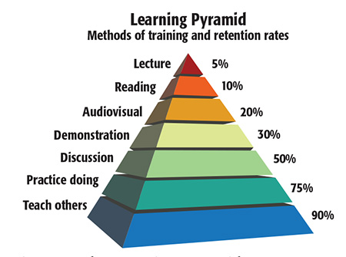

Slide 6
Interactive Teaching Activities
Cooperative learning
pair work
group processing
TGT (or Team Game Tournament)
think-pair-share
small groups skills
aquarium
same-different
Collaborative learning
microphone
three-step-interview
numbered heads
brainstorming

Slide 7
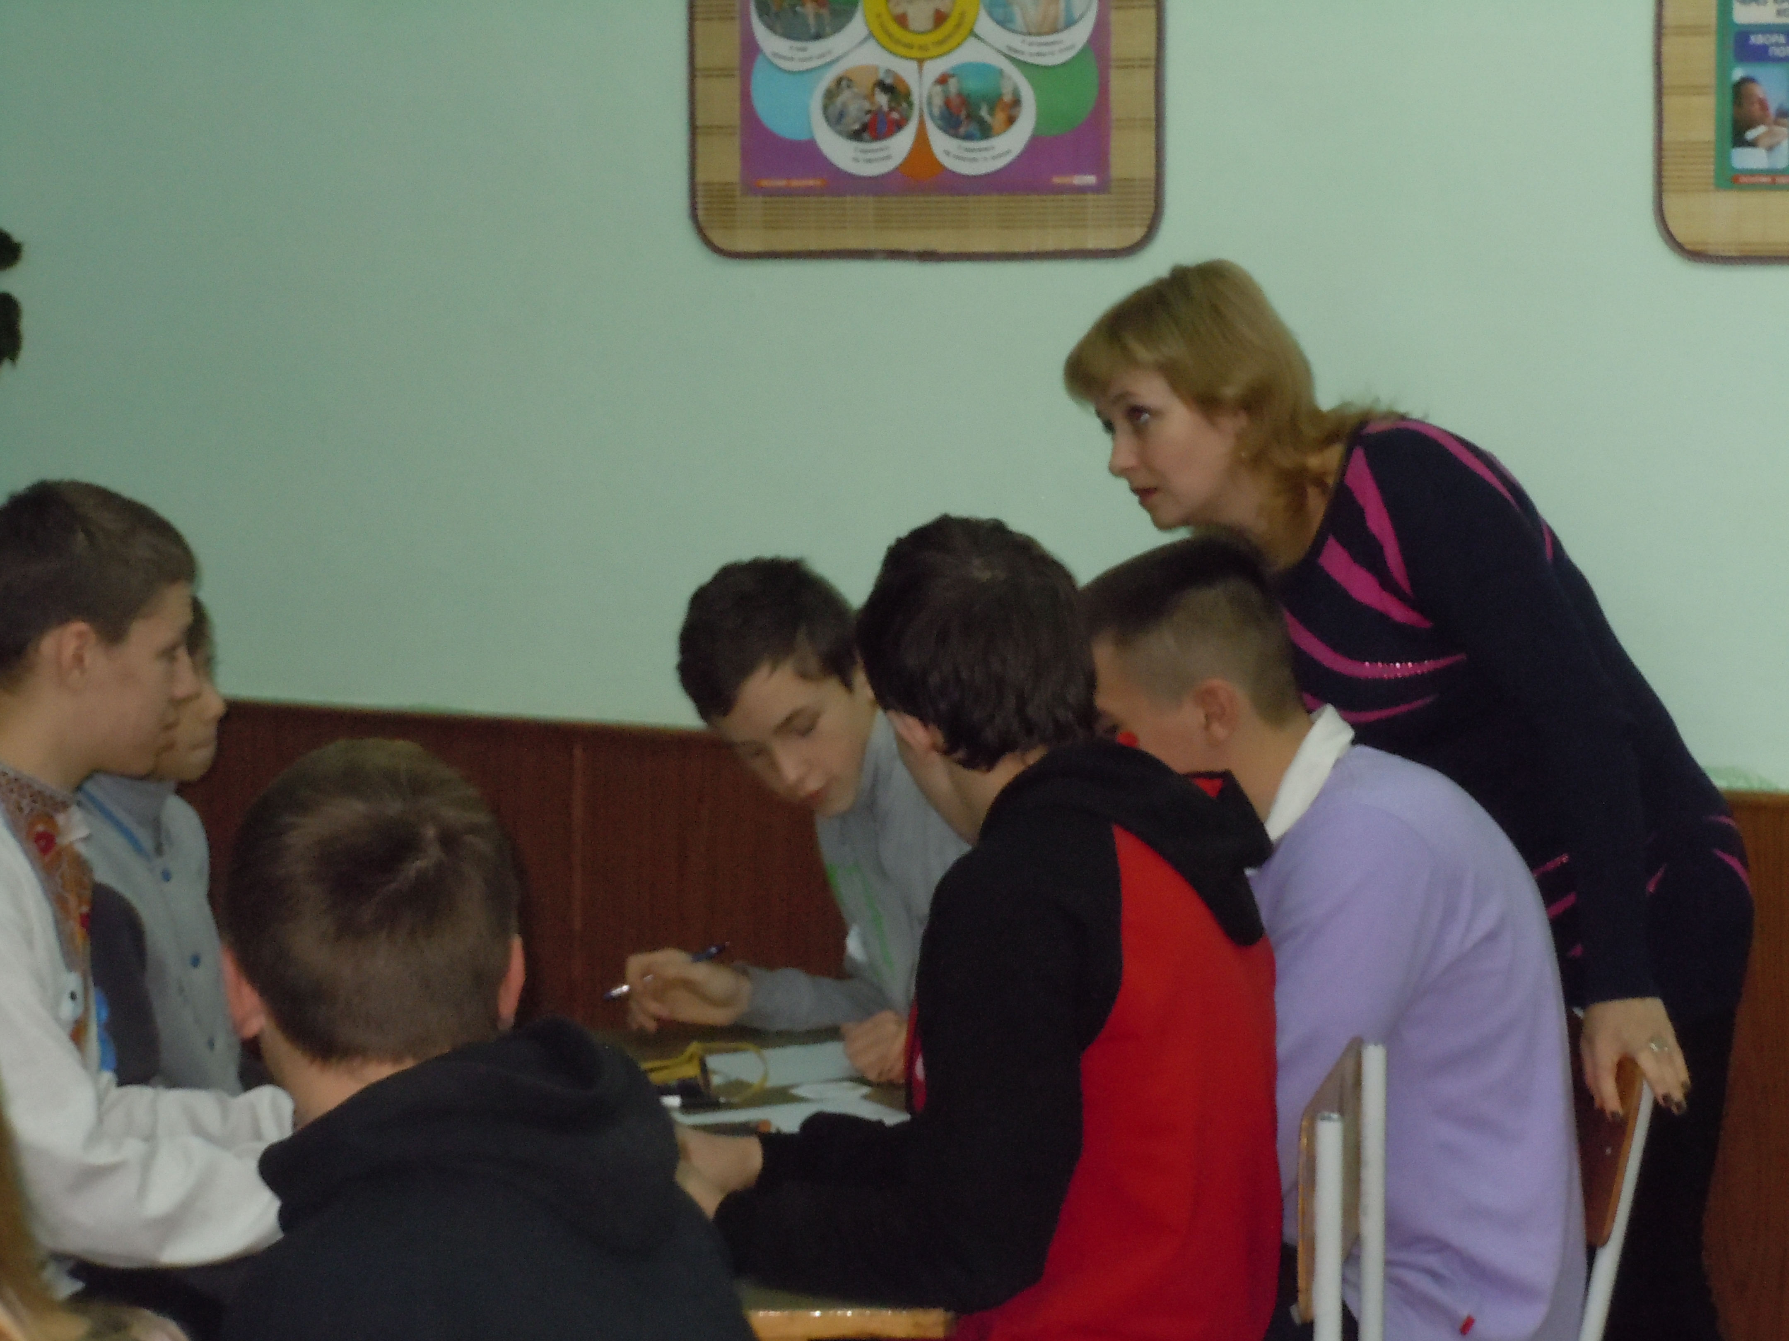
Situational learning
games
role-plays
acting out
partners
invented dialogues
Class discussions
problem-solving tasks
project works
talk-show
interviews
debates

Slide 8
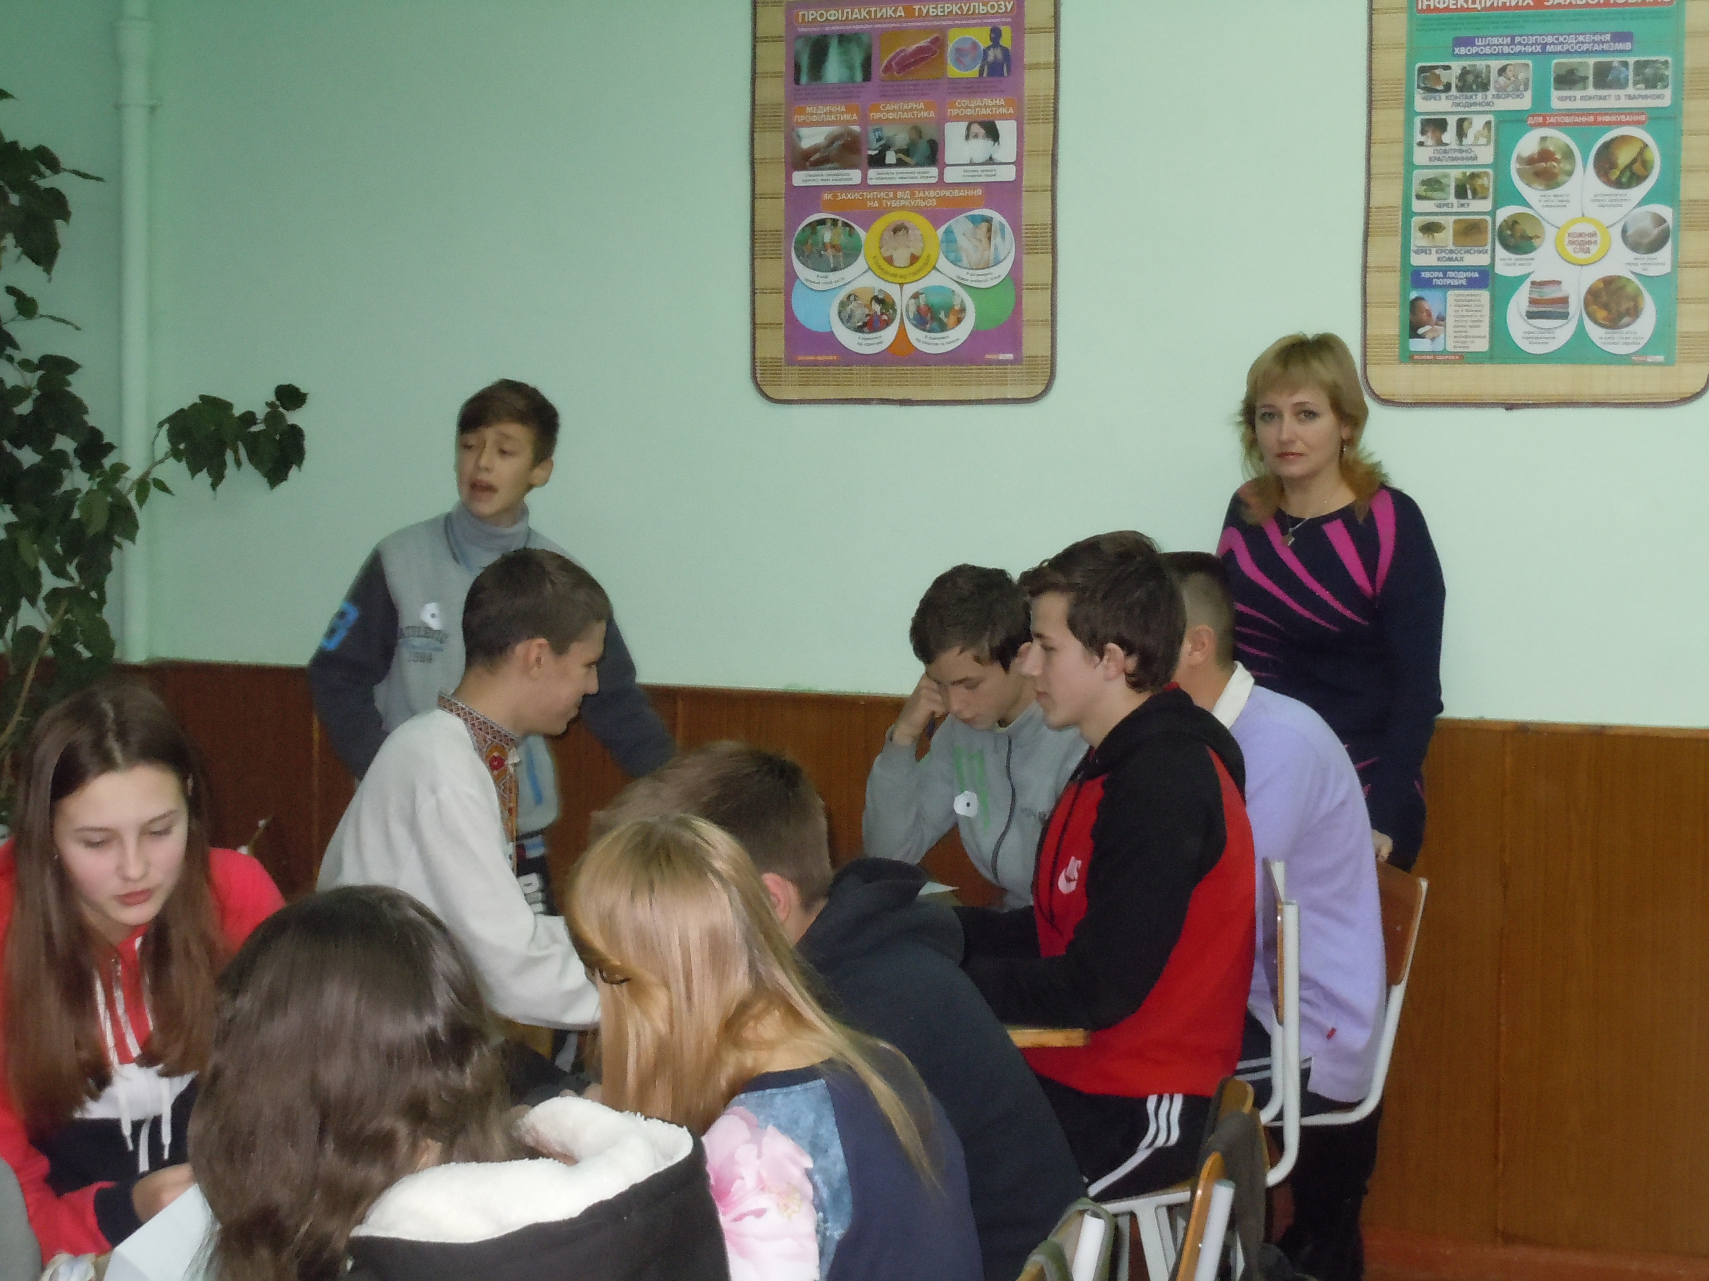
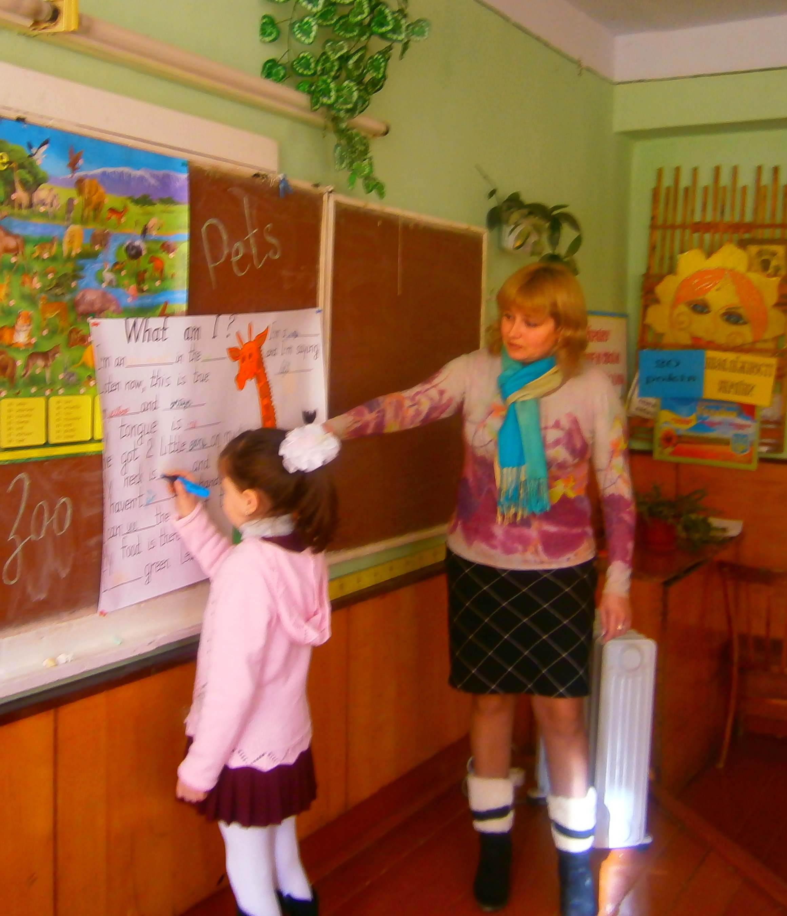
non-traditional lessons
lesson –excursion
lesson- conference
television bridge
lesson- game
lesson-trip
poetry lesson
lesson-tournament
linguistic stagecoach

Slide 9
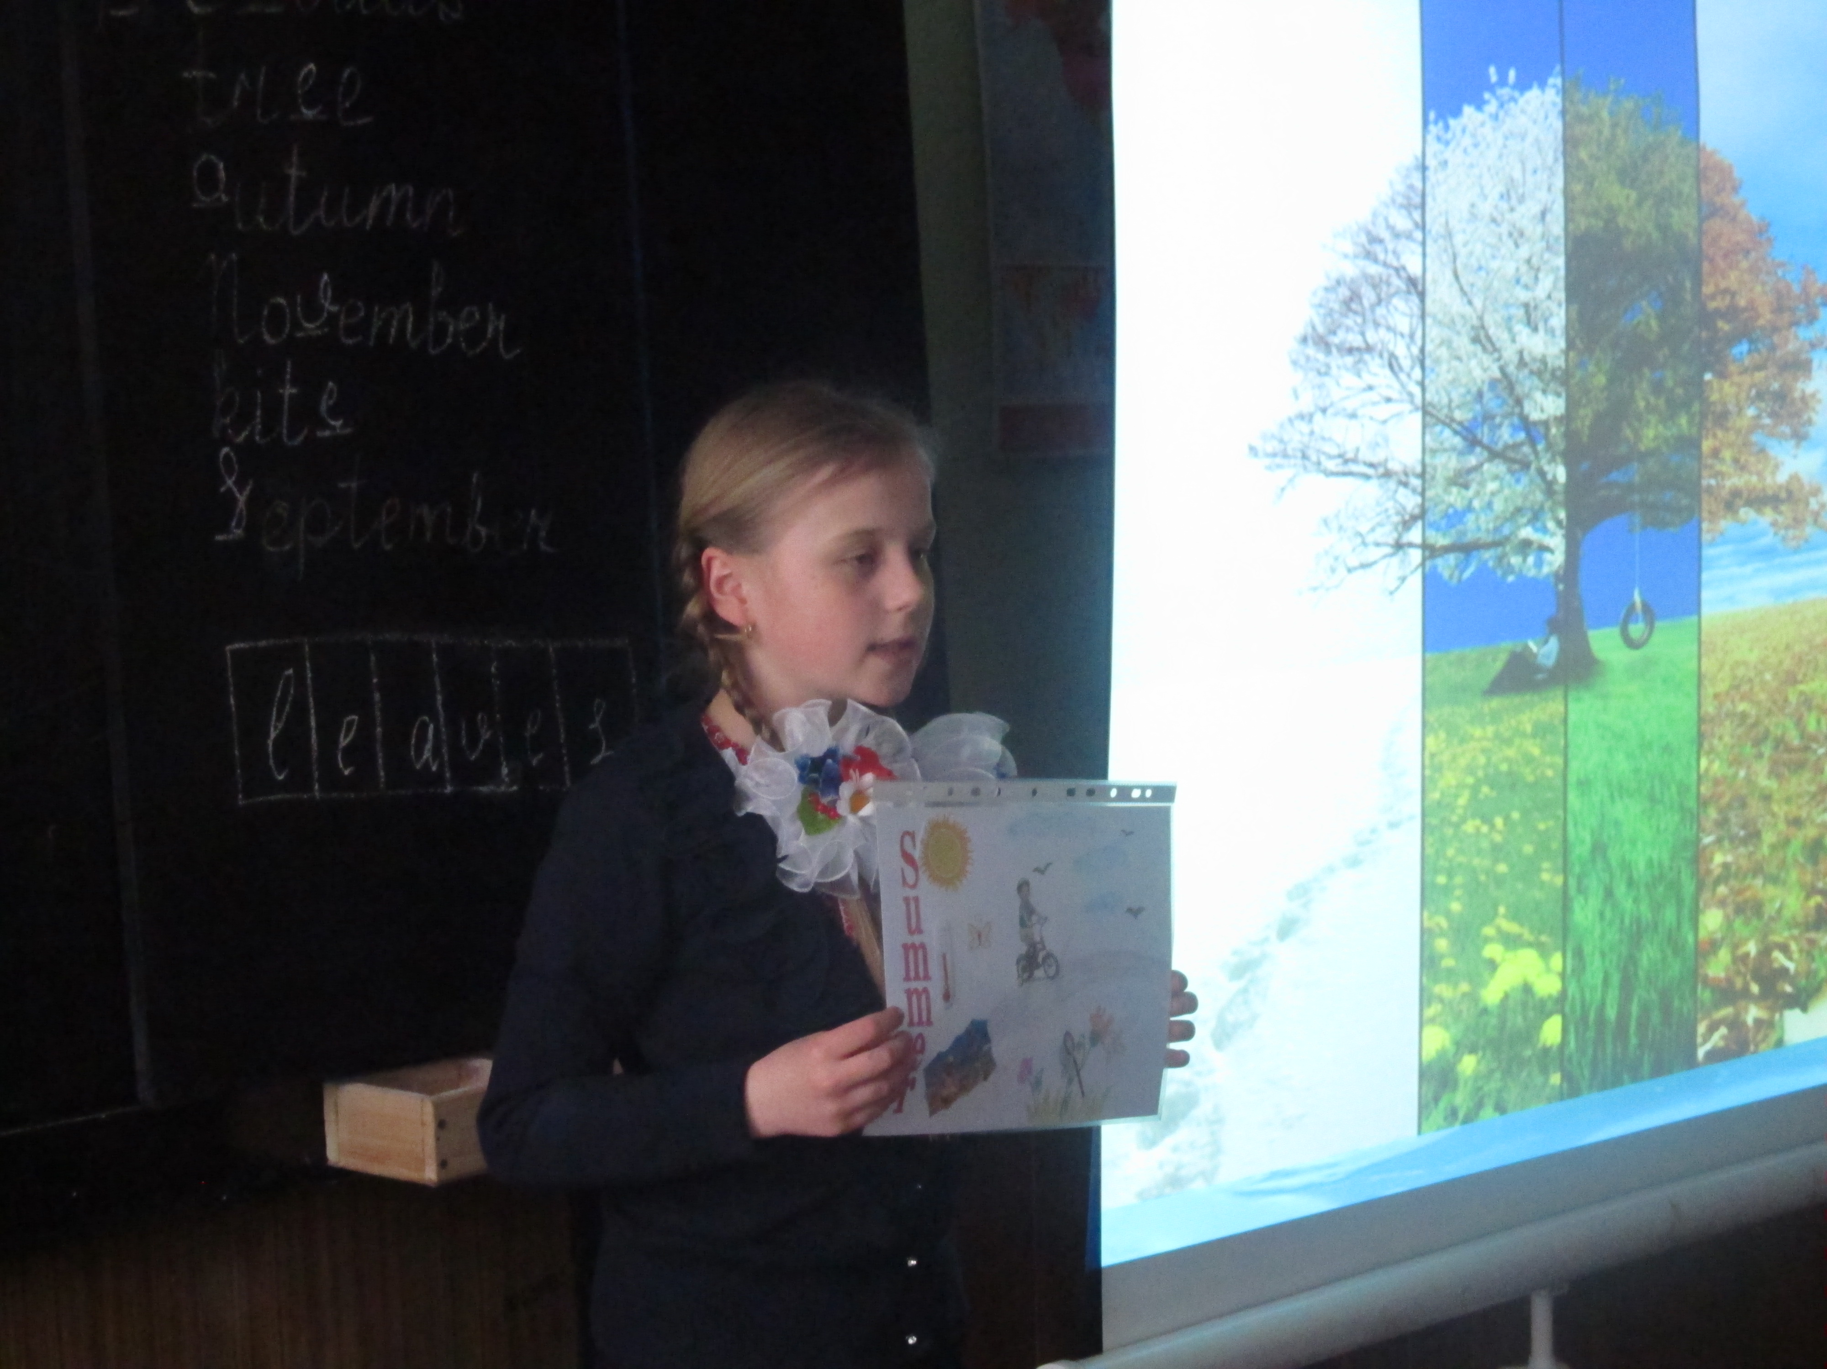
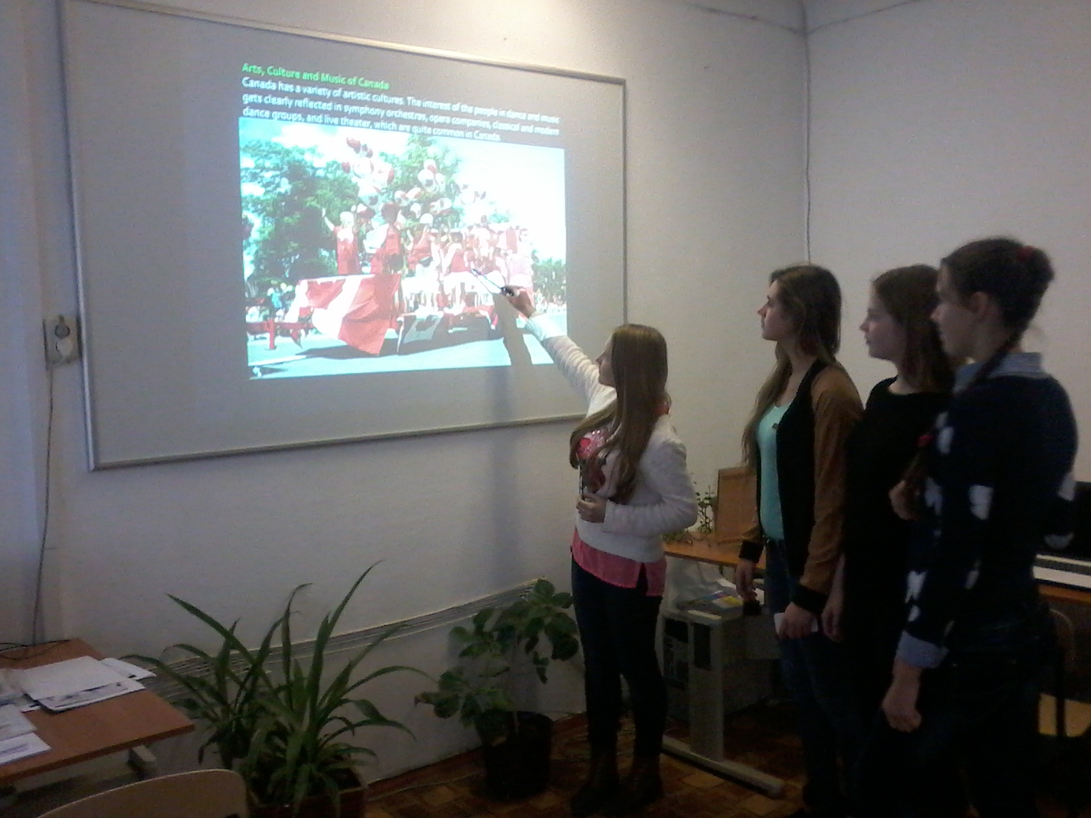
Project techniques as one of the basic methods in Competence-Based Teaching

Slide 10
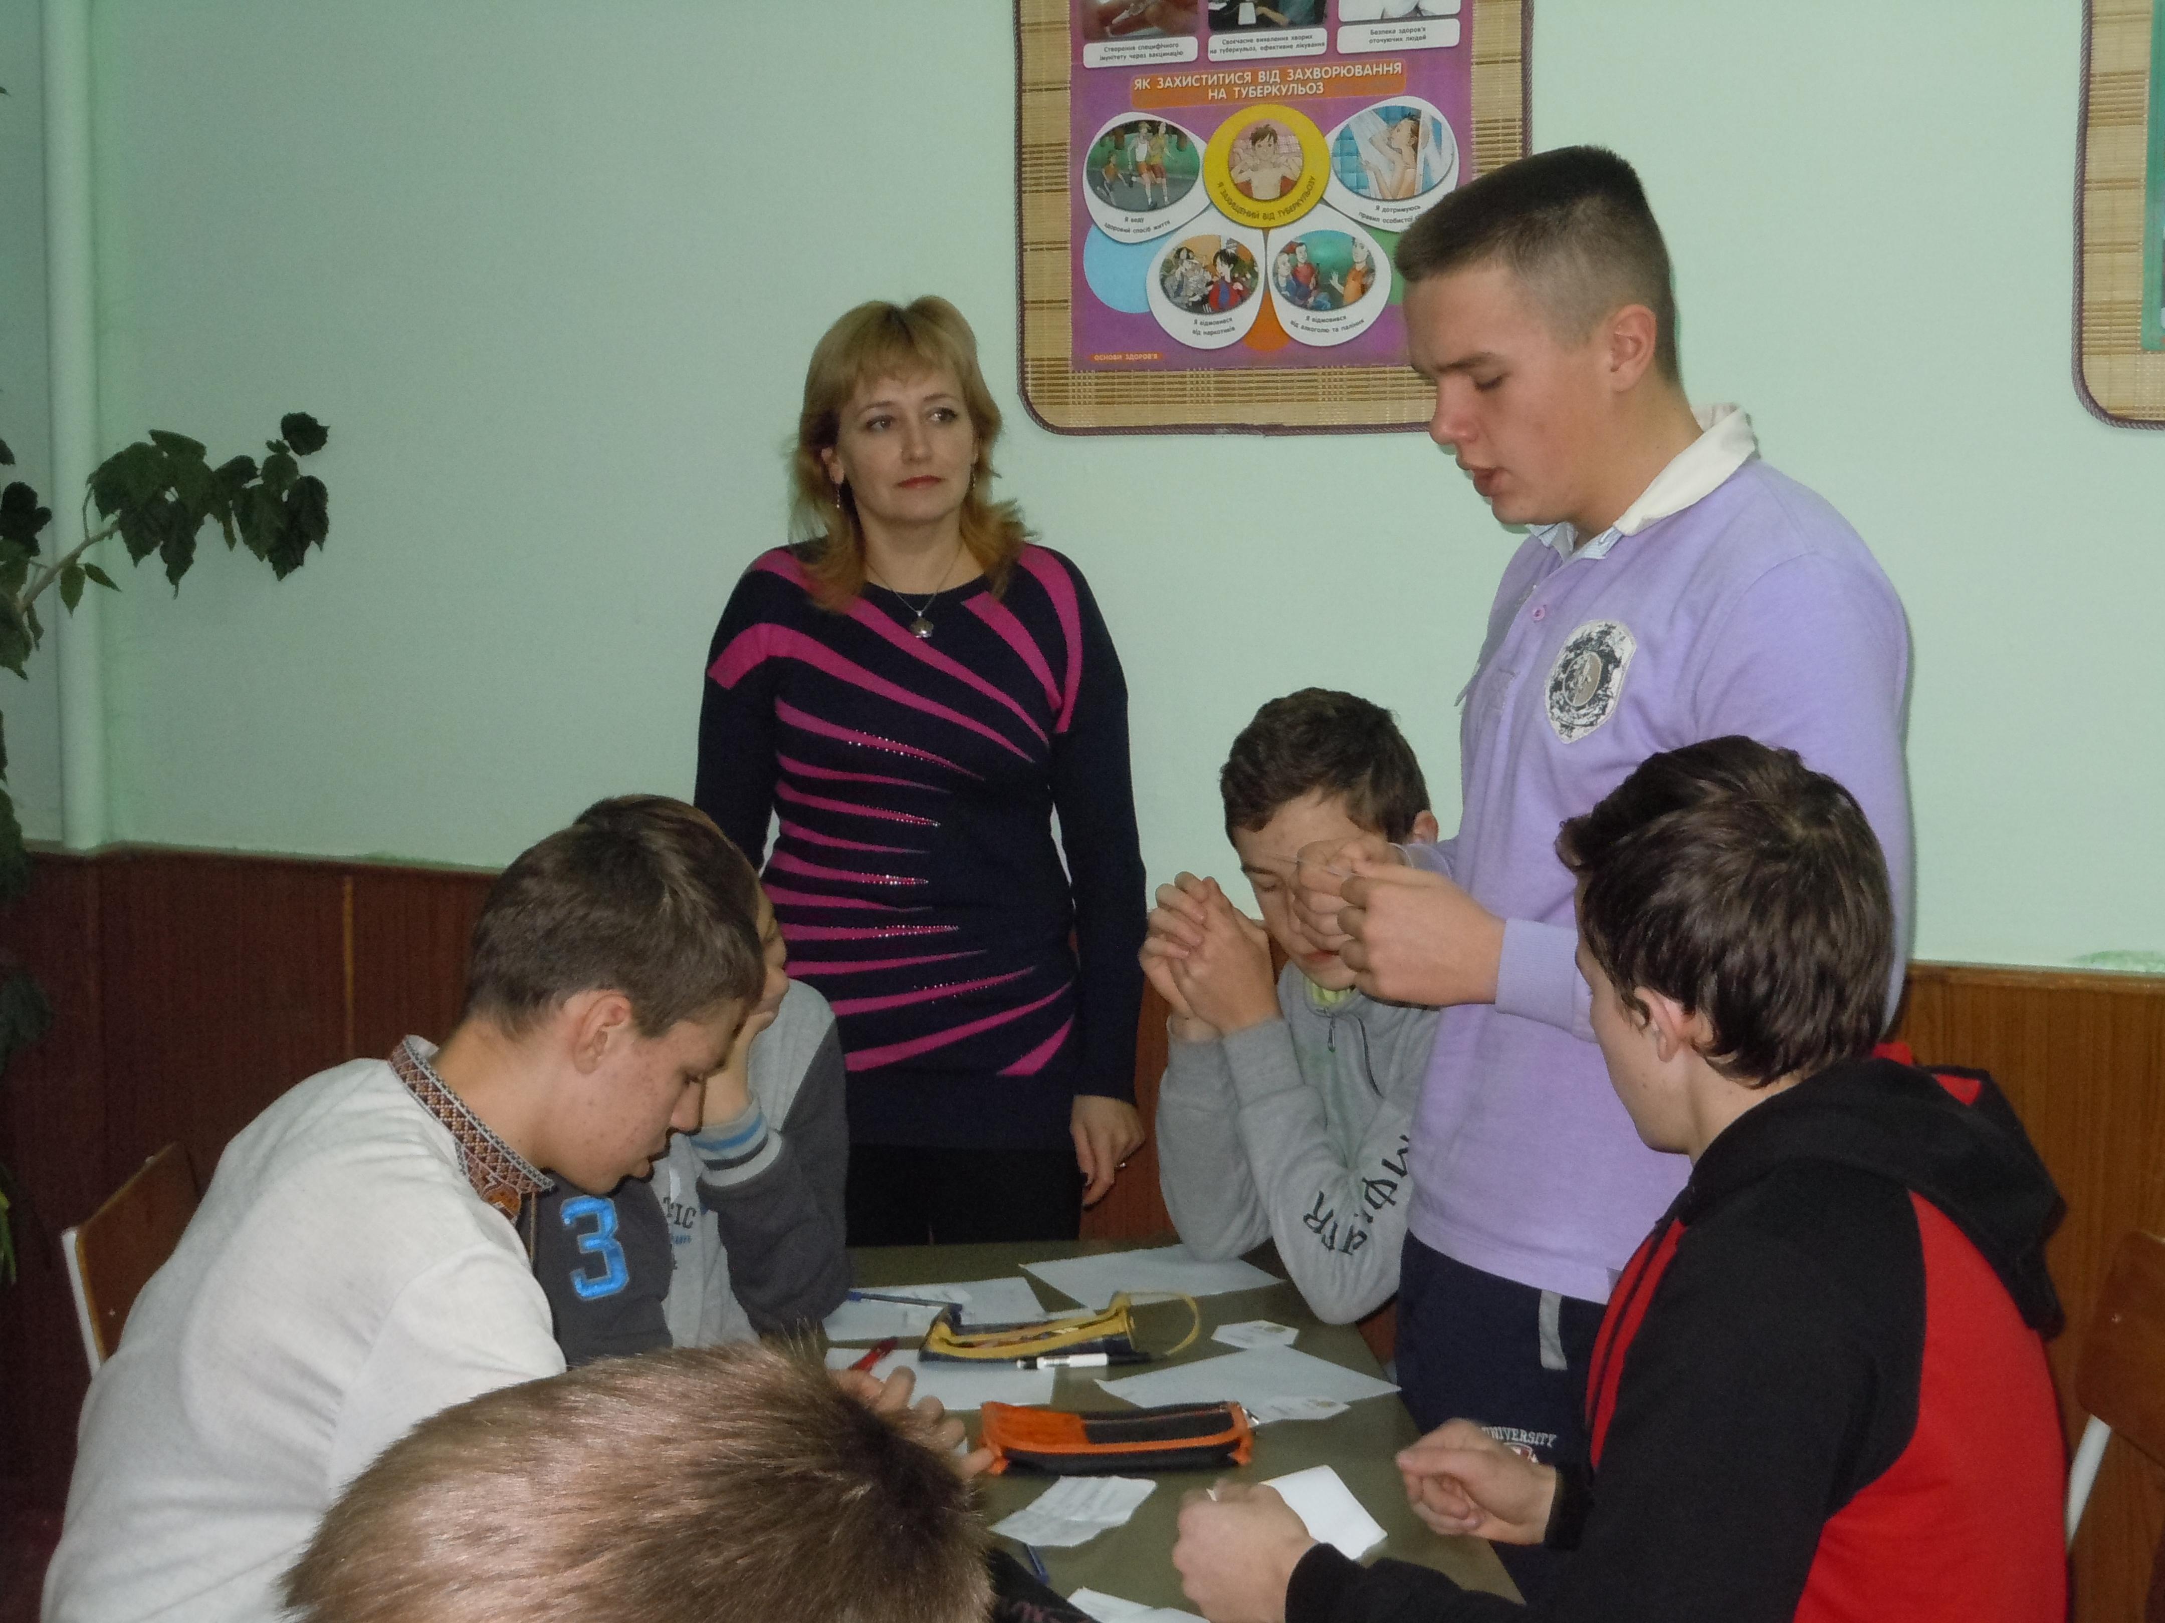
Group processing
Interview
Rotating trios
Fishbowl
Snowball pyramids
Socratic Talk
Debating

Slide 11
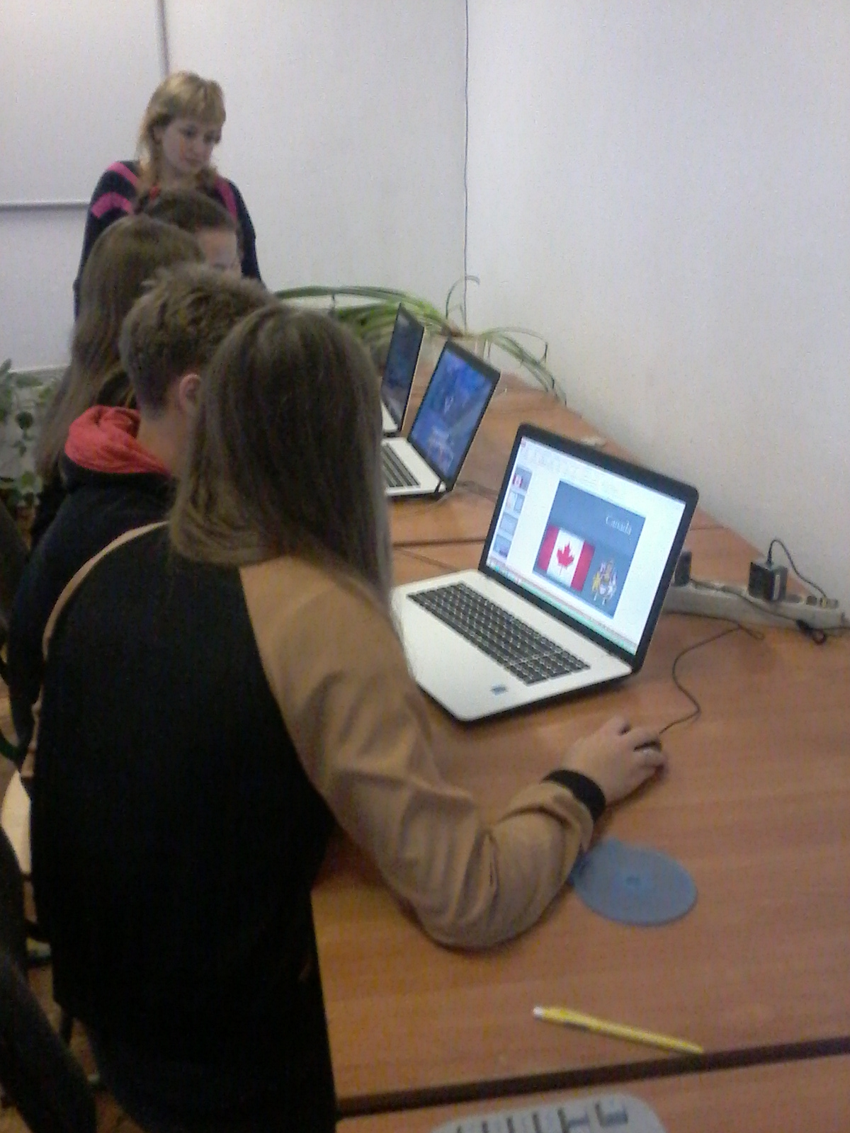
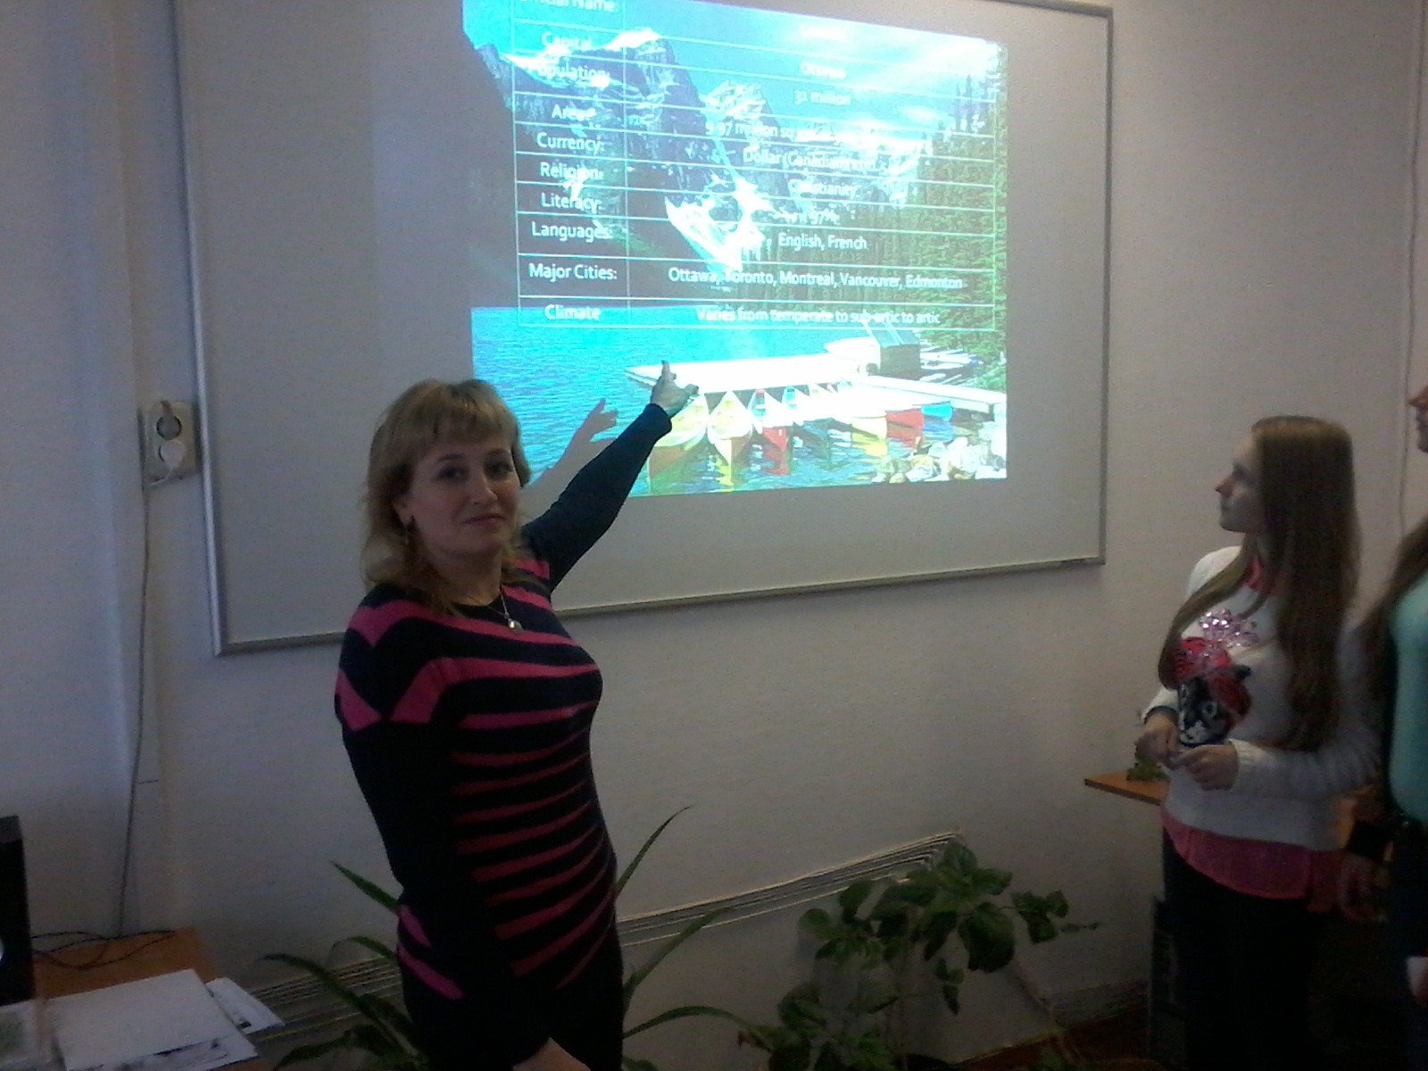
An effective use of ICT and multimedia technologies in competence learning English

Slide 12
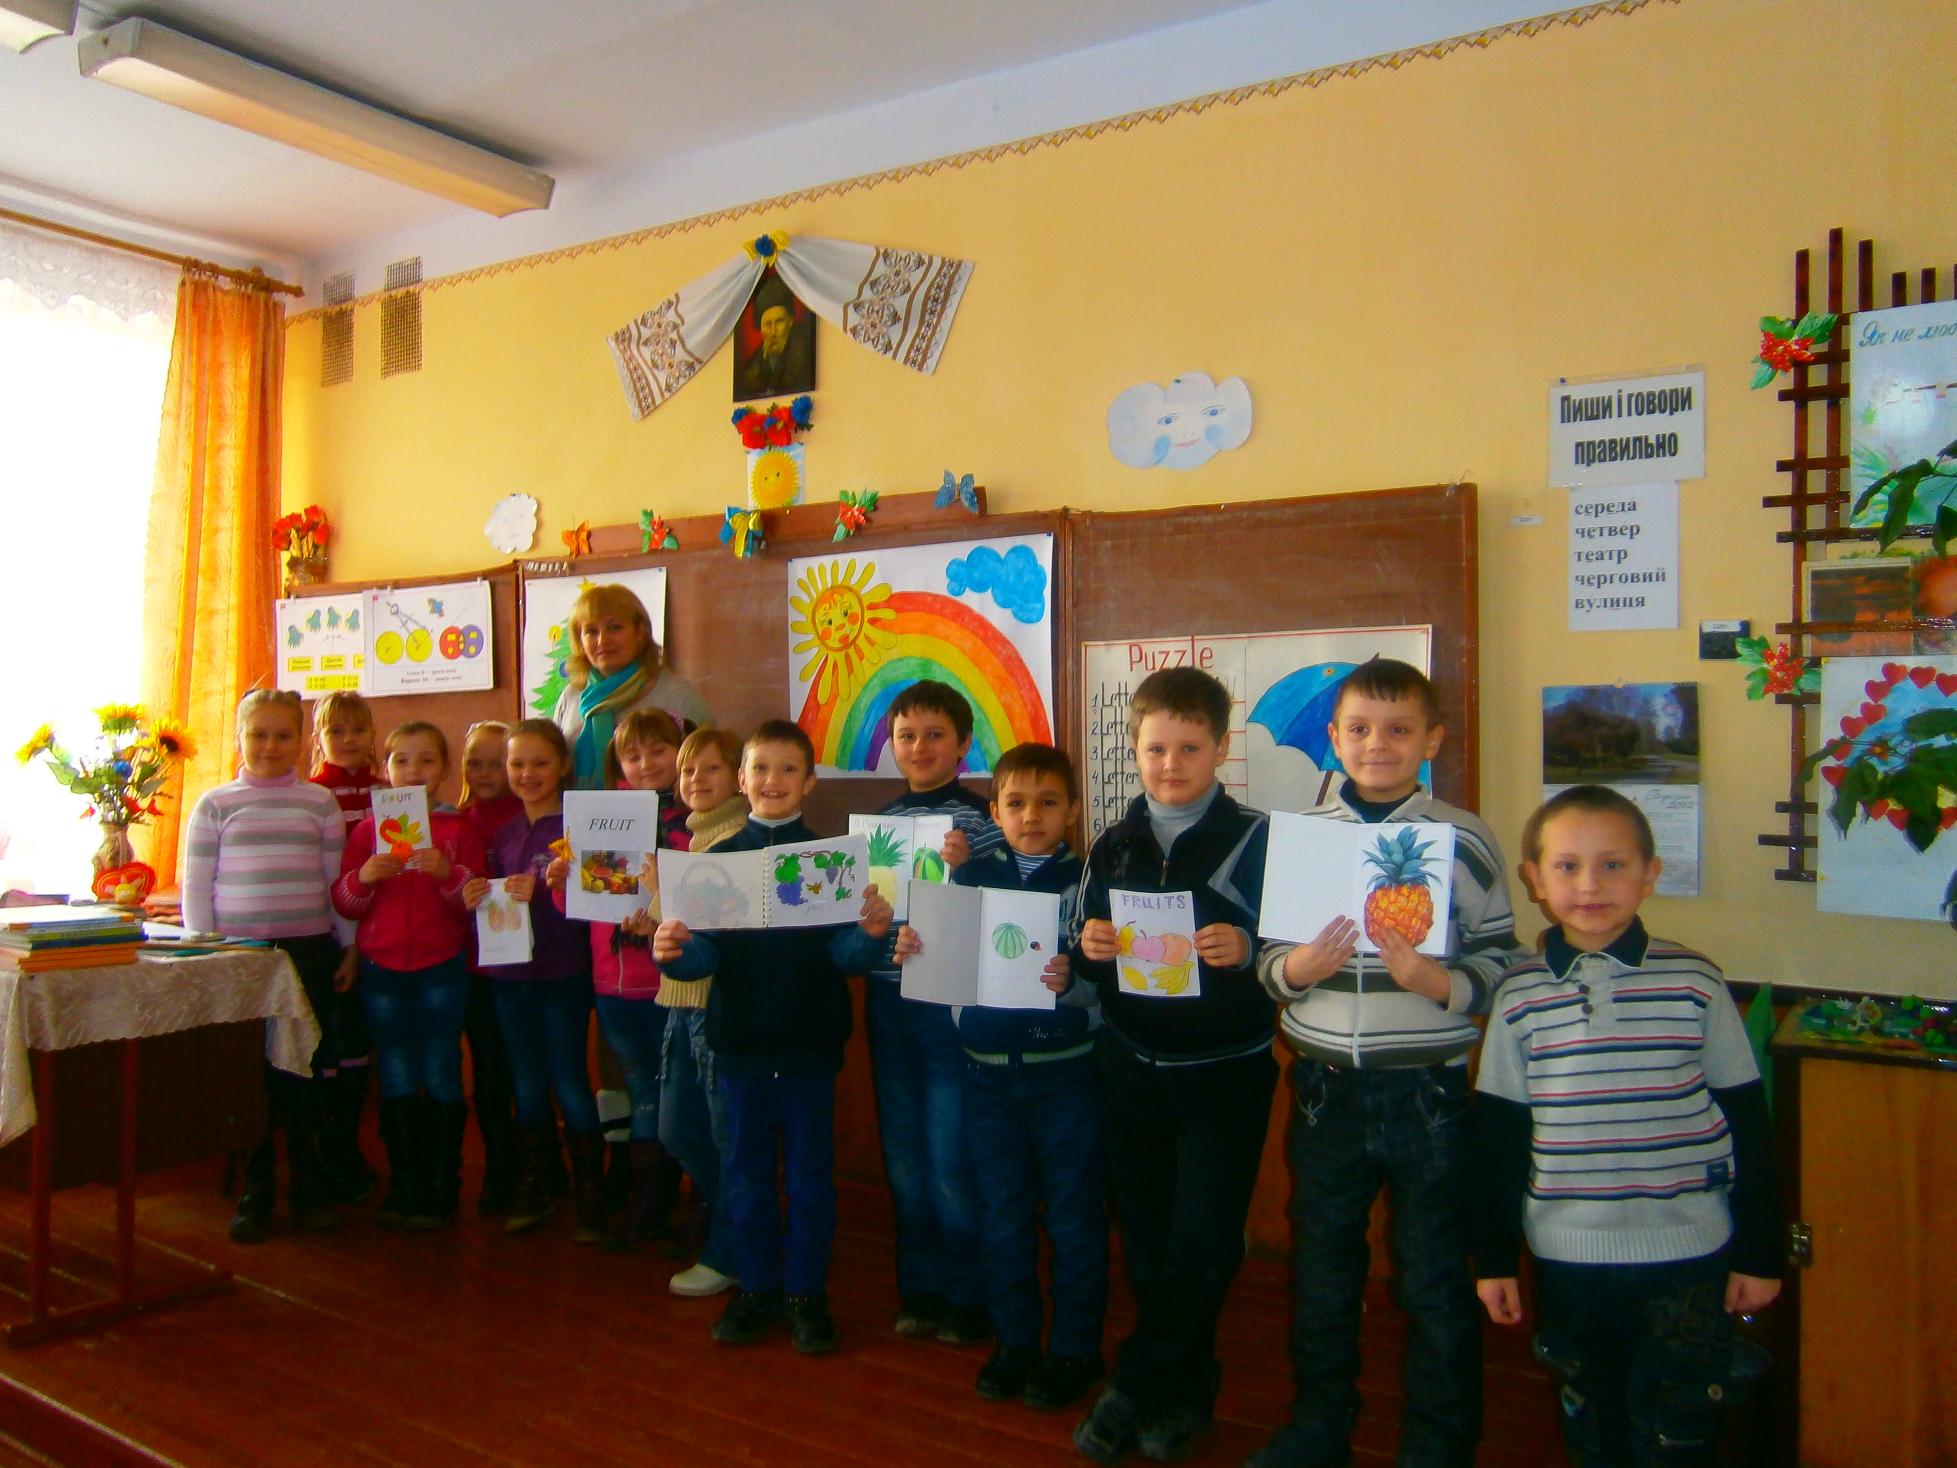
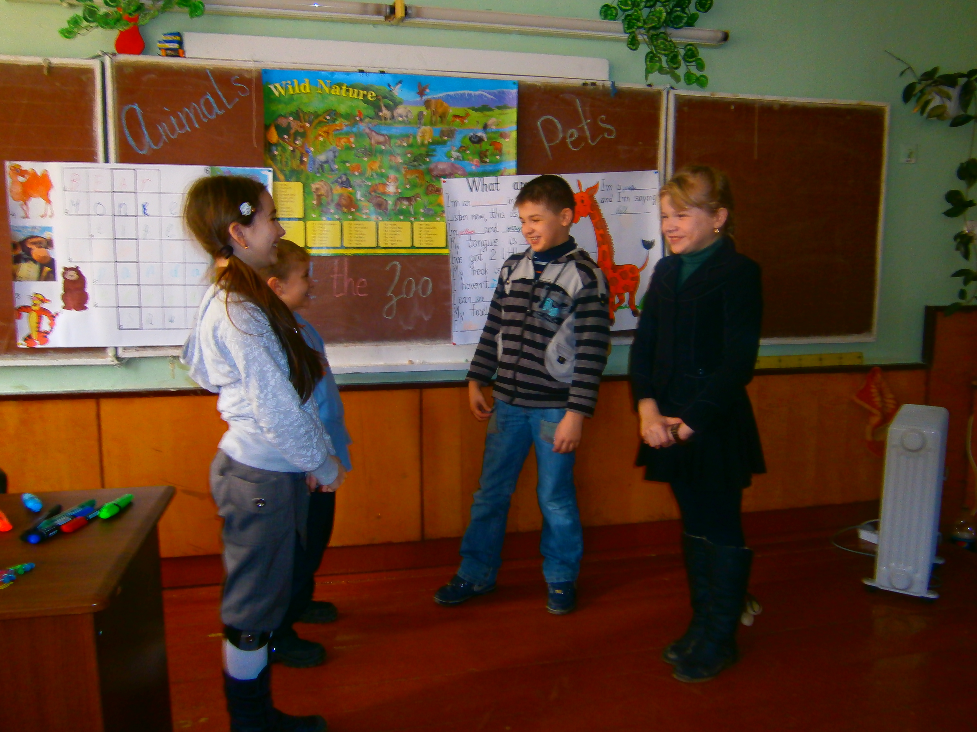
Extra-Curricular Activities
individual
group
creative
performance
team
Teacher is a counselor of children who leads them the way of peace, faith and truth.

