Slide 1
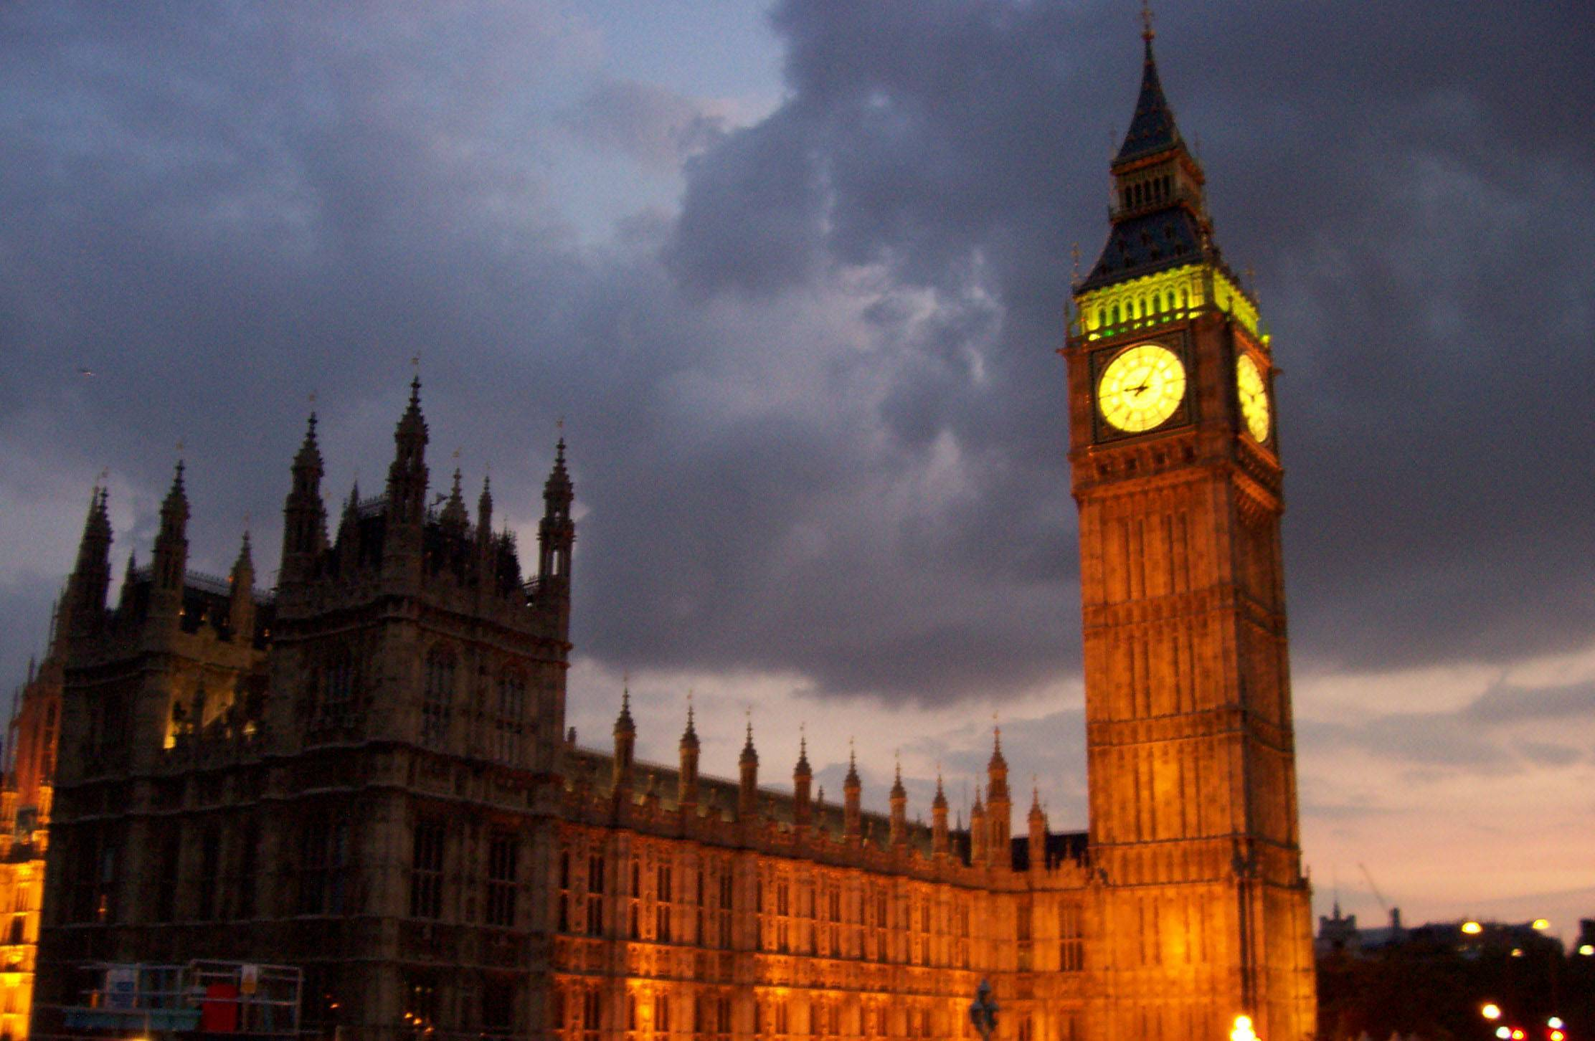
X
London

Slide 2
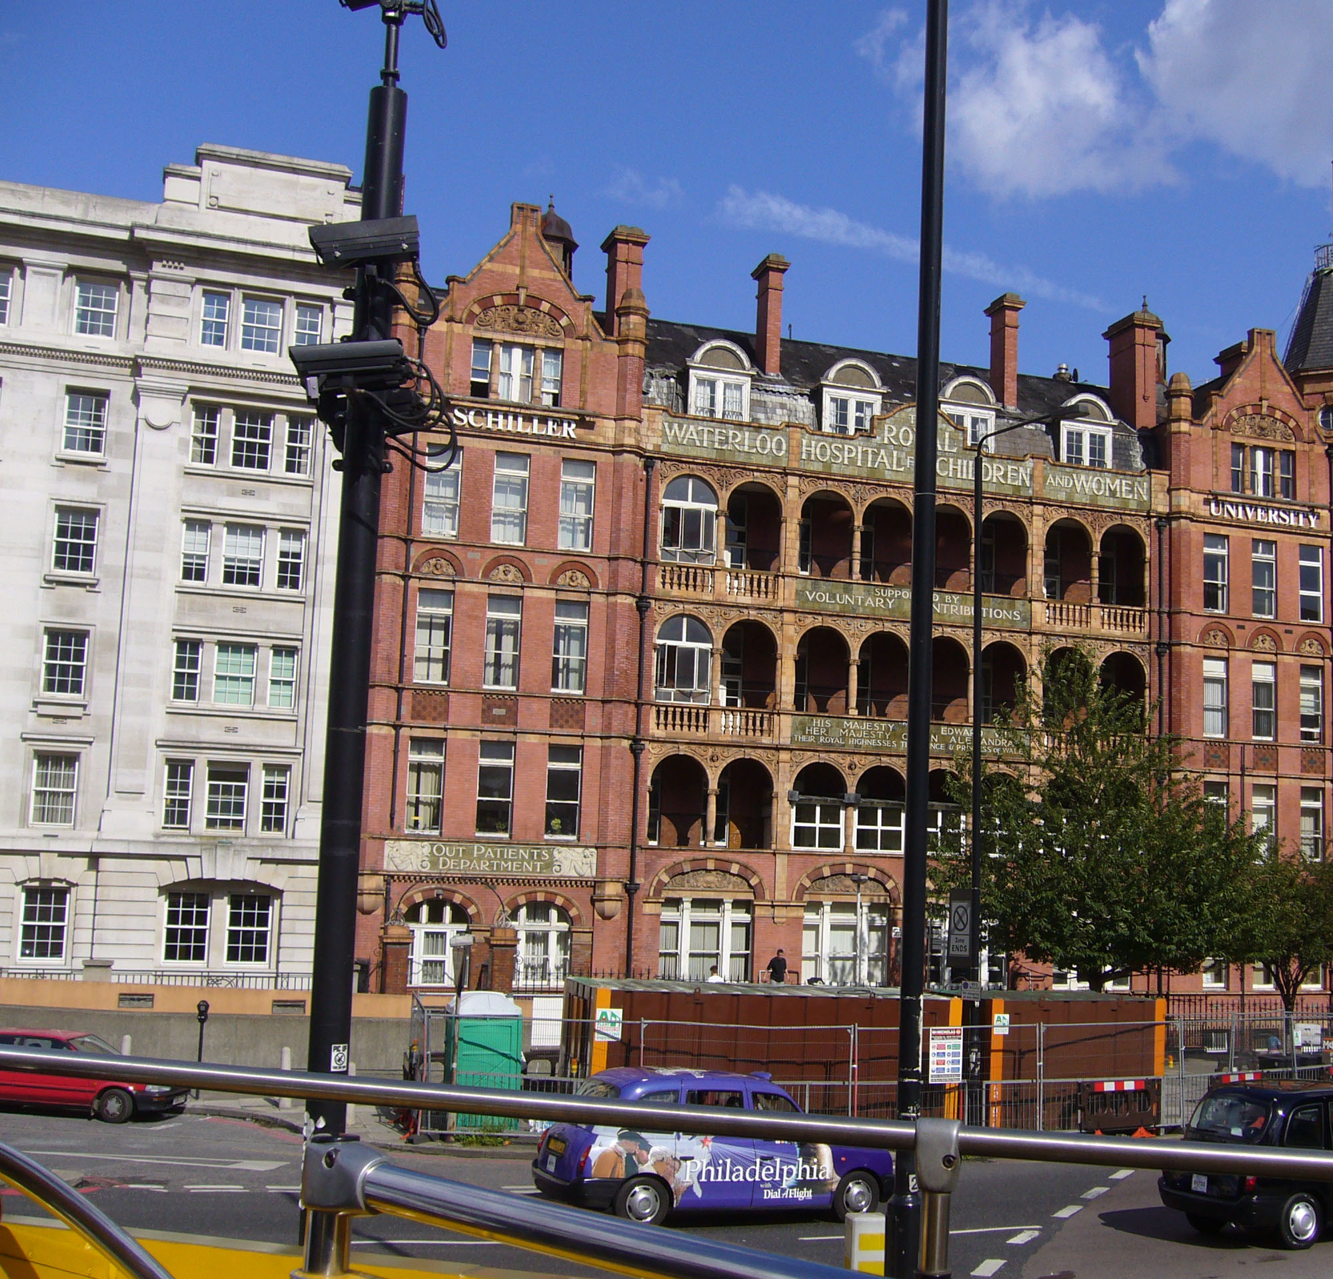
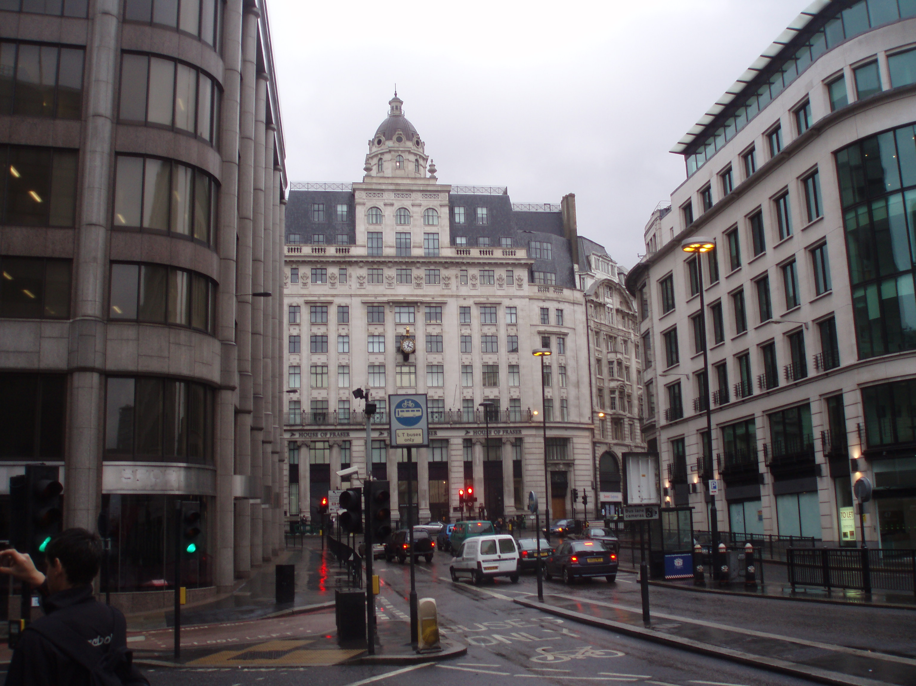
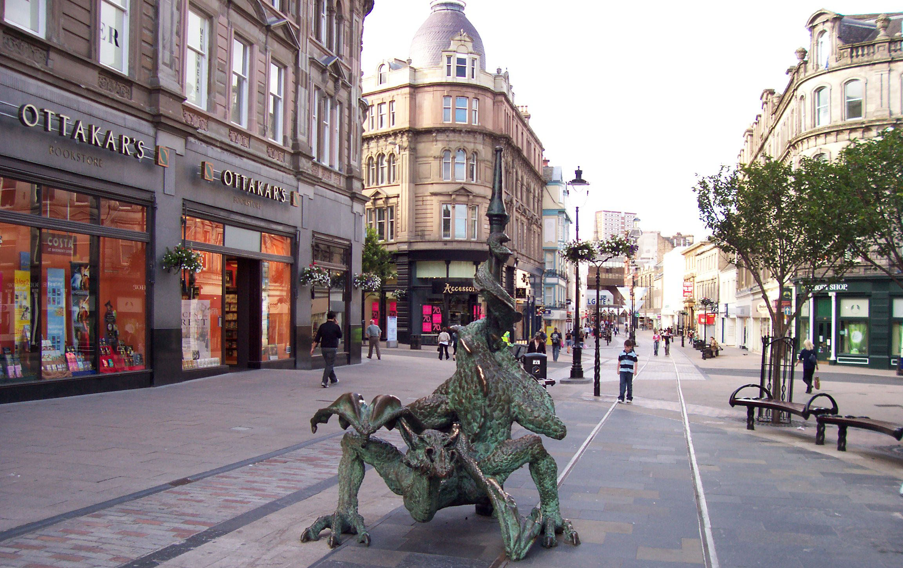
The capital of Great Britain is London which is the largest city of the country and one of the largest cities in the world. It is situated on both banks of the river Thames. Its population is more than 9 million people. London is an old city. Its history counts more than two thousand years. London consists of four main parts: the City, Westminster, the West End, the East End.
X
London

Slide 3
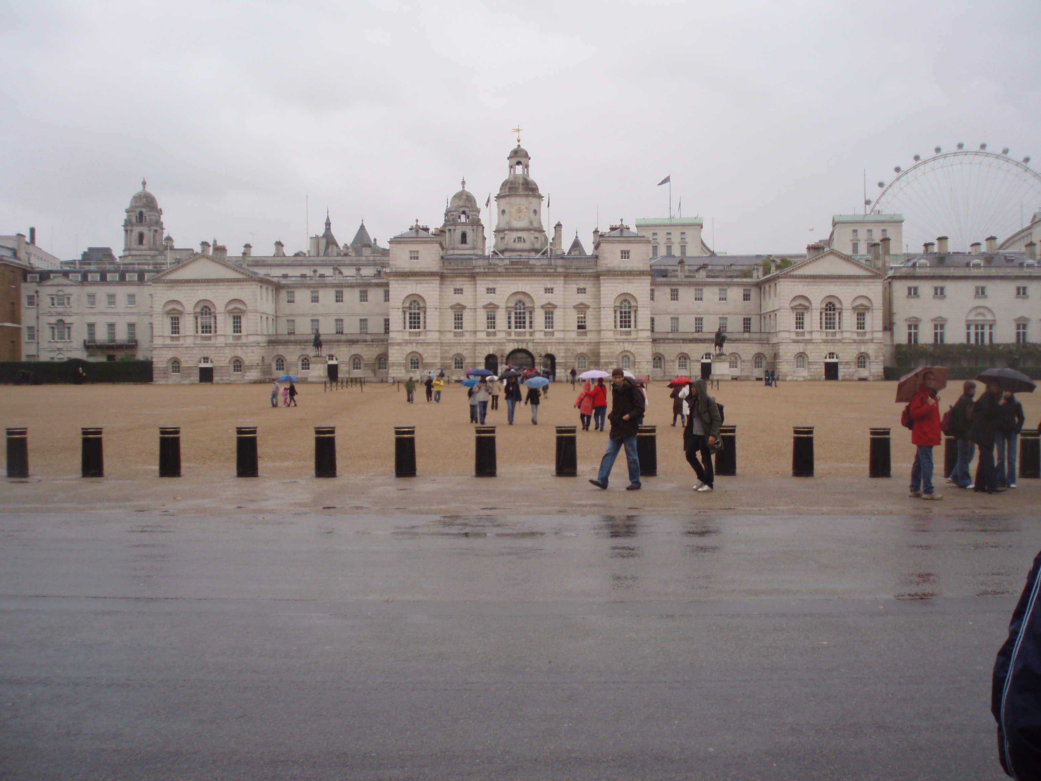
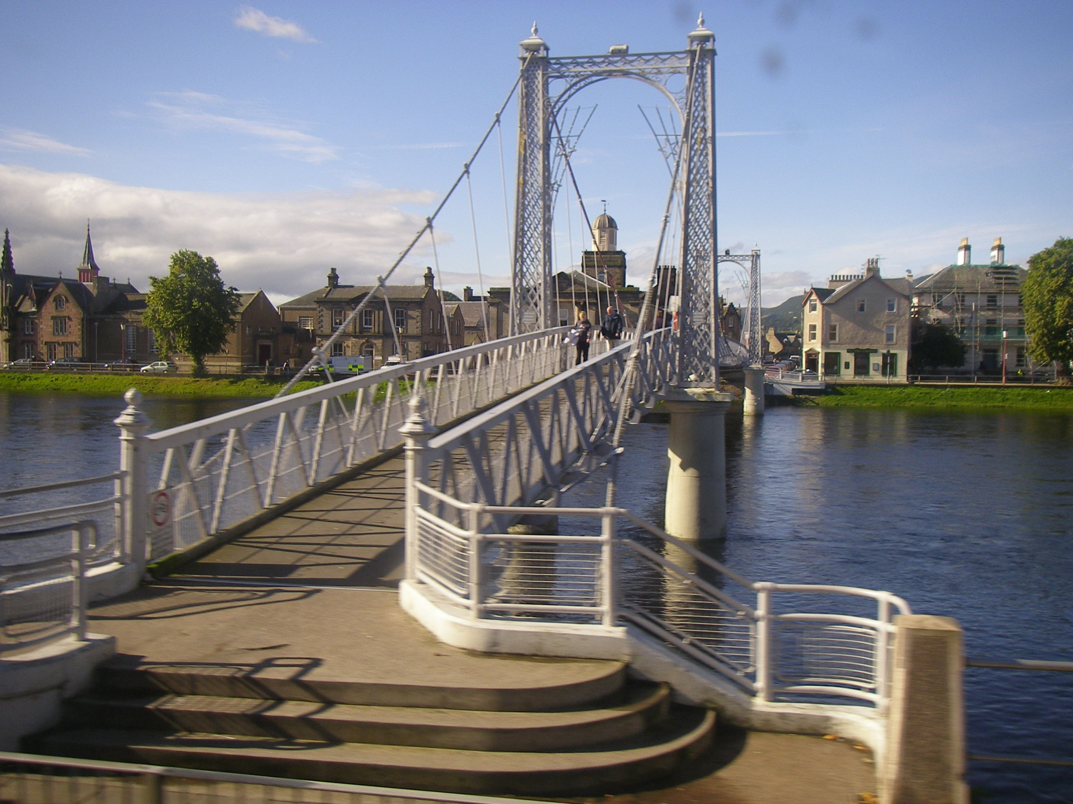
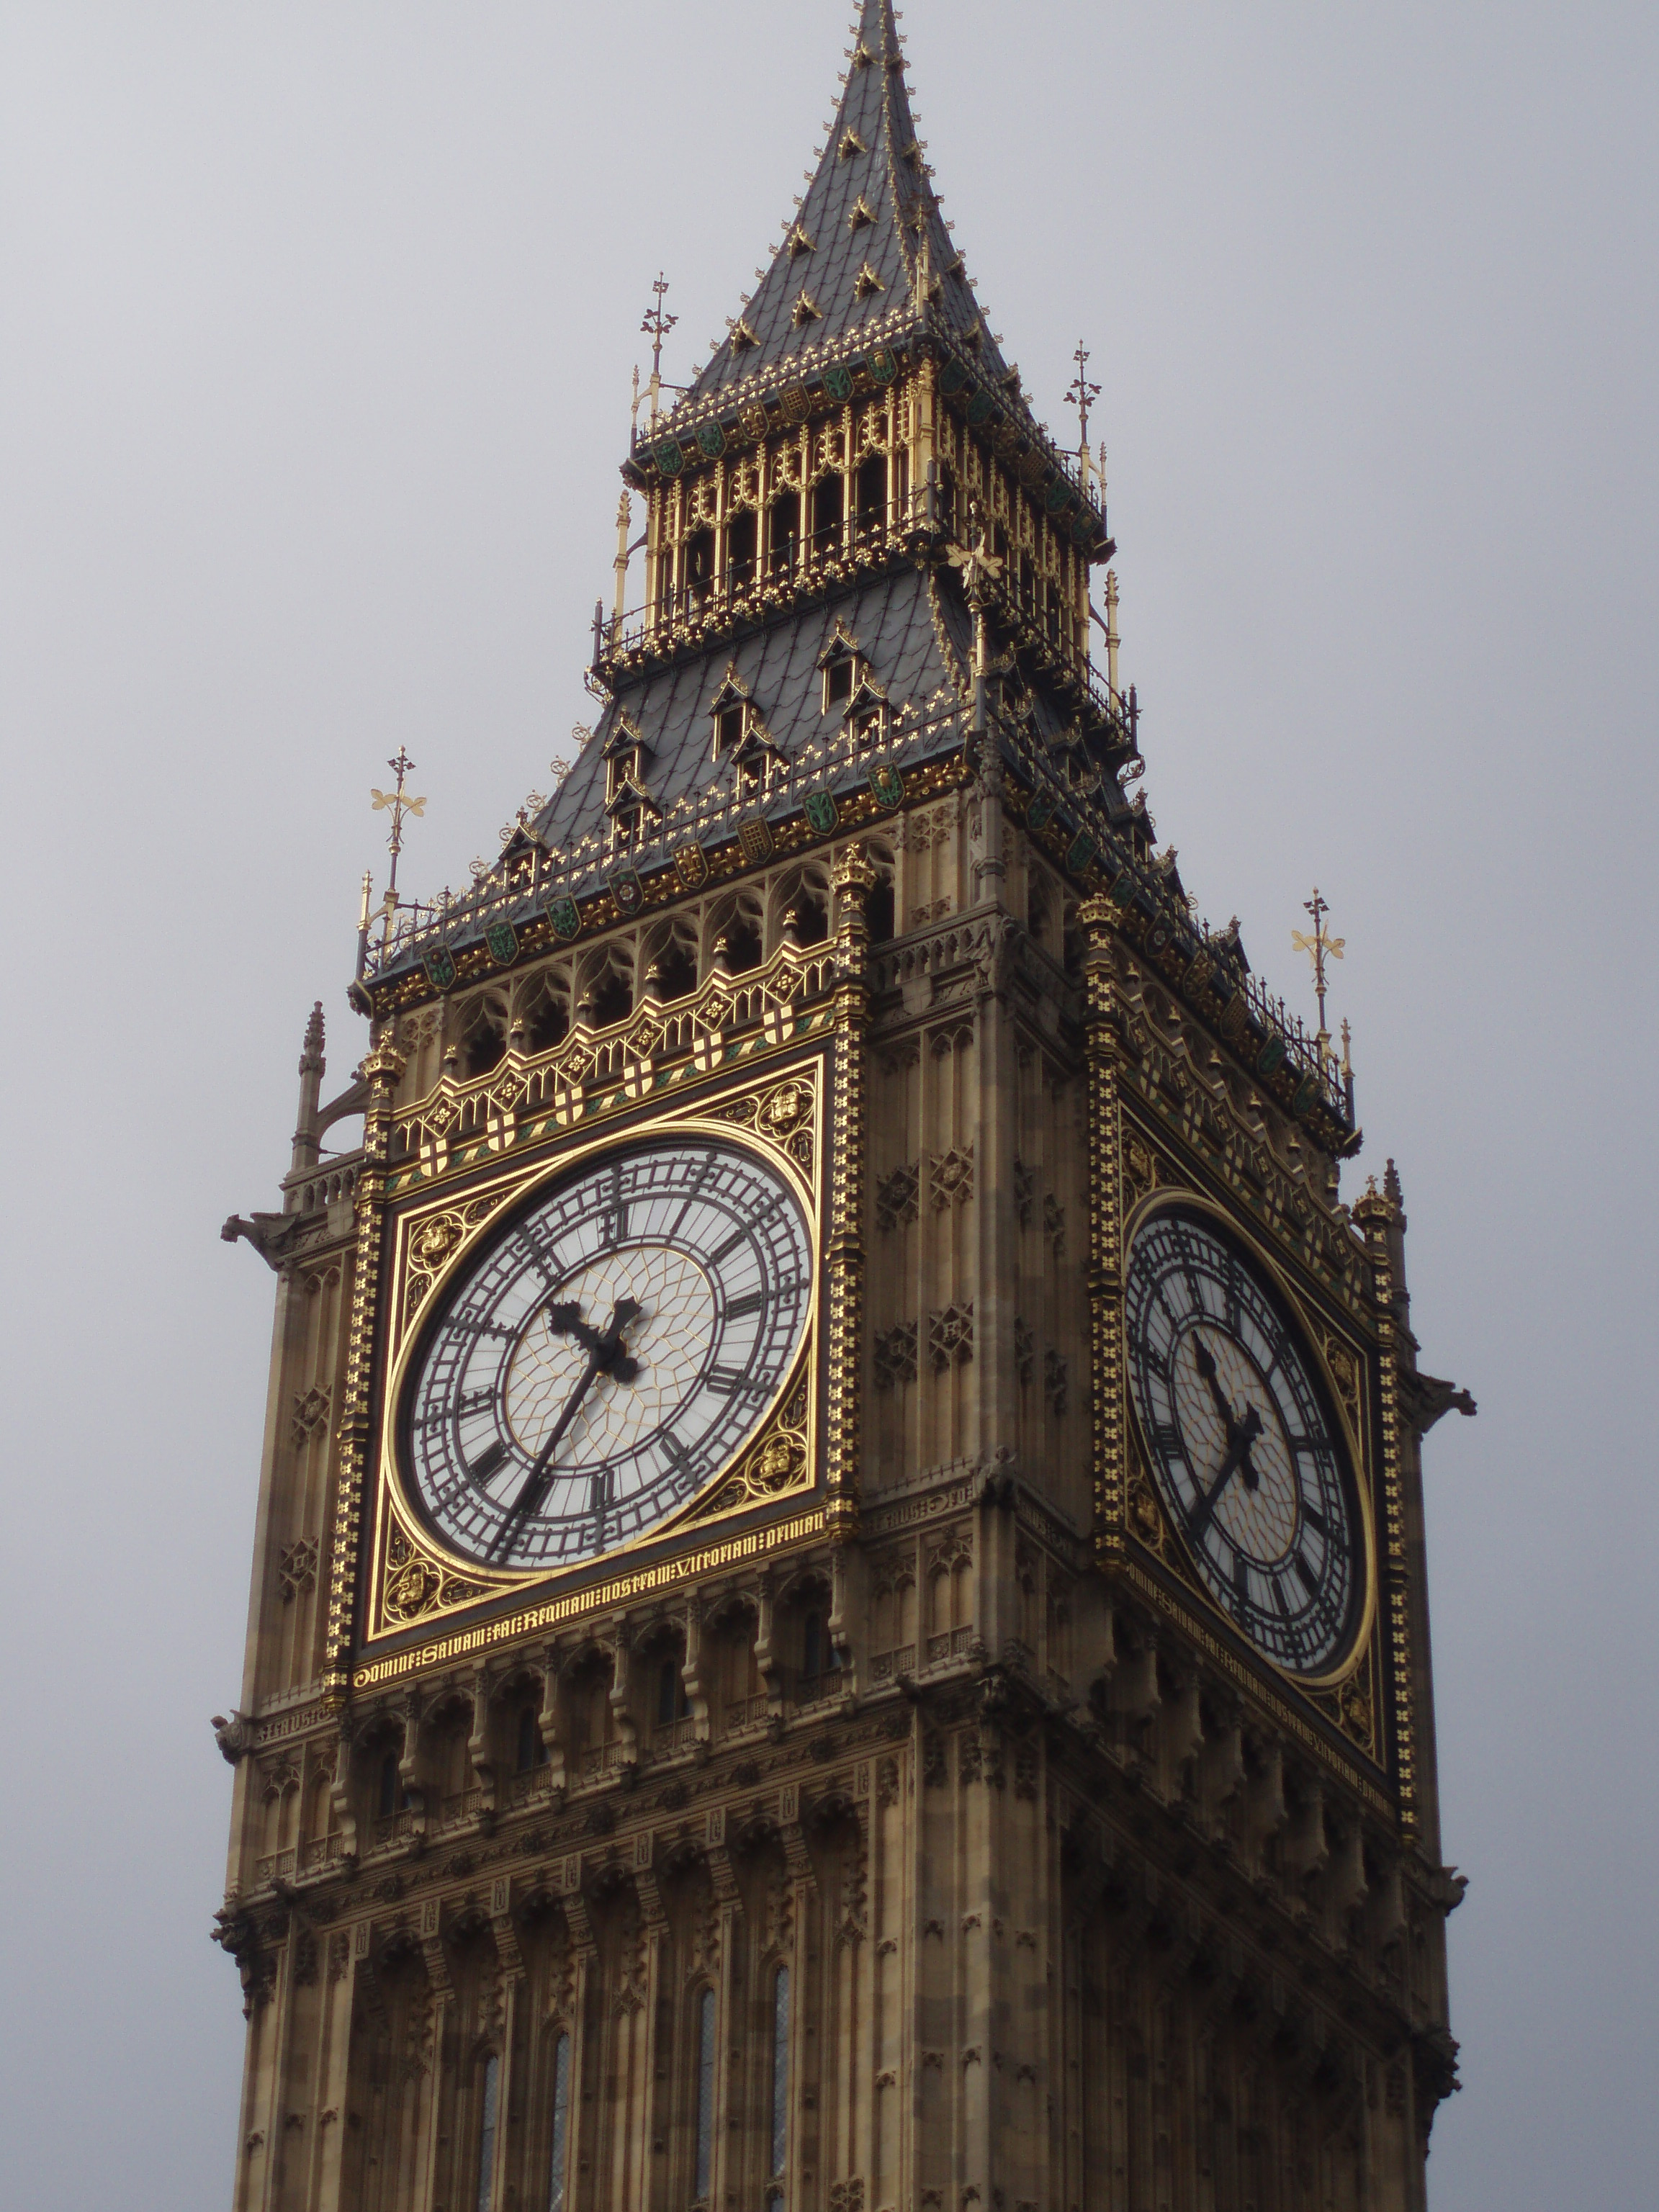
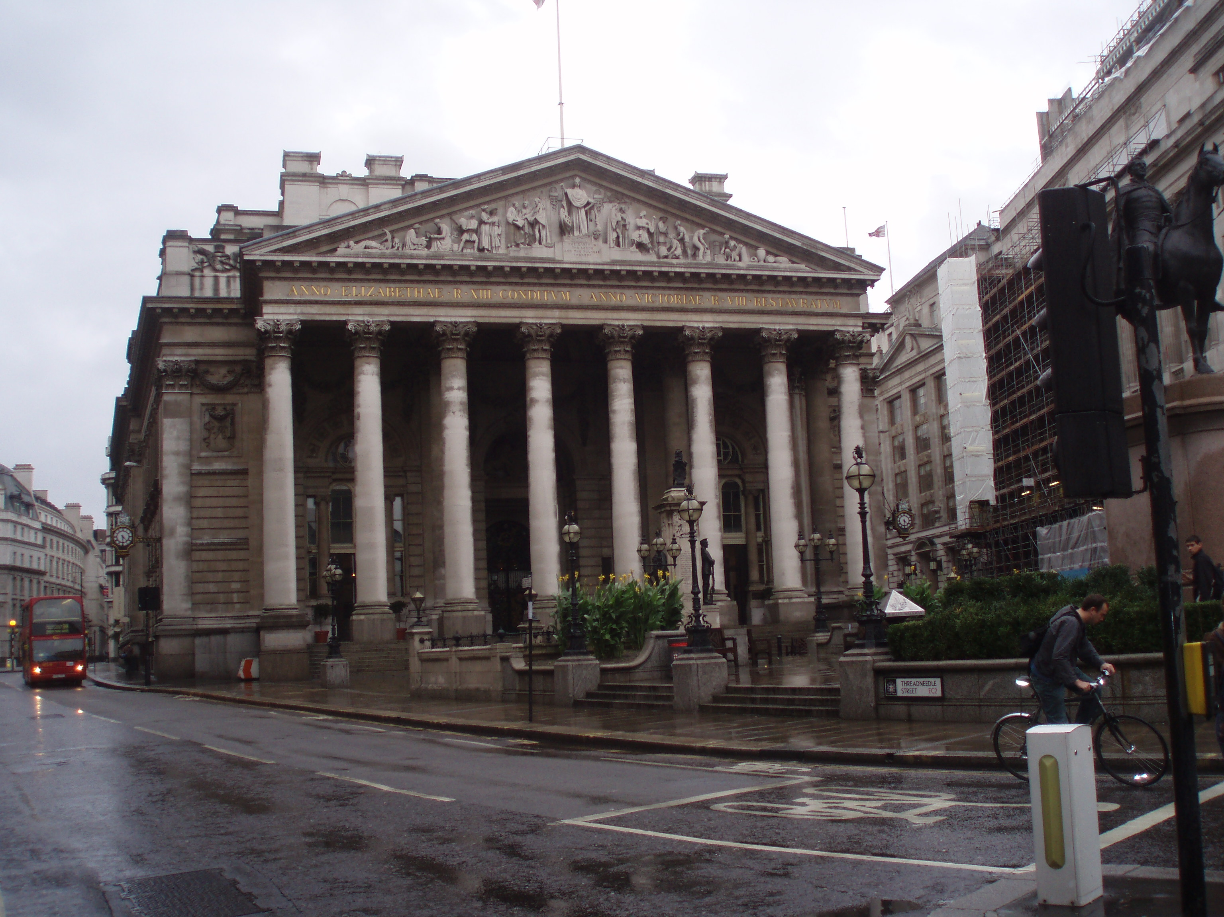
London’s most famous sights are the Tower of London and Tower Bridge, Big Ben and the Houses of Parliament, Trafalgar Square and St. Paul’s Cathedral, Buckingham Palace and Westminster Abbey.
The sights of London.
X

Slide 4
Trafalgar Square
X
is the main square of central London, where a number of famous buildings and monuments, including the National Gallery and Nelson’s Column are situated. Admiral Nelson is the national hero of the UK who defeated the French at the Battle of Trafalgar in 1805.

Slide 5
The National Gallery
X
Has got the best collection of paintings in Britain. It is rich in paintings by Italian masters such as Raphael, and it contains pictures of all European schools of art such as works by Rembrandt, Rubens, Van Dyck, Murillio, El Greco, and nineteenth century French masters. Admission to the Gallery is free.

Slide 6
Buckingham Palace is the official London residence of the Queen. It was built in the 18th century. When the flag is flying on the top the queen is at home. The ceremony of changing of the guard takes place here daily at 11.30 a.m.
X

Slide 7
The Houses of Parliament
X
is the seat of British government. It stands on the left bank of the river Thames and is about 1,000 feet in length.

Slide 8
Big Ben is the name of the huge clock on the clock tower of the Houses of Parliament. It is the biggest clock bell in Britain.
X

Slide 9
Westminster Abbey is a royal church. It is very old and beautiful. Here you can see the tombs of many British kings and queens and famous people (Newton, Darwin, Chaucer, Dickens).
X

Slide 10
The Tower of London
X
It used to be a fortress, then a royal residence, then a prison. Today it is a museum known for all sorts of unique collections. The guard of the Tower wears costumes of the Middle Ages.

Slide 11
The Tower Bridge
X
is probably the most beautiful and famous bridge among many others which cross the river Thames.

Slide 12
St. Paul’s Cathedral
X
is an outstanding masterpiece of a famous architect sir Christopher Wren. The architect is buried inside of it. These words are written on his grave: ”If you want to see his monument, look around”.

Slide 13
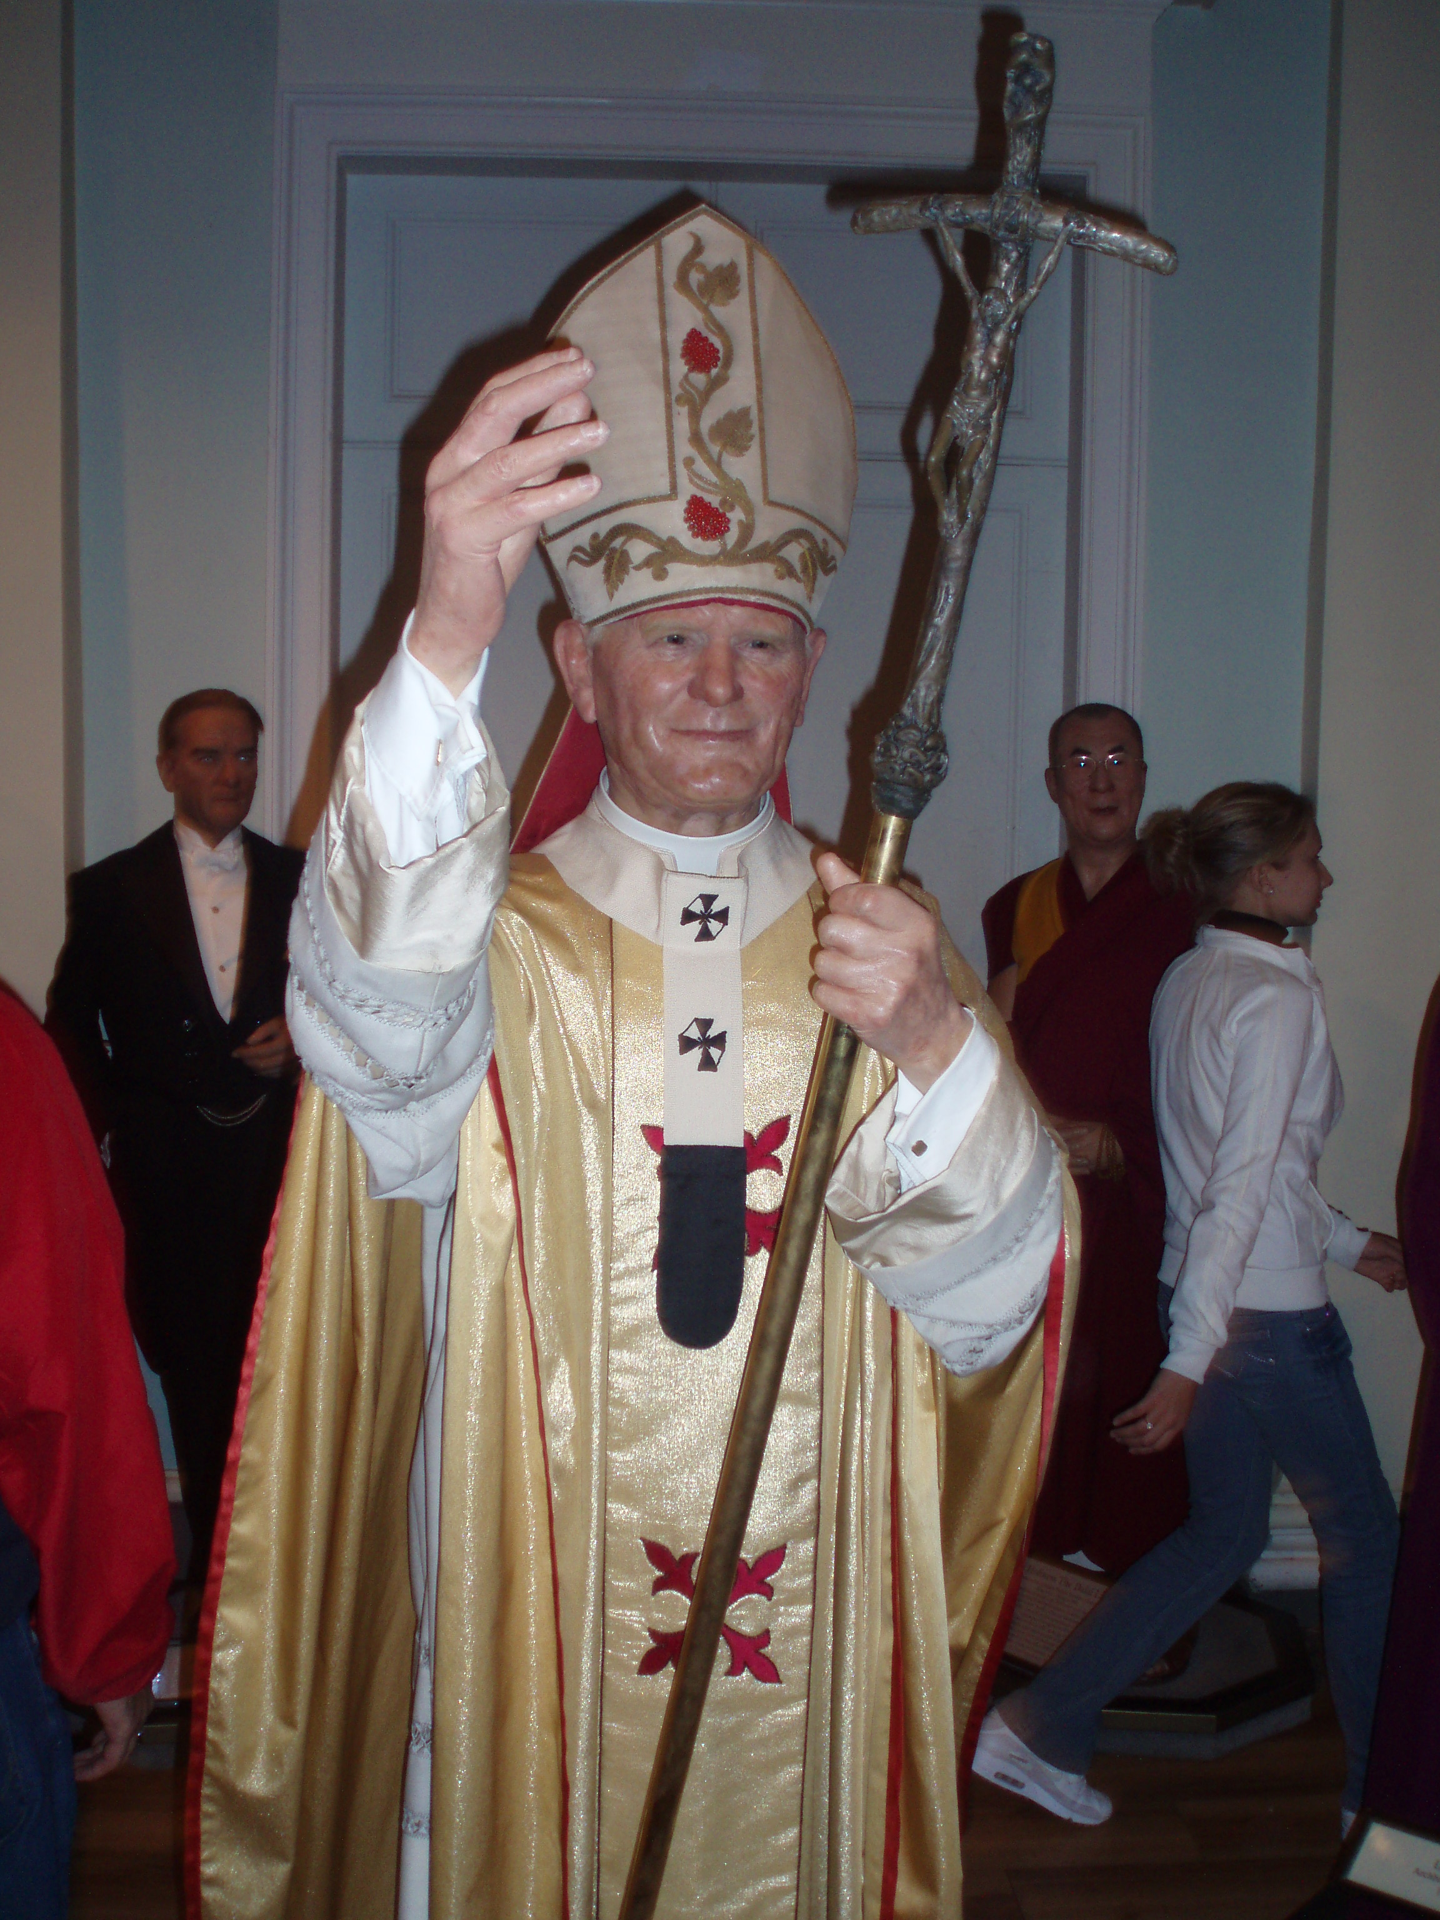
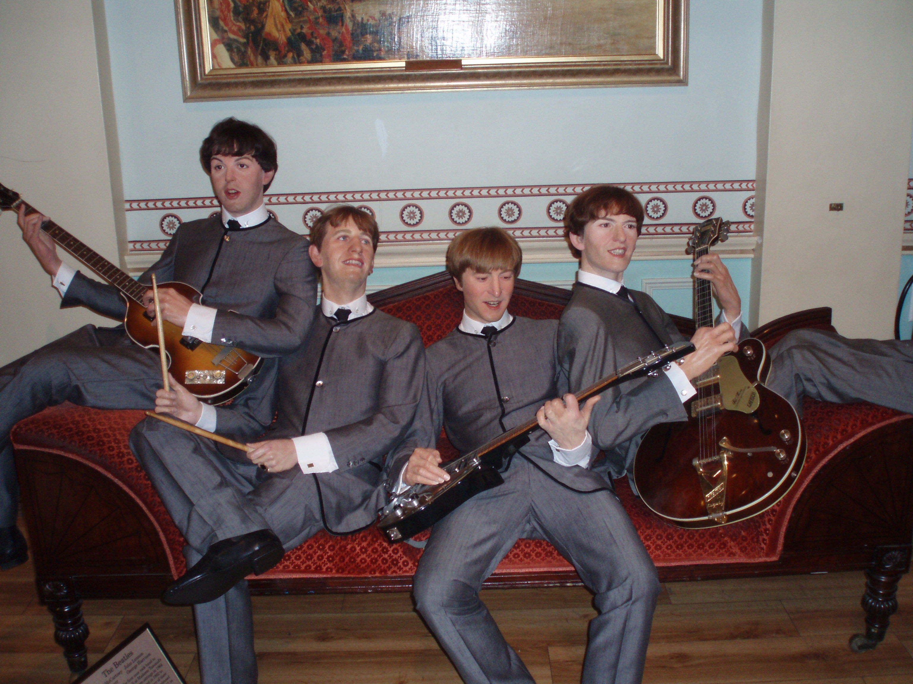
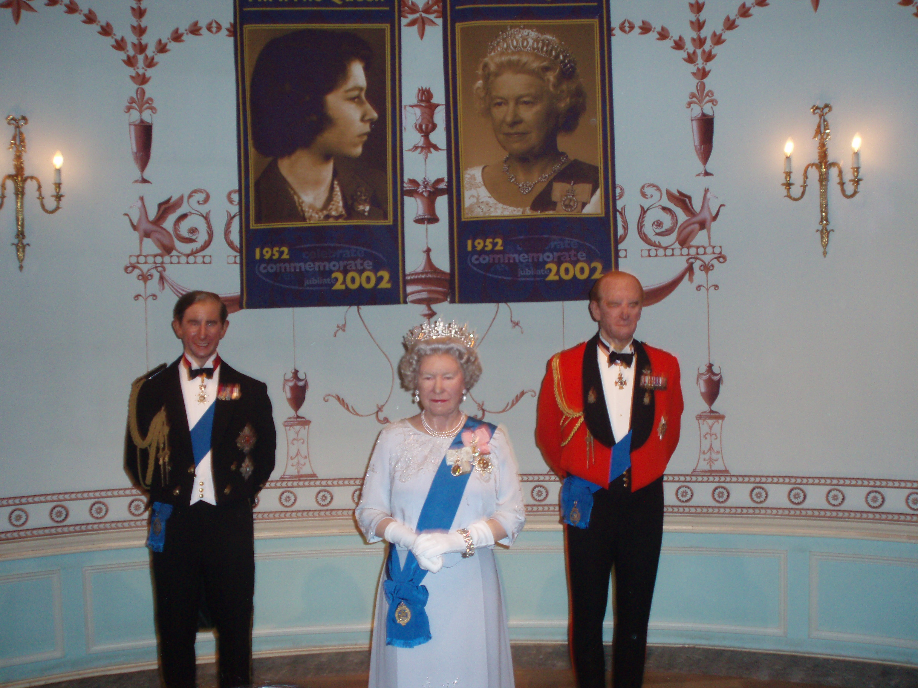
Madame Tussaud’s is the best-known and most visited waxwork exhibition in the world.
X

Slide 14
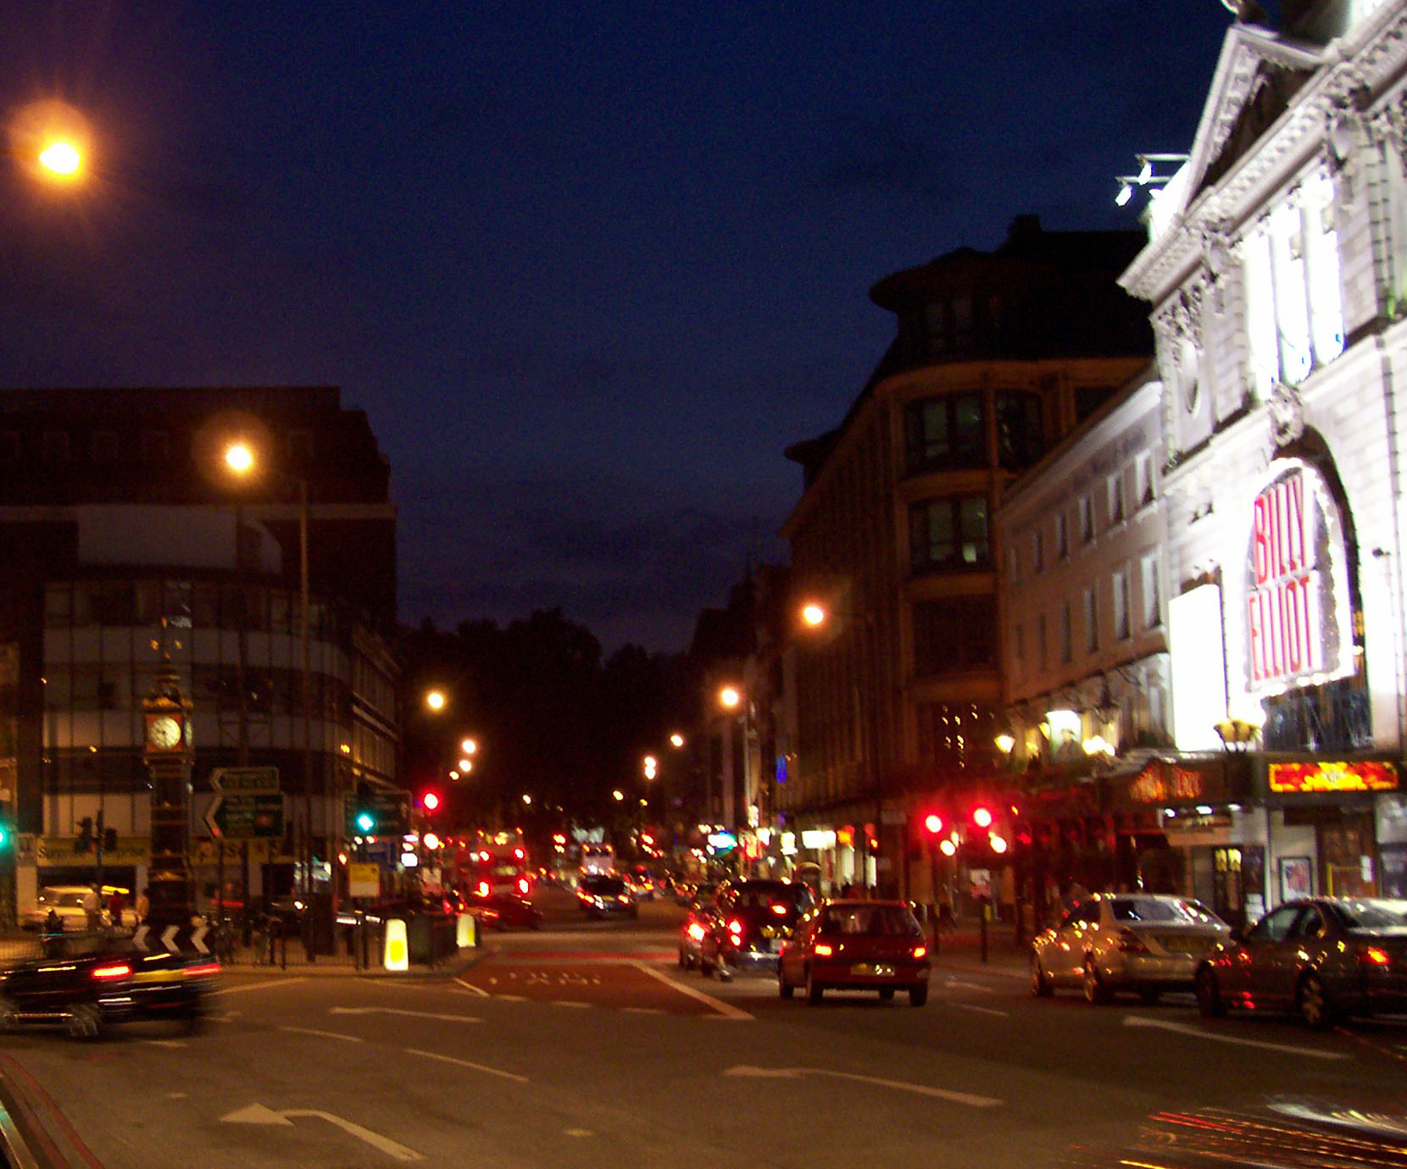
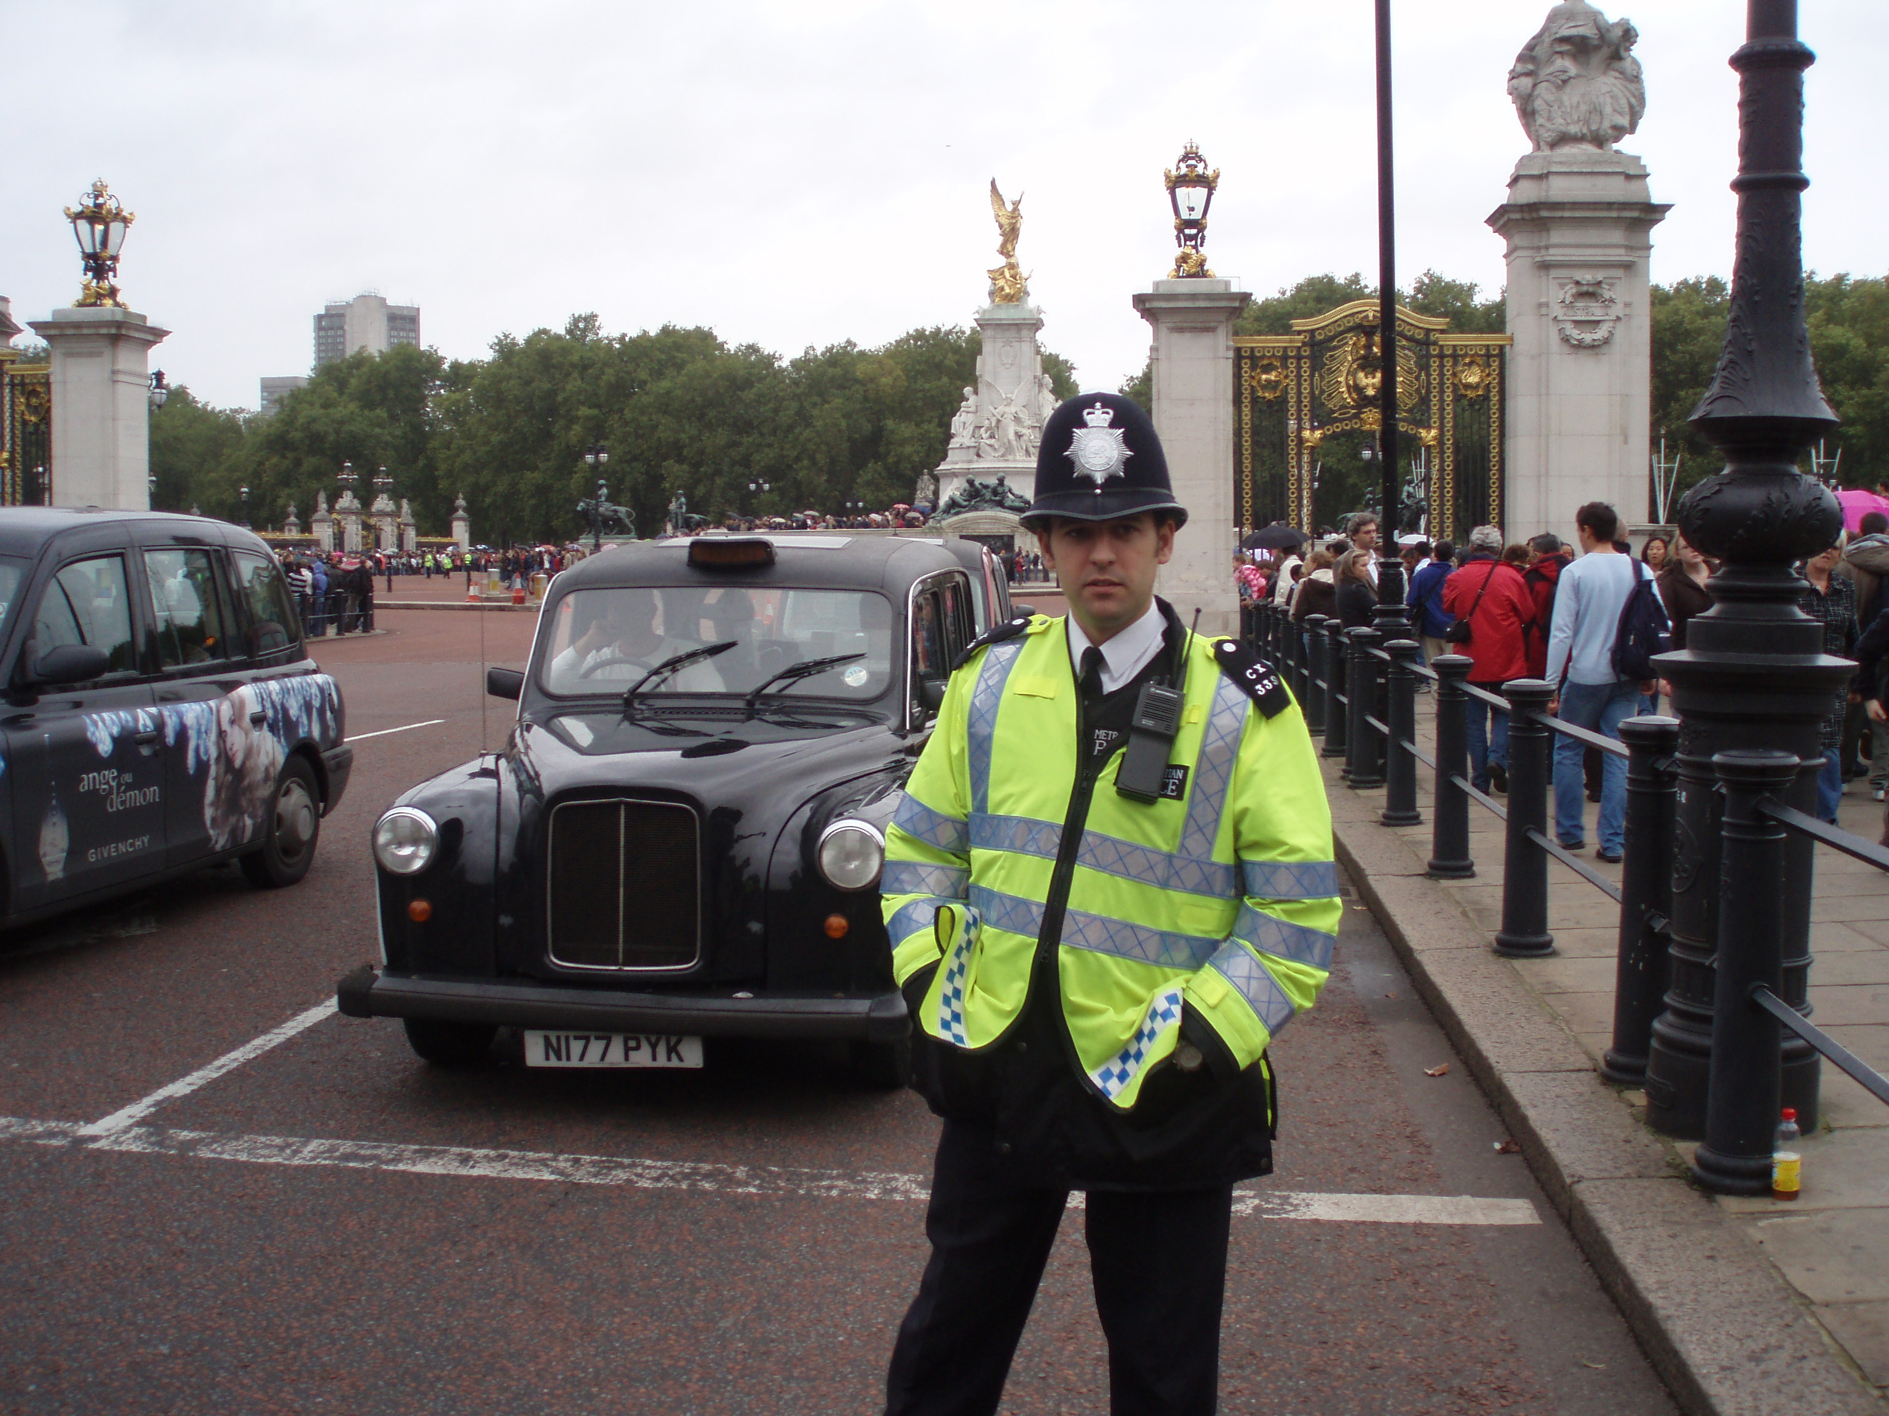
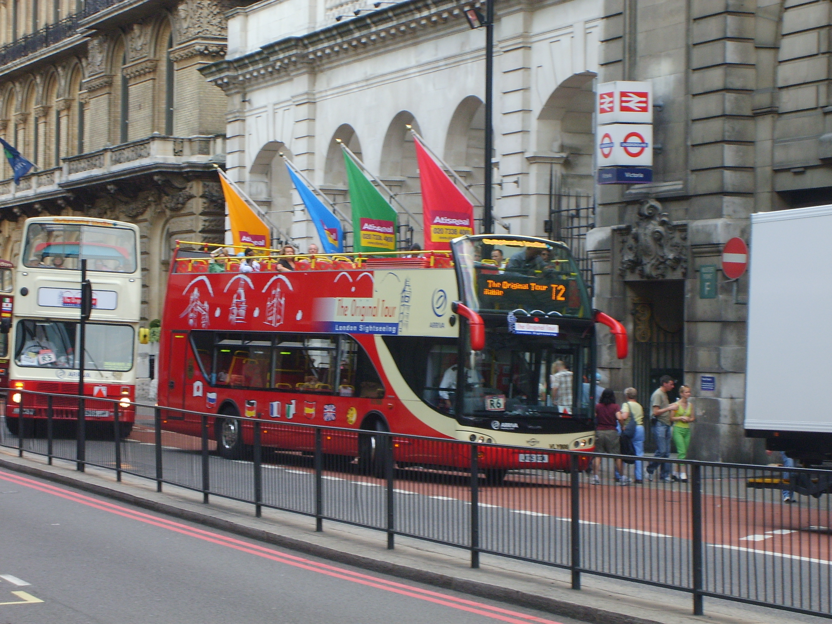
There are many cars and buses in London. They go on the left side of the road, and not on the right. London taxis are called “black cabs” (most of them are black). You can see red double-deckers in the streets too. There is the Tube (an underground) in London too. It is the oldest and one of the largest in the world.
Means of transport
X

