Slide 1
Name: Oksana
Surname: Babin
Place of job: School-Gymnasia
Profession: Teacher of English
Credo: “A teacher affects eternity; She can never tell where her influence stops”
Henry Brooks Adams
Theme of my research:
“Ways of enriching and extending vocabulary in the
process of
teaching English”

Slide 2
Why is this theme relevant?
If you spend most of your time studying grammar, your English will not improve very much. You will see most improvements if you learn more words and expressions. You can say very little with grammar, but you can say almost everything with words.
Without grammar very little can be conveyed, without vocabulary nothing can be conveyed.
A further major difference between first and second language vocabulary learning is in the potential size of the lexicon in each case.
An educated native speaker will probably have a vocabulary of around 20000 words.
Most adult second language learner will be lucky to have acquired 5000 words families even after several years of study.
Minimum level of second language learner is 2000 words.
Most researchers nowadays recommend a basic vocabulary of at least 3000 word families.

Slide 3
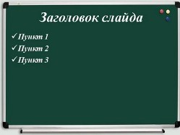
To effectively acquire
new vocabulary,
students must go
through four
essential stages:

Slide 4
Stage 1: Noticing and understanding new words
Introducing nouns, things, objects, animals, etc
Introducing adjectives.
Introducing abstracts.

Slide 5
Stage 2: Recognizing new words
Bingo (Make bingo cards with illustrations, and call out each word)
Matching (Students may be required to match opposites, synonyms, or a word with its definition, as well as a picture to a word)
Fill in the blanks (with options) (Hand out a piece of written text with blank spaces that must be filled in from a list of words)

Slide 6
Stage 3: Producing vocabulary
Descriptions (Students may describe a picture from the newspaper putting new vocabulary to good use)
Filling in the blanks
Mind maps or brainstorming (Tell students they need to think of words they can use to describe smth , for example, the weather. Write “weather” in the center of a board or whiteboard and circle it)
Guess what I’m thinking (Students take turns describing something, and guessing what it is)

Slide 7
Golden rules of creative teacher
Encourage children to comment on what they are doing
Use revising to make children memorize better
Encourage children to experiment with the language and avoid emphasizing mistakes
Exploit body language and intonation to develop children’s comprehension skills
Change activities every 7 minutes

Slide 8
Rule
Use games for both fun and learning
Rule
Exploit children’s imagination to create stories and situation.
Rule
Provide children with an opportunity to have their own choice in solving problems or doing tasks.
Rule
Highlight children’s success to encourage further learning.
Rule
Avoid concentrating of every single word. Focus on the meaning of a message but not on individual words.

Slide 9
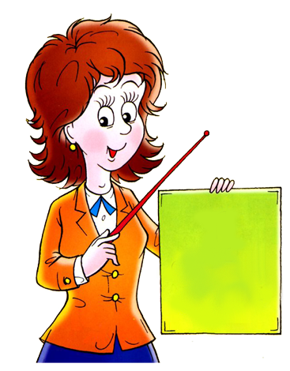
T
E
A
C
H
E
R
Terrific
Energetic
Able
Cheerful
Hard-working
Enthusiastic
Responsible

Slide 10
QUOTATIONS
“Never stop learning, because life never stops teaching”.
“There are lots of keys to each child and success depends on how you turn this or that key.”
“The mediocre teacher tells. The good teacher explains. The superior teacher demonstrates. The great teacher inspires.”
“The art of teaching is the art of assisting discovery.”

Slide 11
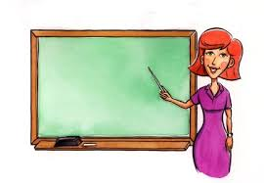
Jokes for the classroom

Slide 12
“I was born in California”
“Which part?”
“All of me”
A: Look at your face! I know what you had for breakfast.
B: What was it?
A: Eggs.
B: No, that was yesterday.

Slide 13
The teacher to a student: Conjugate the verb “to walk” in present simple.
The student: I walk. You walk…
The teacher interrupts him: Quicker please.
The student: I run. You run…
A: Why are all those people running?
B: They are running a race to get a cup.
A: Who will get the cup?
B: The person who wins.
A: Then why are all the others running?

Slide 14
Pupils of school-gymnasia who were the finalists of future leaders exchange(FLEX)
Kateryna Polishchuk – 2007-2008
Victoriia Dilna – 2008-2009
Yulia Nikolaichuk – 2008-2009
Yuriy Bondarchuk – 2014-2015
Victoria Vaydych – 2015-2016

Slide 15
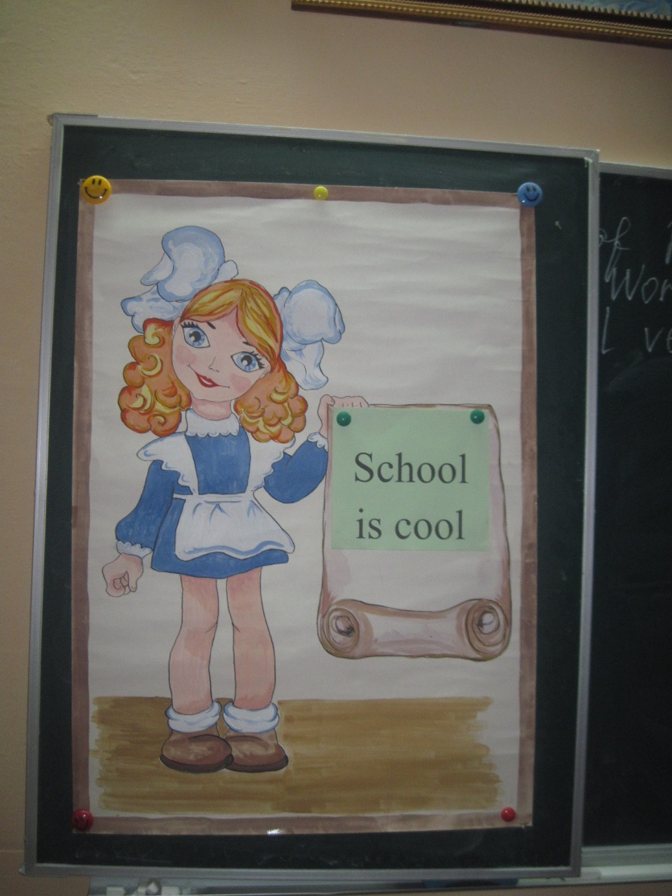
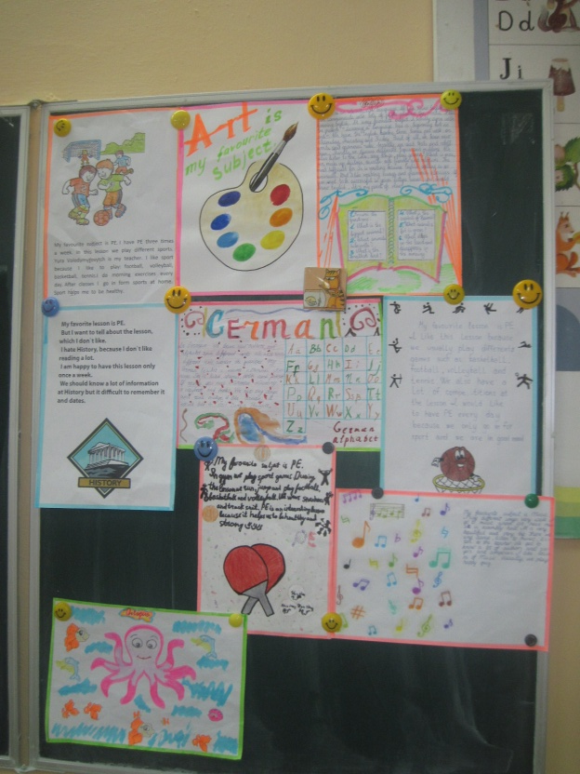
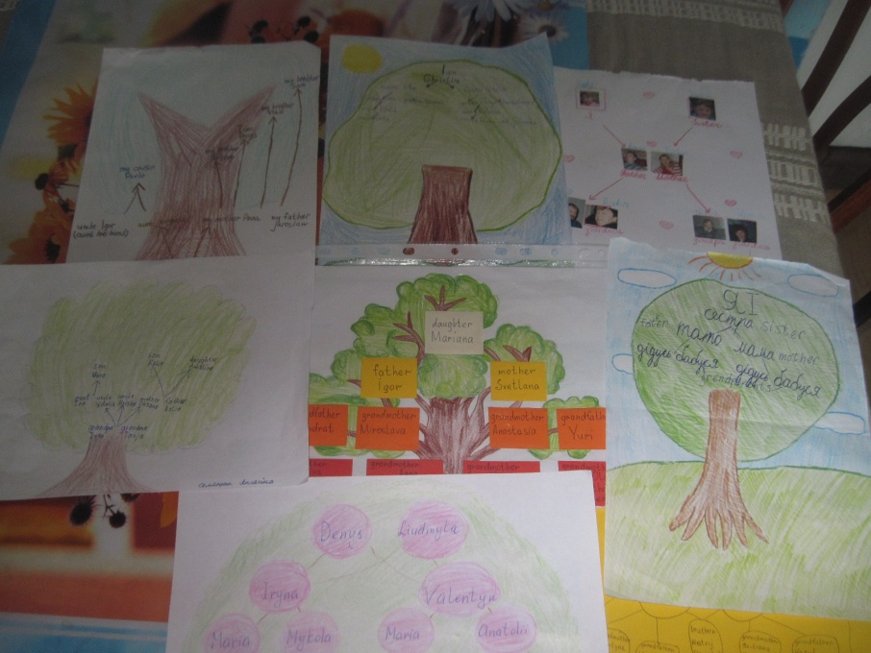
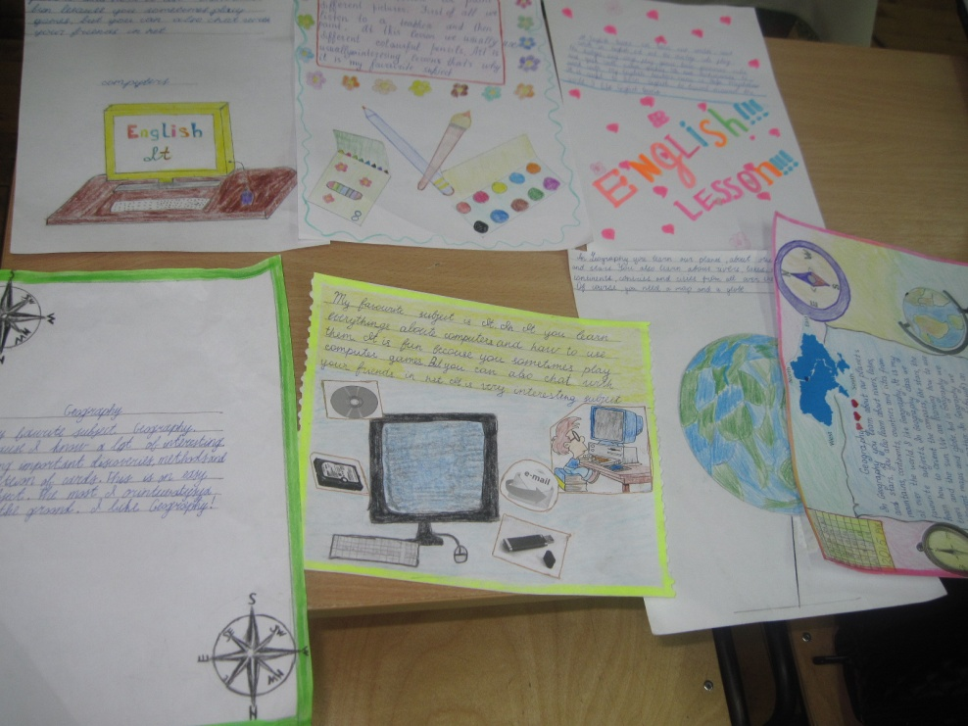
Project works done by pupils of different ages

Slide 16
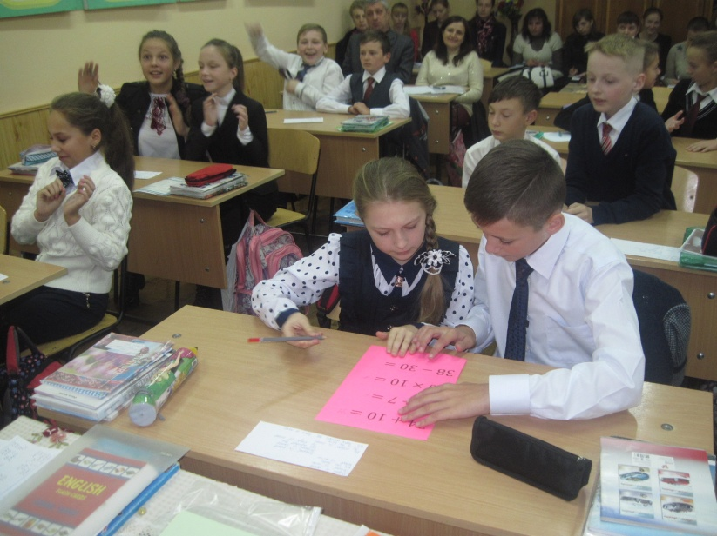
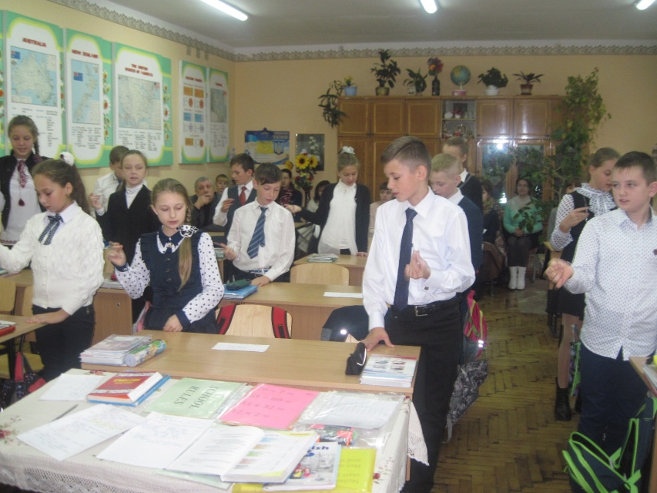
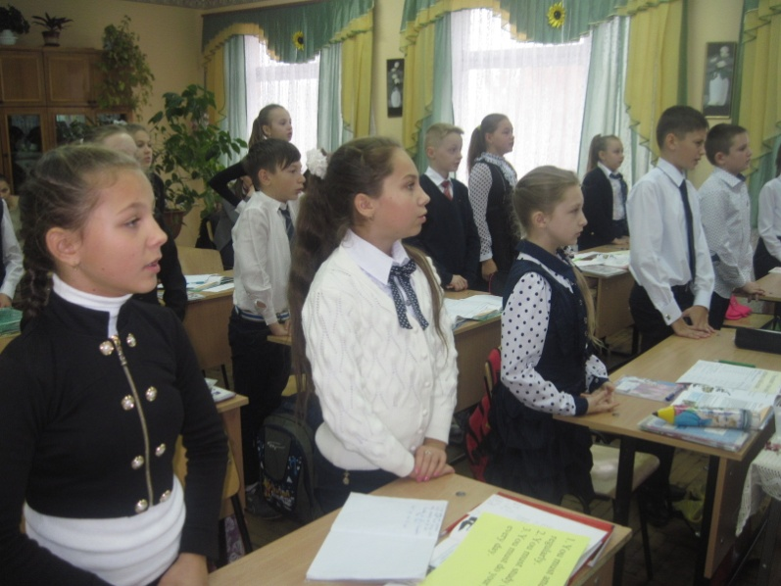
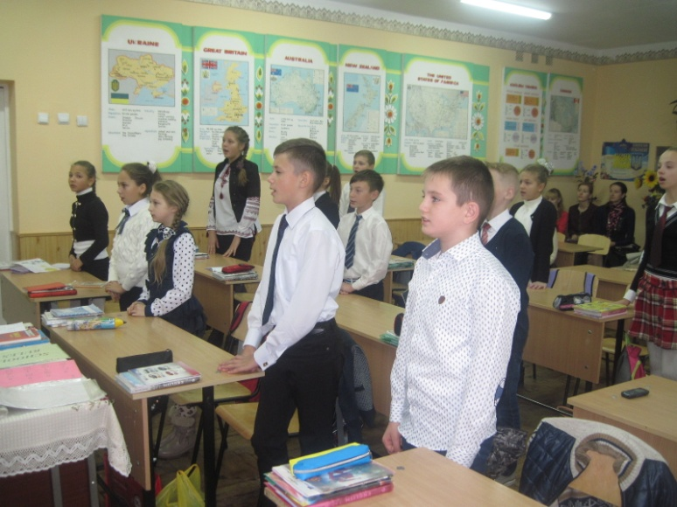
Kids like learning English
Learning a language has a beginning but no end.

Slide 17
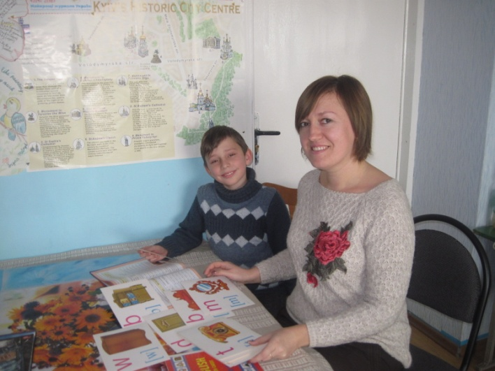
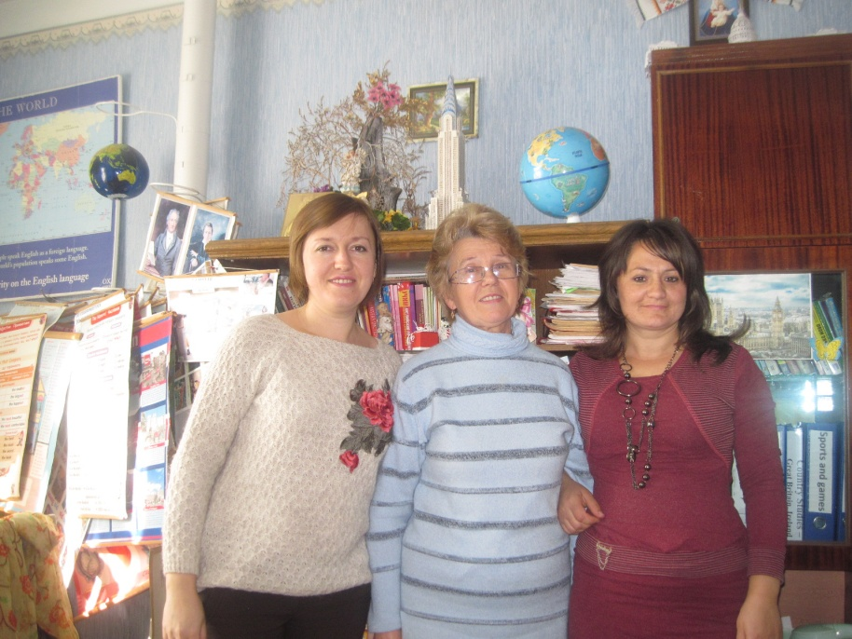
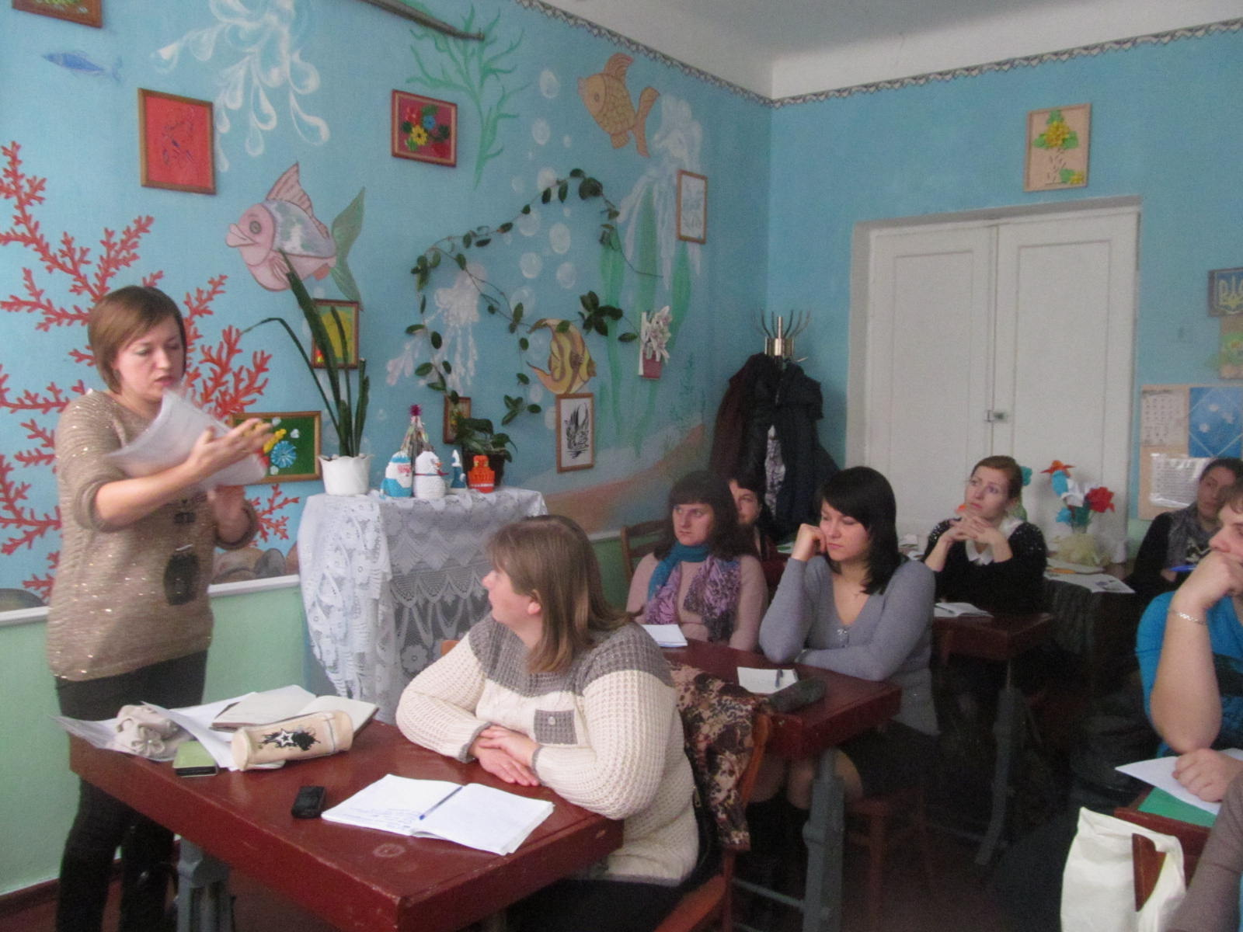
Fruitful work in the resource centre

Slide 18
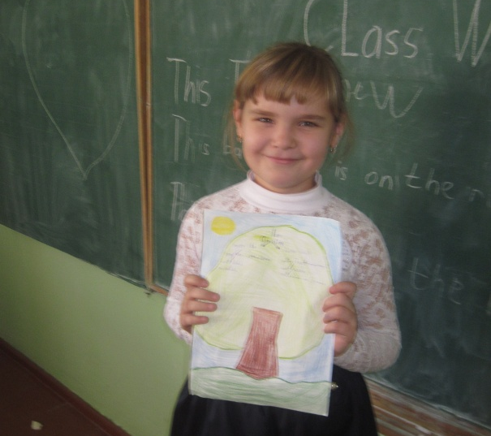
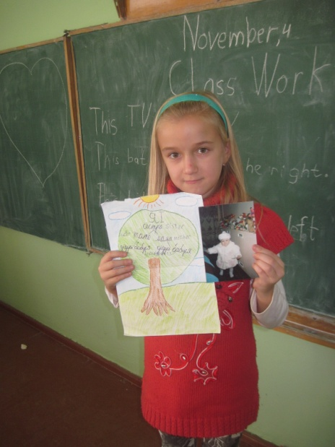
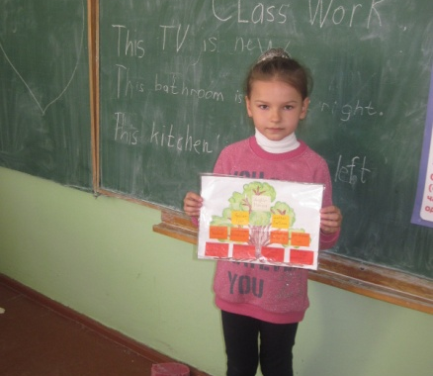
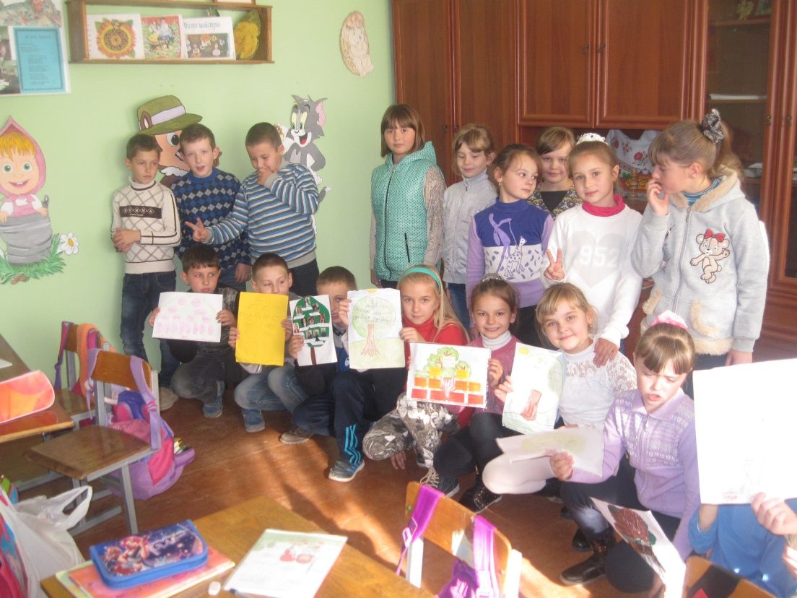
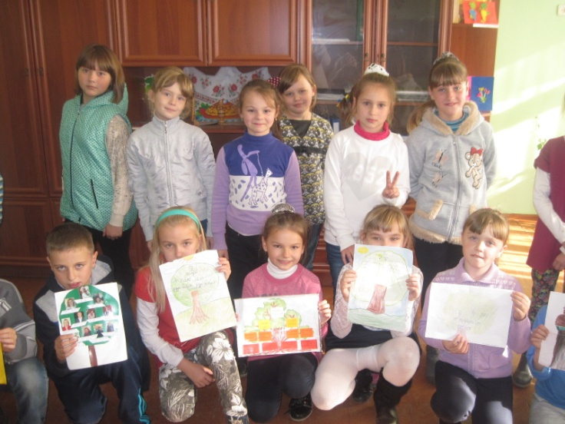
THE BEST WAY TO EDUCATE PUPILS IS TO MAKE THEM HAPPY

