Slide 1
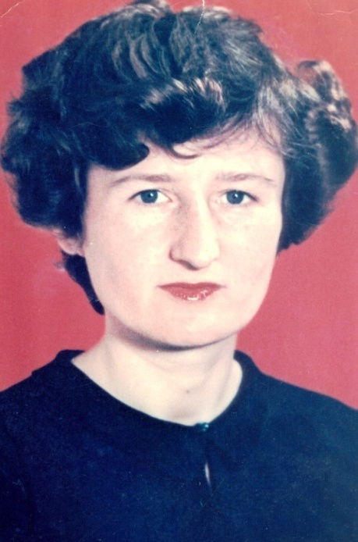
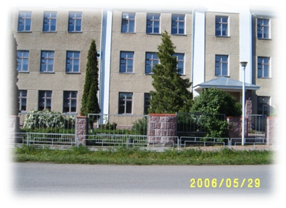
Nationwide Competition “ Teacher of the Year – 2016”
Liudmyla Kovalchuk
a teacher of English
School of Probishna

Slide 2
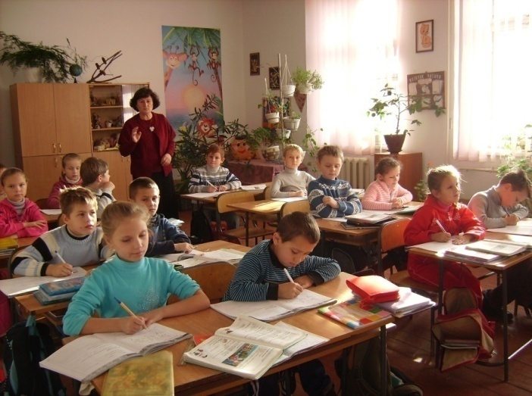
Methodological Problem
The formation of communicative competence
by implementing creative education

Slide 3
Formation of communicative competence - the goal of learning a foreign language.
communication
the need for communication
ability to communicate
practice communication

Slide 4
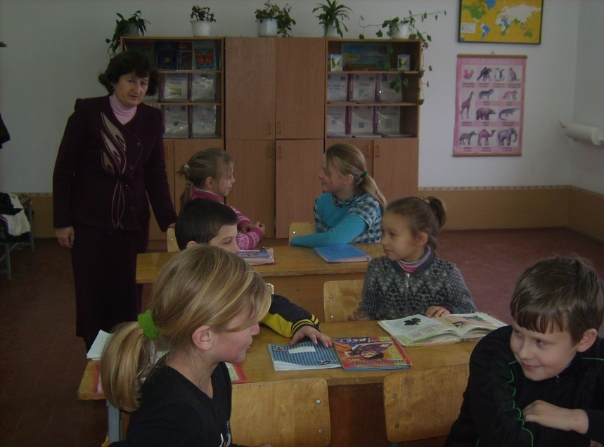
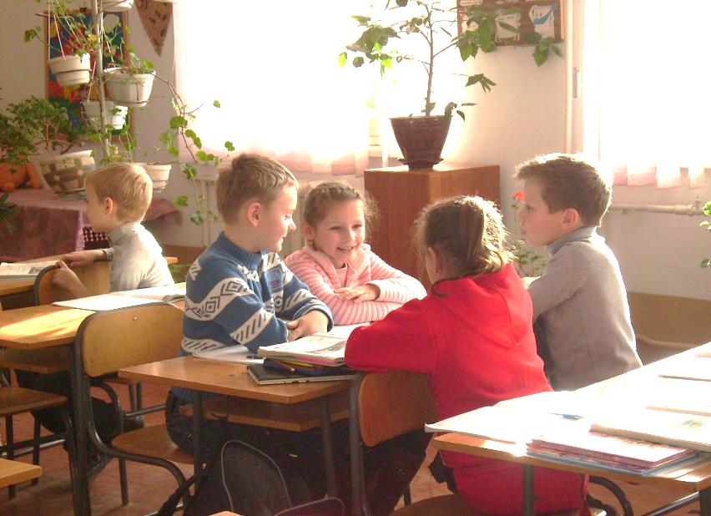
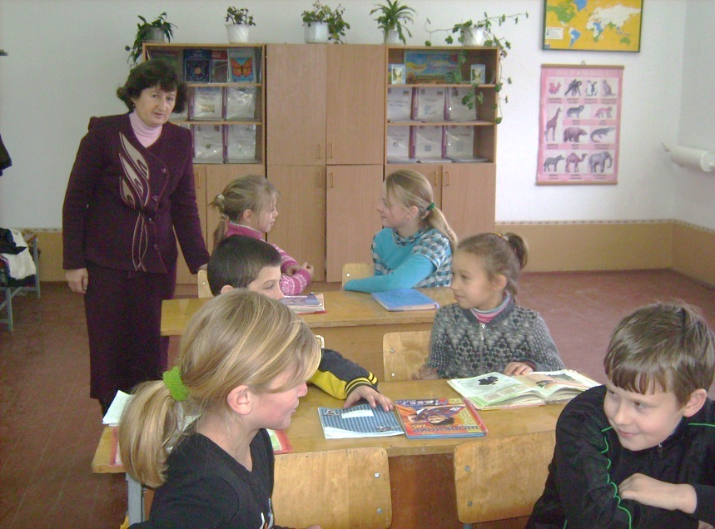
Techniques of interactive training :
pair work:
group work
brainstorming
interview
Role game

Slide 5
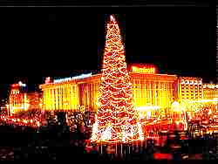
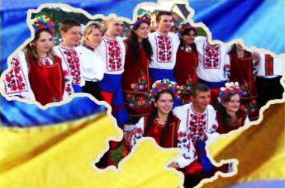
SPIDERGRAM
Imagine our country being a sunflower. What will be the petals?
People
Holidays
Language
Customs
Ukraine
Symbols
Cities
History

Slide 6
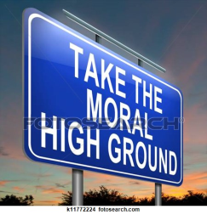
My Motto
My duty is to teach children not only the subject but form the personalities of high moral values.
Treat other people as
you want to be treated yourselves

Slide 7
ROUND- TABLE- TALK Stick to the highest values of life.
LOVE
HEALTH
FRIENDSHIP
FAMILY
VALUES
OF LIFE
PEACE
HOME
KINDNESS
NATIVE LAND

Slide 8
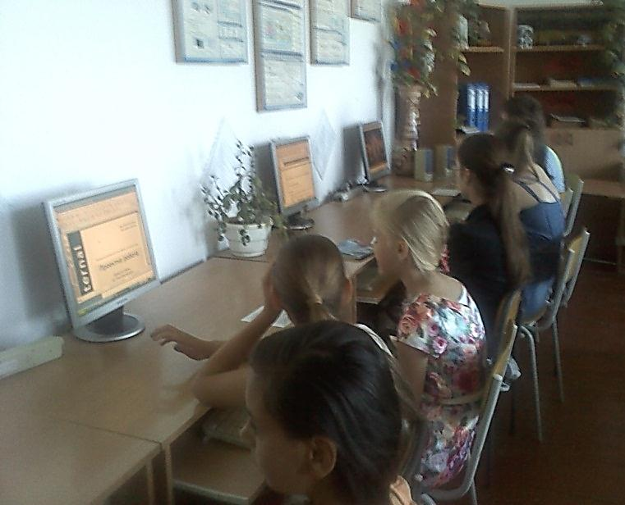
At my lessons I use computer technologies

Slide 9
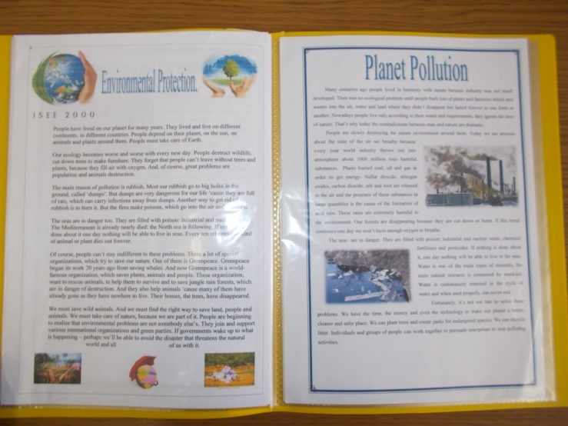
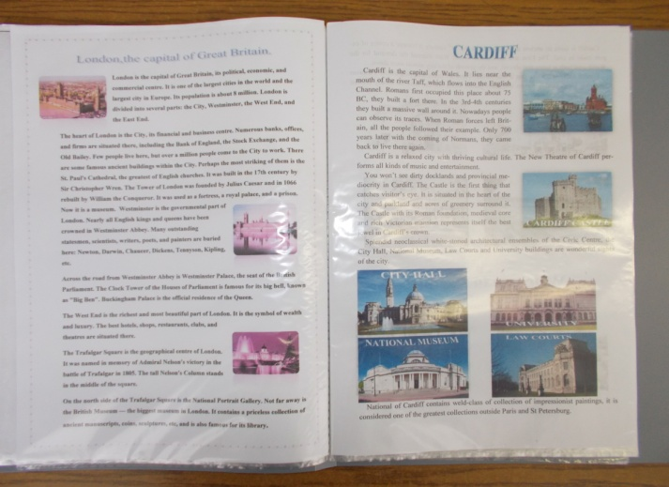
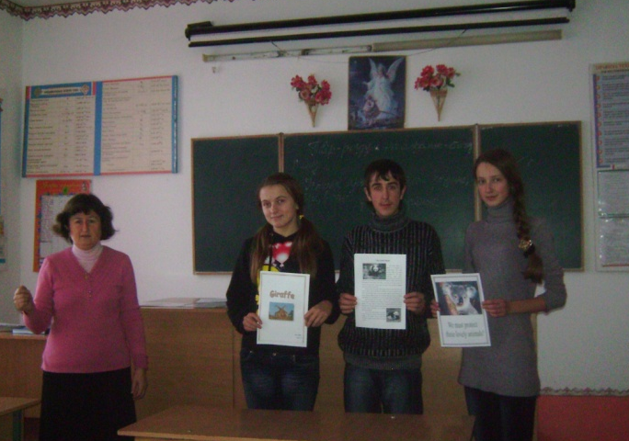
My students’ presentations

Slide 10
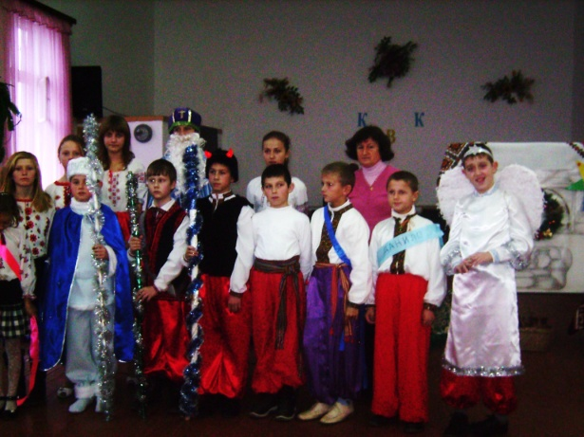
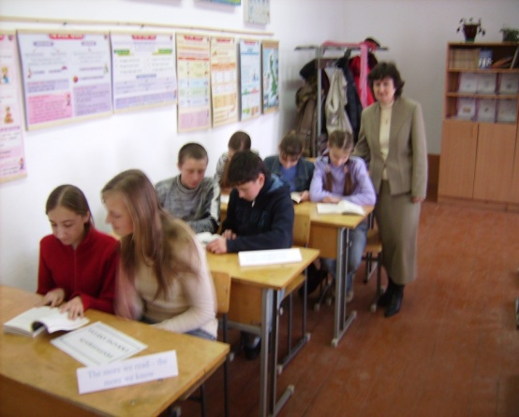
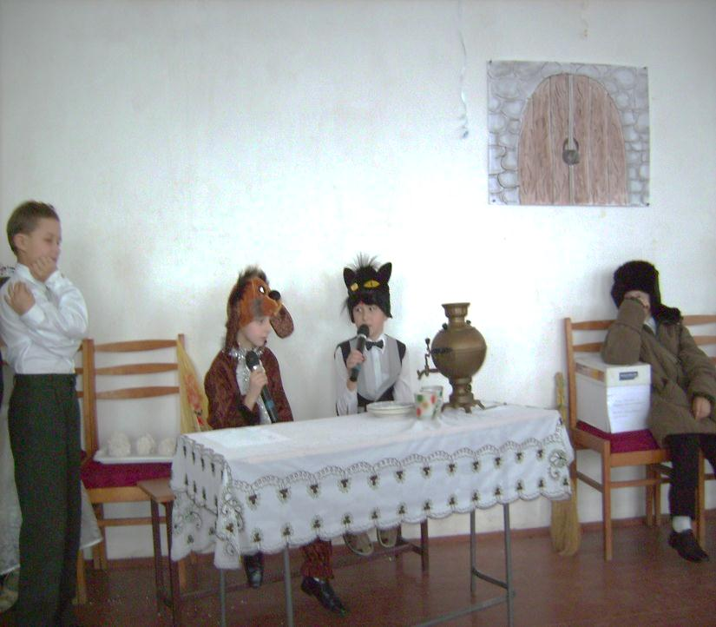
Extra-curricular activities
Members of the circle “The lovers of English" organize competitions of songs and poems, performances, parties.

Slide 11
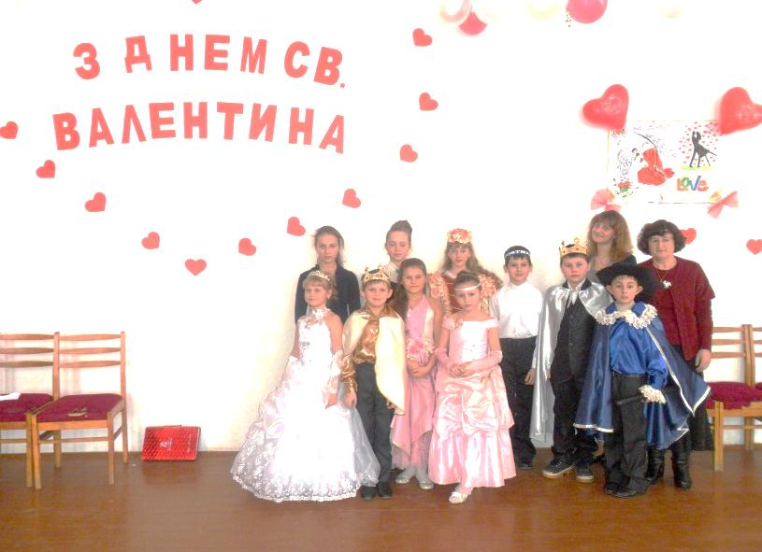
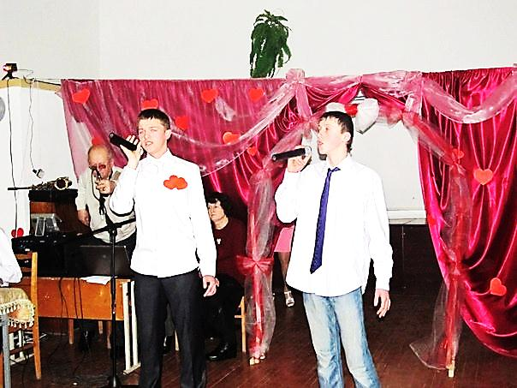
The week of English Project “ St. Valentine‘s Day“
Love is above all

Slide 12
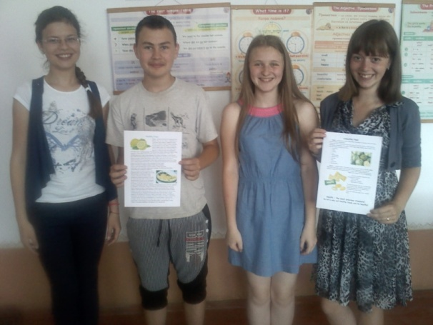
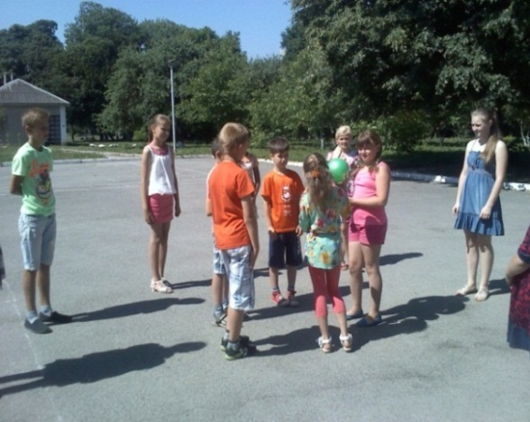
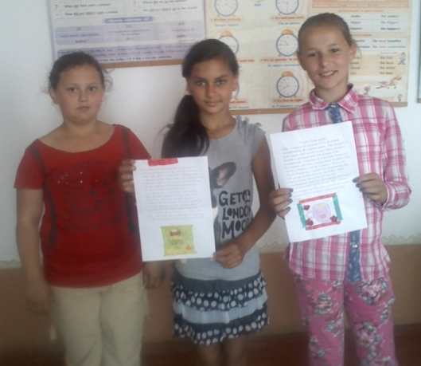
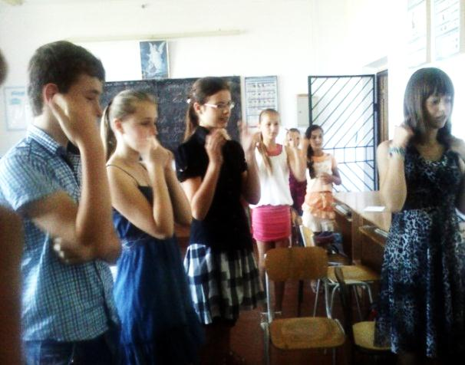
Summer camp Project “Healthy life”
Health is above wealth
“Friends” “Stars” “Smile”

Slide 13
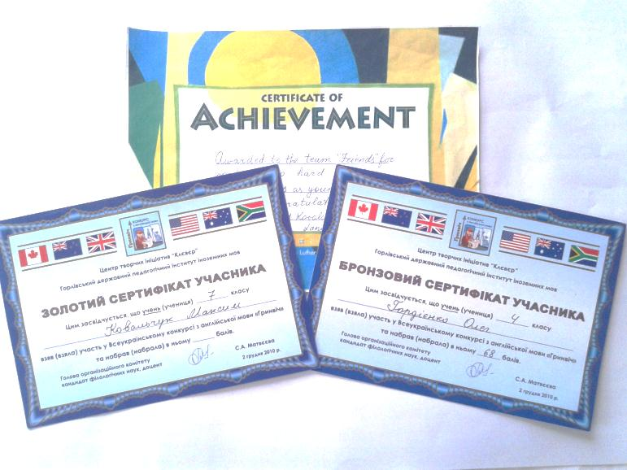
Participation in the Contests and Olympiads
THE WINNERS ( II ROUND)
TETIANA KAI
MAXYM KOVALCHUK
KHRYSTYNA IVANTSIV

Slide 14
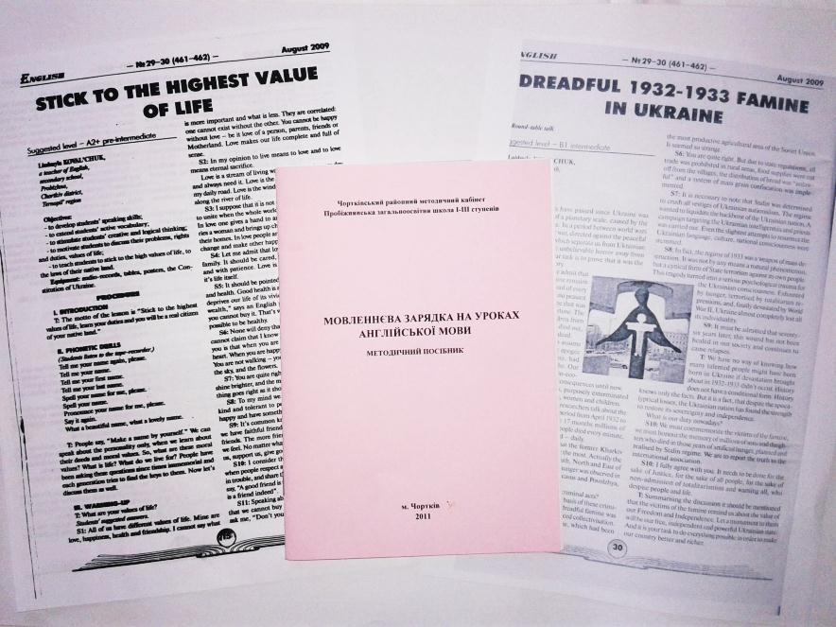
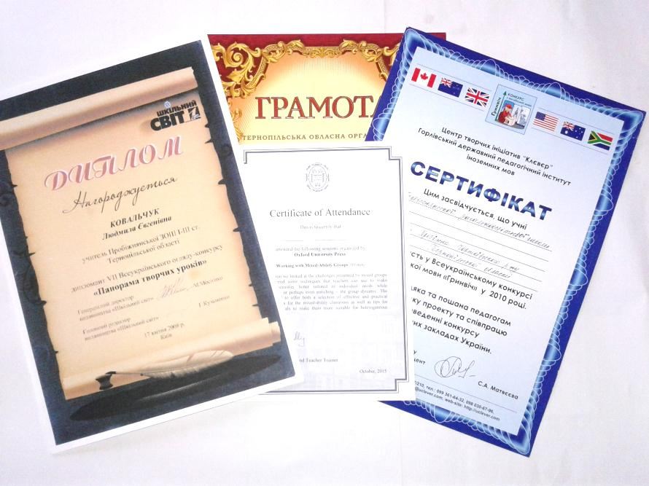
My Achievements
Methodological manual
“Warming-up activities
Published lessons

Slide 15
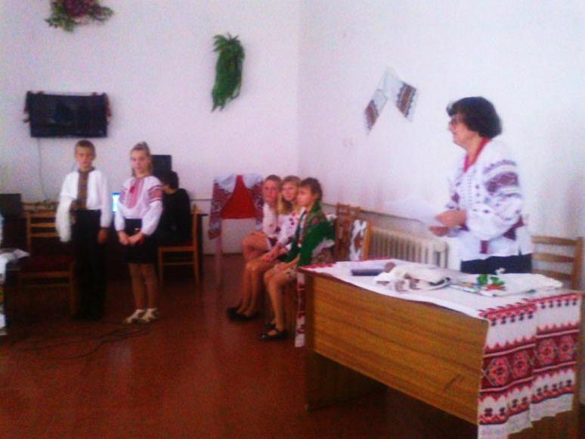
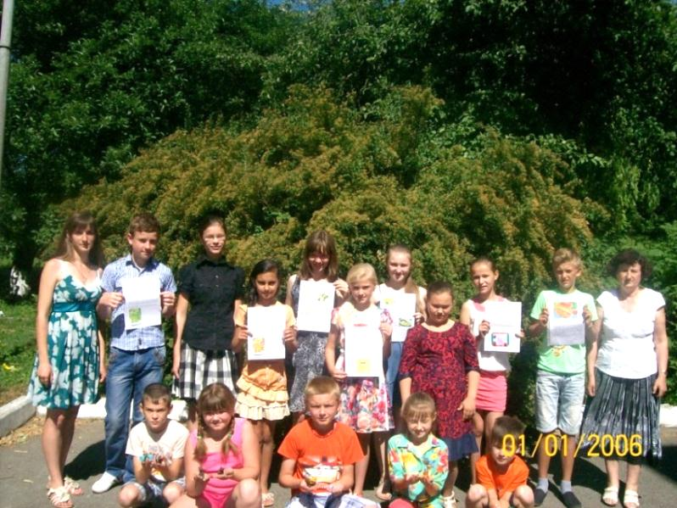
Doing what you like is freedom. Liking what you do is happiness.
H. Skovoroda
A real teacher lives as teaches.

