Slide 1
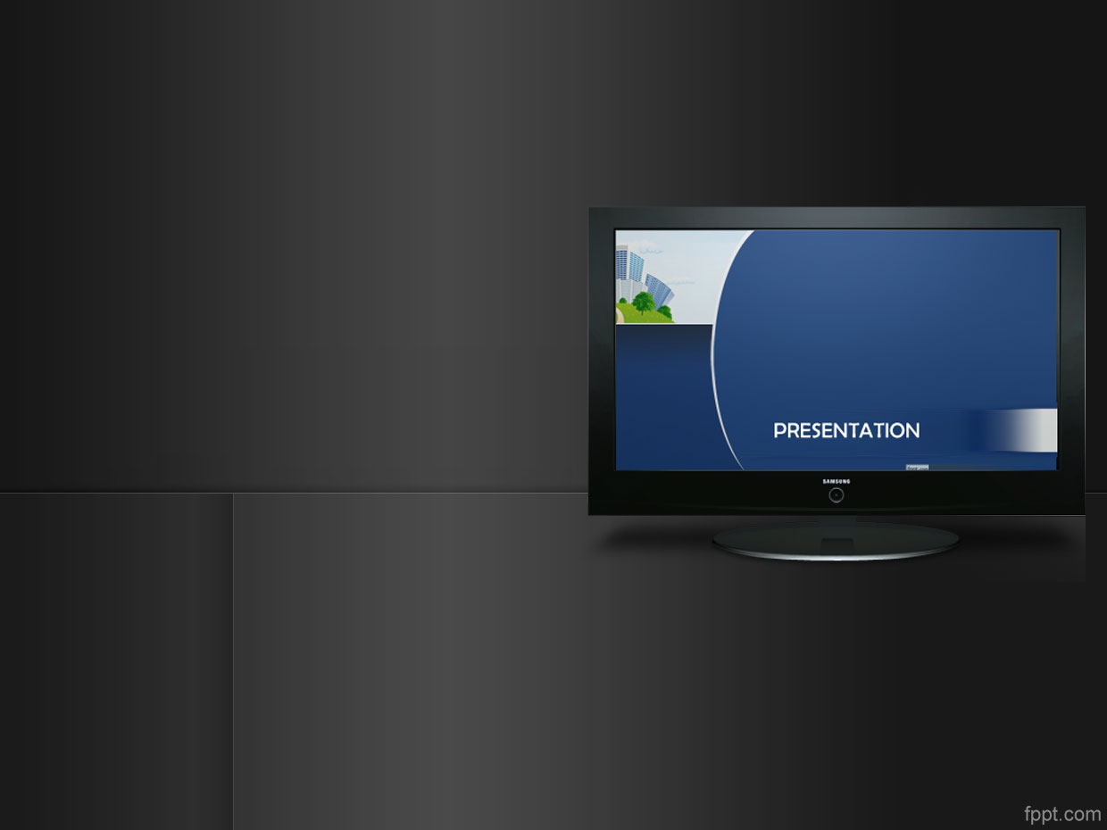

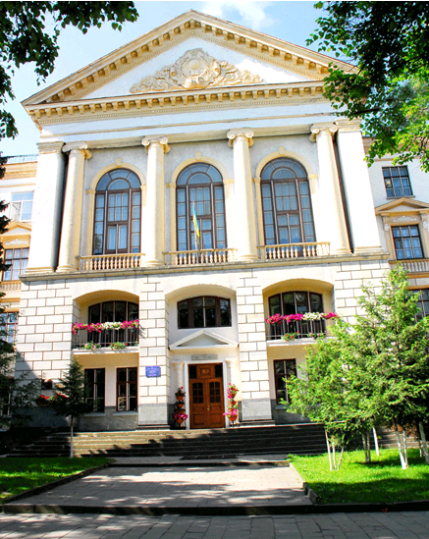
Presentation
of the work experience
Тернопільська спеціалізована
школа І-ІІІ ступенів №3
з поглибленим вивченням
іноземних мов

Slide 2
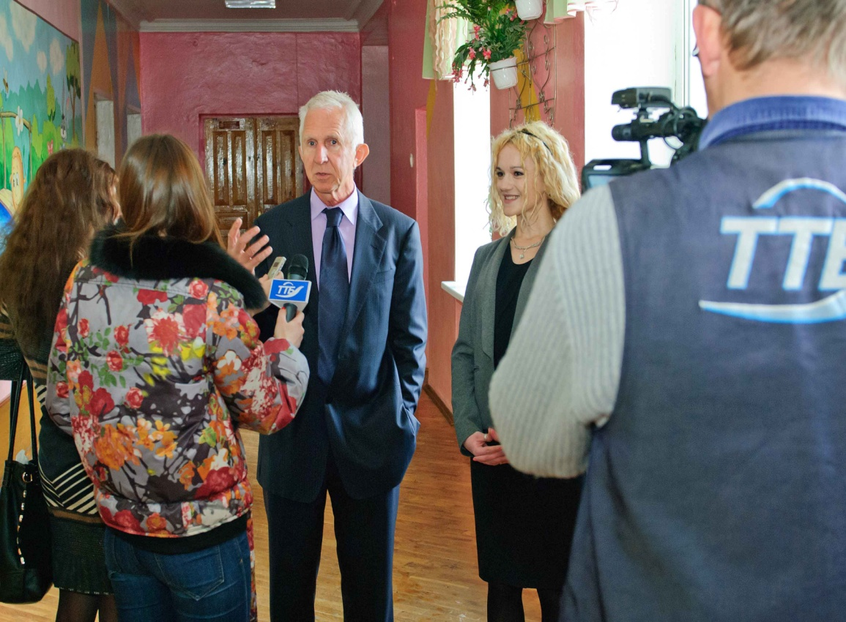
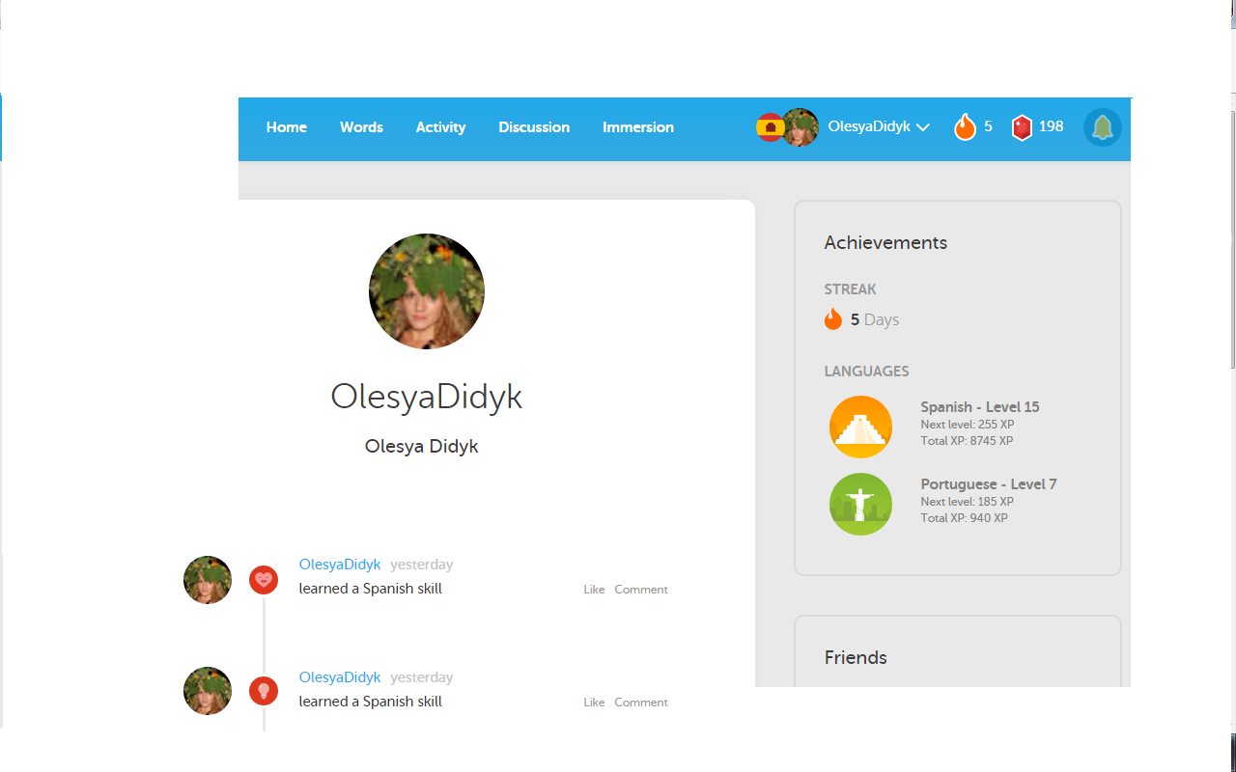
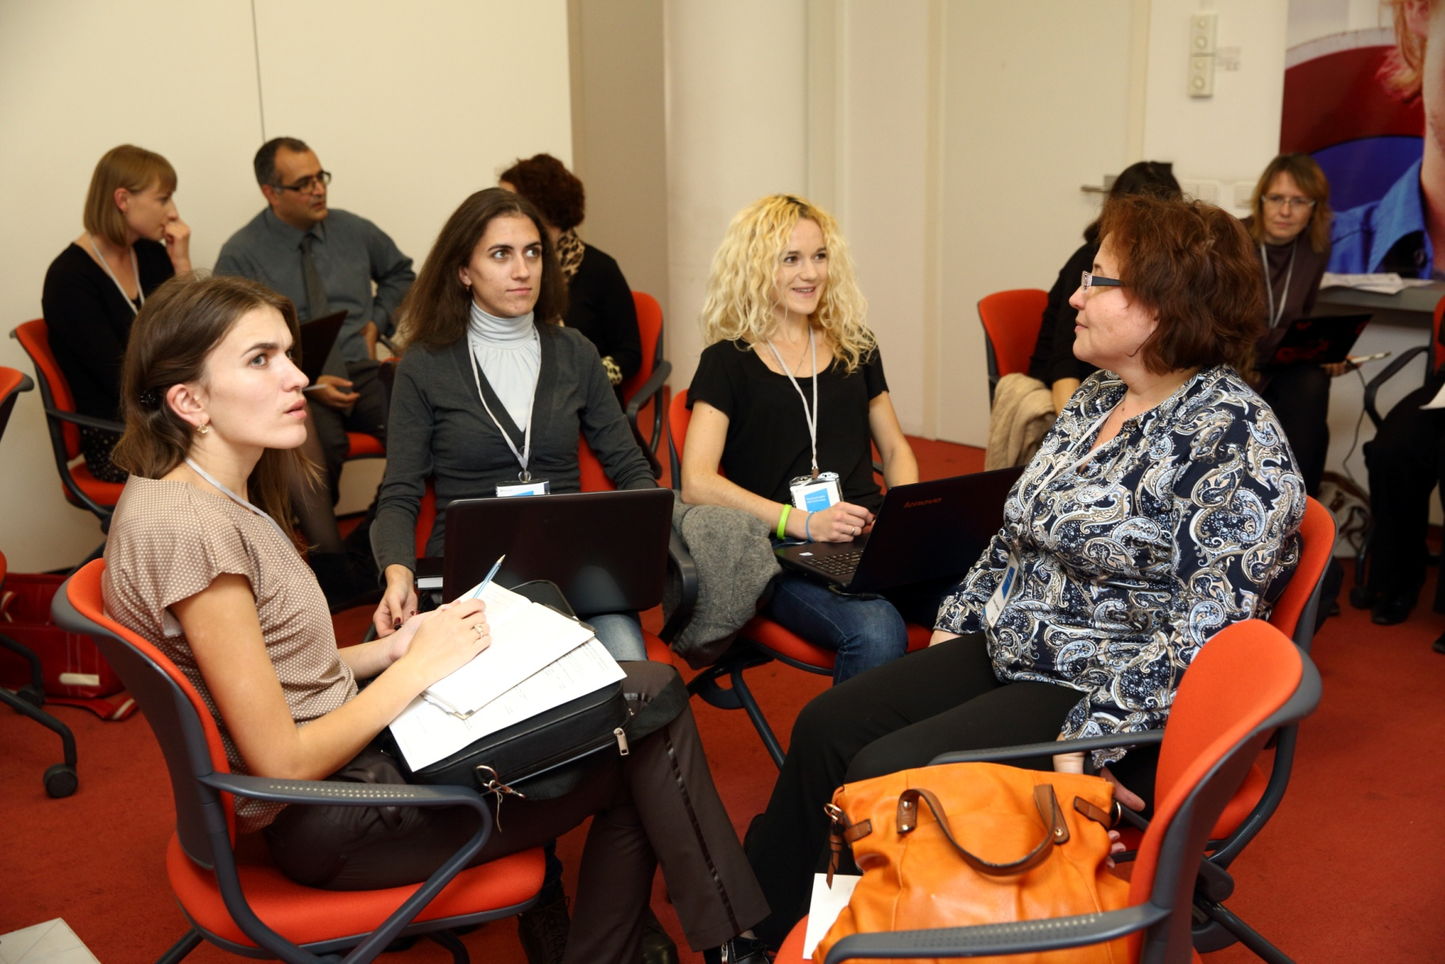
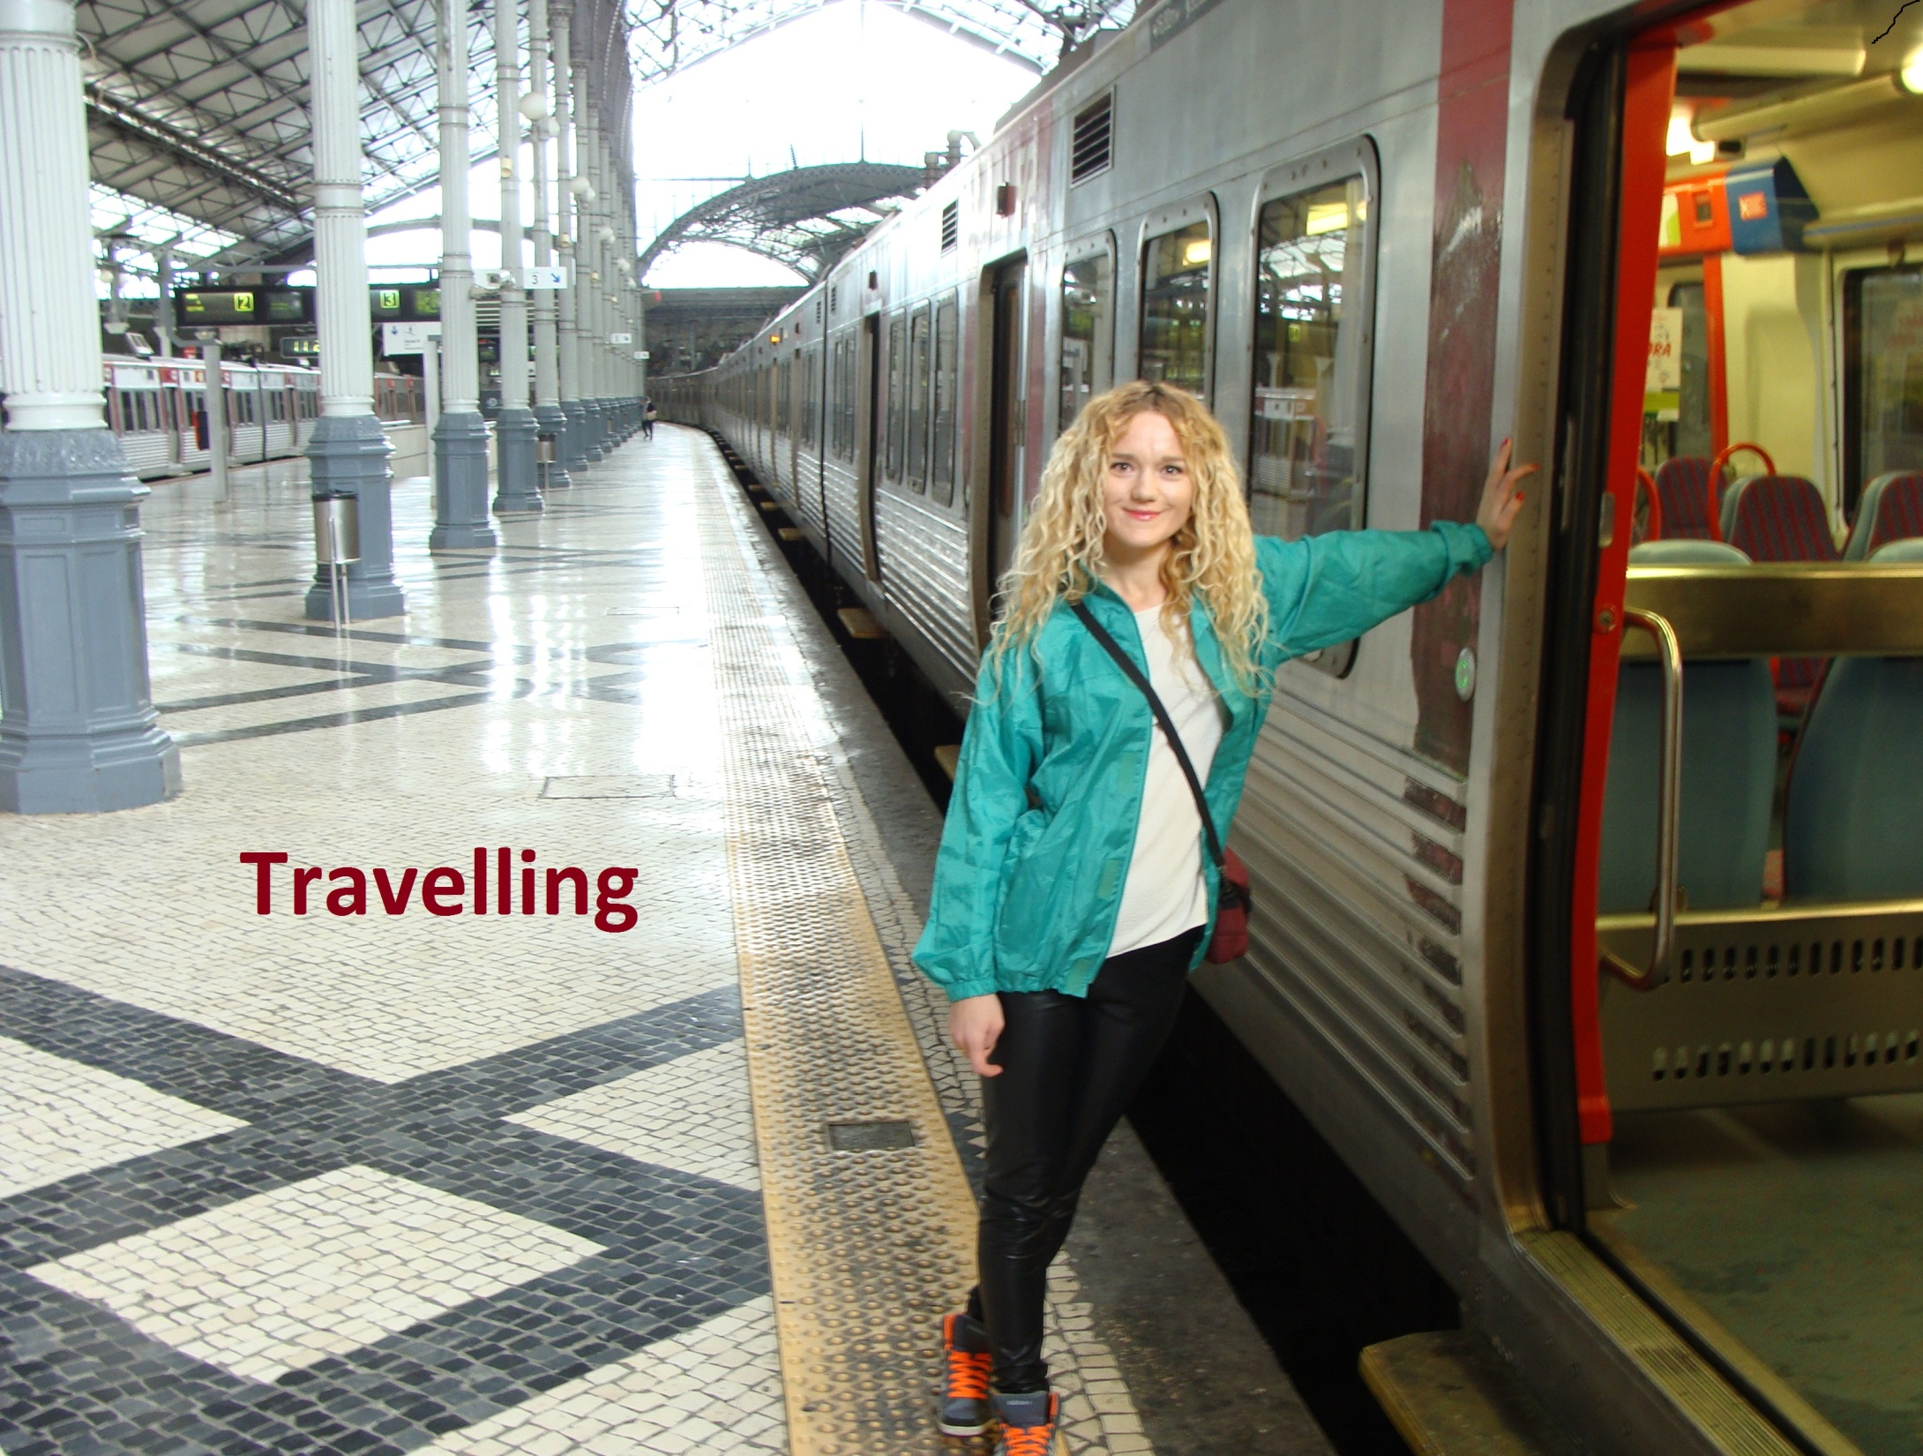
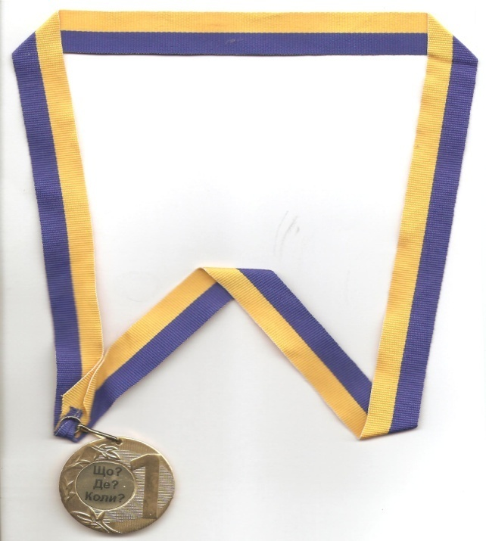
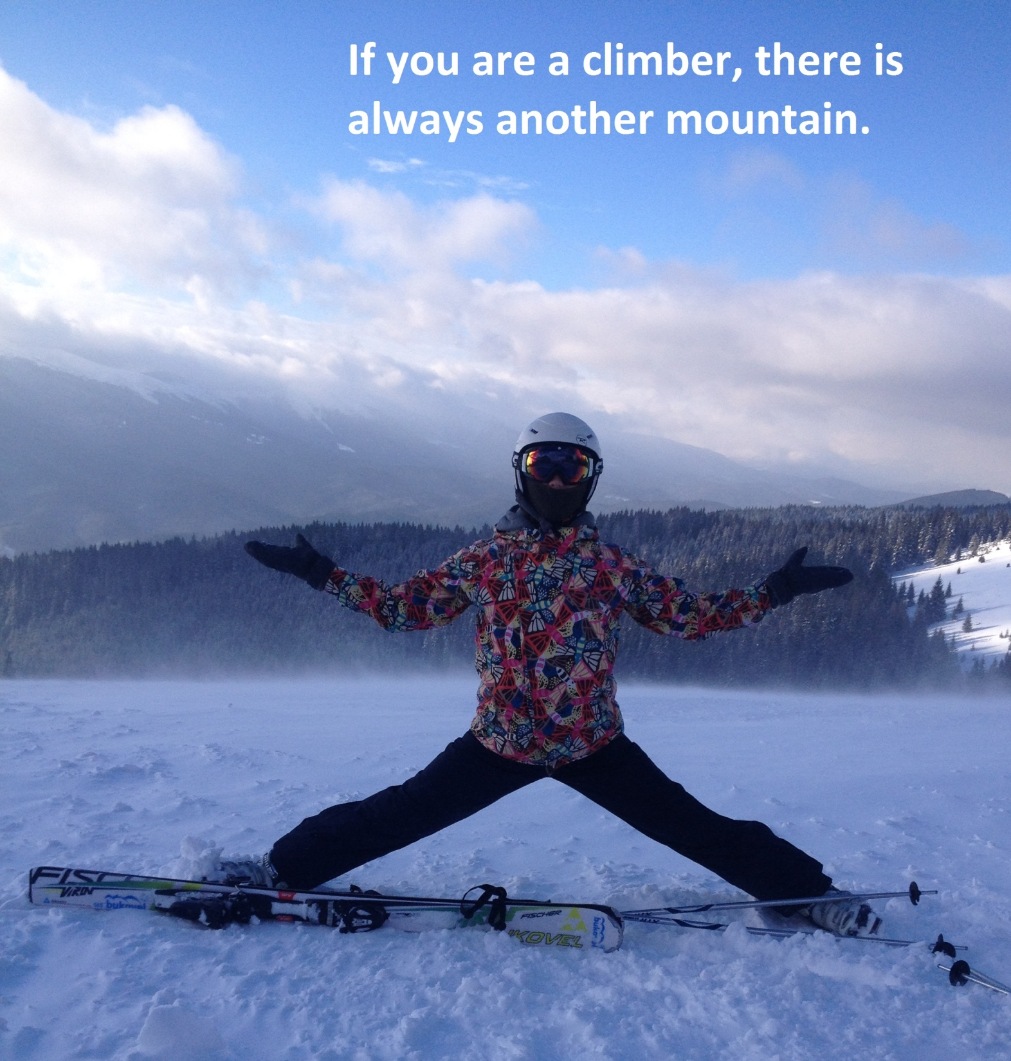
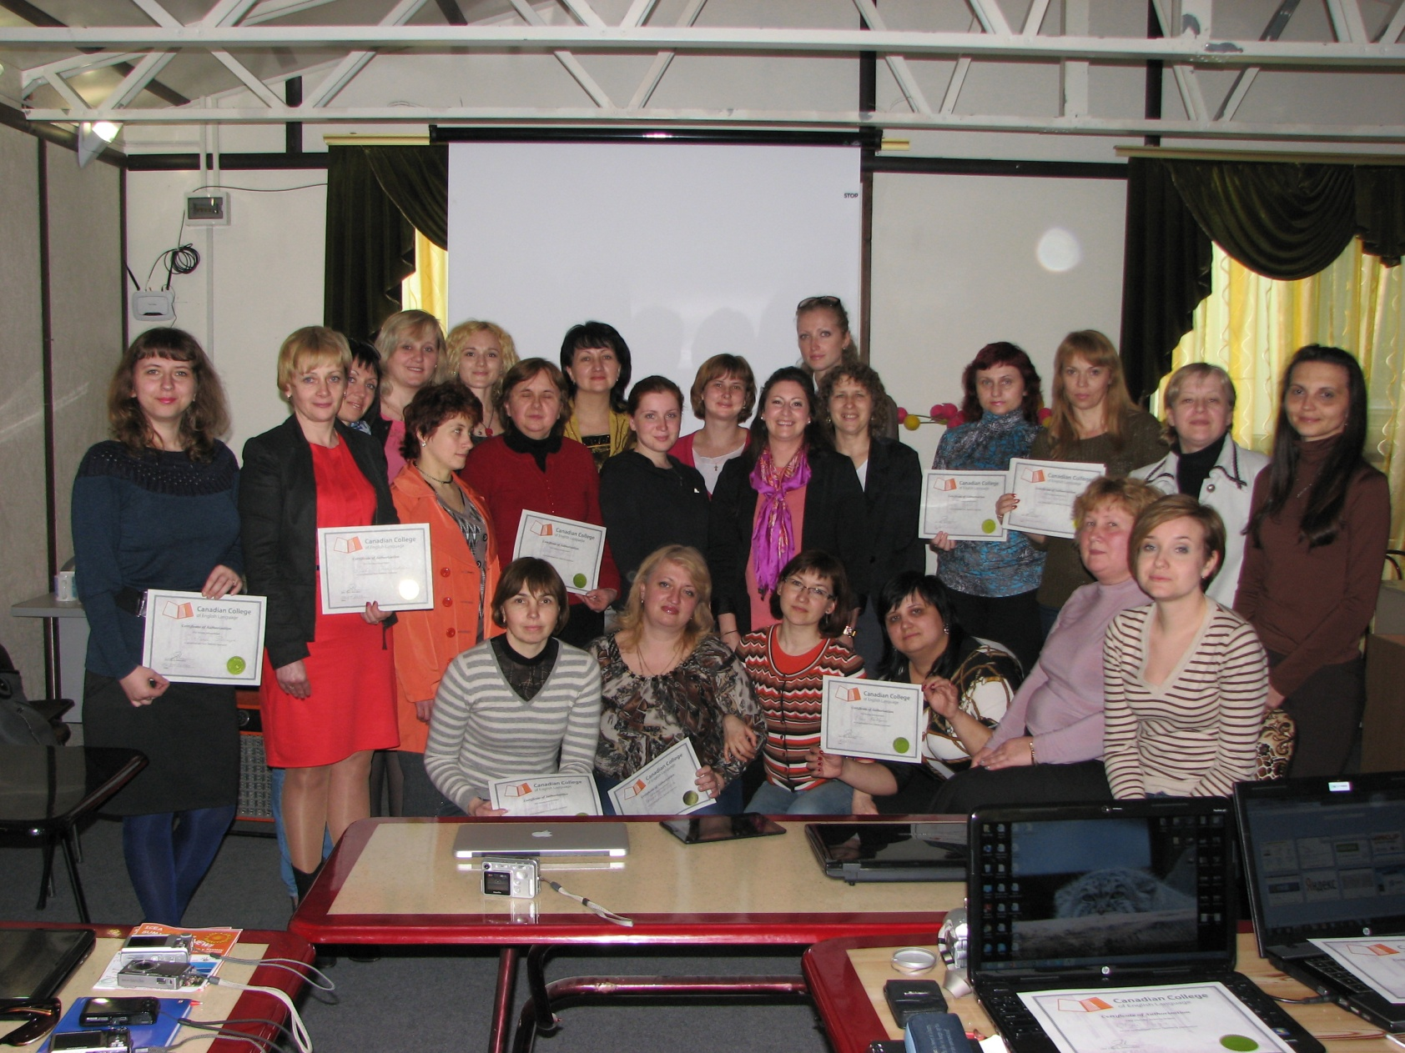
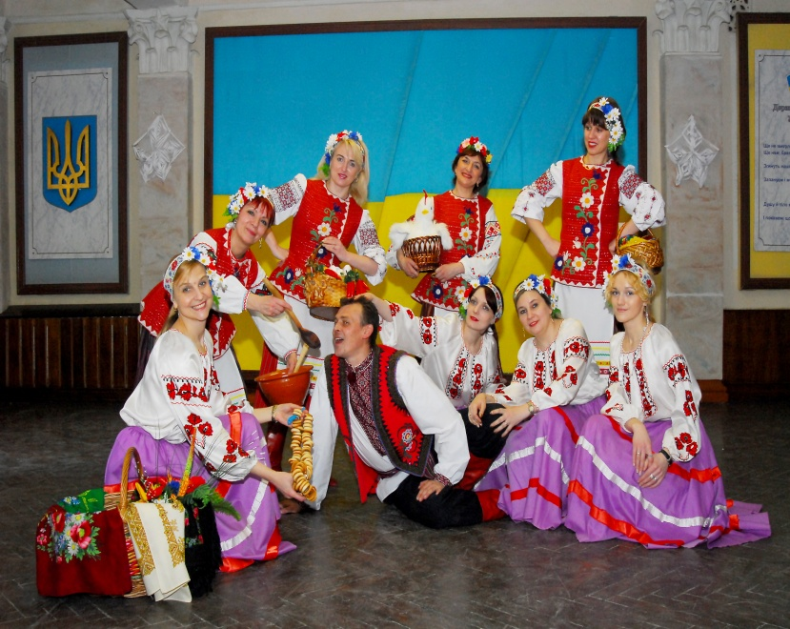
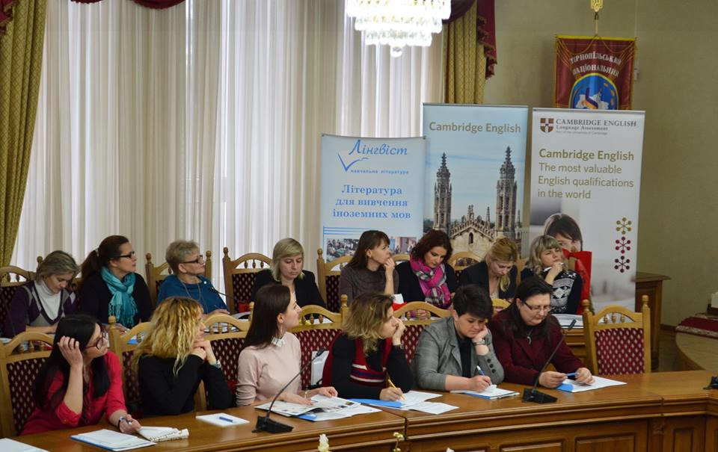
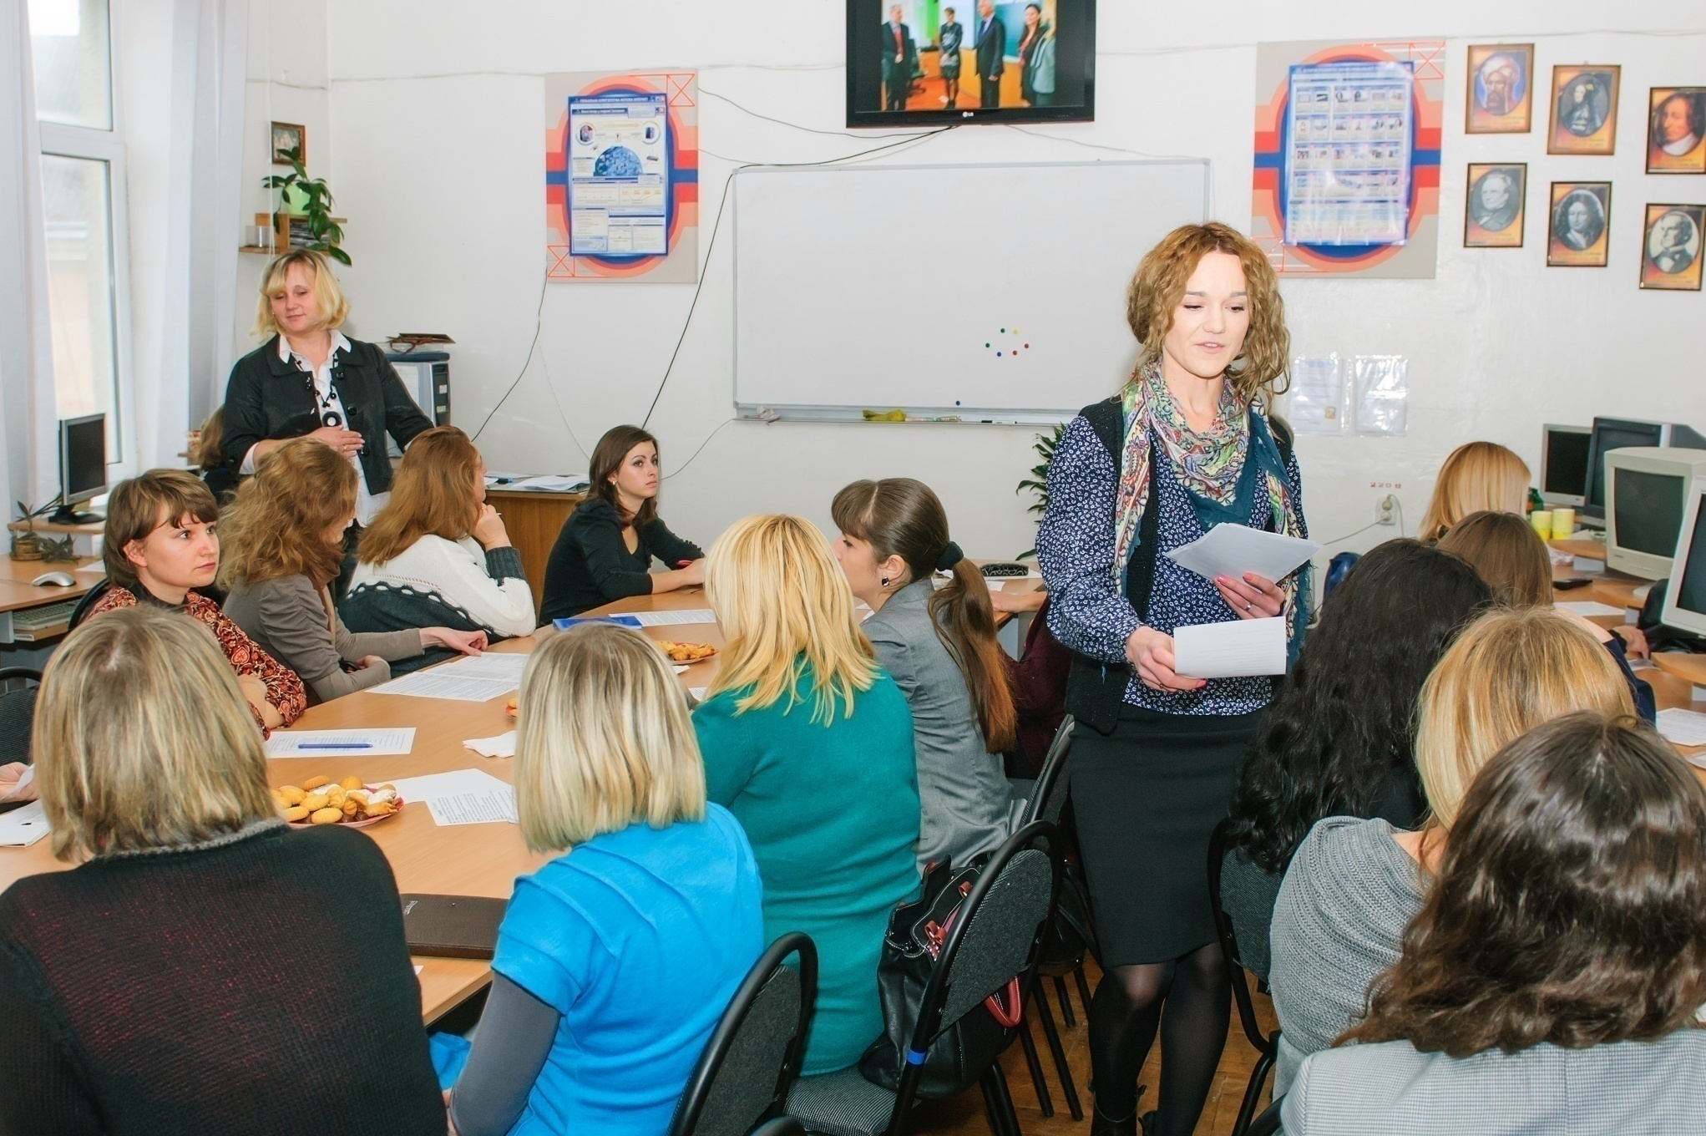
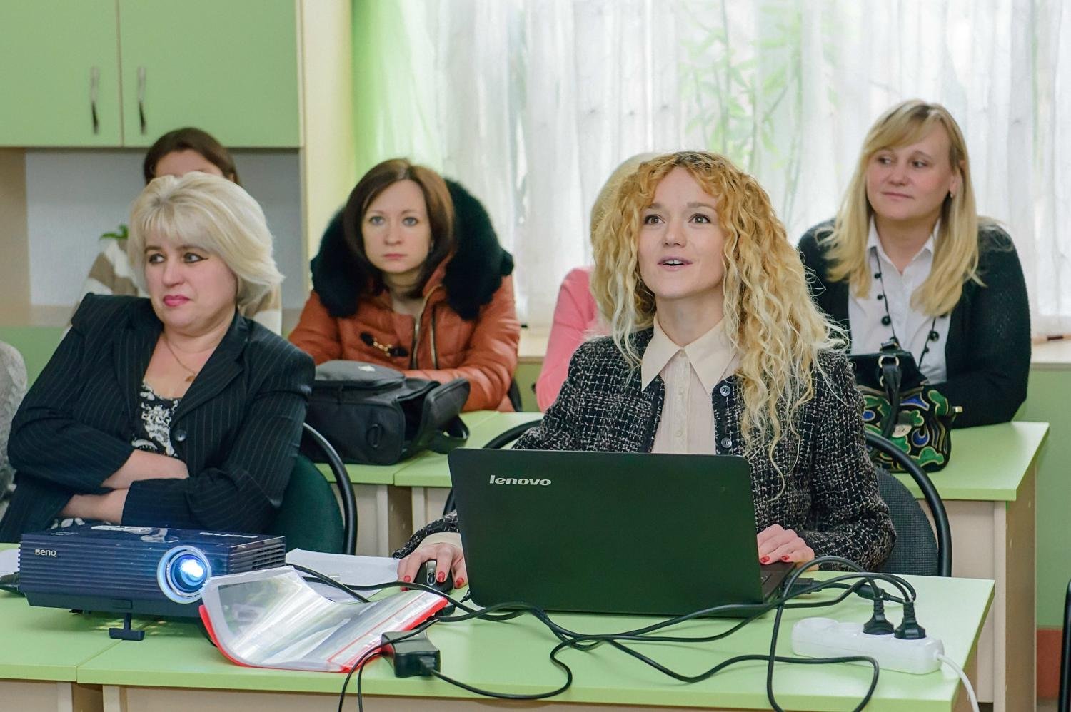
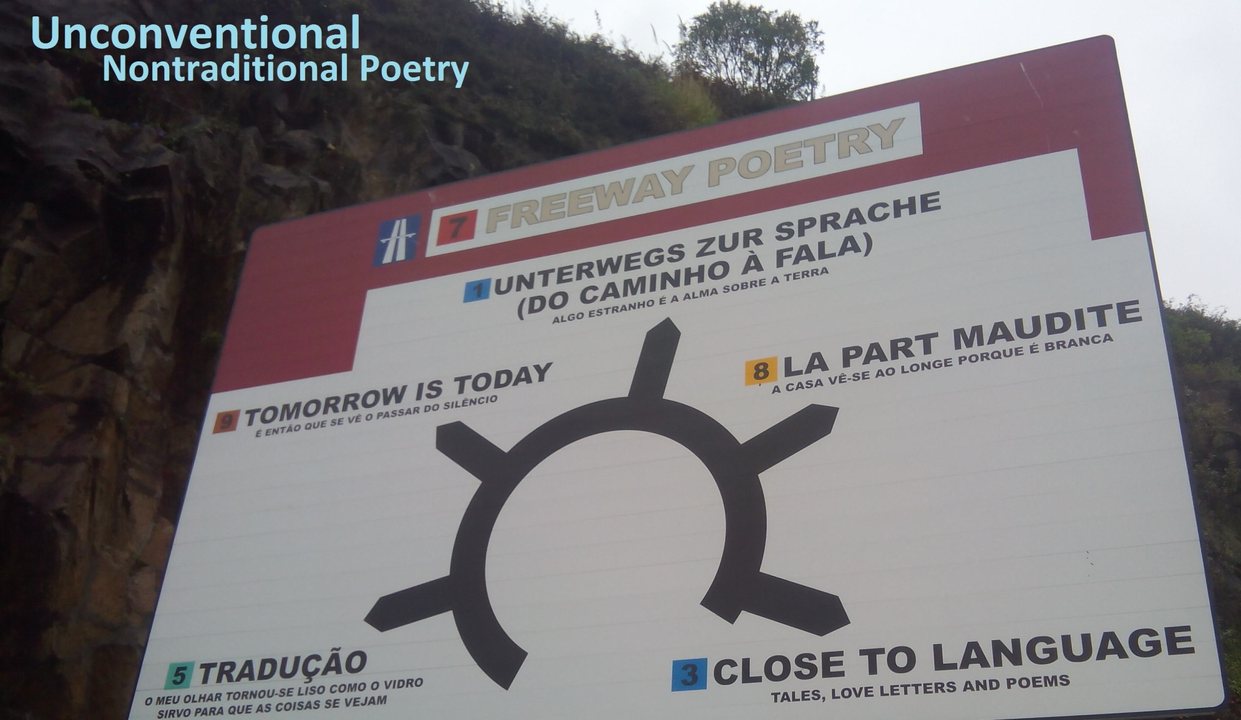
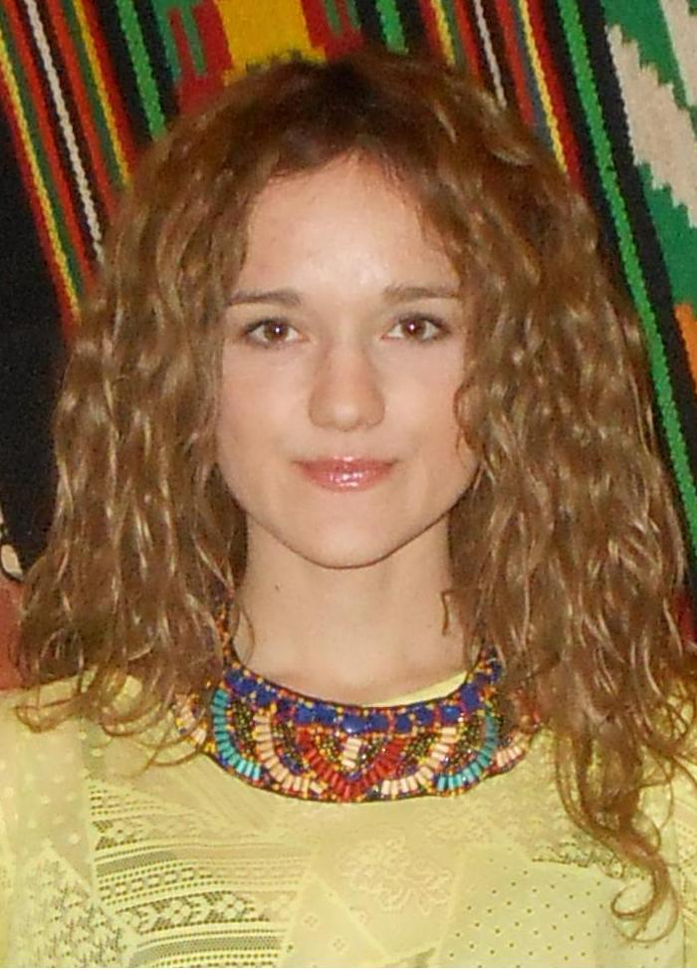
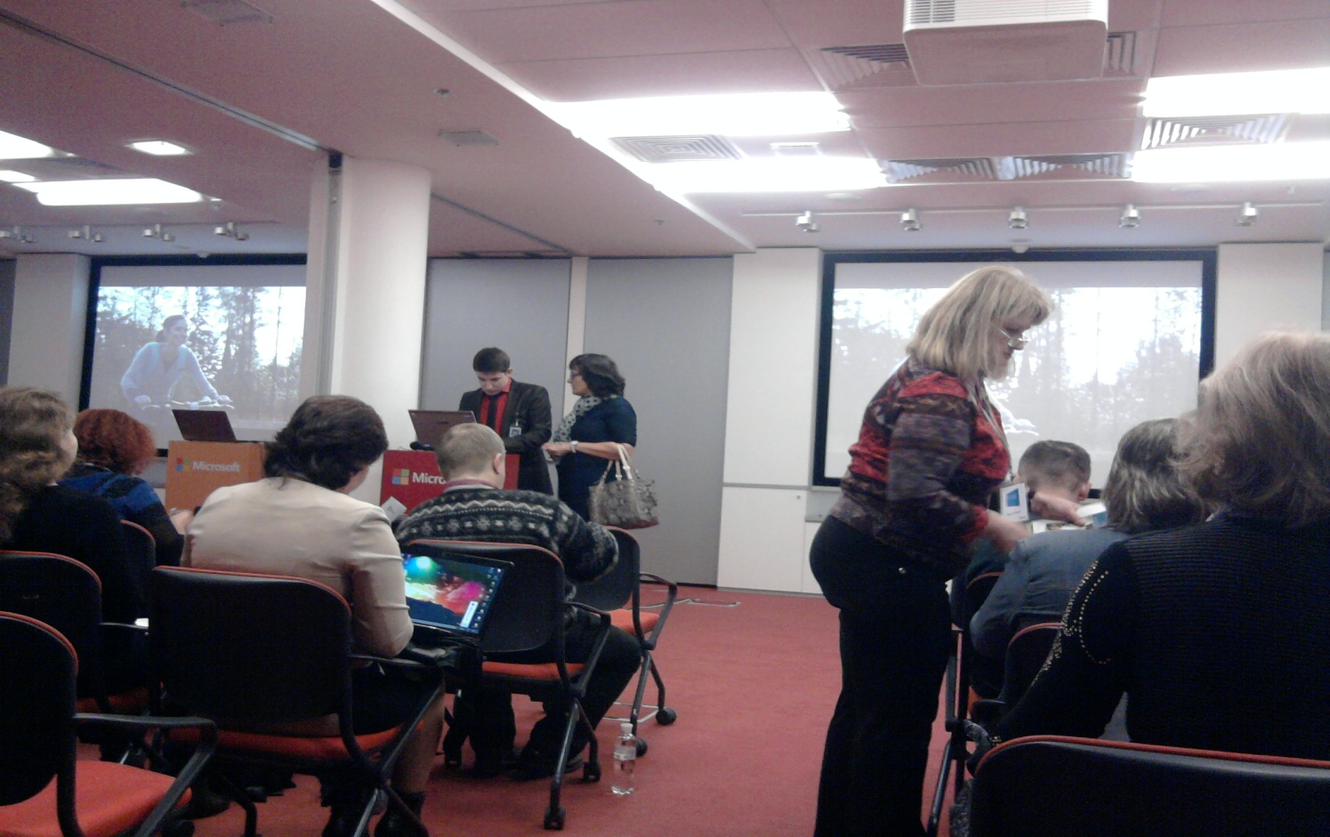
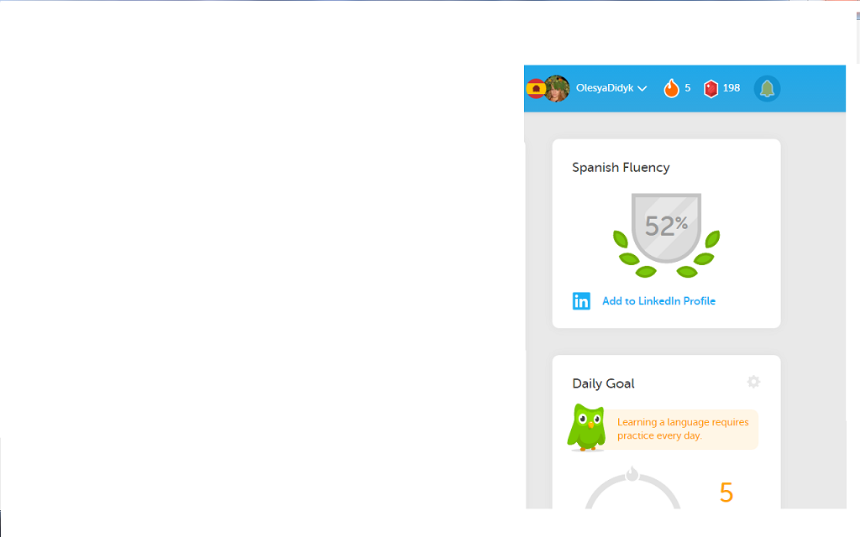
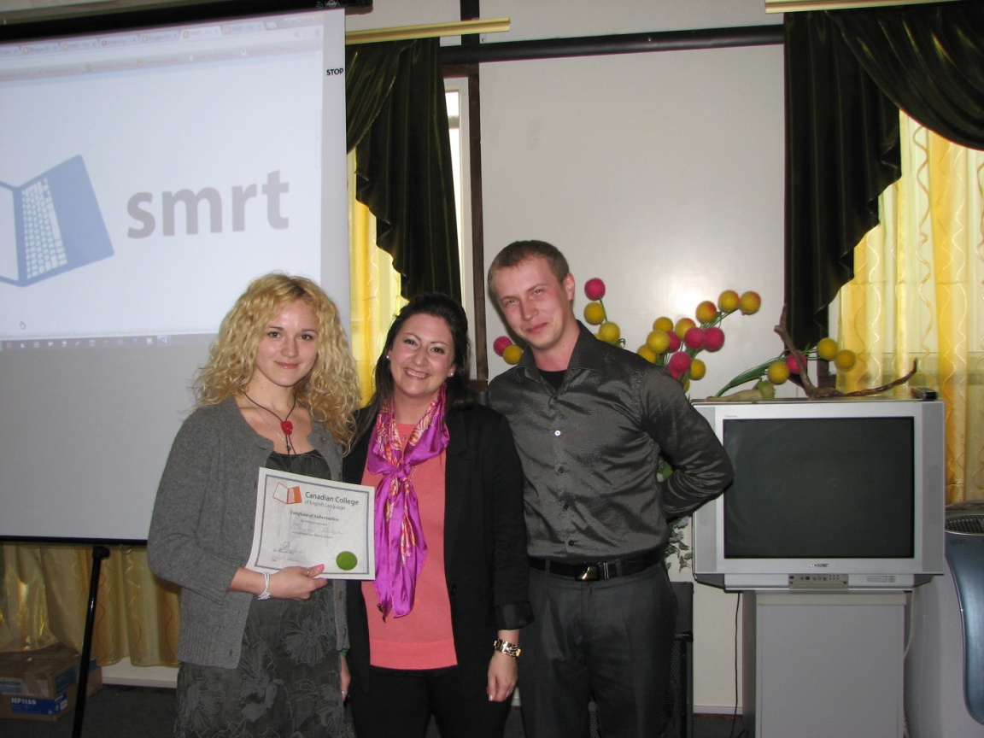
My authenticities
Olesya Didyk
All-round development is core;
Professional development is vital (seminars, workshops, master classes, trainings, programs, courses etc.);

Slide 3
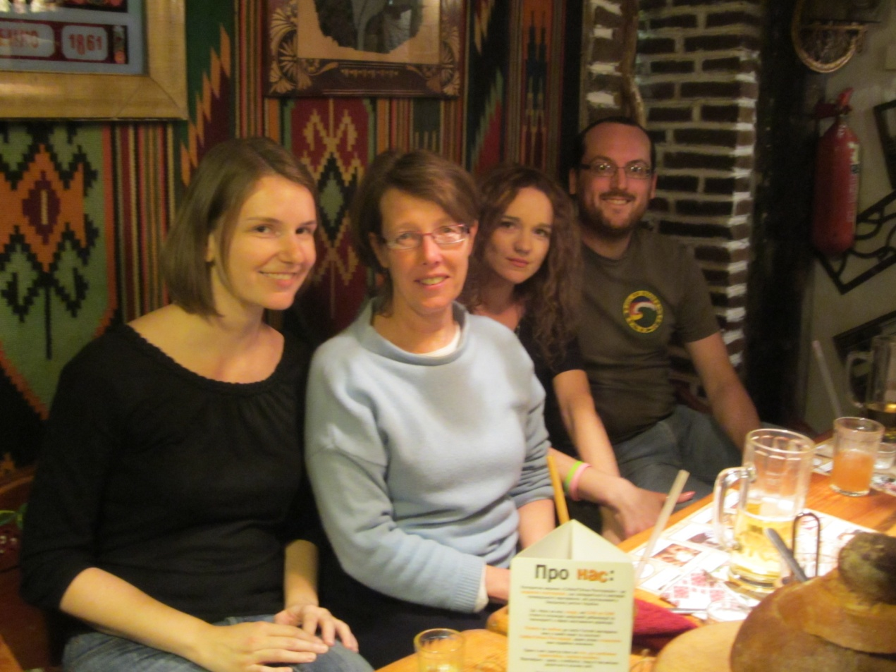
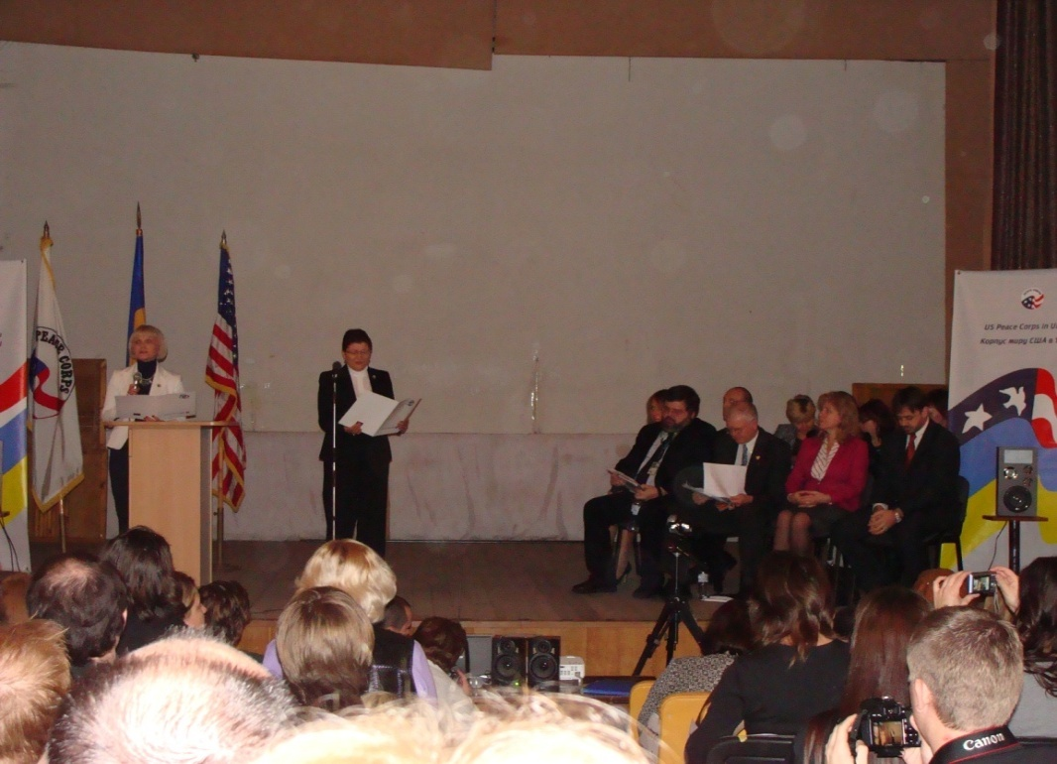
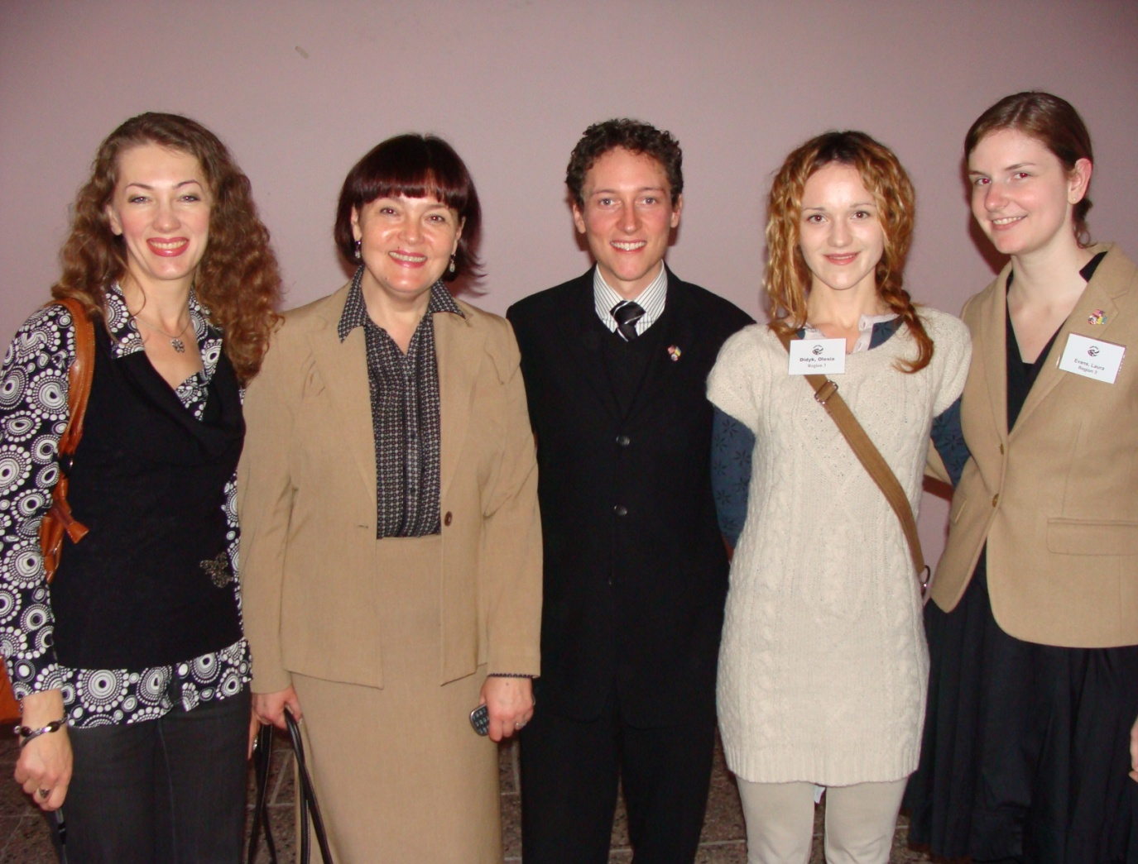
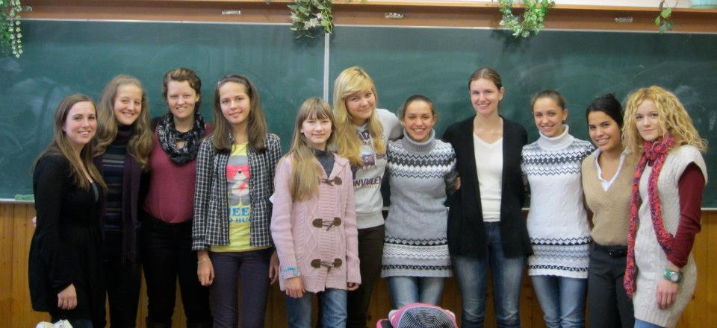
My authenticities
Olesya Didyk
Peace Corps collaboration as indispensable experience and self-improvement;
Acknowledgements in proficiency

Slide 4
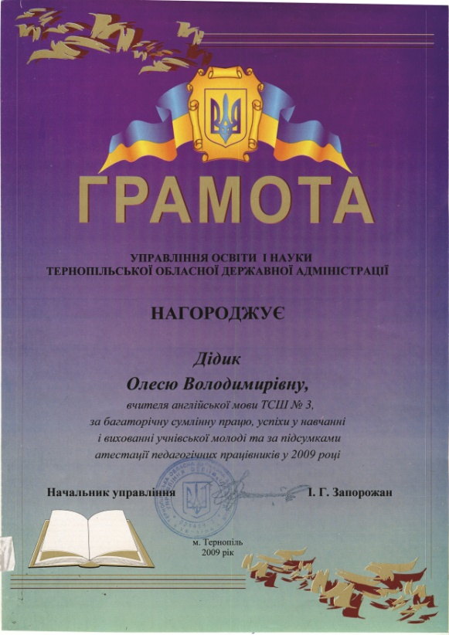
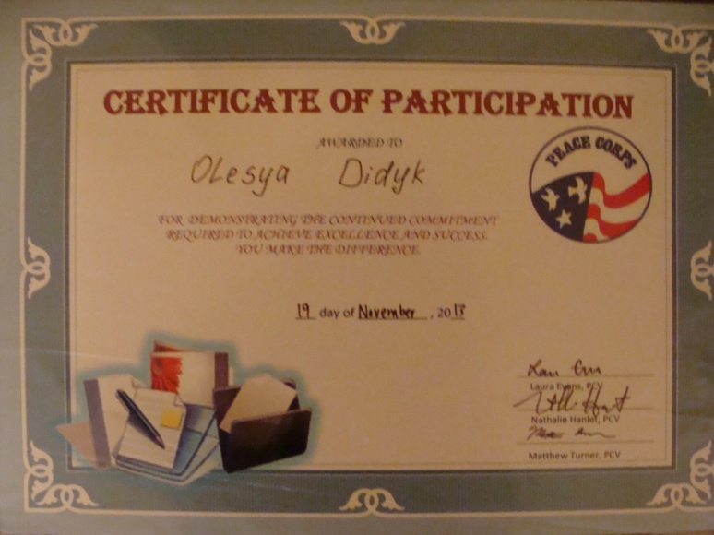

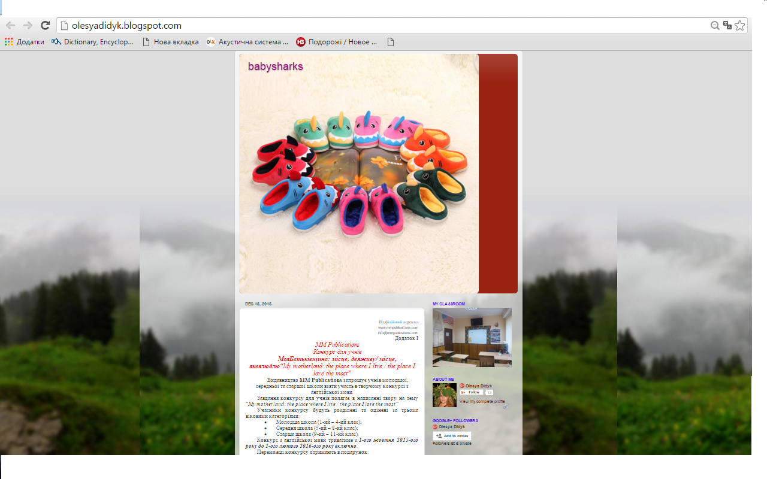
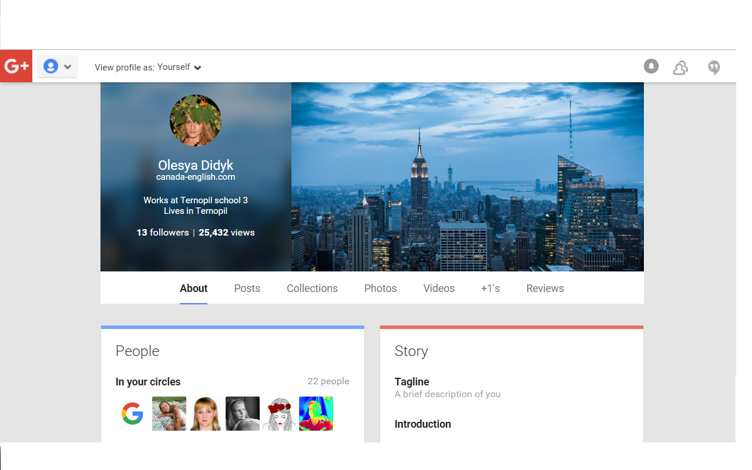
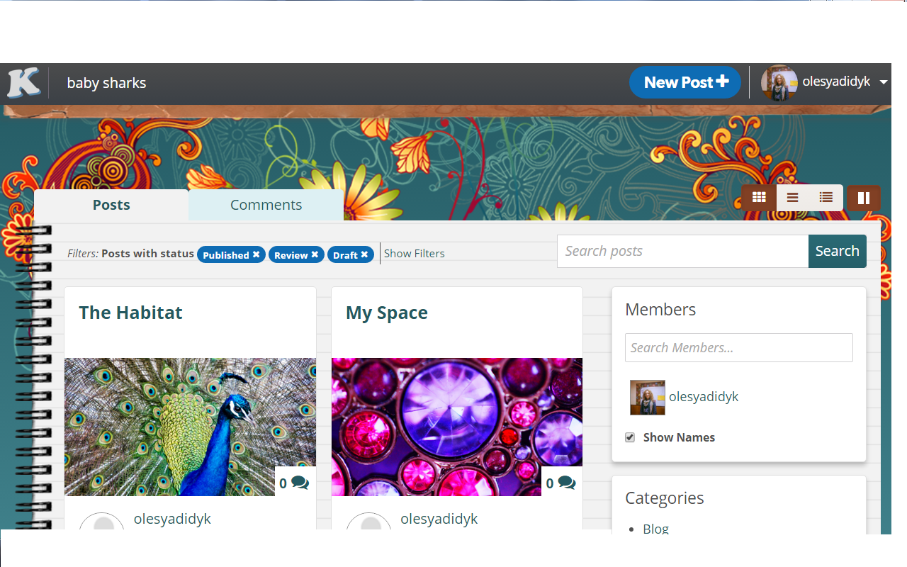

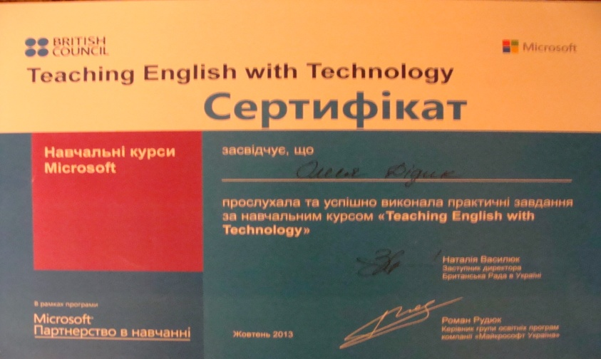
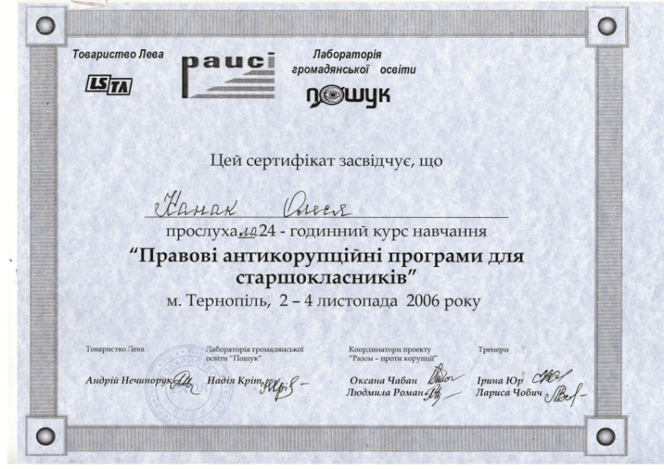
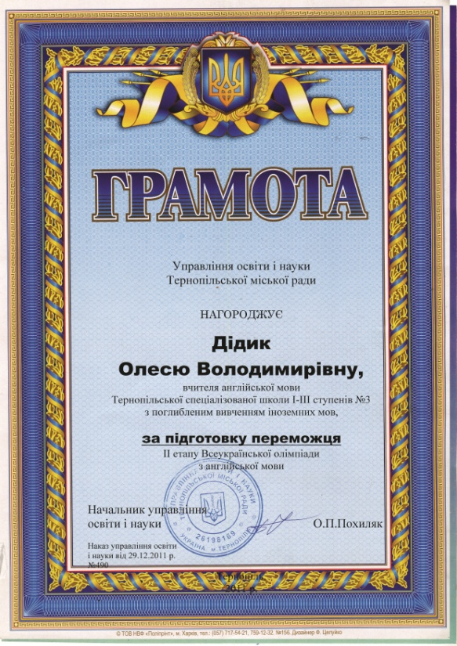
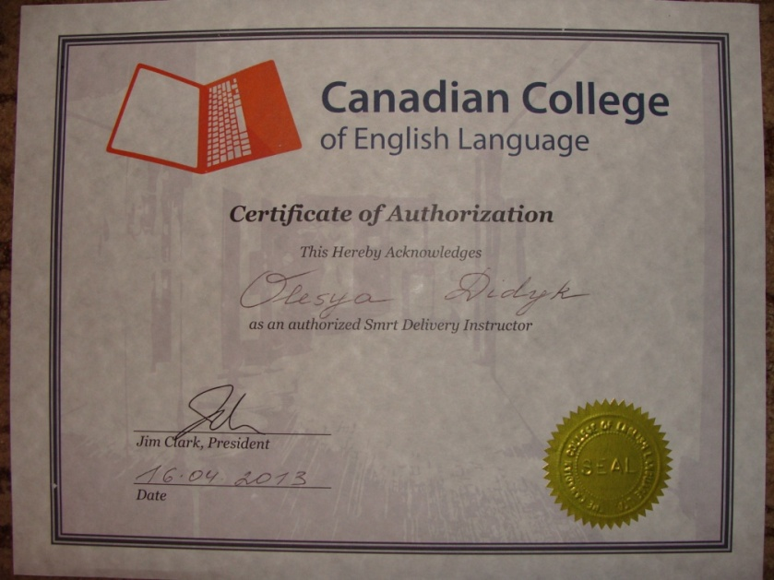
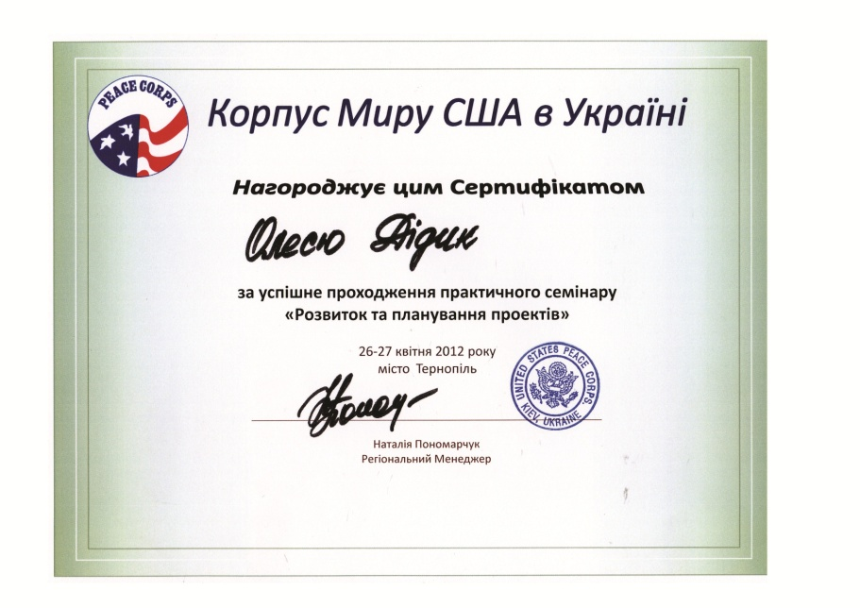
Your Book Title Here
Your Book Title Here

Slide 5

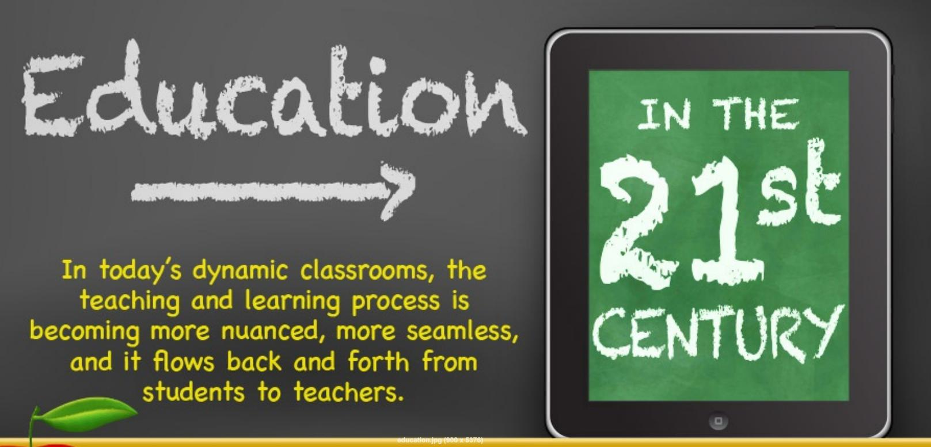
A combination of communicative approach, counterpoint/critical thinking and incorporation of new technologies in English language/literature classes in the middle and high school.

Slide 6






21st Century Study Skills
ENGAGEMENT
SELF-DIRECTION
MOTIVATION
The 4 – C’s

Slide 7


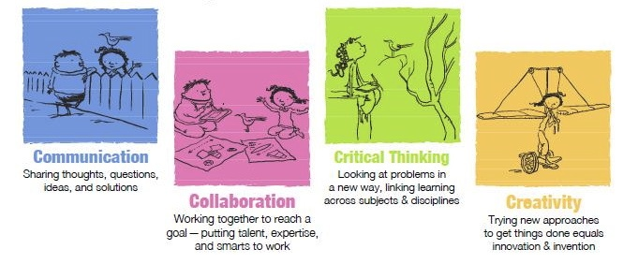
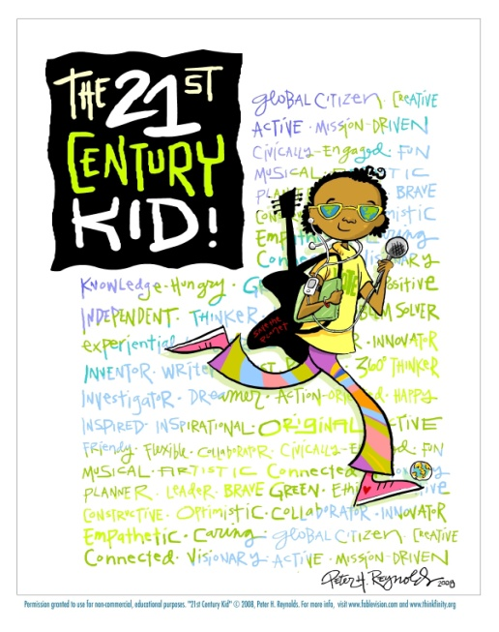
The 4- C’s

Slide 8
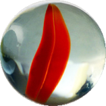
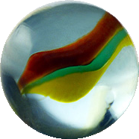
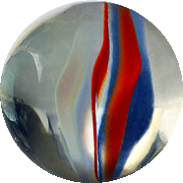
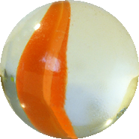
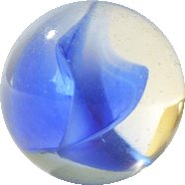












Communicative approach
Linguistic Discourse Pragmatic Sociolinguistic Sociocultural
Vocabulary
Semantics
Grammar
Phonology
Longer spoken turns
Interaction
Open conversation
Interpret meaning in real situations
Use linguistic resources
Language used appropriately in social contexts
Awareness of background knowledge and cultural assumptions

Slide 9
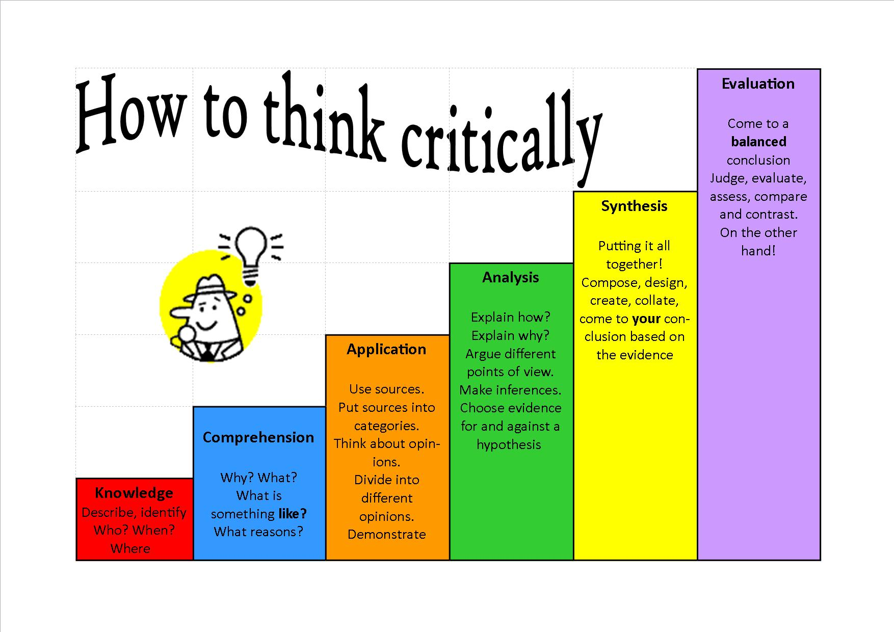

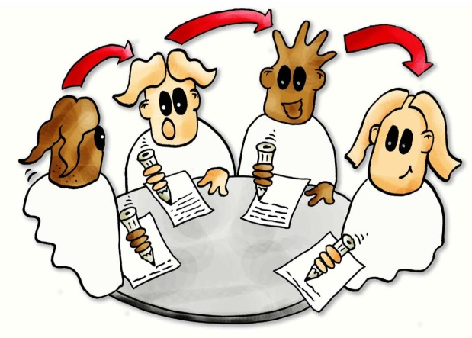
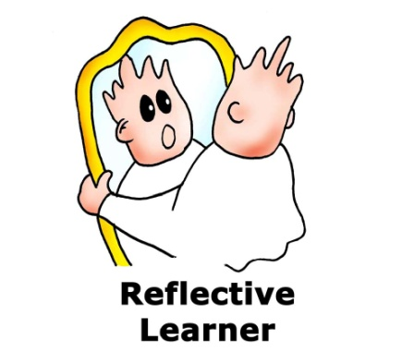


Slide 10
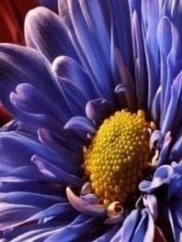
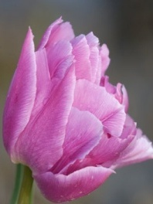
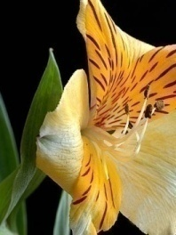
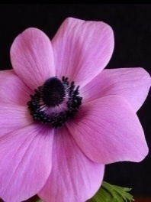
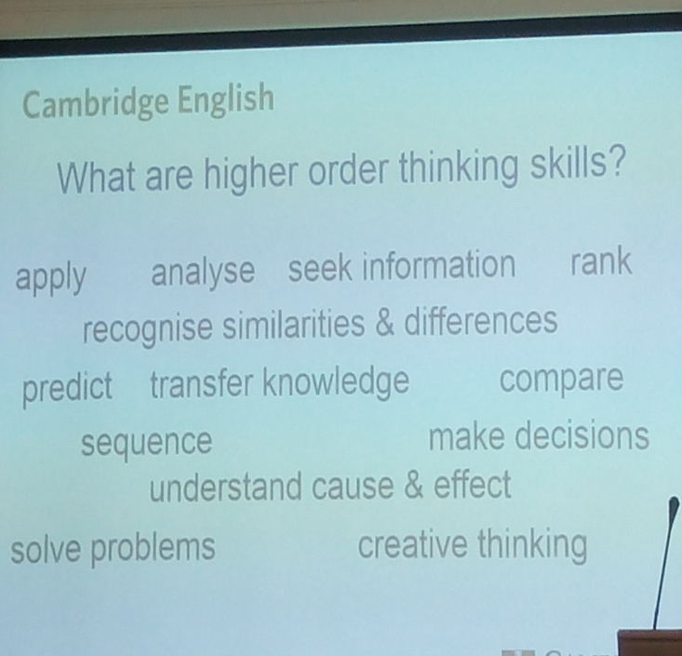
Is there more future or more past?
How many bricks is a wall?
Are you more like a square or a circle? Why?
Is soup a food or a drink?
What are some ways you could celebrate "Backwards Day?"
Does killing time damage eternity?

Slide 11
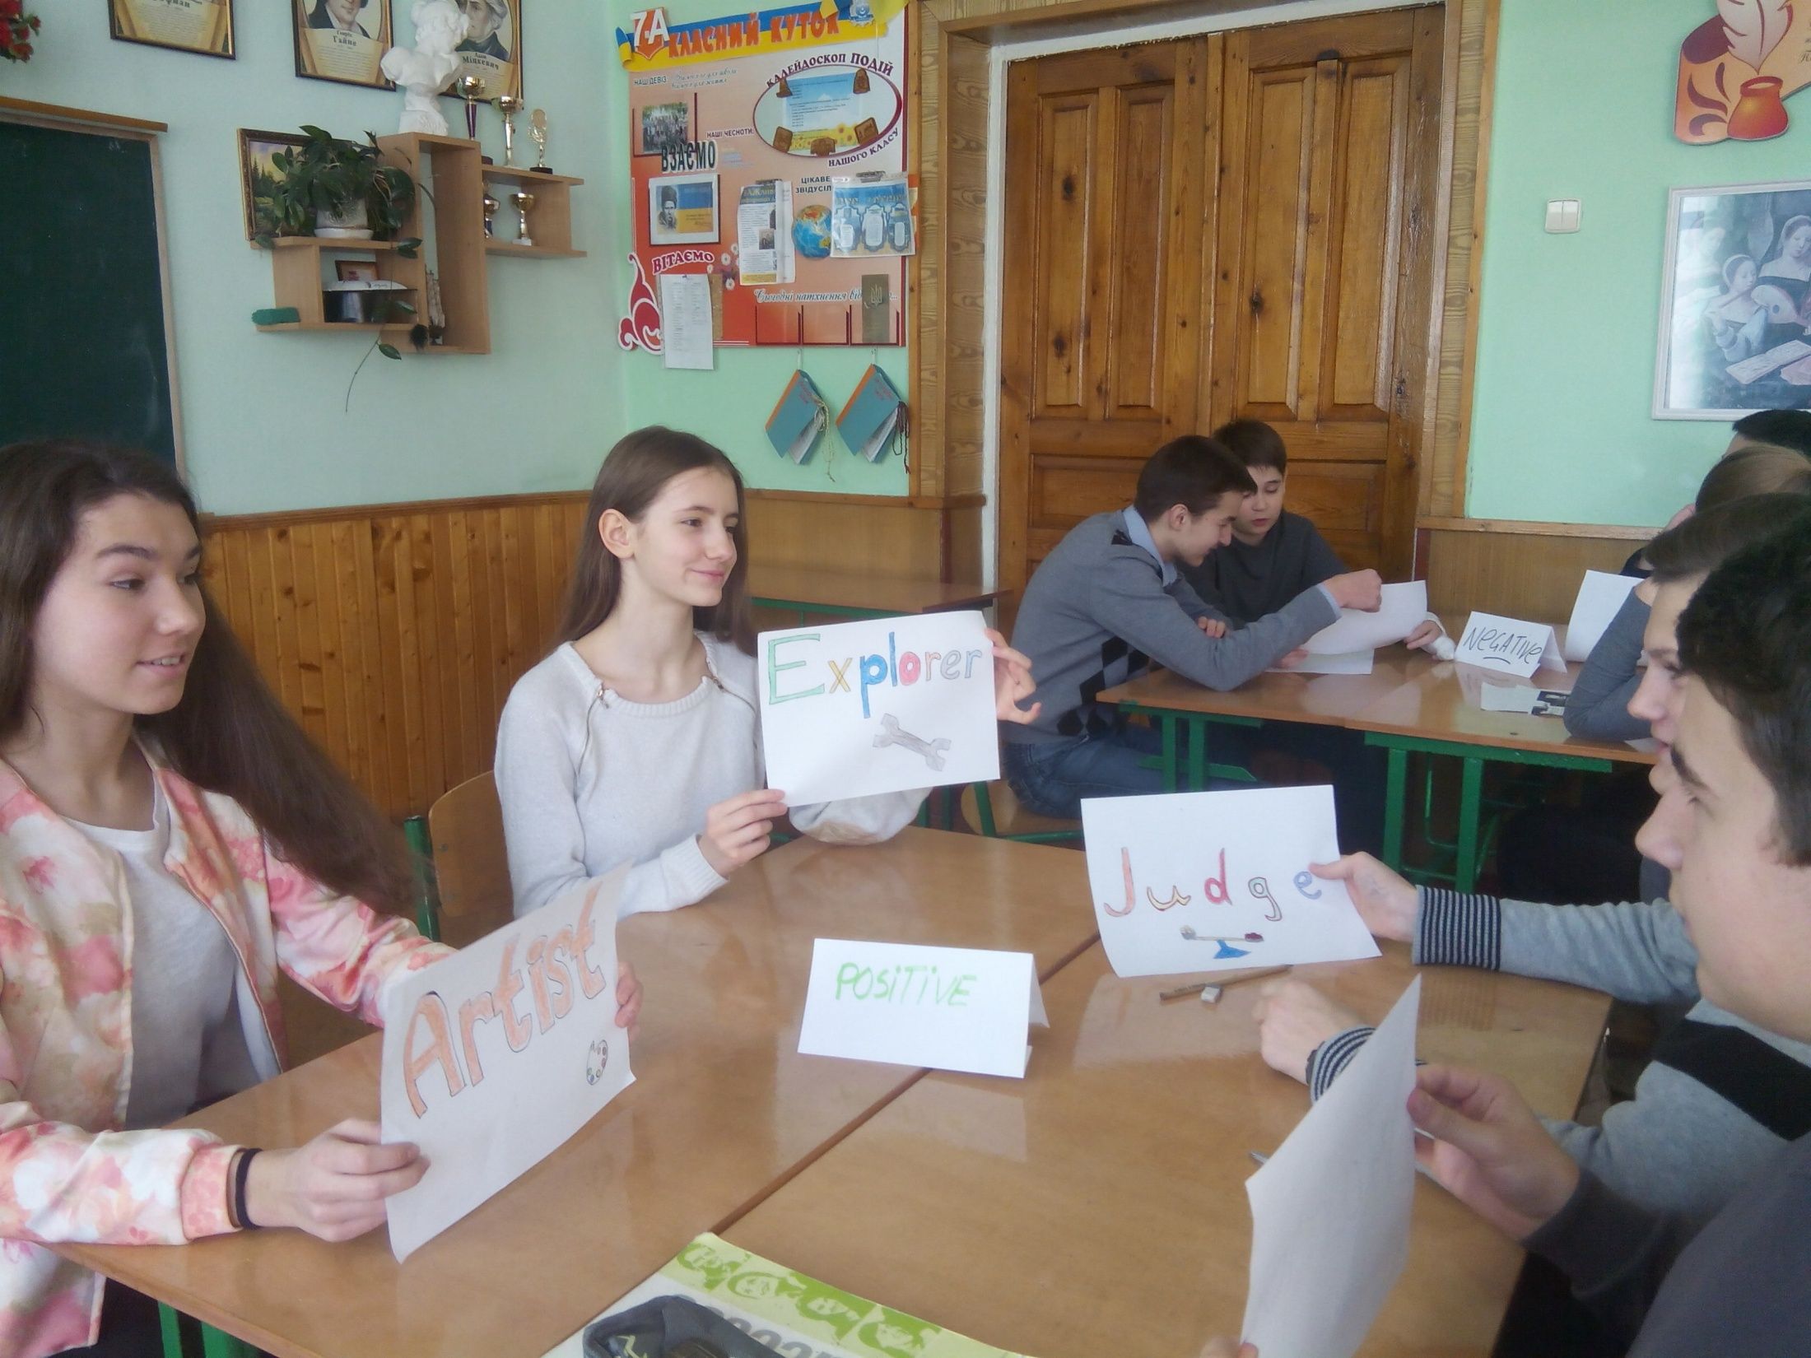
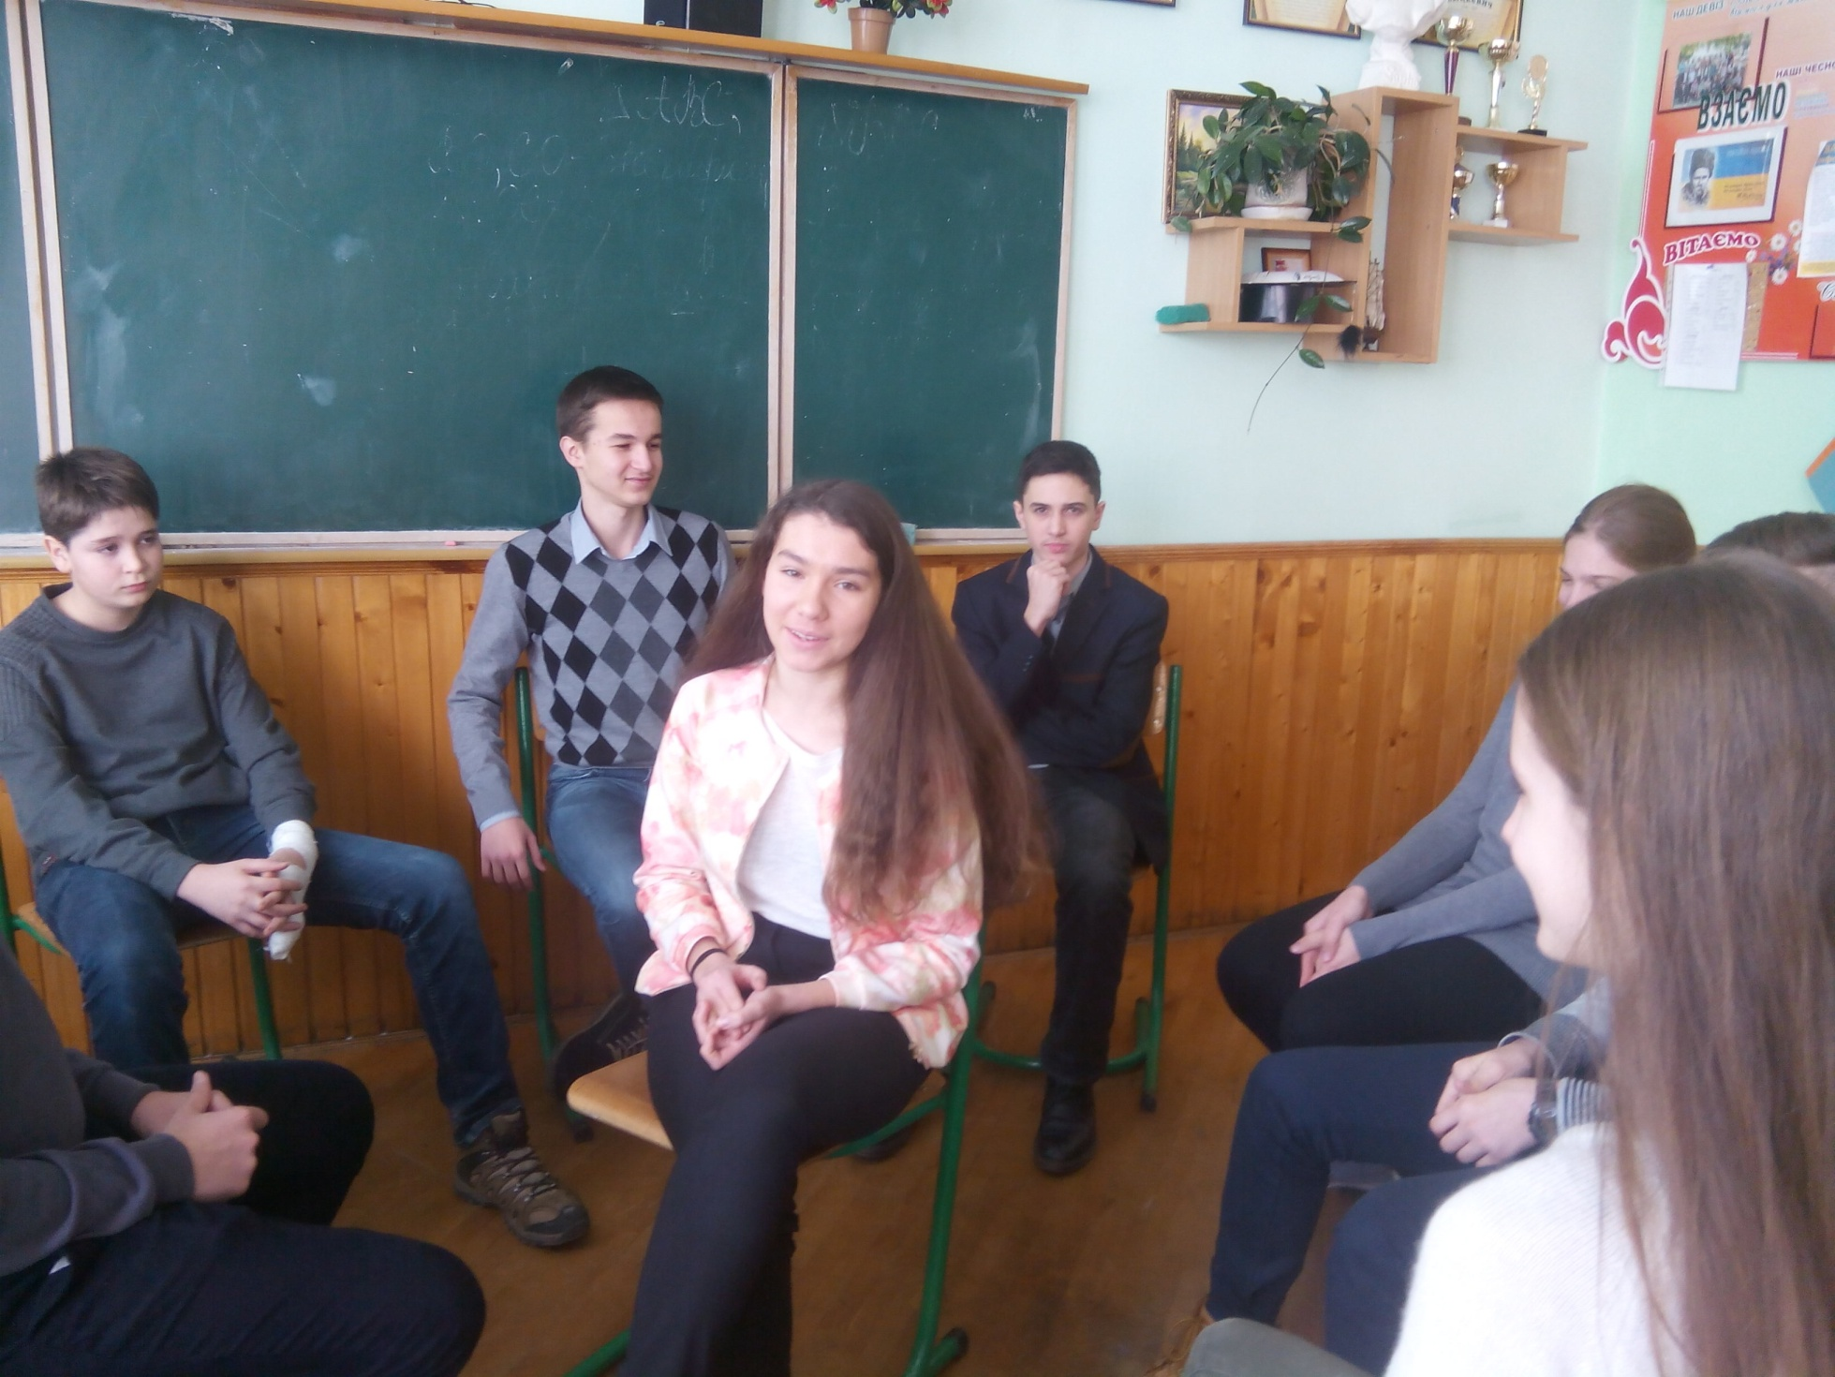


















Goal
SCAFFOLDING
POST IT
SHOW BAGS
WRITE ROUND ROBIN
Execute
CAROUSEL
JIGSAW
Evaluate
FACE FOLDER
NOTION DOUGHNUT
Visualize
FLIPPED CLASSROOM
Focus and plan
HOT CHAIR
GALLERY
THINKING HATS
BRAINSTORM
Represent
ETC.
Notes:
Keywords:
Steps, Goal, achievement, process

Slide 12











Incorporation of new technologies

Slide 13















Slide 14











My authenticities
Olesya Didyk
Extracurricular work and after school activities are essential, educational and uplifting.
The endless challenges of education keep me motivated and inspired.

