Slide 1
The future belongs to those,
who believe in their dreams

Slide 2
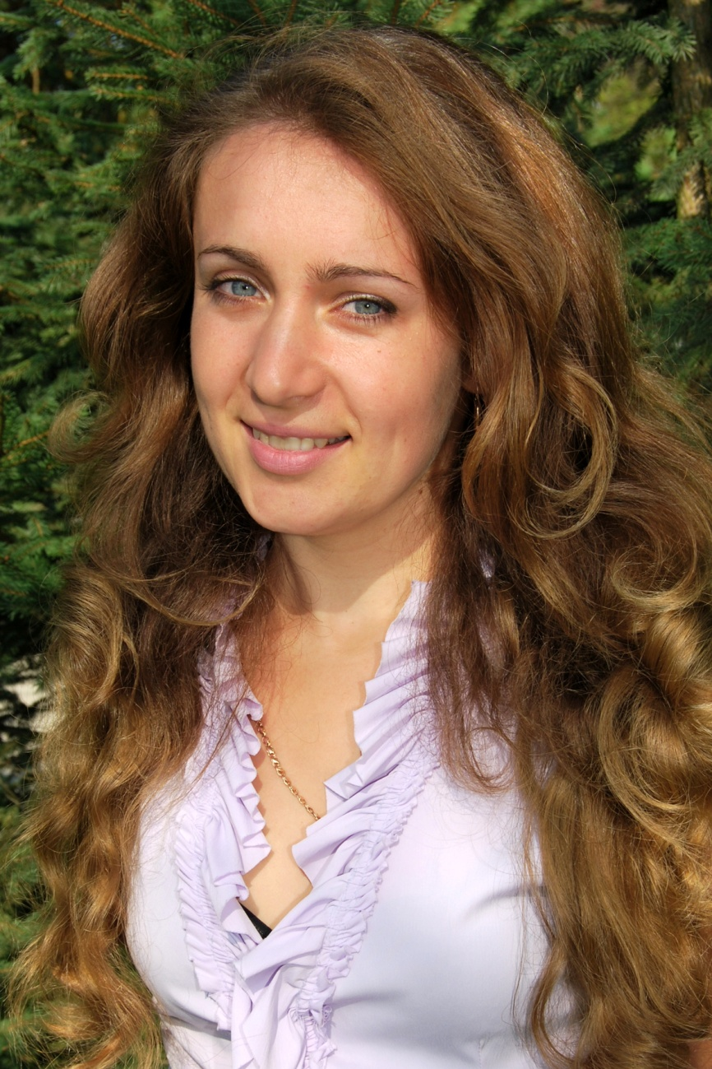
Graduated from
The Kremenets Pedagogical
Institute named after
T.G.Shevchenko
English Teacher
Golovatiuk Lilia Mykolaivna
Has worked at school of Vyshnivets since 2006
The motto is:
The more kindness, love and work you give, the more self-sufficient and wise generation you get
The theme has been worked on:
“Using of communicative method at English lessons to stimulate communicative activity of pupils”

Slide 3
It is my firm belief that communicative competence is the ability to use the language correctly and appropriately to accomplish communication goals. The desired outcome of the language learning process of students is the ability to communicate competently, not the ability to use the language exactly as a native speaker does.
- Although I still wish my pupils could.
”I am” is

Slide 4
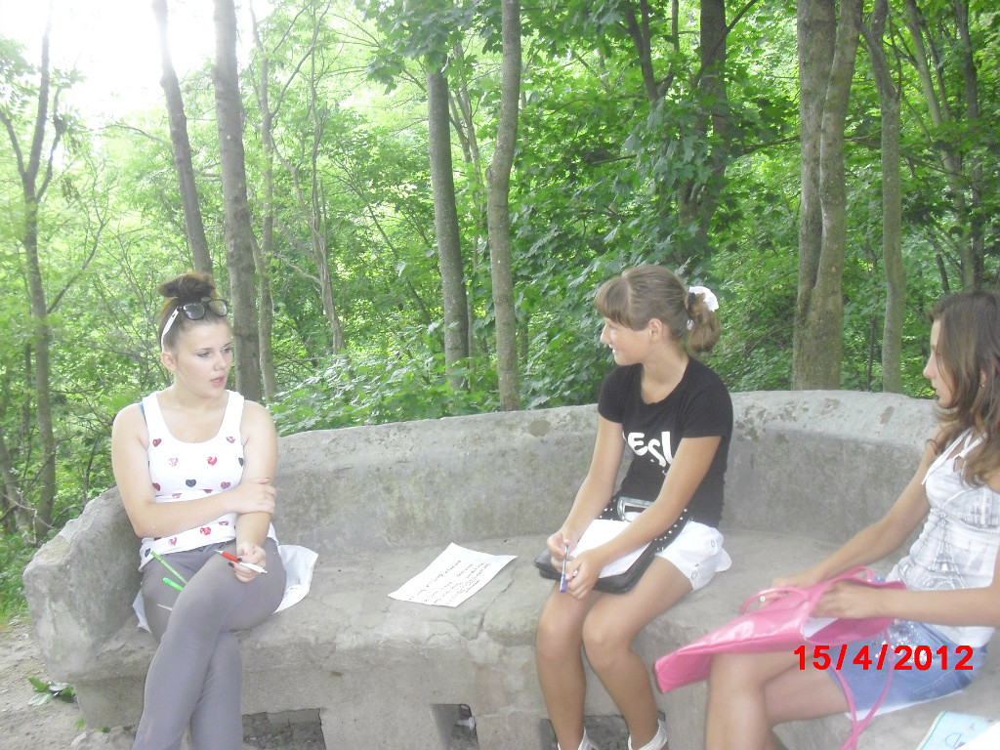
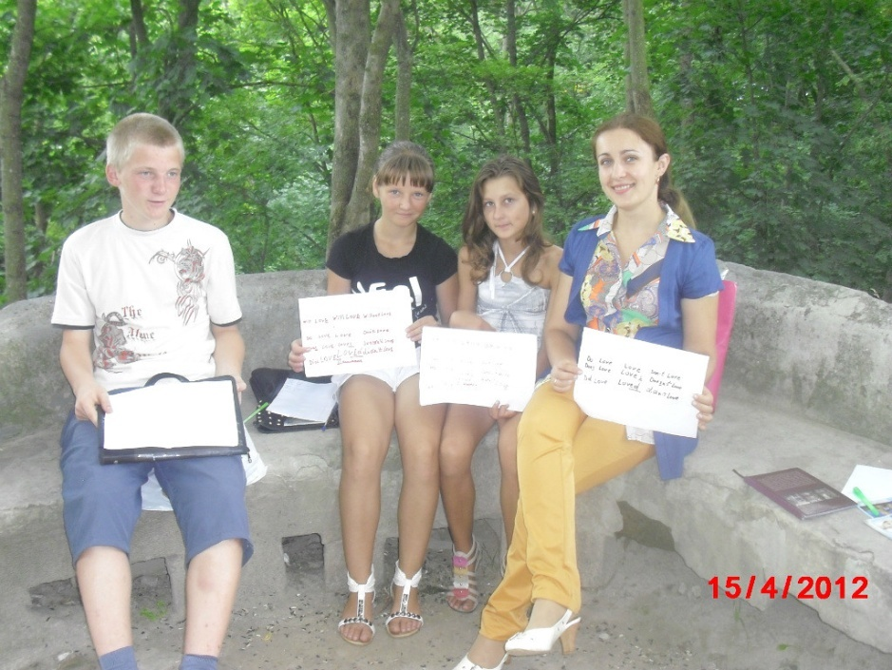
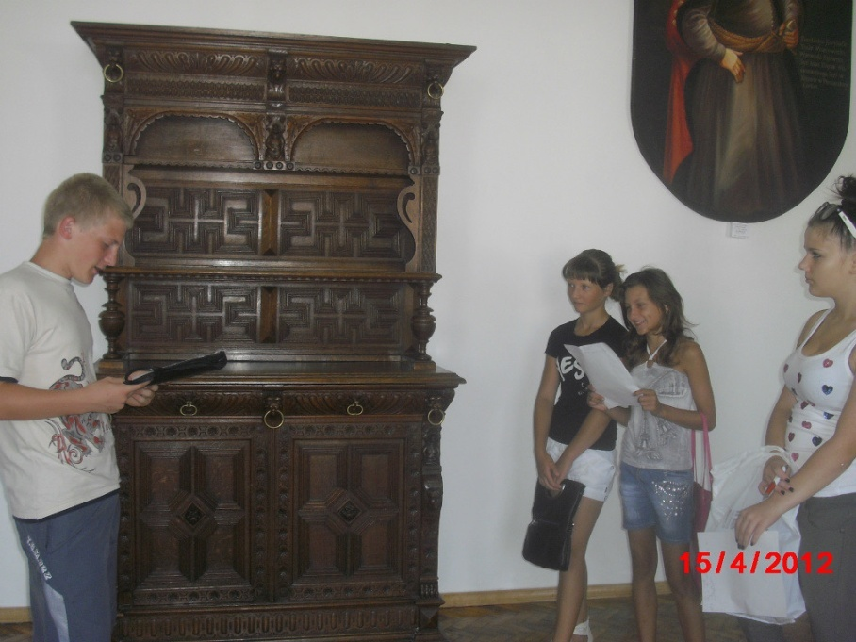
“Language is the blood of the soul into which thoughts run and out of which they grow”
(Oliver W.Holmes)
repotedly

Slide 5
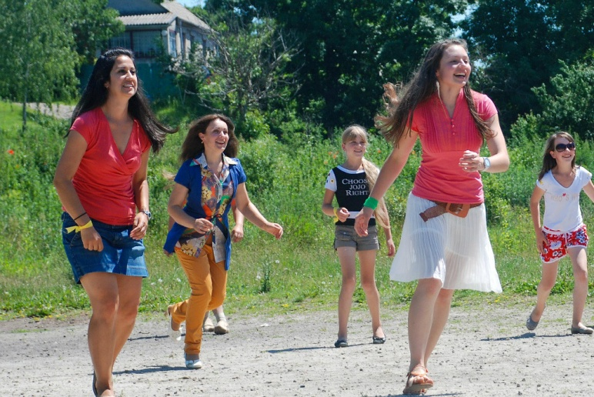
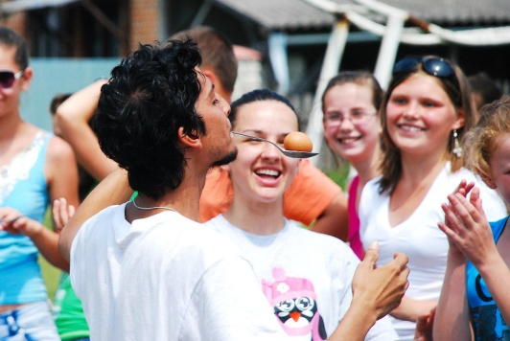
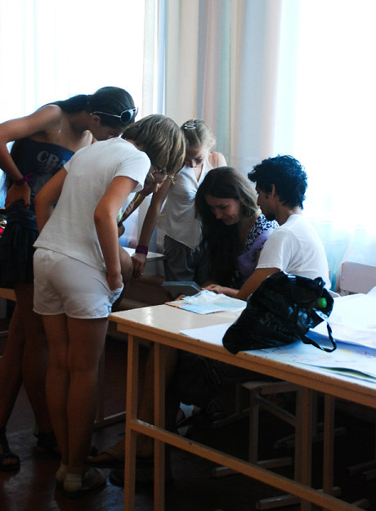
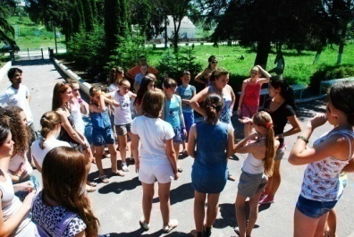
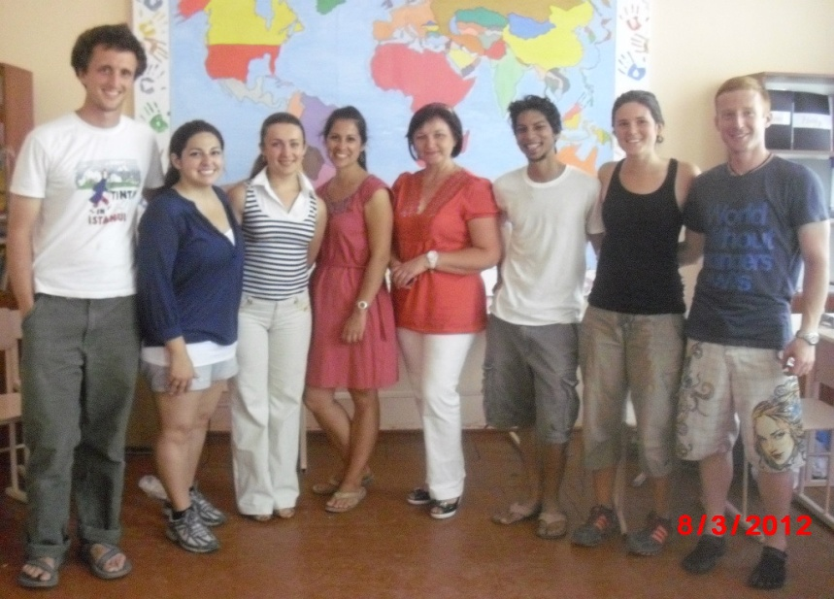
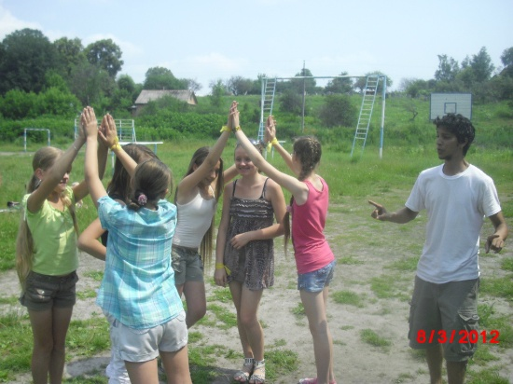
“All languages are siblings” (Amolkumar Uderwar)
the shortest

Slide 6
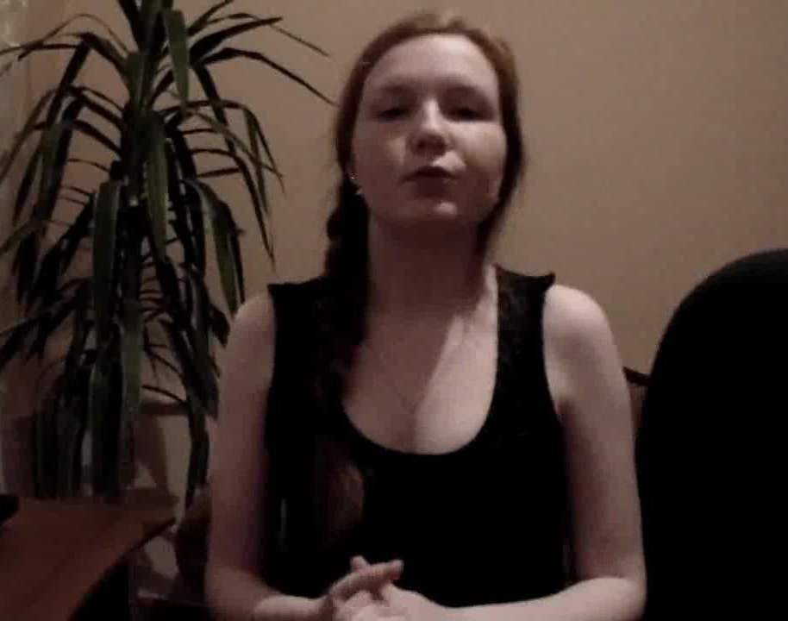
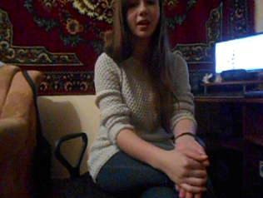
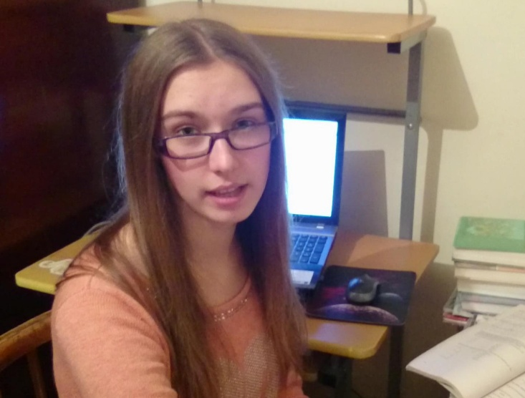
“A riot is the language of the unheard ”
(Marting L. King)
sentence

Slide 7
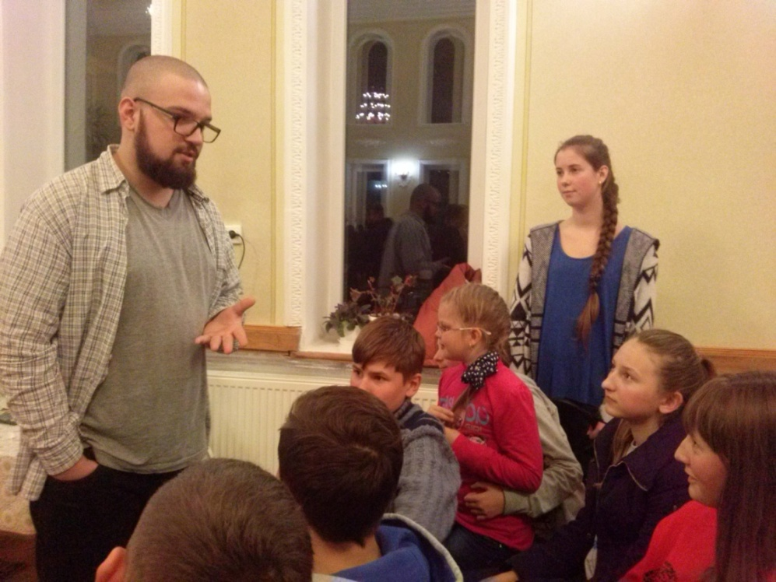
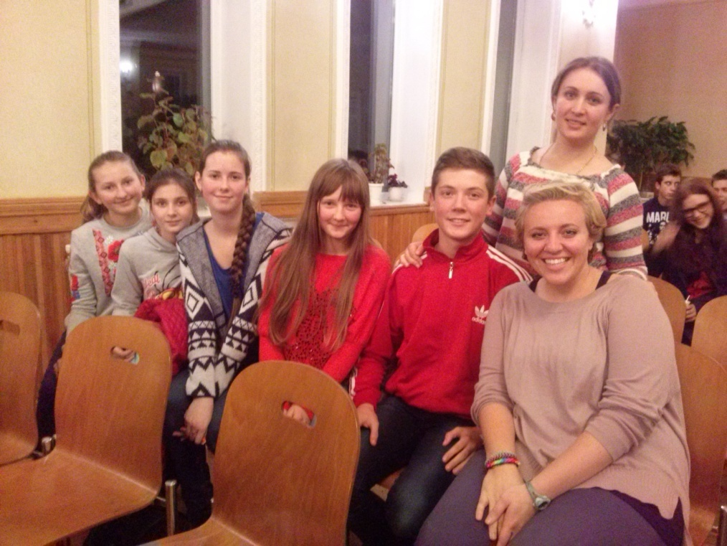
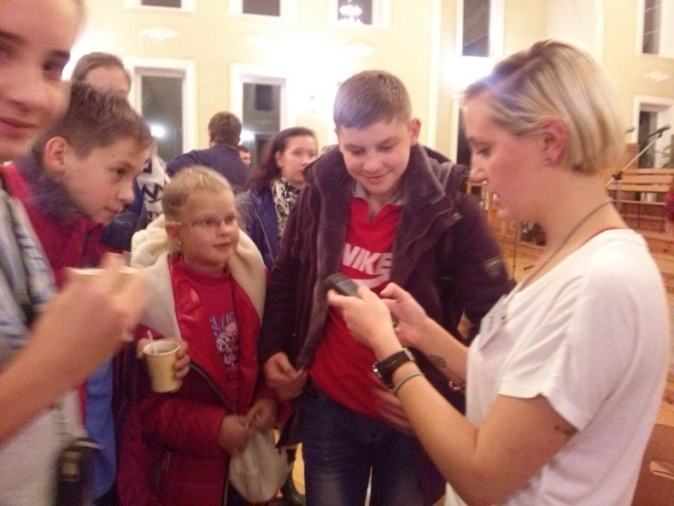
“Story is well told if you have nothing to say but the beginning”
(Rajat K.Chakrabarty)
in the English language.

Slide 8
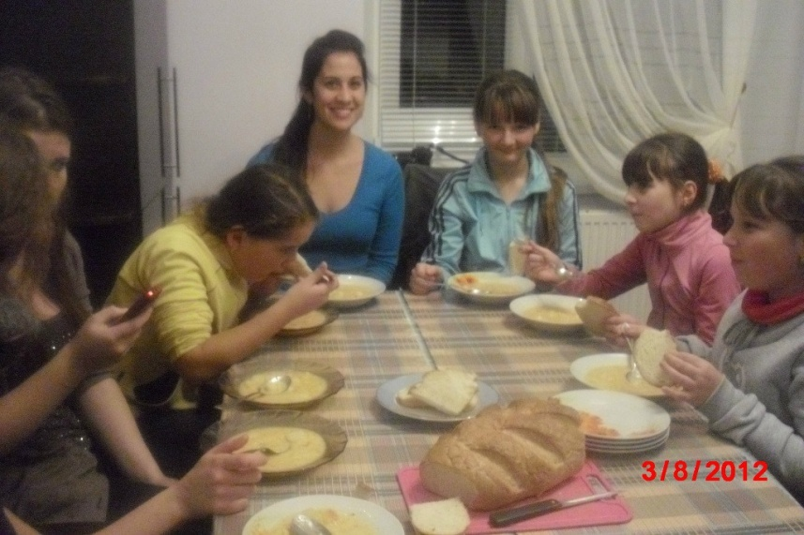
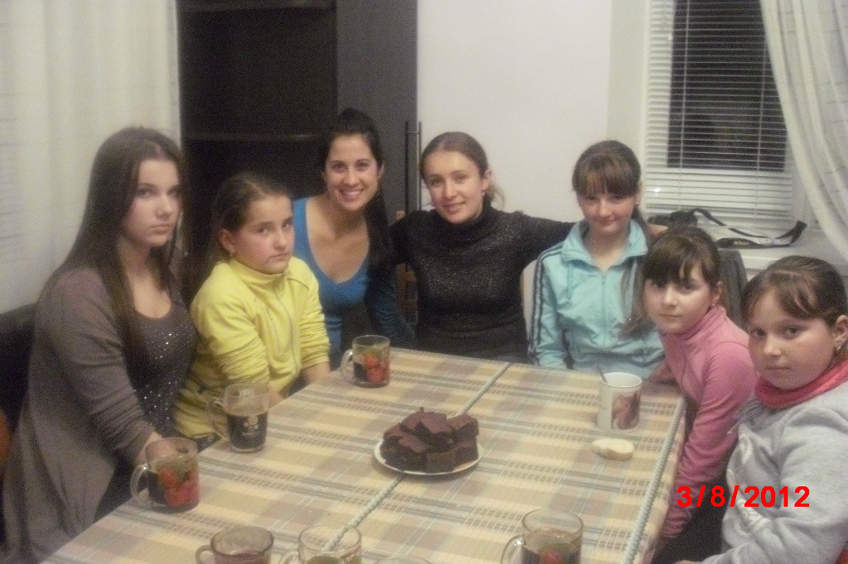
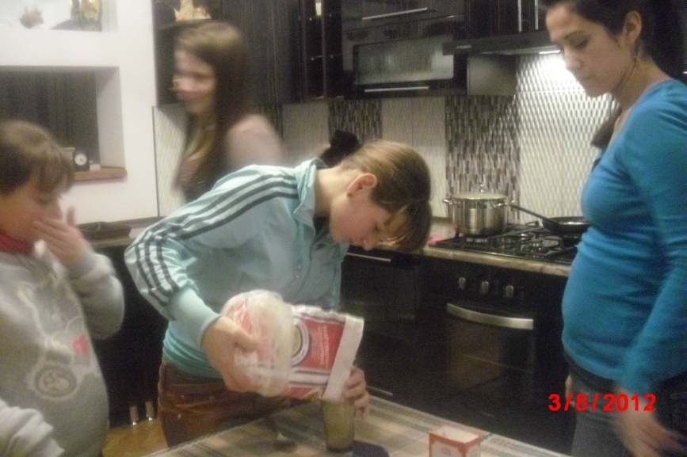
If you talk to a man in a language he understands, that goes to his head. If you talk to him in his language, that goes to his heart
Could it be that
(Nelson Mandela)

Slide 9
”I do “
I agree.
It is more of an approach or philosophy than a highly structured methodology. David Nunan famously listed five key elements to the communicative approach:
An emphasis on learning to communicate through interaction in the target language.
The introduction of authentic texts into the learning situation.
The provision of opportunities for learners to focus, not only on the language but also on the learning process itself.
An enhancement of the learner's own personal experiences as important contributing elements to classroom learning.
An attempt to link classroom language learning with language activation outside the classroom.

Slide 10
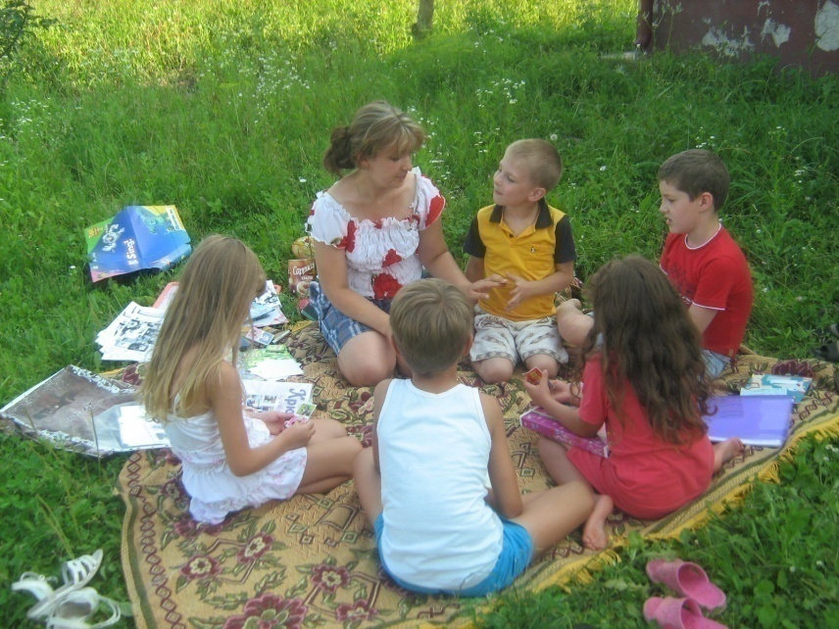
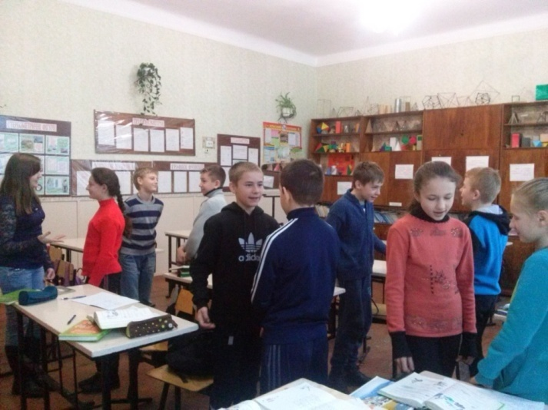
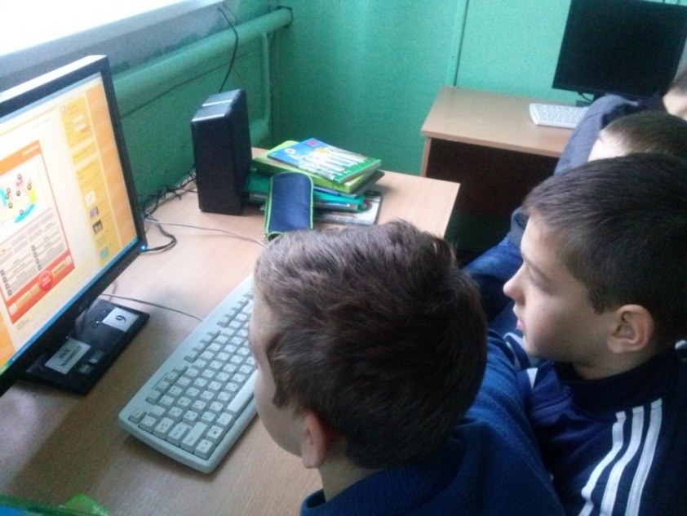
is
“Kindnes is the language which the deaf can hear and the blind can see”
(Mark Twain)

Slide 11
Materials and how they can be used
the longest
Task-based material consists of exercise handbooks, cue cards, activity cards, pair-communication practice materials and student-interaction practice booklets.
They will typically contain visual cues, pictures and sentence fragments which the learners can use as a starting point for conversation.

Slide 12
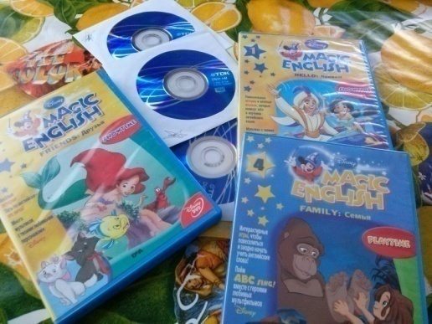
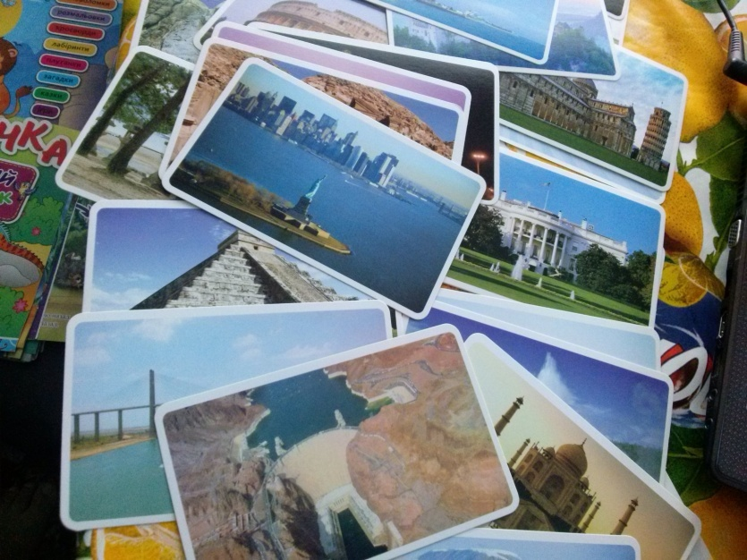
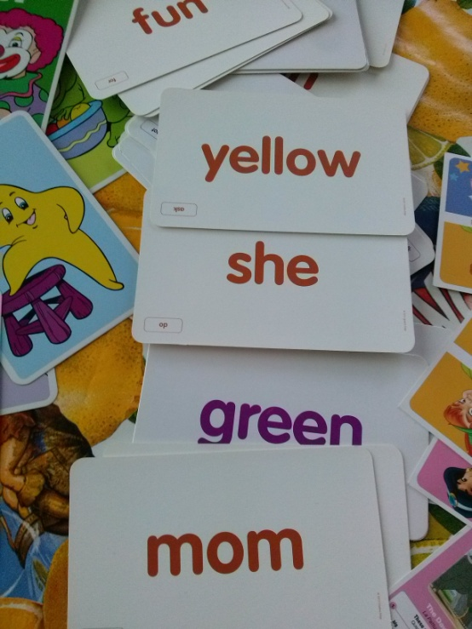
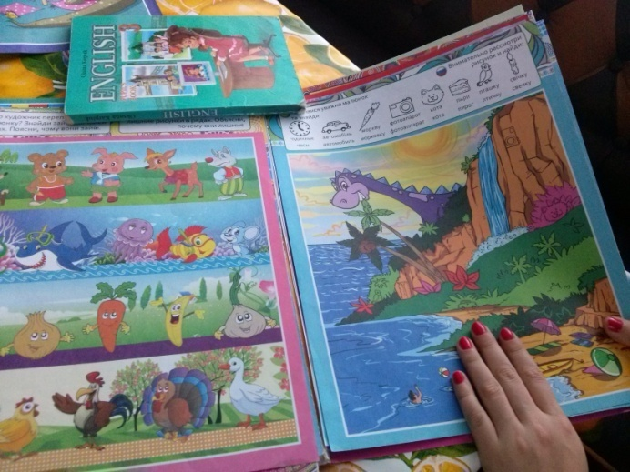
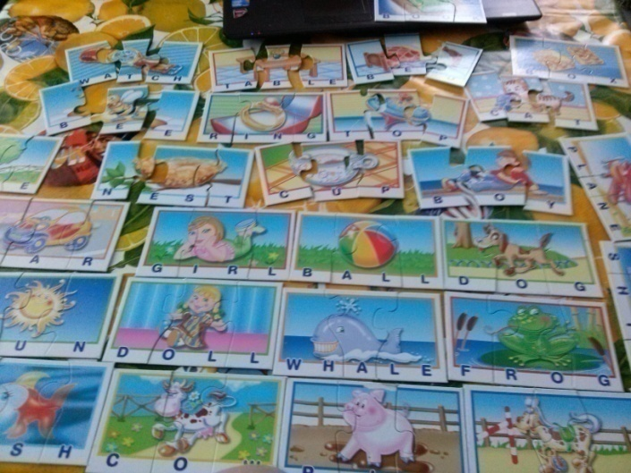
“Language is the dress of thought”
(Samuel Johnson)
senteance ?

Slide 13
“I am” is repotedly the shortest sentence in the English language. Could it be that “I do” is the longest sentence?

