Slide 2
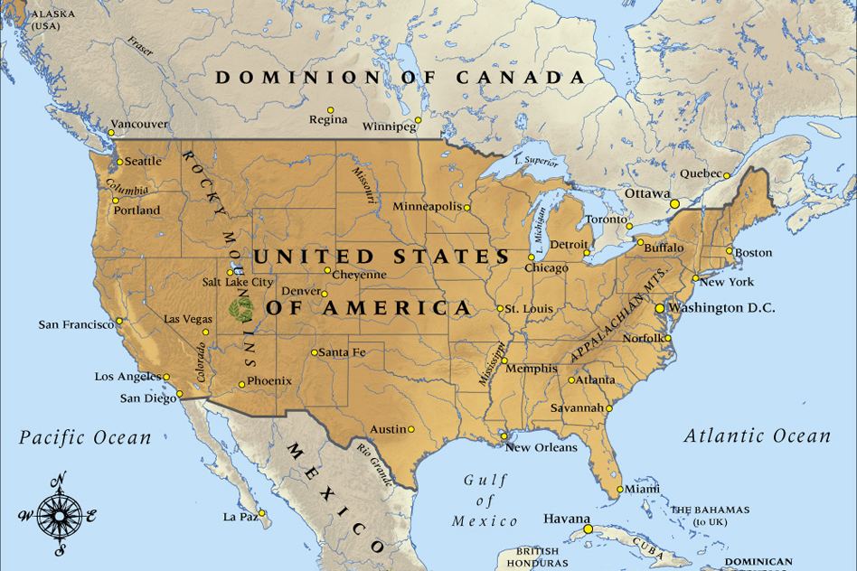

Slide 3
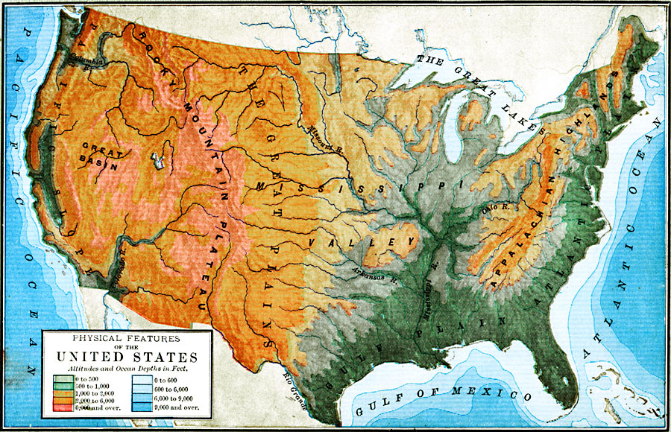

Slide 4
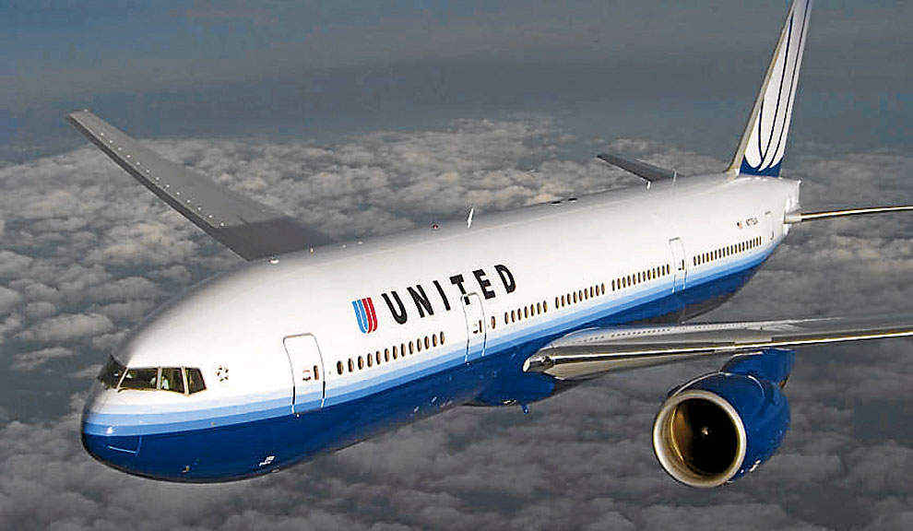

Slide 5
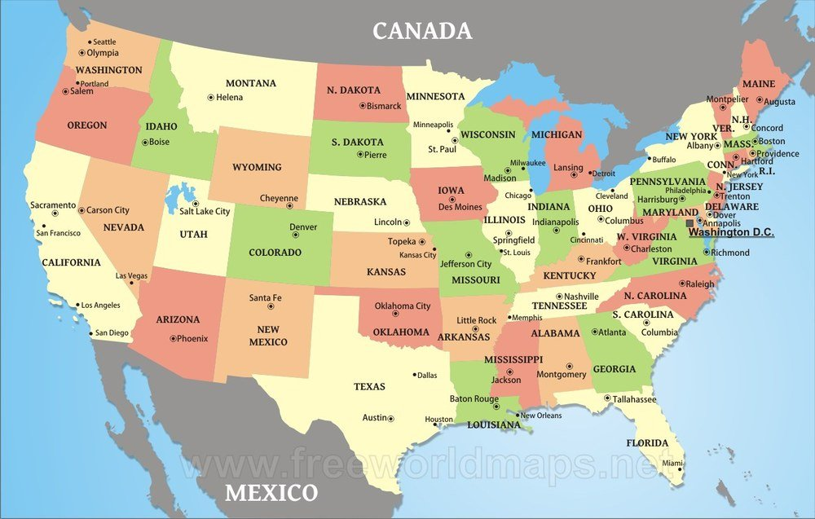

Slide 6
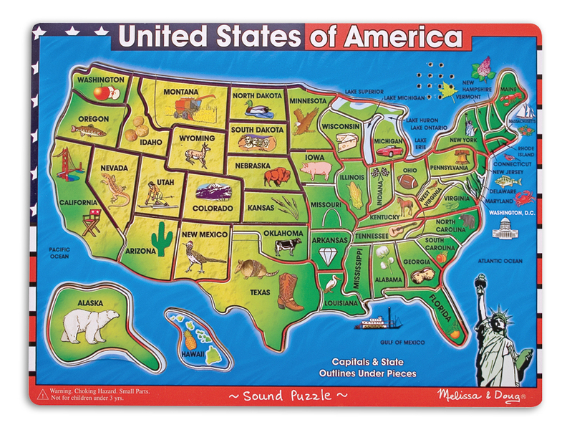

Slide 9
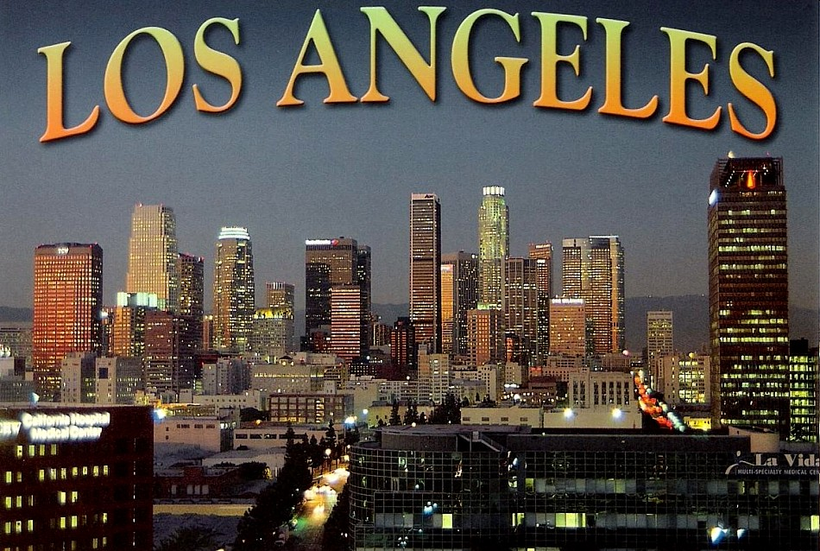

Slide 11
- Which is the biggest state of the USA? - Where is Hollywood? - What is the longest river? - What is the name of the parliament - What is the President’s residence? - What is the biggest city of the USA? - What is no industry city in the USA? - How many states are in America?
QUIZ

Slide 12
Our heritage: American! A treasure we all share, Our family trees have brought us here, From almost everywhere.
Our heritage: American! A family of all, A blend of cultures forming one, United, standing tall.

