Slide 1
Table Manners -You must sit up straight at the table. -You must eat with a knife and a fork. -You mustn't eat with your fingers. -You mustn't lick your fingers. -You must put your dirty knife, spoon and fork on your plate after finishing to eat. -You mustn't put your elbows on the table. It is not polite. -You mustn't talk with your mouth full. -You should say "Thank you" after the meal.

Slide 2
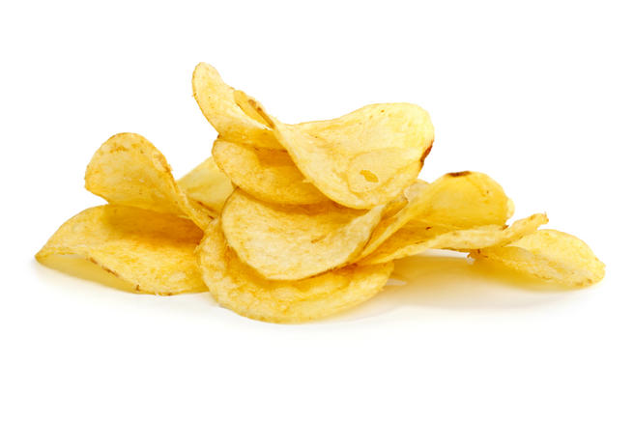
Over five million kilograms of crisps are eaten in Britain every week.

Slide 3
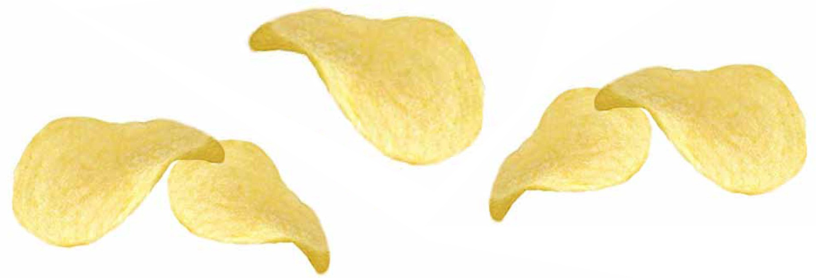
True. Other figures concerning the national passion for potato crisps are: 5kg per person per year = 293 mln kg total consumption per year = 0,8 mln kg per day = 556 kg per minute.

Slide 4
People in Britain are buying 20 % less food from supermarkets today than they did ten years ago.

Slide 5
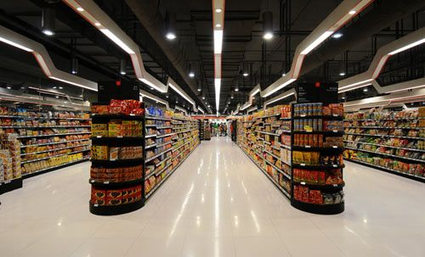
False. Supermarkets have more than doubled their share of food sales in the past ten years.

Slide 6
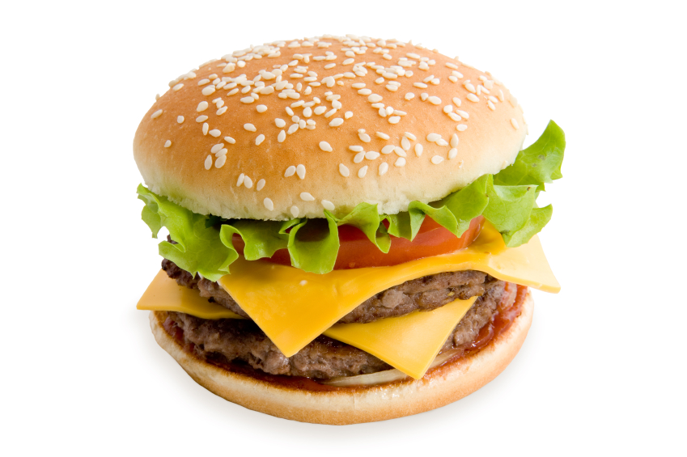
The British spend about 1,26 billion pounds a year on hamburgers, double what they spend on medicines.

Slide 7
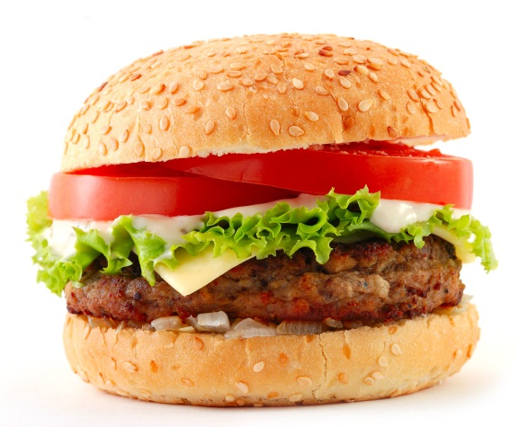
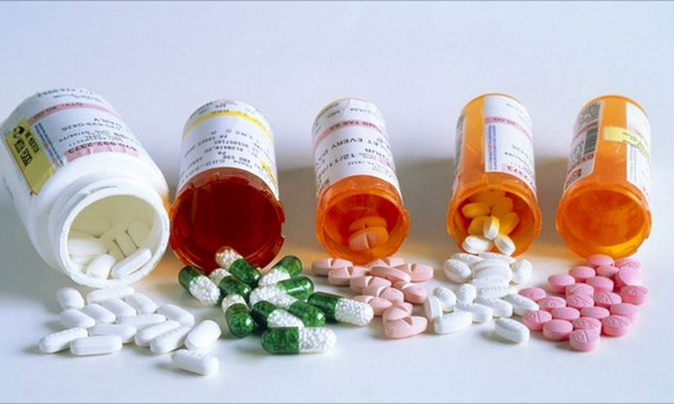
False. 1,26 billion pounds is spent on hamburgers, but this is less than half of what is spent on medicines.

Slide 8
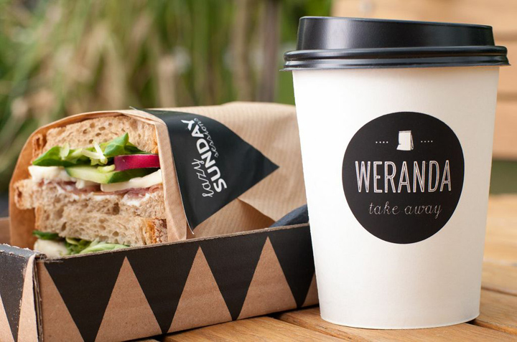
There are more Chinese take-aways than there are fish and chip shops in the UK.

Slide 9
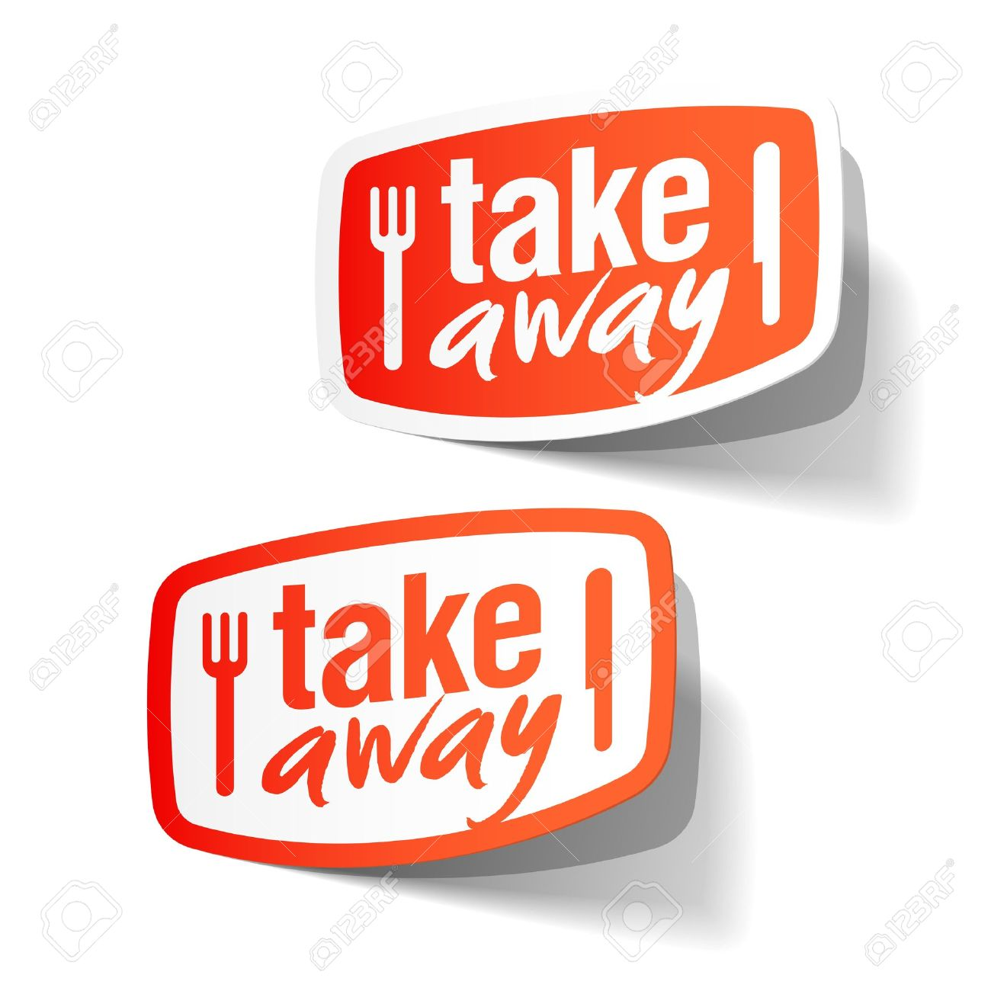
True

Slide 10
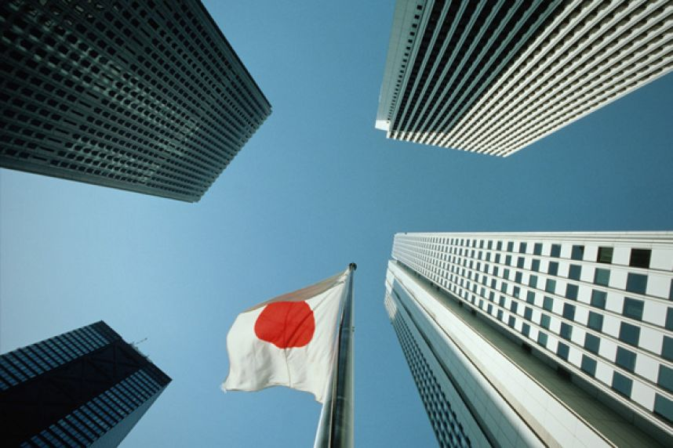
The biggest owner of pubs in Britain is a Japanese bank.

Slide 11
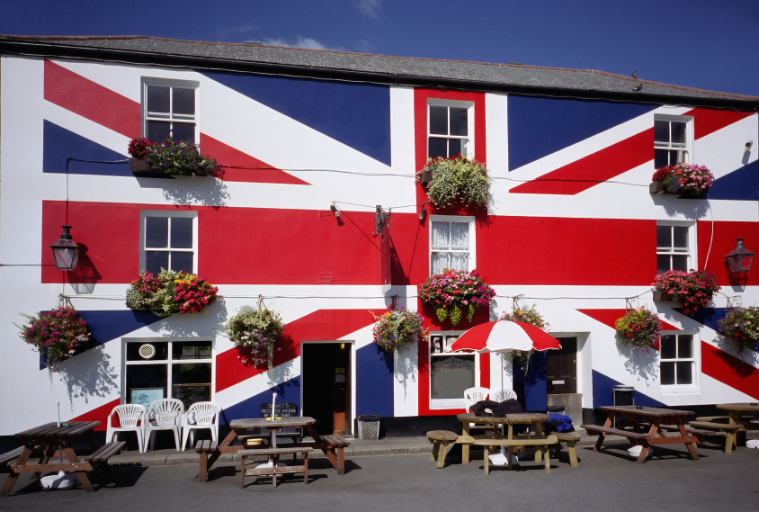
True. Nomura Bank owns 3,998 British pubs (March 1998 figure).

Slide 12
One of the most successful food programmes on TV recently was called "Two Fat Ladies". It celebrated some of the richest, heaviest, fattiest foods in British and world cooking.

Slide 13
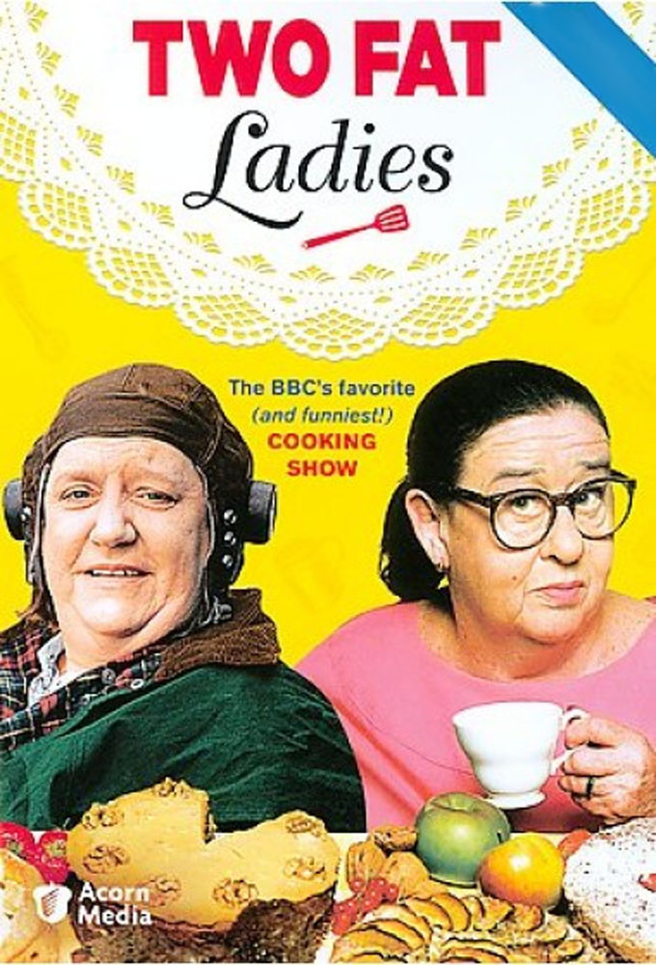
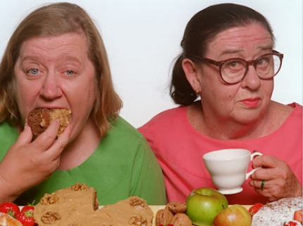
True.

Slide 14
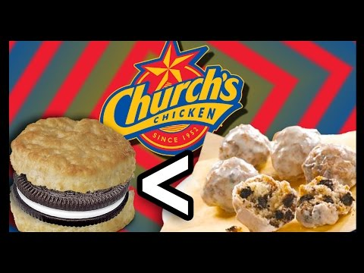
In 1997, a frozen food company started selling chocolate-flavoured carrots and pizza-flavoured sweet corn to encourage children to eat fresh vegetables.

Slide 15
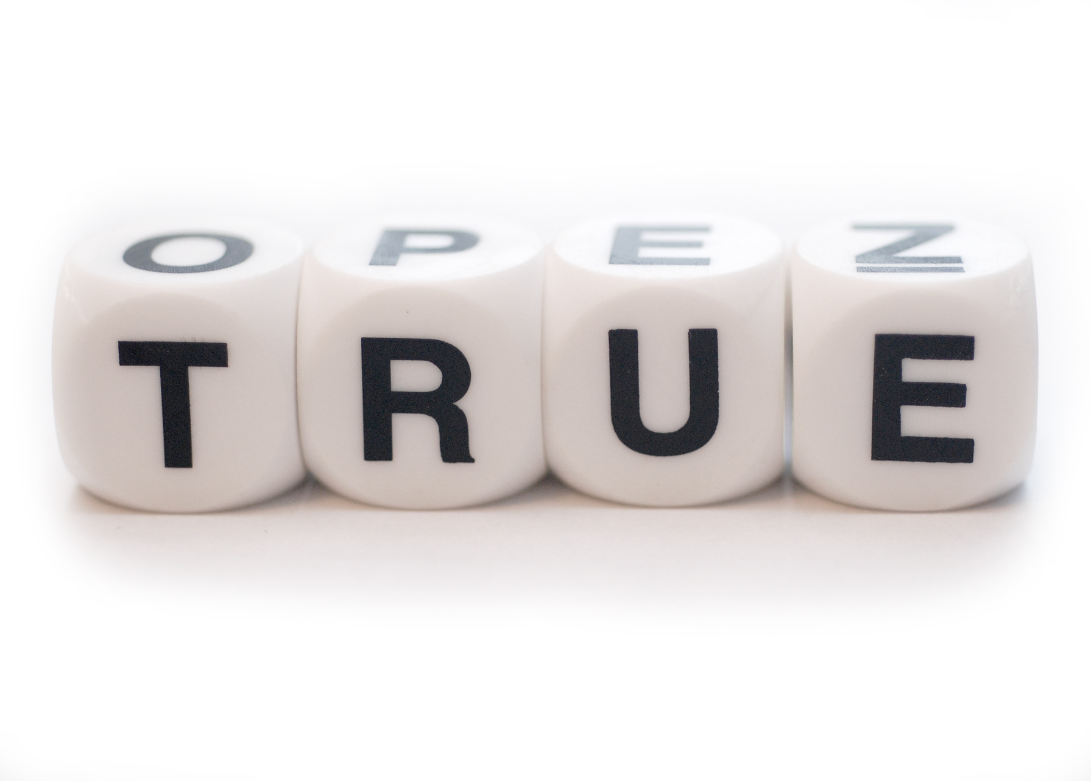

Slide 16
You can always eat (drink)… You can eat (drink)… sometimes. Never eat (drink)….

