Slide 1
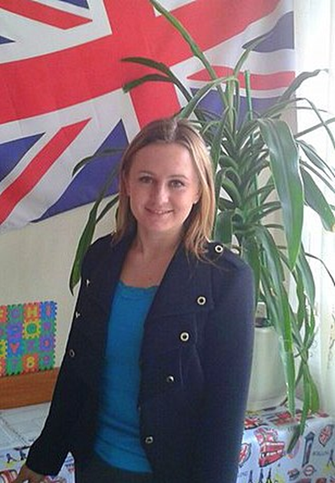
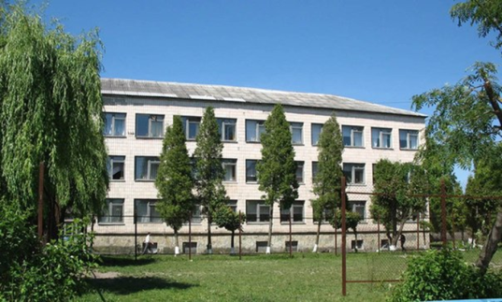
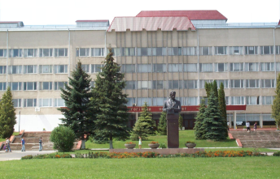
THE TEACHER OF ENGLISH OF SCHOOL №3 IN BEREZHANY KHIMIAK IRYNA MYKOLAIVNA
1996-2007 - SCHOOL №1 IN BEREZHANY
2007-2012 - Ternopil Volodymyr Hnatyuk National Pedagogical University

Slide 2
MOTTO: A good teacher not just imparts training but also inspires the student to learn. Aristotle

Slide 3
THEME: PROVIDING AND IMPROVING STUDENTS’ MOTIVATION IN LEARNING FOREIGN LANGUAGE
Highly motivated individuals persist at the task, desire high levels of performance and come back to the task time and time voluntarily.

Slide 4
Some students seem easier to motivate than others. IT DEPENDS ON STUDENTS’ - interests - abilities - sex differences (girls appear more motivated in language activities) - ethnic differences - socioeconomic and - family background variables

Slide 5
Reason to take action may be
intrinsic
extrinsic

Slide 6
Some ways for teachers to motivate struggling teens to stay on task:
Pay attention, do not ignore problems.
Communicate with parents about their child’s progress.
Recognize child’s achievements.
Celebrate students – motivate the teens to succeed by focusing on their strengths.
Never give up.

Slide 7
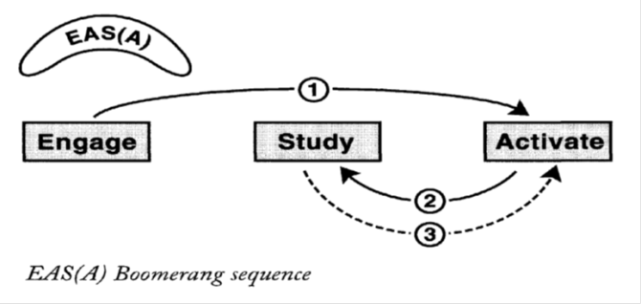
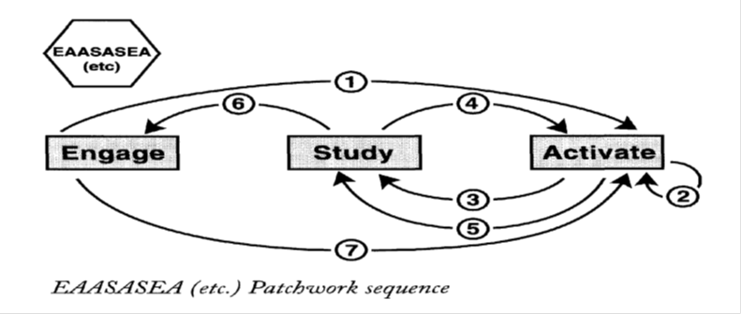
Harmer’s method in teaching E(Engage)-S(Study)-A(Activate)
Engage: this is the point in a teaching sequence where teachers try to arouse the students’ interests, thus involving their emotions.
Activate: this element describes exercises and activities which are designed to get students using language as freely and communicatively as they can.
Study activities are those where the students are asked to focus in on language (or information) and how it is constructed .
Some kinds of Harmer’s lessons

Slide 8
WHAT I USE TO MOTIVATE MY PUPILS
exploit talents
video
games
realia
references
competitions
pen pals
appropriate reading
songs

Slide 9
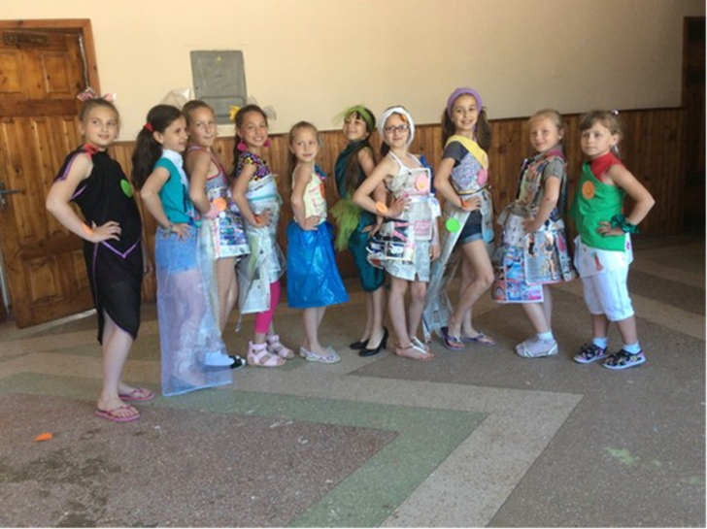
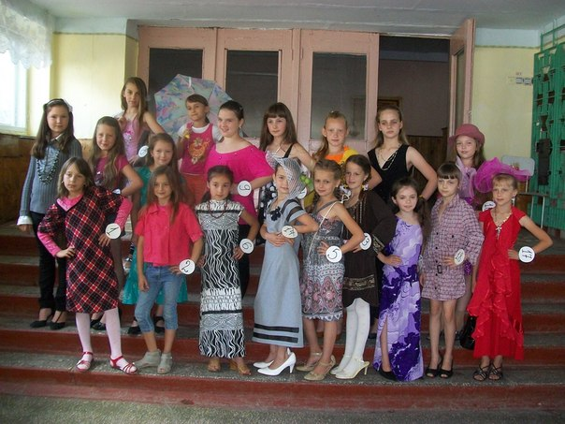
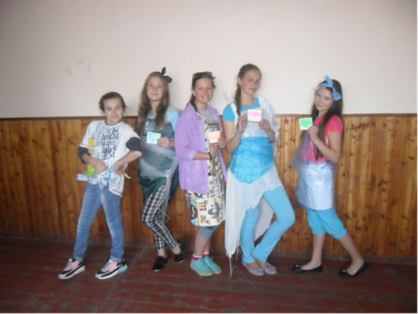
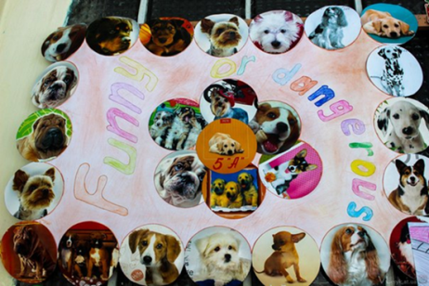
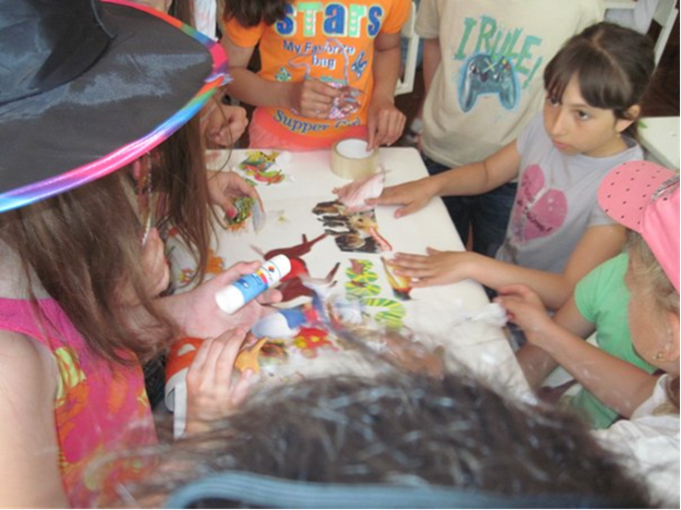
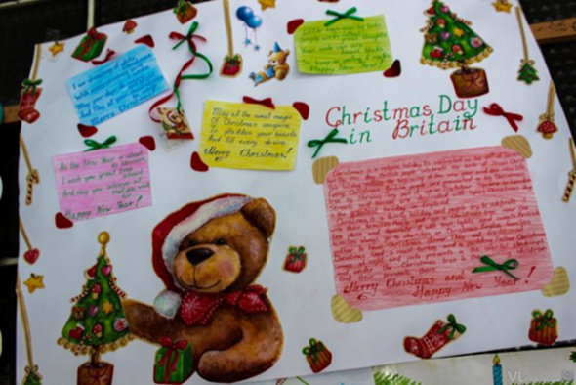
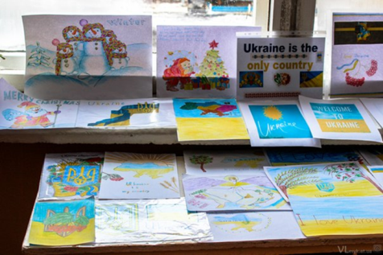
Fashion show
Project Work

Slide 10
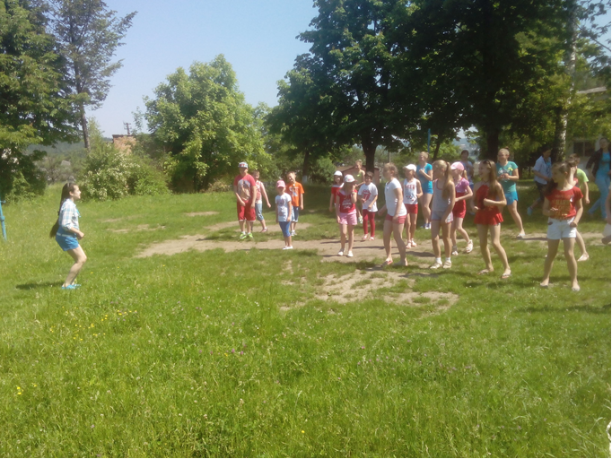
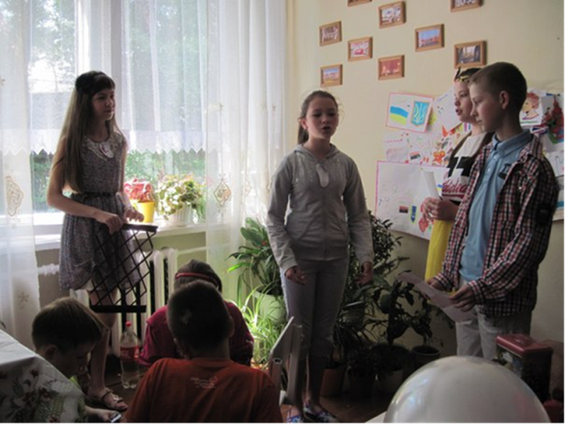
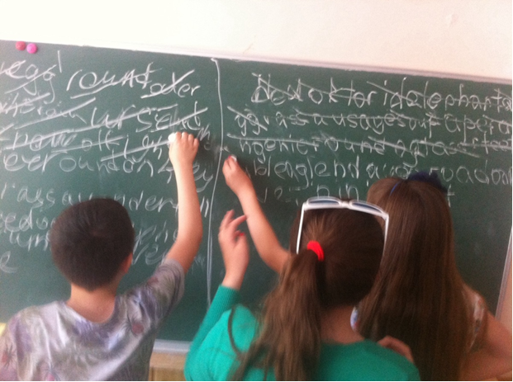
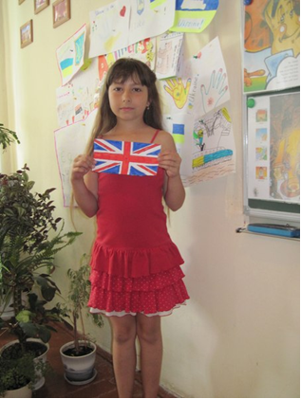
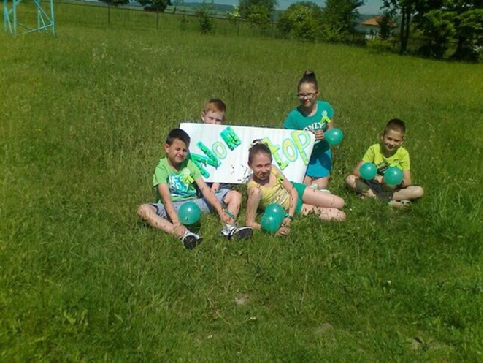
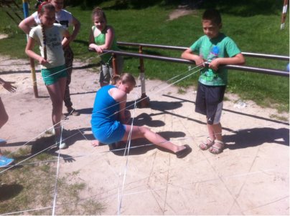
English Language Camp

Slide 11
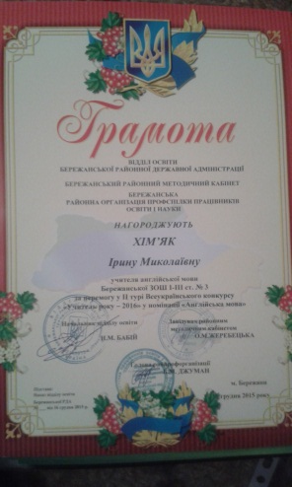
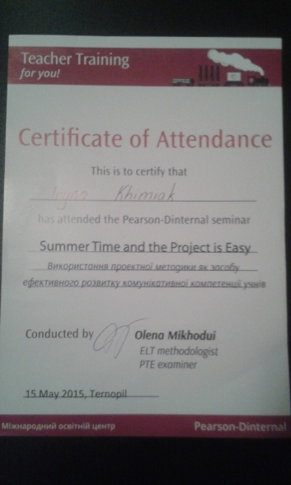
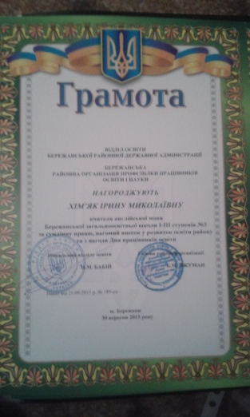
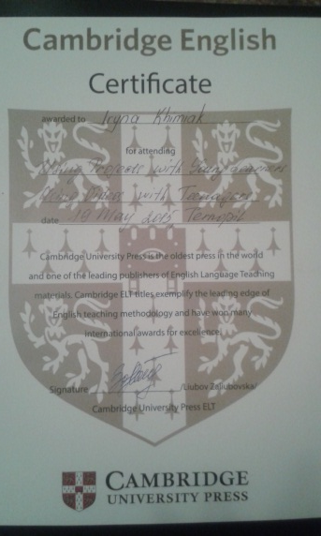
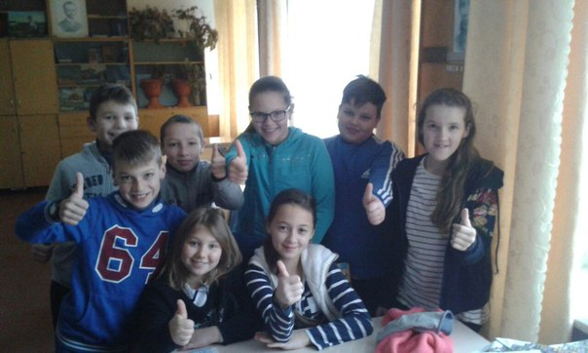
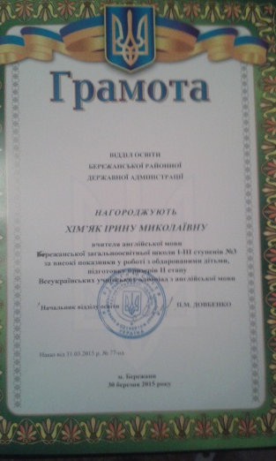
TEACHER
PUPILS
RESULT
and
GOOD ATMOSPHERE

