Slide 1

Domestic animals

Slide 2
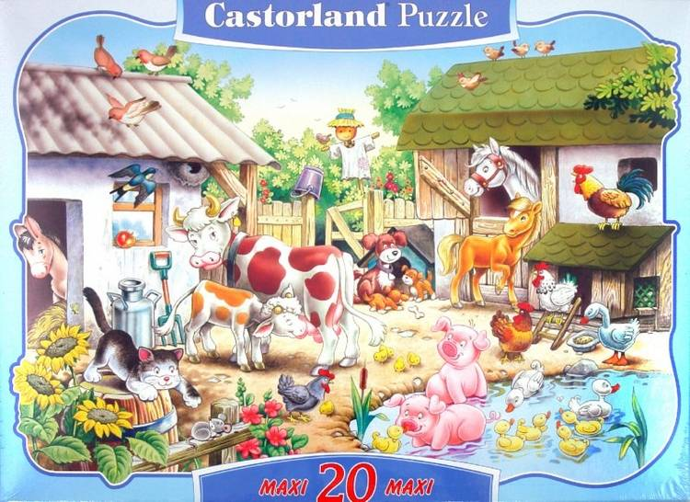

Slide 3

Have (Has) = иметь
A hen
A duck
A cow
A goose
A horse
A pig
A goat
A sheep
has

Slide 4
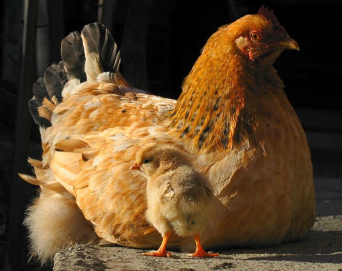
The hen has a chicken.
What does it say?
Cheep, cheep, cheep, cheep,
All through the day.

Slide 5
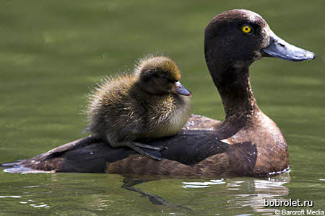
The duck has a duckling.
What does it say?
Qwack, qwack, qwack
All through the day.

Slide 6
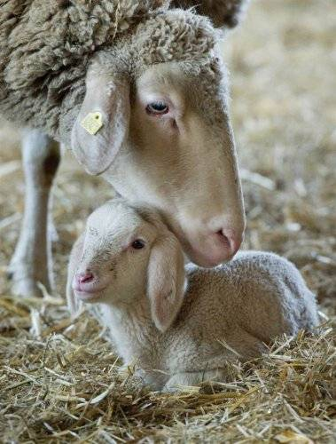
The sheep has a lamb
What does it say?
Baa, baa, baa, baa
All through the day

Slide 7
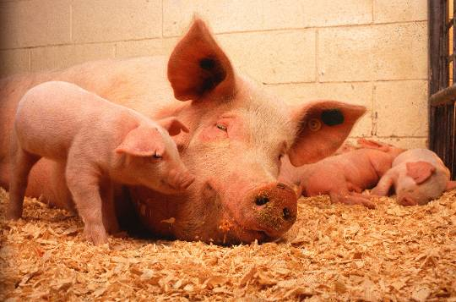
The pig has a piglet.
What does it say?
Khrju, khrju, khrju
All through the day

Slide 8
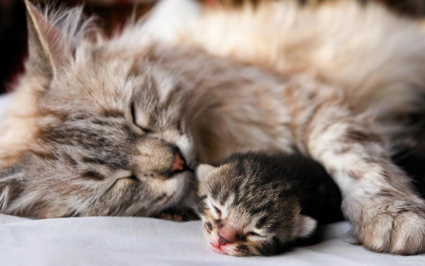
The cat has a kitten.
What does it say?
Mew, mew, mew, mew
All through the day.

Slide 9
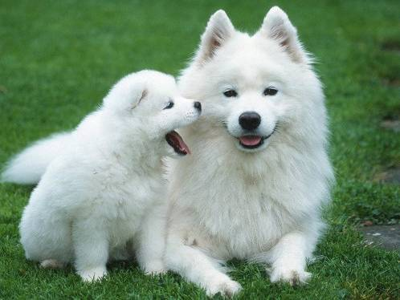
The dog has a puppy.
What does it say?
Bow, bow, bow, bow
All through the day.

Slide 10
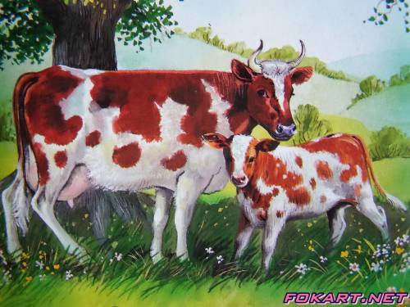
The caw has a calf.
What does it say?
Mu, mu, mu, mu
All through the day.

Slide 11
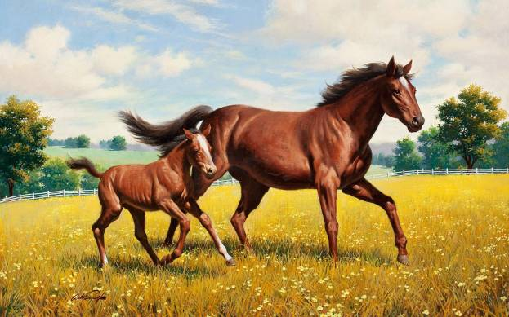
The horse has a foal.
What does it say?
Jogogo, jogogo, jogogo
All through the day

Slide 12
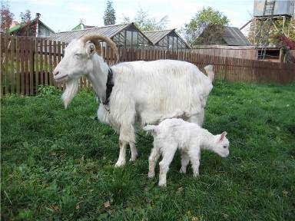
The she-goat has a kid.
What does it say?
Me, me, me, me
All through the day

Slide 13
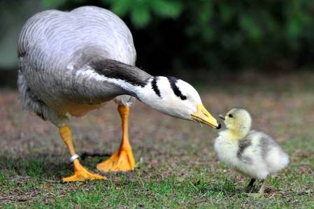
The goose has a gosling.
What does it say?
Ga, ga, ga, ga
All through the day.

Slide 14
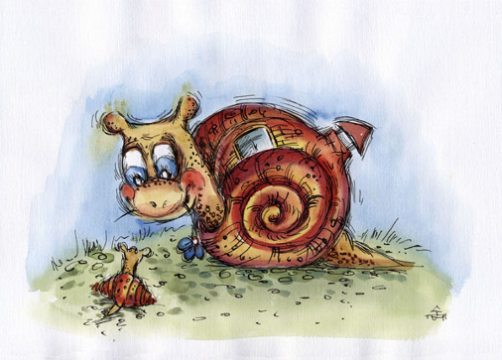
The snail has a baby.
What does it say?
It doesn’t say anything
All through the day.

Slide 15
