Slide 1
The Use of Interactive Methods in Teaching English to Form Life Competency of Pupils

Slide 2
Life Competency – the Key Elements
Use tools interactively (language, technology, information)
Interact in heterogeneous groups
Act autonomously

Slide 3
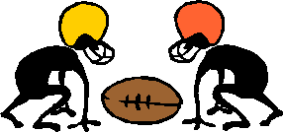
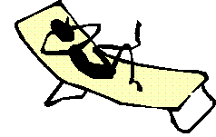
Interaction in Heterogeneous Group
Positive Interdependence (sink or swim together)
Face-to-Face Interaction (promote each other's success)
Individual & Group Accountability ( no hitchhiking! no social loafing)
Interpersonal & Small-Group Skills
Group Processing
Leadership
Decision-making
Trust-building
Communication
Conflict-management skills

Slide 4
Forms of Work Used to Teach Interaction in Heterogeneous Groups
brainstorm
discussion
debate (oral and written)
role play
a poster/project summing up the topic
“tree of solutions”
“garden of expectations”
fishbowl
carousel
running dictations
various games
treasure hunt
find somebody who…
board games
friendly favourites
Buddy Venn diagrams
a test with a crib
computer and multimedia
pentagon

Slide 5
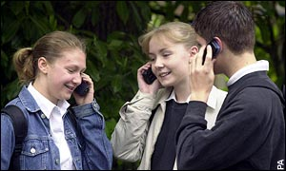
Interactive Use of Tools
Mobile Phones
Films
English ring tones
My perfect phone
Phone book secrets
This is the off button
60-second movies
Phone whispers
Instant film scripts
Favourite film keywords
Casting
Watching the detectives (imaginary movie)

Slide 6
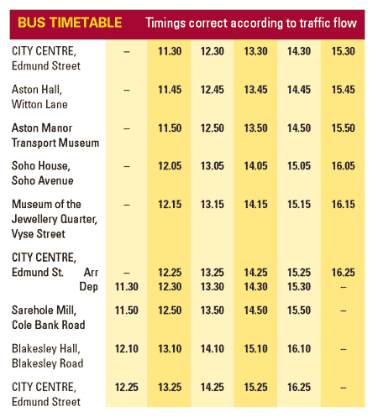
Interactive Use of Tools
Timetables
Interpreting abbreviations
Pair discussion – planning a journey
Tense practice
Phone call role plays
Word brainstorming
Creative writing - A terrible journey
Internet research

Slide 7
Interactive Use of Tools
Using Computer and Multmedia
A tool is only as good
as its master
Tests (including online)
Fast flash pictures
Fast flash vocabulary
Fast flash stories
Fast flash dictations
Internet
Project work
Interactive games and tasks

Slide 8
The Need for Rules
Discuss Need for Rules
List Rules
Select Best Rules
Compile Class List of Rules
Vote for Top Six Class Rules
Post Rules

Slide 9
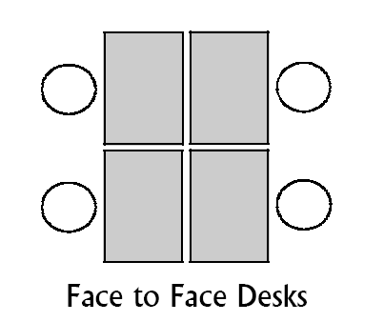
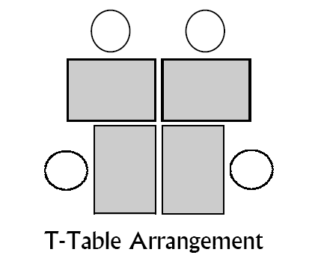
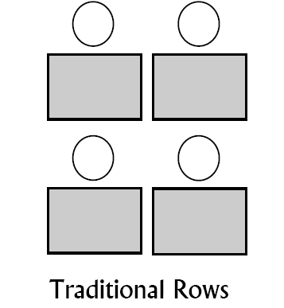
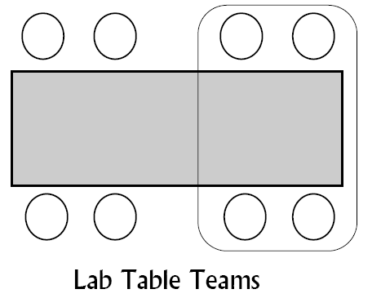
Seating Options for Interactive Learning

Slide 10
Typical Problems
1) Pupils do not have the tools (grammar, vocabulary) necessary to state and prove their point of view.
2) Often pupils do not have their own opinion on the subject, or are afraid of discussing it in front of everyone. They are afraid of being mocked or criticized.
3) Sometimes pupils are not willing to listen to others, to evaluate objectively. They are not ready to compromise.
4) At first, it is hard for pupils to move around a lot, to switch places and methods of work.
5) In small groups, the leaders would usually try to “pull” the group forward, while weaker pupils tend to become passive.
6) Pupils often act in clearly negativistic and antagonistic way in order to be different, to attract attention. Instead of arguments, they start playing with words.

Slide 11
Positive Changes Observed:
increased motivation;
pupils learn to make joint decisions as a group;
pupils learn how to communicate and resolve conflicts more effectively;
pupils see a personal meaning in their studies;
pupils improve their thinking operations: analysis, synthesis, generalization, prediction, abstract and critical thinking;
pupils learn to take responsibility for their actions and decisions.

Slide 12
Recommendations for Interactive Teaching
have a clear purpose for each lesson you are delivering;
make sure the material is engaging and interactive;
give students the opportunity to direct their own learning;
mistakes are integral in the learning process – don't be scared of them;
humour releases tension – use it often!
always have a backup plan when using technology;
be flexible with your lesson plans;
organize, organize and more organize; have folders for each class' work;
be consistent with punishment and rewards;
always have some extra activities for students who finish early;
allow more advanced students to help those having problems;
use all resources that you have at your disposal

Slide 13
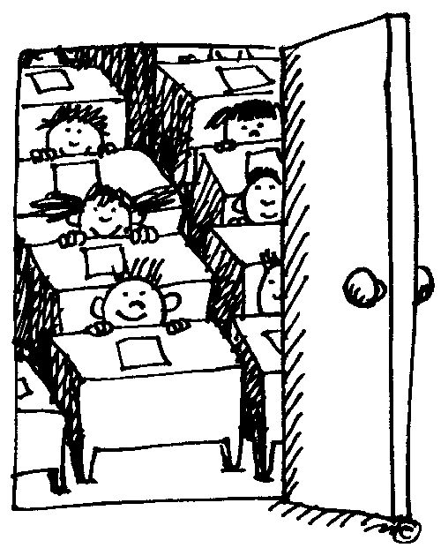
Final Notes…
It's not what is poured into a student that counts, but what is planted.
'To be a teacher you must be a prophet - because you are trying to prepare people for a world in the future.‘
Teachers open the door, but you enter by yourself!

